Slide 1

REVIEW 1
Lesson 1. Language

Slide 2
OBJECTIVES
01
02
03
By the end of this review, students will have revised:
PRONUNCIATION
VOCABULARY
GRAMMAR

Slide 3
01
Pronunciation
Unit 1. /ɑː/ and /ʌ/
Unit 2. Final sounds /s/ and /z/
Unit 3. /b/ and /p/

Slide 4
Vocabulary
Unit 1. My new school
School things and activities
Verb (play, do, have, study) + Noun
02
Unit 2. My house
Types of house
Rooms and furniture
Unit 3. My friends
Body parts and appearance
Personality adjectives

Slide 5
Grammar
03
Present simple
Adverbs of frequency
Possessive case
Prepositions of place
Present continuous

Slide 6

Pronunciation
1. Choose the word whose underlined part is pronounced differently.
1.
A.
ears
B.
eyes
C.
lips
/ɪə(r)z/
/aɪz/
/lɪps/
2.
A.
cat
B.
father
C.
calm
/kæt/
/ˈfɑːðə(r)/
/kɑːm/
C.
lamps
3.
A.
lights
B.
pencils
/laɪts/
/ˈpenslz/
/læmps/
B.
rules
C.
rooms
4.
A.
notebooks
/ˈnəʊtbʊks/
/ruːlz/
/rʊmz/
C.
mother
5.
B.
homework
A.
brother
/ˈbrʌðə(r)/
/ˈhəʊmwɜːk/
/ˈmʌðə(r)/

Slide 7
Pronunciation
2. Write the names of school things and furniture in the house which begin with /b/ and /p/.
/b/: book,
board,
bed,
bag,
blanket,…
/p/: pen,
pencil,
pan,
picture,
pencil case,...

Slide 8
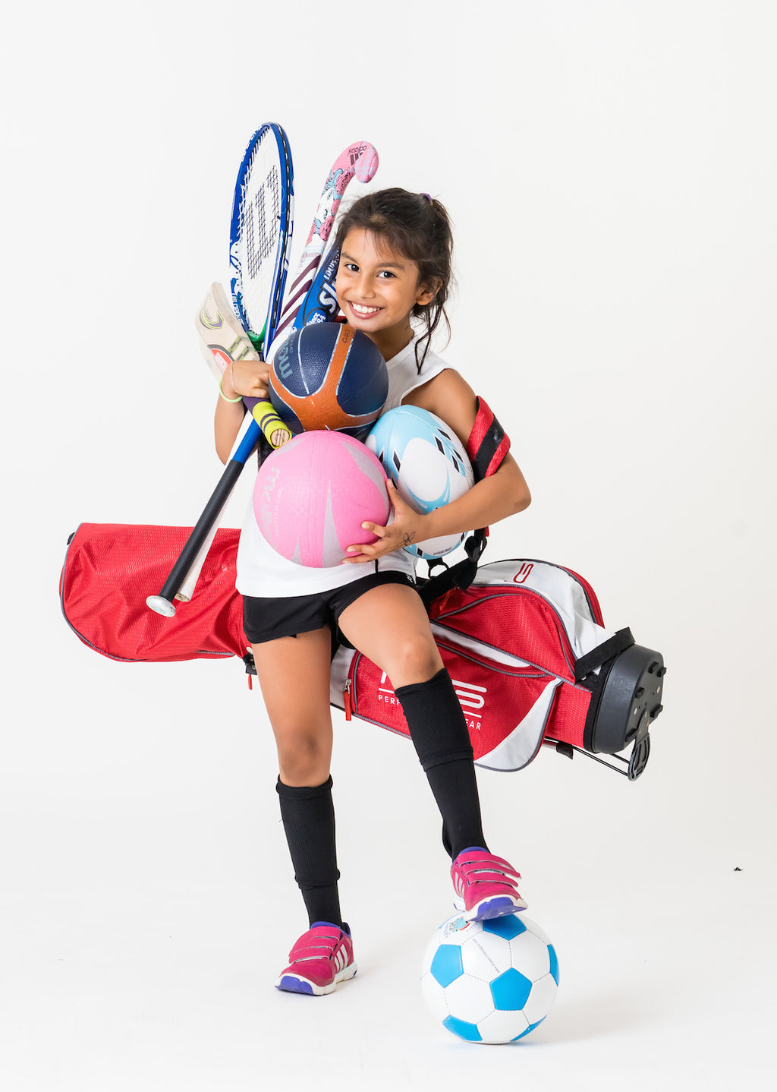


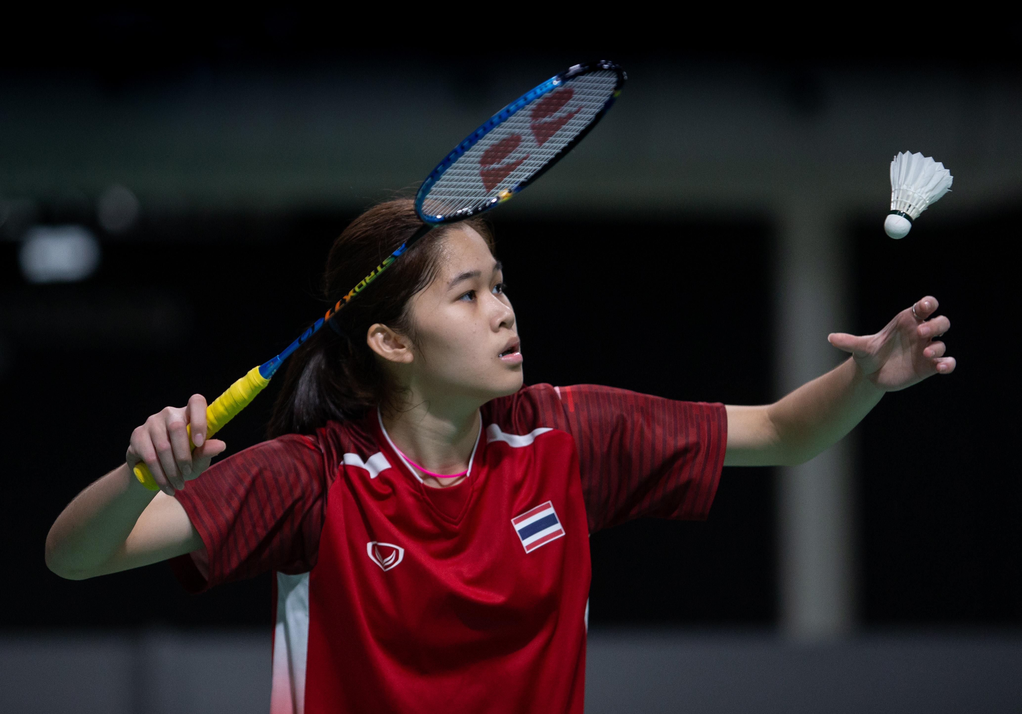
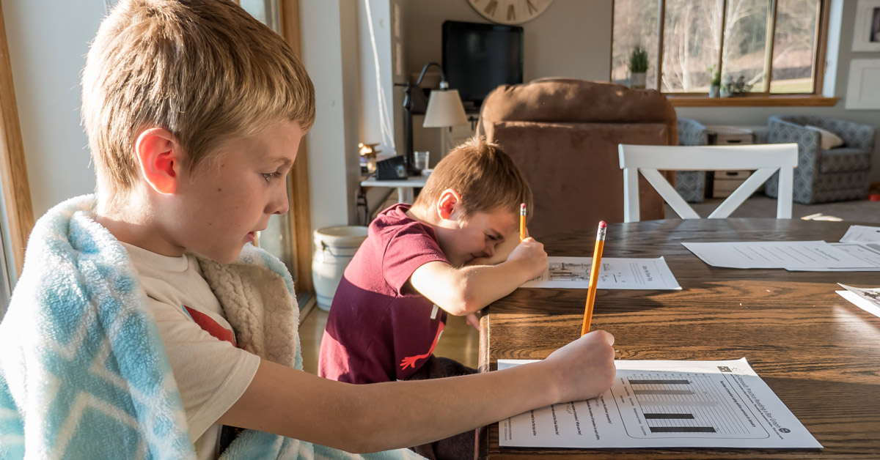
Vocabulary
3. Complete the words.
1.
E l
4.
sports
English
s r
2.
5.
badminton
h w
b m n
homework
3.
lunch
l h
Now write the words in the correct group.
play | do | have | study
sports
homework
lunch
English
badminton

Slide 9
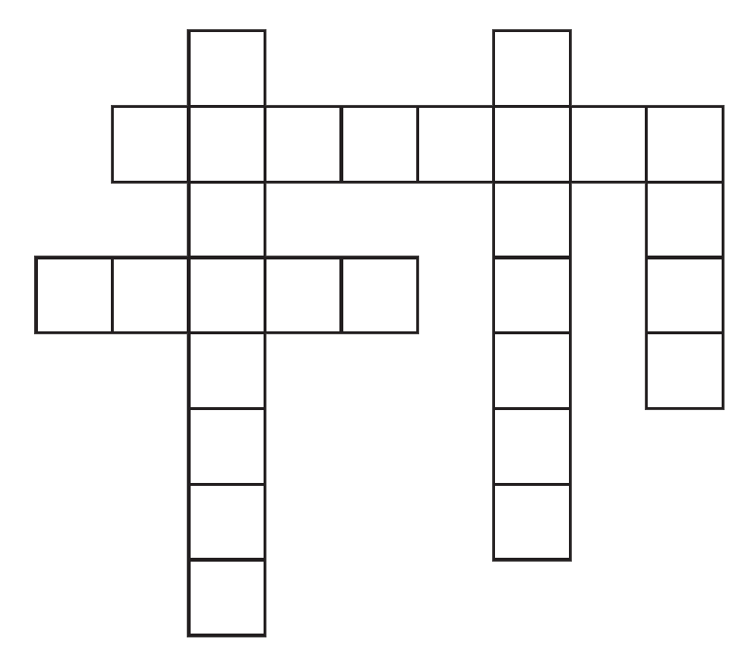
Vocabulary
4. Solve the crossword puzzle.
DOWN
1
2
1.
She likes to meet new people.
She’s .
f
r
i
e
n
d
l
y
k
i
t
c
h
e
n
4
e
a
r
s
3
c r e a t i v e
2.
People cook meals in this room.
4.
You hear with them.
c h e e k
5
ACROSS
3.
He’s good at drawing.
He’s very .
5.
It’s a side of the face, below the eyes.
Notes:
Ấn vào các số để hiện ra đáp án

Slide 10

Notes:
Ấn vào các số để hiện ra đáp án

Slide 11
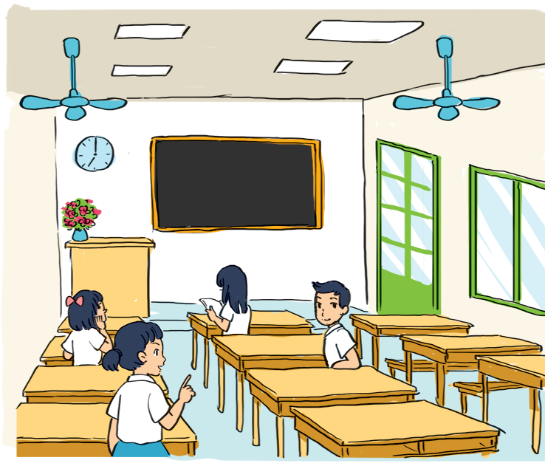
Grammar
5. Look at the picture of a classroom.
Choose the best answer A, B, or C.
1. There is a blackboard and a clock_________the wall.
A. in B. on C. behind
2. A vase of flowers is on the_________desk.
A. teacher's B. teachers C. teacher’
3. A boy and three girls are_________the classroom.
A. in B. on C. in front of
4. The window is_________ the big door.
A. behind B. next to C. under
5. A girl_________her book now.
A. reads B. reading C. is reading

Slide 12
Grammar
5. Look at the picture of a classroom.
Choose the best answer A, B, or C.
There is a blackboard and
a clock_________the wall.
A. in
B. on
C. behind

Slide 13
Grammar
5. Look at the picture of a classroom.
Choose the best answer A, B, or C.
2. A vase of flowers is on the_________desk.
A. teacher's
B. teachers
C. teacher’

Slide 14
Grammar
5. Look at the picture of a classroom.
Choose the best answer A, B, or C.
3. A boy and three girls are_________the classroom.
A. in
B. on
C. in front of

Slide 15
Grammar
5. Look at the picture of a classroom.
Choose the best answer A, B, or C.
4. The window is_________ the big door.
A. behind
B. next to
C. under

Slide 16
Grammar
5. Look at the picture of a classroom.
Choose the best answer A, B, or C.
5. A girl_________her book now.
A. reads
B. reading
C. is reading

Slide 17
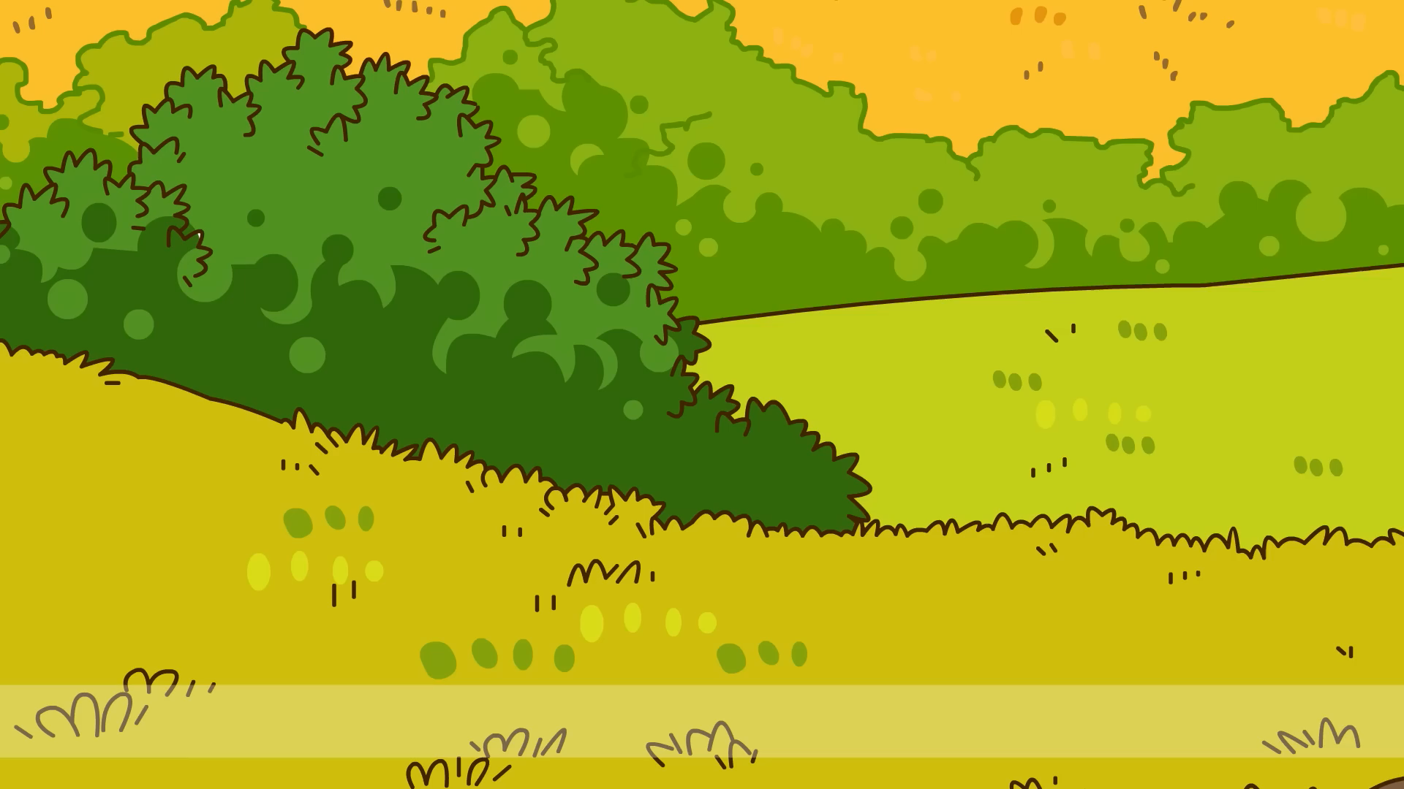
Notes:
Ấn vào các số để hiện ra đáp án

Slide 18
Grammar
6. Complete the sentences with the present simple or the present continuous form of the verbs in brackets.
6. Underline the signal and subject in each sentence.
What tenses are there?
1. We can't go out now. It (rain)_________.
2. What time_________you (have) _________ breakfast every day?
3. - _________she (study) _________English now?
- No, she isn't.
4. My dog (like) _________ my bed very much.
5. My mother (not cook) ___________now. She (read) _________
a book.

Slide 19
Grammar
6. Complete the sentences with the present simple or the present continuous form of the verbs in brackets.
1. We can't go out now. It (rain)_________.
is raining
→ Present continuous: It + is + V-ing

Slide 20
Grammar
6. Complete the sentences with the present simple or the present continuous form of the verbs in brackets.
2. What time_________you (have) _________ breakfast every day?
do
have
→ Present simple
→ Question
Wh + do + you + V + O + Adv?

Slide 21
Grammar
6. Complete the sentences with the present simple or the present continuous form of the verbs in brackets.
3. - _________she (study) _________English now?
- No, she isn't.
Is
studying
→ Present continuous.
→ Question.
Is + she + V-ing + V?

Slide 22
Grammar
6. Complete the sentences with the present simple or the present continuous form of the verbs in brackets.
4. My dog (like) _________ my bed very much.
likes
→ Present simple.
→ Talk about hobby.
It + Vs/es + O

Slide 23
Grammar
6. Complete the sentences with the present simple or the present continuous form of the verbs in brackets.
5. My mother (not cook) ___________now.
She (read) _________a book.
isn't cooking
is reading
→ Present continuous.
→ Negative and positive sentences.
She + isn’t (is not) + V-ing
She + is + V-ing

Slide 24
Wrap-up
01
03
02
04
What have you revised today?
What is the structure in present simple?
A. S + Ved + O
B. S + is/am/are + V-ing + O
C. S + is/am/are + Adj + O
A. Vocabulary
B. Grammar
C. Pronunciation
D. Skills
What is the correct answer?
How to pronounce these underlined parts?
/stɑːts/
A. Do homework
B. Play karate
C. Have football
A. starts
B. cartoon
C. Sunday
/kɑːˈtuːn/
/ˈsʌndeɪ/

Slide 25
Thank you!
Do you have any questions?

