Slide 1

Review 1
Lesson 2. Skills

Slide 2
Objectives
01
02
03
04
By the end of this review, students will have revised skills they have practised in Units 1 – 2 – 3:
Reading
Speaking
Listening
Writing
About school.
About rooms and furniture
About friends and summer camps.
Type of school one would you like to go to.
Introducing someone.
Describing houses, rooms, and furniture.
Giving suggestions.
About friends and summer camps.
Asking about appearance and personality.
About school activities.
About someone’s house.
About best friends.
A paragraph about one’s school.
An email to a friend describing a house.
A diary entry about best friends.

Slide 3
Reading

Slide 4
1. Choose A, B, or C for each blank in the email below.
From: an@fastmail.com
To: nick@fastmail.com
Subject: My best friend
Hi Nick,
It’s great to hear from you. I want to tell you about my best friend.
My grandma is my best friend. She is 68 years old. She (1) _____ with our family.
She was a maths teacher (2) _____ a secondary school. She likes (3) _______ up early and watering the flowers in our garden. She usually helps (4) _______ with my homework. In the evening, she tells me interesting stories. She also listens (5) _______ me when I’m sad. I love my grandma very much.
What about you? Who’s your best friend?
Bye bye,
An
1. A. lives B. works C. goes
2. A. for B. on C. at
3. A. going B. staying C. getting
4. A. I B. me C. my
5. A. with B. to C. for
help sb with sth

Slide 5
2. Read the text and answer the questions.
1. Where is the writer's new school?
MY SCHOOL
My new school is in a quiet place not far from the city centre. It has three buildings and a large yard. This year there are 26 classes with more than 1000 students at my school. Most students are hard-working and kind. The school has about 40 teachers. They are all helpful and friendly. My school has different clubs: Dance, English, Arts, Football and Basketball. I like English, so I am in the English club. I love my school because it is a good school.
2. What are the students like?
3. What are the teachers like?
4. How many clubs are there in the school?
5. Why does the writer love the school?

Slide 6
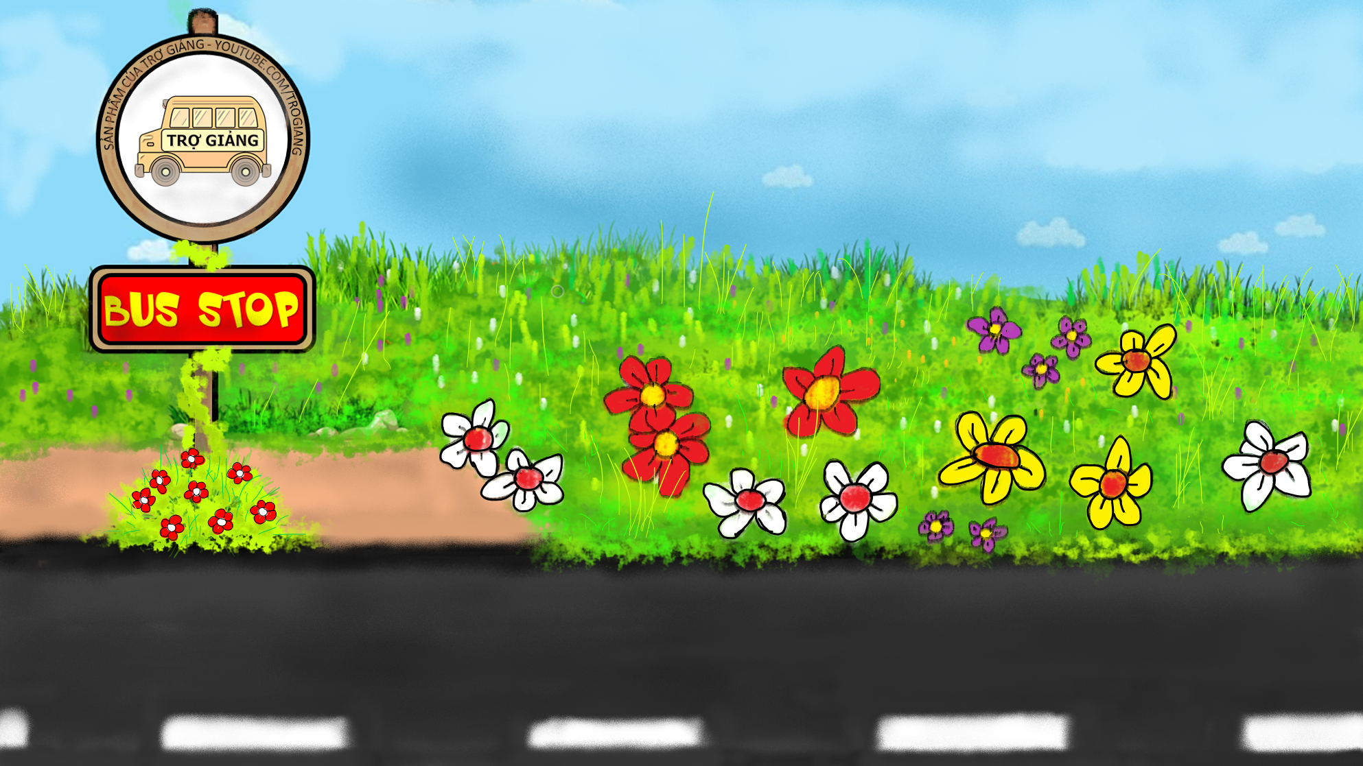








Stop the bus
Bus stop
PLAY

Slide 7
Nội dung trò chơi :
Học sinh trả lời đúng thì được lên xe còn không trả lời đúng thì ngược lại.
Thao tác chơi :
Bước 1 : Bấm vào màn hình đưa ra đáp án sau khi học sinh trả lời xong.
Bước 2A : Nếu học sinh trả lời đúng thì bấm vào
RIGHT/ĐÚNG
để mời học sinh lên xe.
Bước 2B : Nếu học sinh trả lời sai thì bấm vào
WRONG/SAI
học sinh không được lên xe.
Bước 3 : Bấm vào màn hình để qua câu hỏi tiếp theo.

Slide 8

1. Where is the writer's new school?
It's in a quite place not far from the city center.
RIGHT
WRONG

Slide 9


2. What are the students like?
They are hard-working and kind.
RIGHT
WRONG

Slide 10

3. What are the teachers like?
They're all helpful and friendly.
RIGHT
WRONG

Slide 11
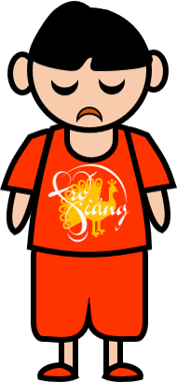
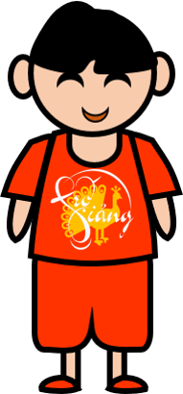
4. How many clubs are there in the school?
There are 5 clubs in the school.
RIGHT
WRONG

Slide 12


5. Why does the writer love the school?
Because it’s a good a school.
RIGHT
WRONG

Slide 13
Speaking

Slide 14


Interview
3. Work in group of three.
About your school
What he/she dislikes + reasons
What he/she likes + reasons

Slide 15

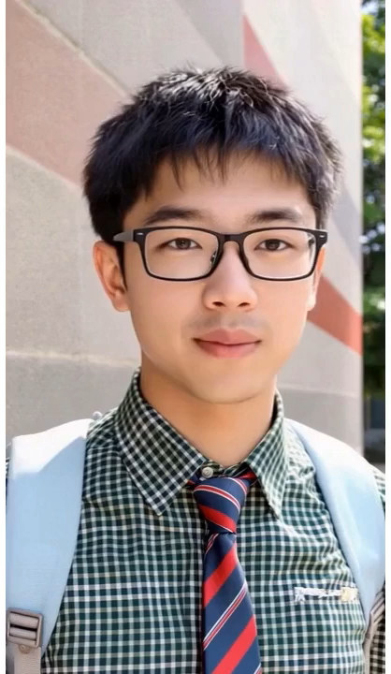
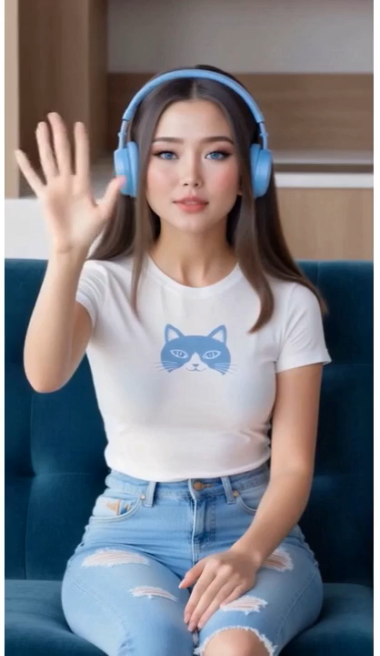
Example:
Presentation

Slide 16
Listening

Slide 17

4. Listen and fill each blank with ONE word.
Everybody is at ______________.
Mi’s mother is watering the __________in the garden.
Mi’s father is in the ________room.
Her younger brother is ________in her bedroom.
Vi is watching ___________.

Slide 18
4. Listen and fill each blank with ONE word.
1. Everybody is at ______________.
home
An: Why is it so quiet, Mi? Are you home alone?
Mi: No. Everybody is here, but they are in different rooms.

Slide 19
4. Listen and fill each blank with ONE word.
2. Mi’s mother is watering the __________in the garden.
plants
An: Where's your mum? Is she cooking in the kitchen?
Mi: No. She's watering the plants in the garden.

Slide 20
4. Listen and fill each blank with ONE word.
3. Mi’s father is in the ________room.
living
An: And where's your dad?
Mi: He's in the living room.

Slide 21
4. Listen and fill each blank with ONE word.
4. Her younger brother is ________in her bedroom.
sleeping
An: What about your younger brother? Is he with your mum?
Mi: No. He's sleeping in my bedroom. My cousin, Vi, is here too.

Slide 22
4. Listen and fill each blank with ONE word.
5. Vi is watching ___________.
TV
Mi: My cousin, Vi, is here too.
An: What's she doing?
Mi: She's watching TV.

Slide 23
Writing

Slide 24
5. Write an email of about 50 words to your friend.
Tell him/ her about a family member.
Use these questions below.
1. Who is the person?
2. How old is he / she?
3. What does he / she look like?
4. What is he / she like?
Hi___________,
Thanks for your email. Now I’ll
tell you about my___________.
___________________________
Write me soon and tell me
about a member in your family.
Best,

Slide 25
5. Write an email of about 50 words to your friend.
Tell him/ her about a family member.
Use these questions below.
Hi Linh,
Thanks for your email. Now I’ll tell you about my mother. She is 45 years old. She's tall and beautiful with long black hair. She is caring because she always takes good care of me. She prepares food and uniform for me to go to school every morning. She's also kind because she usually helps the neighbours whenever they get trouble.
Write me soon and tell me about a member in your family.
Best,

Slide 26
Peer check
1. Are the verbs in the correct form?
2. Are the nouns in the correct form?
3. Is the spelling correct?
4. Has the paragraph answered all questions?

Slide 27
HOMEWORK
- Review the vocabulary and grammar point in unit 1-2-3
- Do exercises in the workbook
- Prepare for the mid-term test

Slide 28
Thank you!

