Slide 1

WELCOME TO OUR CLASS!
Presented by: ……………………………………..

Slide 2
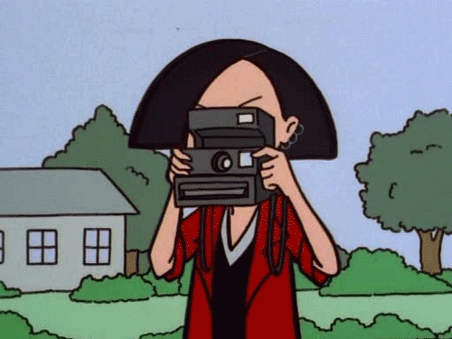
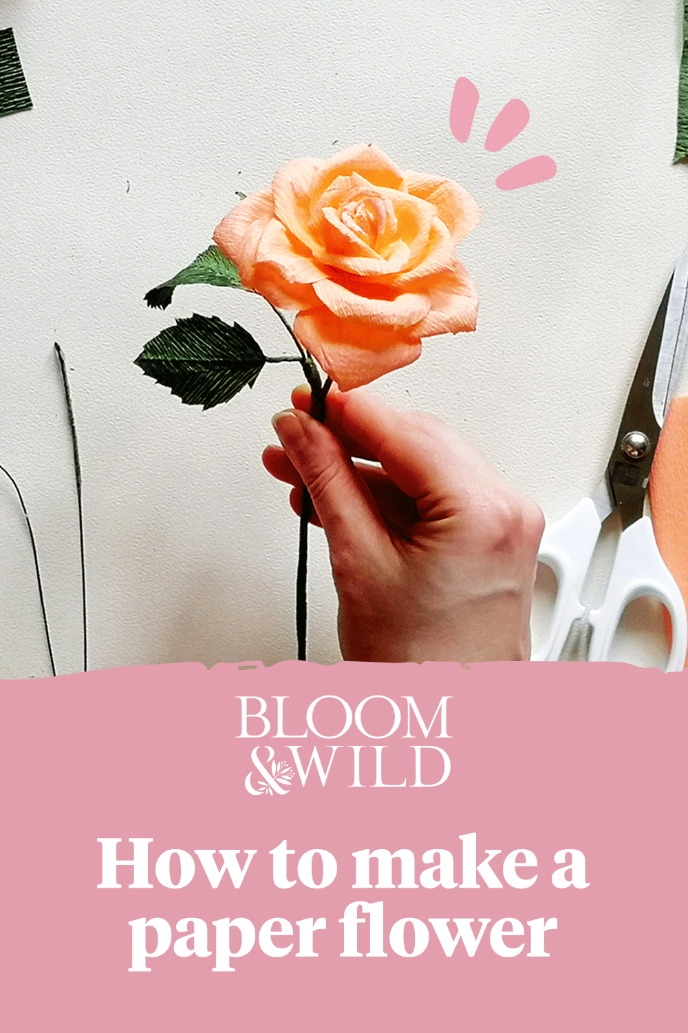

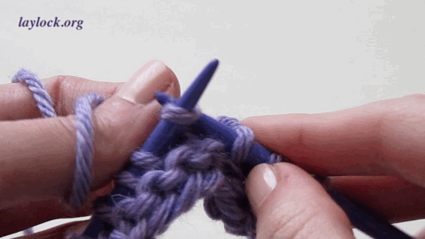
Guess the topic:
HOBBIES

Slide 3
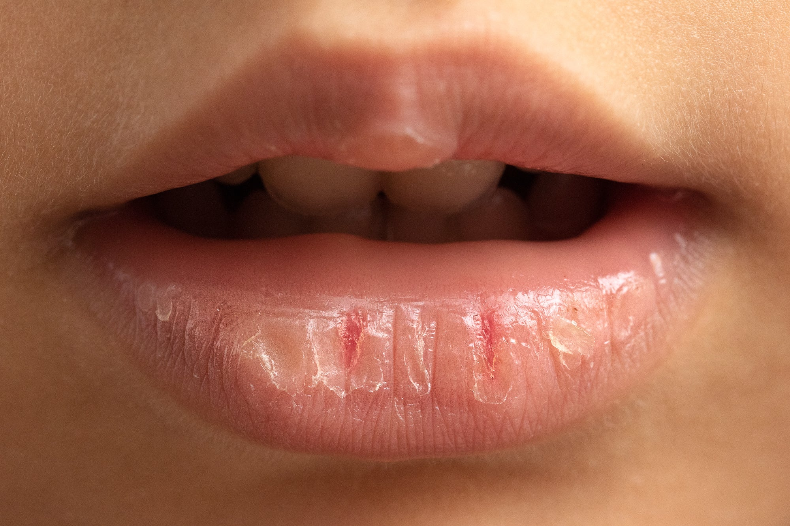
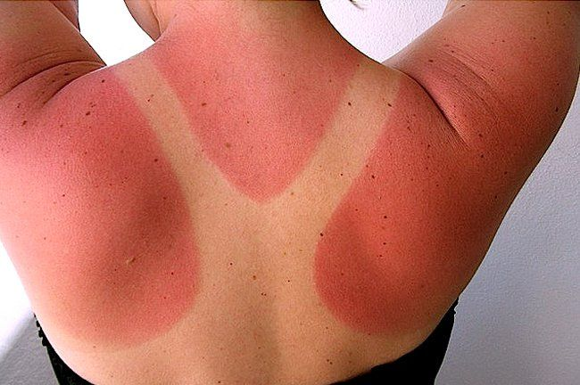
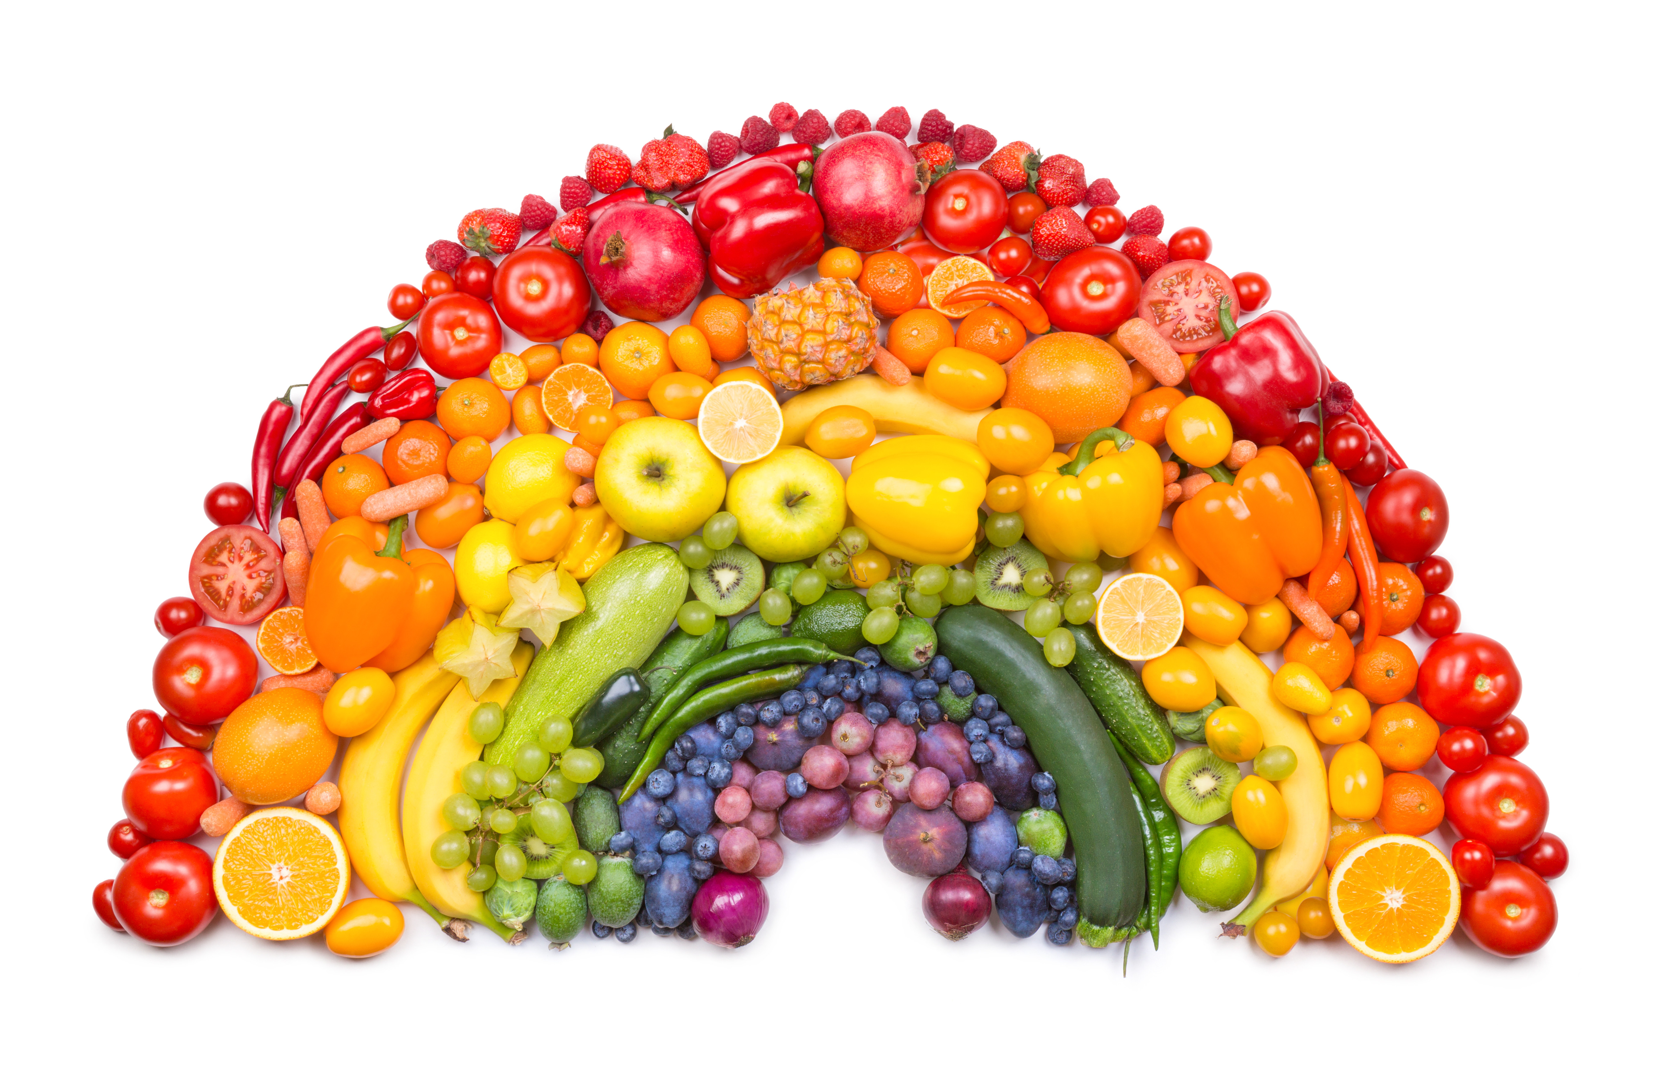
Guess the topic:
HEALTHY LIVING

Slide 4
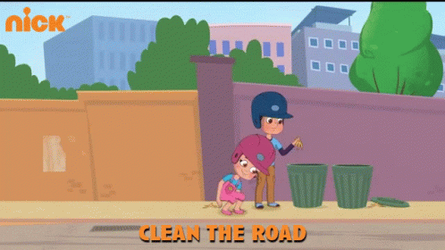
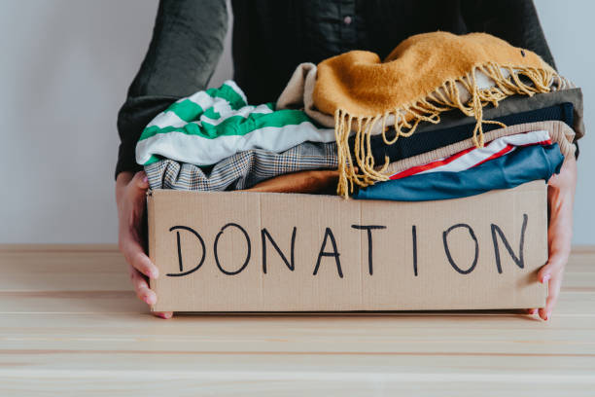
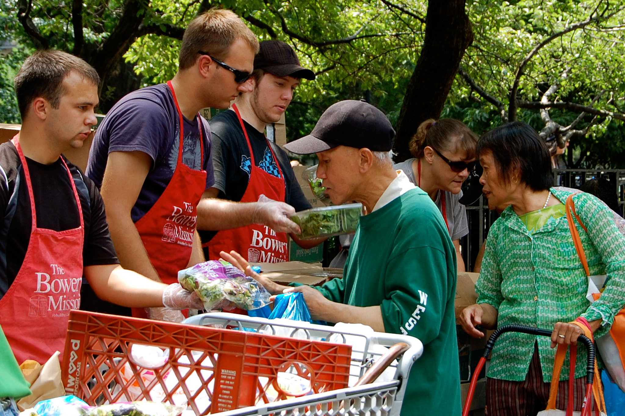
Guess the topic:
COMMUNITY SERVICE

Slide 5
REVIEW 1
Lesson 1. Language

Slide 6

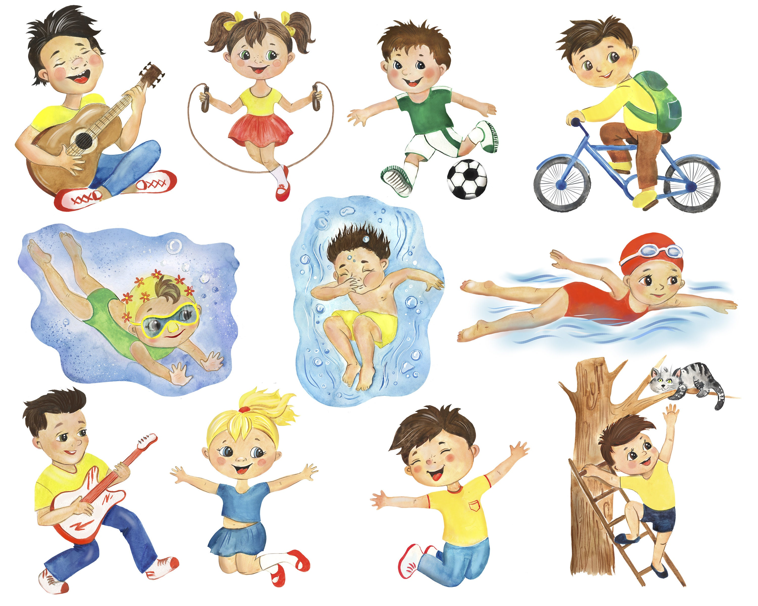
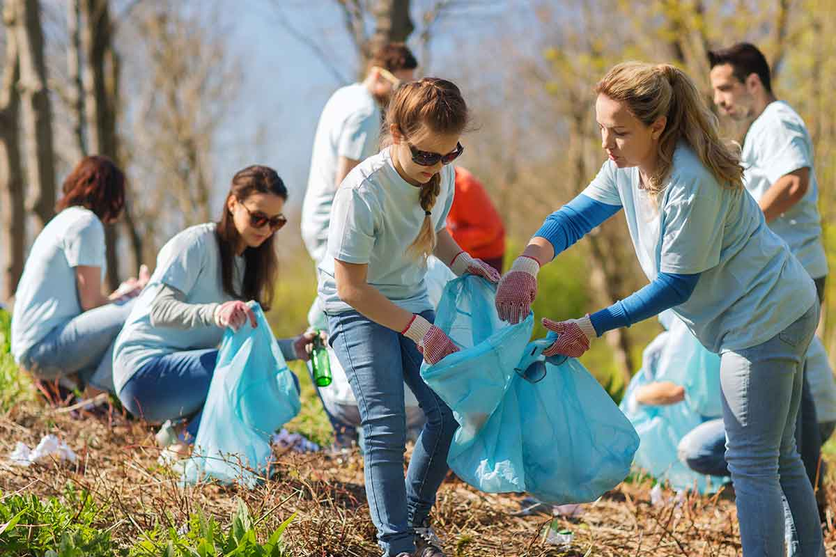
OBJECTIVES
By the end of the lesson, students will have revised the language they have learnt in Units 1 – 2 – 3.

Slide 7
Pronunciation
/ə/ and /ɜː/
/f/ and /v/
/t/, /d/, and /ɪd/.

Slide 8


1. Circle the word in which the underlined part is pronounced differently.
Listen, check and repeat.
1. A. proverb B. together C. exercise 2. A. learn B. earn C. hear 3. A. collected B. cleaned C. decided 4. A. listened B. helped C. watched 5. A. laugh B. ghost C. rough
/ˈprɒv.ɜːb/
/təˈɡeð.ər/
/ˈek.sə.saɪz/
/lɜːn/
/ɜːn/
/hɪər/
/kəˈlek.tɪd/
/kliːnd/
/dɪˈsaɪdɪd/
/ˈlɪsənd/
/helpt/
/wɒtʃt/
/lɑːf/
/ɡəʊst/
/rʌf/

Slide 9
Vocabulary
Unit 1. Hobbies
Verbs of liking and disliking
Unit 2. Healthy living
Healthy activities
Health problems
Unit 3. Community service
Community activities

Slide 10
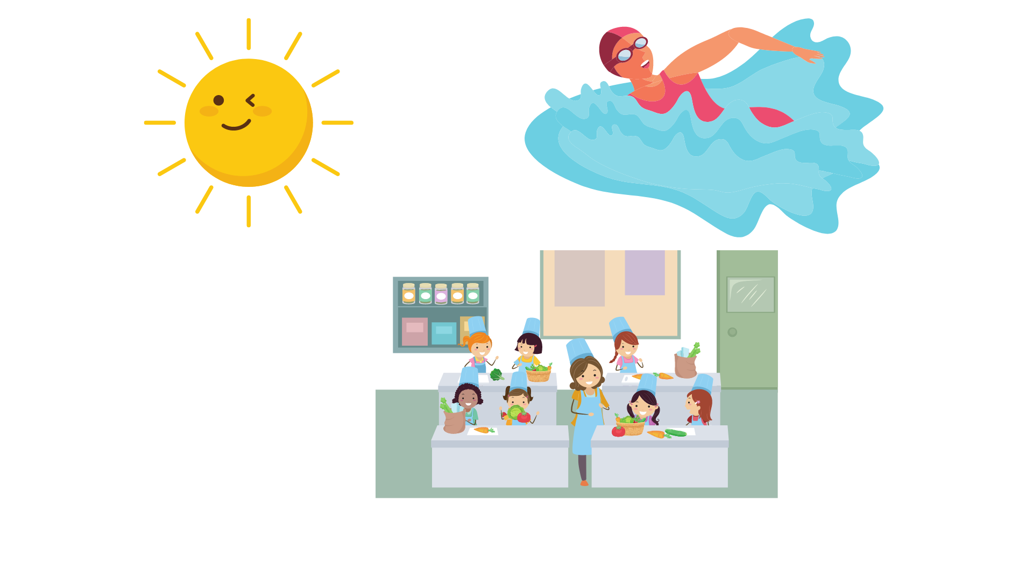
2. Put the phrases below in the correct columns.
raising money for charity
helping street children
doing sport
cleaning your room
collecting stamps
donating clothes
doing volunteer work
doing judo
Activities you do for…
yourself | your community
cleaning your room
collecting stamps
doing judo
doing sport
donating clothes
doing volunteer work
helping street children
raising money for charity

Slide 11

3. Complete the sentences with the words and phrases below.
hobby
coloured vegetables
chapped lips
community
mountainous areas
taking photos
1. Eating _______________________ and exercising can help you keep fit and stay healthy. 2. The Donate a Book event helps children in _______________________. 3. My brother spends a lot of time making models. That’s his ________________. 4. If you have ___________________, use lip balm. 5. There are many things you can do to help your ________________. 6. I love ________________ of the sunset

Slide 12
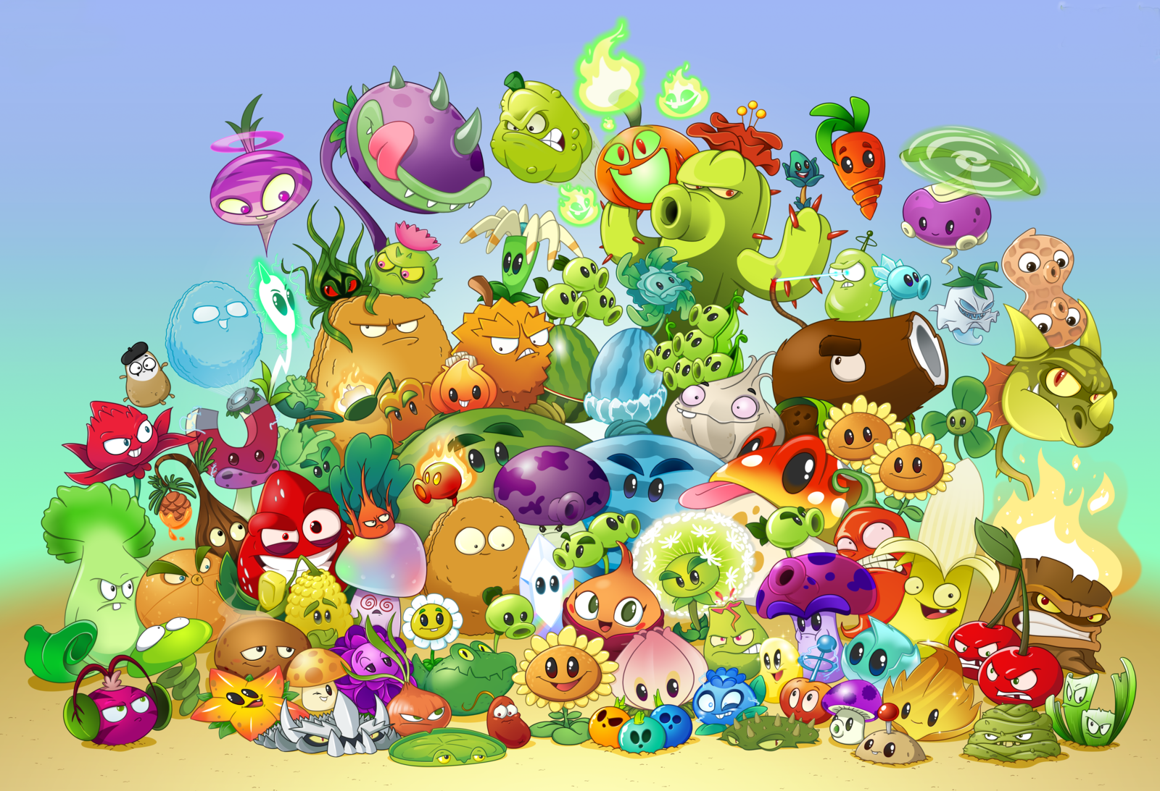
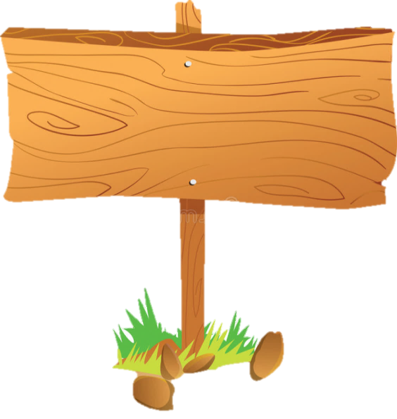
THE SECRET GARDEN

Slide 13
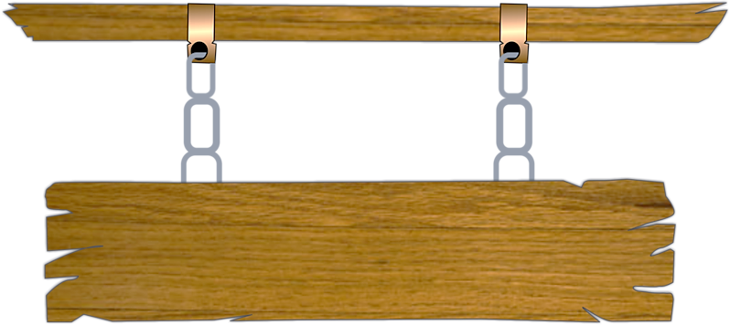
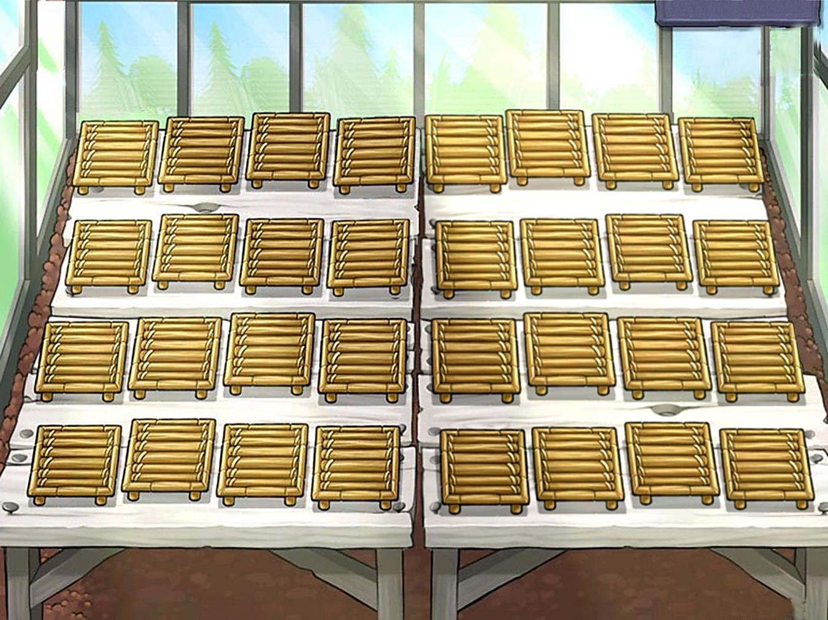
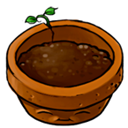
Work in groups to give the answers
If the answer is correct, choose a plant to get your mark.
The group that has the most mark will be the winner.

Slide 14
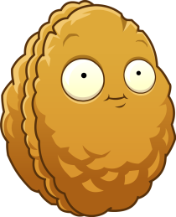
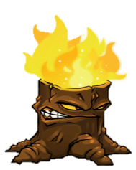


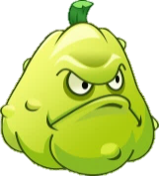
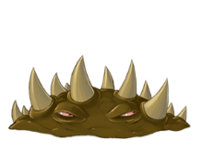


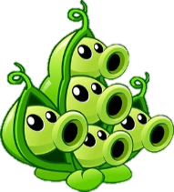
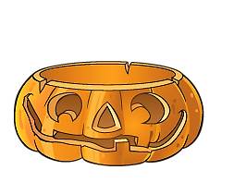
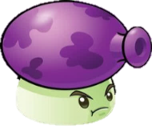
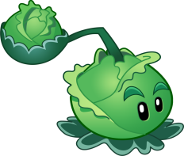


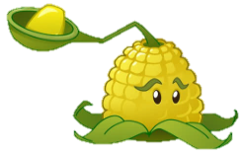
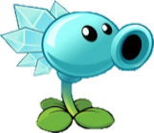





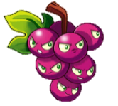
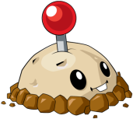

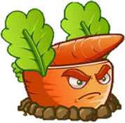
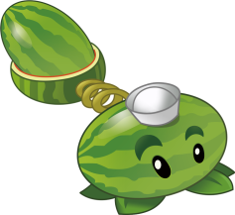

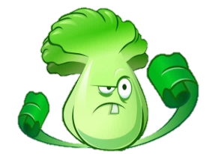
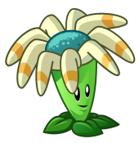










200
150
100
100
150
100
100
100
100
300
100
200
150
200
100
150
250
150
200
100
400
150
100
100
300
300
100
200
200
100
100
150

Slide 15
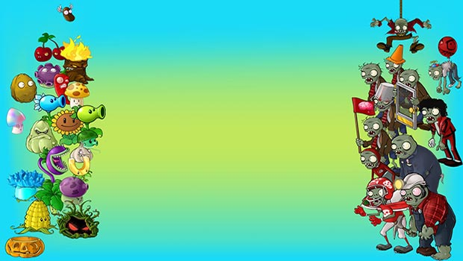
Check your answers.
hobby
mountainous areas
community
coloured vegetables
chapped lips
taking photos
1. Eating ______________________ and exercising can help you keep fit and stay healthy.
Notes:
Bấm màn hình để quay lại slide 14

Slide 16
Check your answers.
hobby
mountainous areas
community
coloured vegetables
chapped lips
taking photos
2. The Donate a Book event helps children in _______________________.

Slide 17
Check your answers.
hobby
mountainous areas
community
coloured vegetables
chapped lips
taking photos
3. My brother spends a lot of time making models. That’s his ________________.

Slide 18
Check your answers.
hobby
mountainous areas
community
coloured vegetables
chapped lips
taking photos
4. If you have ___________________, use lip balm.

Slide 19
Check your answers.
hobby
mountainous areas
community
coloured vegetables
chapped lips
taking photos
5. There are many things you can do to help your ________________.

Slide 20
Check your answers.
hobby
mountainous areas
community
coloured vegetables
chapped lips
taking photos
6. I love ________________ of the sunset.

Slide 21
Look at the answers again
1. Eating coloured vegetables and exercising can help you keep fit and stay healthy. 2. The Donate a Book event helps children in mountainous areas. 3. My brother spends a lot of time making models. That’s his hobby. 4. If you have chapped lips, use lip balm. 5. There are many things you can do to help your community. 6. I love taking photos of the sunset.

Slide 22
Grammar
1. The present simple
2. Simple sentence
3. The past simple

Slide 23
The present simple
I/ You/ We/ They + Vo
He/ She/ It + V(s/es)
POSITIVE
I/ You/ We/ They + don’t + Vo
He/ She/ It + doesn’t + Vo
NEGATIVE
Do + I/you/we/they + Vo?
→ Yes, I do / No, I don’t
Does he/she/it + Vo?
→ Yes, she/he/it does
→ No, she/ he/it doesn’t
QUESTIONS

Slide 24
Simple sentence
S + V
S + V + O
S + V + O + Adv

Slide 25
The past simple
S + V2/ed
POSITIVE
S + didn’t + Vo
NEGATIVE
Did + S + Vo…?
Yes, S + did.
No, S + didn’t
QUESTIONS

Slide 26
4. Fill in the blanks with the correct tense of the verbs in brackets.
1. He often (read) ___________ books in dim light, so his eyes hurt. 2. ___________ you (do) ___________ the gardening at the weekend? 3. Ordinary people (need) ___________ about 2,000 calories a day to stay healthy. 4. I (cannot) ___________ ride a bicycle when I was 6. 5. Last summer Phong (not volunteer) _________________ to teach maths to street children. 6. We (join) ___________ the project Plant a Tree in 2019 to make our area green.
reads
He + often + Vs/es + O.
Do
do
Do + you + V + O?
need
They + V + O.
could not
S + could + O + when I was 6.
didn’t volunteer
Last summer + S + did not + V + O.
joined
S + Ved + O + in 2019.

Slide 27
5. Turn the sentences into negative statements or questions.
1. She liked exercising. (not) → She ___________________________________________________________________________________. 2. My family always spends time doing housework together on Sundays. (not) → My family ___________________________________________________________________________. 3. I used a lot of suncream during my holiday. (not) → I ______________________________________________________________________________________. 4. My community organised a fair to raise money for the homeless last week. (?) → _______________________________________________________________________________________? 5. Tim makes beautiful pieces of art from dry leaves and sticks. (?) → ________________________________________________________________________________________?

Slide 28
5. Turn the sentences into negative statements or questions.
1. She liked exercising. (not) → She _________________________________________________.
2. My family always spends time doing housework together on Sundays. (not)
→ My family _________________________________________.
3. I used a lot of suncream during my holiday. (not) → I ___________________________________________________.
didn’t like exercising.
doesn’t always spend time doing housework together on Sunday
didn’t use a lot of sun cream during my holiday

Slide 29
5. Turn the sentences into negative statements or questions.
4. My community organized a fair to raise money for the homeless last week. (?)
→ _____________________________________________________?
Did your community organise a fair to raise money for the homeless last week
5. Tim makes beautiful pieces of art from dry leaves and sticks. (?)
→ __________________________________________________?
Does Tim make beautiful pieces of art from dry leaves and sticks?

Slide 30
WRAP - UP
What have we learned today?
* Pronunciation
* Vocabulary
* Grammar

Slide 31

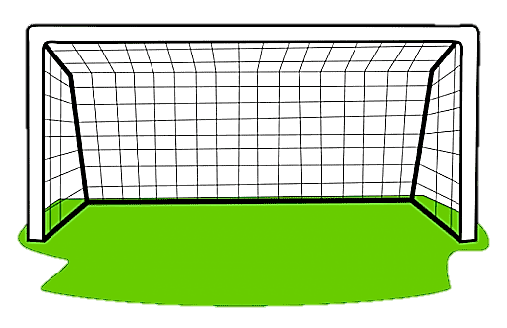
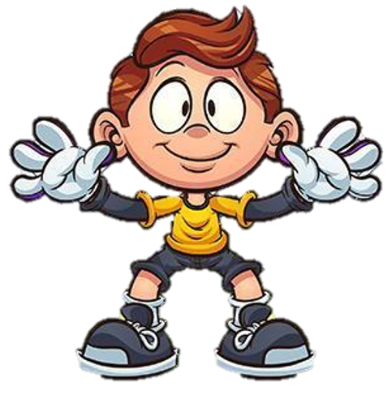

1. Do you fancy ________ around the West Lake with me?
A. going
B. having
C. moving

Slide 32
2. Circle the word that has different pronunciations.
A. agreed
B. succeeded
C. loved

Slide 33
3. Circle the signals of the present simple.
A. last Sunday
B. yesterday
C. everyday

Slide 34
4. I_______ playing board games interesting.
A. find
B. say
C. tell

Slide 35
5. Lan looks red. She was outdoors yesterday. Perhaps she has ______.
A. sunburn
B. spots
C. stomachache

Slide 36
Homework
THANK YOU!
Review the language they have learned
Prepare for the next lesson: Review: Skills

