Slide 1

Review 1 Lesson 2: Skills

Slide 2
Objectives
Reading
Speaking
01
02
Listening
Writing
03
04
About a hobby.
About ance.
About community activities at a school.
About benefits of hobbies.
About how to deal with some health problems.
About the reasons why students join different community activities.
About one’s hobby.
About some advice about healthy habits.
About some community activities and their benefits.
A paragraph about one’s hobby.
A paragraph of some advice to avoid viruses.
An email about community activities one did last summer.

Slide 3
01
reading

Slide 4
1. Read the passage, choose the correct answer A, B, or C.
Happiness is the key to a healthy life. Here are some things you can do to make you happy.
Love others fully
When you love somebody, express your love. Don’t keep it to yourself. There are many ways to do it. For example, you can say “I love you” more often, do things together, and help them when they need you. You can make yourself and others happy by doing so.
Laugh more often
Laughter shows that you are happy, and it has the magic power of making others happy too. Laughter is like medicine. It helps people live longer.
Enjoy adventure
Visit a new place, do a new thing, or talk to a new person every week. You will get new knowledge and experience.

Slide 5
1. Read the passage, choose the correct answer A, B, or C.
1. The phrase “the key” in the first line is closest in meaning to ________.
A. the first factor B. the important factor C. the new factor
2. To show your love to other people, you _________.
A. give them money B. take care of yourself C. do things with them
3. The writer says “Laughter is like medicine” because ________.
A. it makes others laugh too
B. it helps you make friends
C. it helps people live longer
4. You can get knowledge and experience by ___________.
A. visiting new places B. loving other people C. laughing more often
5. The best title for this passage is "_______".
A. Live to be happy B. Laghter is the power of happiness
C. Happiness is hard to find

Slide 6
Check the answer
1. The phrase “the key” in the first line is closest in meaning to ________.
A. the first factor
B. the important factor
C. the new factor
Happiness is the key to a healthy life. Here are some things you can do to make you happy.

Slide 7
Check the answer
2. To show your love to other people, you _________.
A. give them money
B. take care of yourself
C. do things with them
When you love somebody, express your love. Don’t keep it to yourself. There are many ways to do it. For example, you can say “I love you” more often, do things together, and help them when they need you. You can make yourself and others happy by doing so.

Slide 8
Check the answer
3. The writer says “Laughter is like medicine” because ________.
A. it makes others laugh too
B. it helps you make friends
C. it helps people live longer
Laughter shows that you are happy, and it has the magic power of making others happy too. Laughter is like medicine. It helps people live longer.

Slide 9
Check the answer
4. You can get knowledge and experience by ___________.
A. visiting new places
B. loving other people
C. laughing more often
Visit a new place, do a new thing, or talk to a new person every week. You will get new knowledge and experience.

Slide 10
Check the answer
5. The best title for this pasage is "_______".
A. Live to be happy
B. Laghter is the power of happiness
C. Happiness is hard to find
Happiness is the key to a healthy life. Here are some things you can do to make you happy.

Slide 11
02
Speaking

Slide 12

2. Work in pairs.
How much do you know about community service?
Questions | Answers
1. Who can do community service?
2. Who needs community help?
3. What can you do to help them?
Everyone
- Street children. - Old people.
- Poor people.
- Collect used paper to exchange money
- Donate old clothes
- Teach street children

Slide 13
03
Listening

Slide 14

05
3. Listen and complete each sentence with ONE word.
01
While camping, we have a lot of time for __________.
02
When camping near the beach, we can build ________.
03
We can have dinner by an _________ fire.
04
At the campsite, there is no television or ________.
Name one thing we should bring along when camping _________.

Slide 15
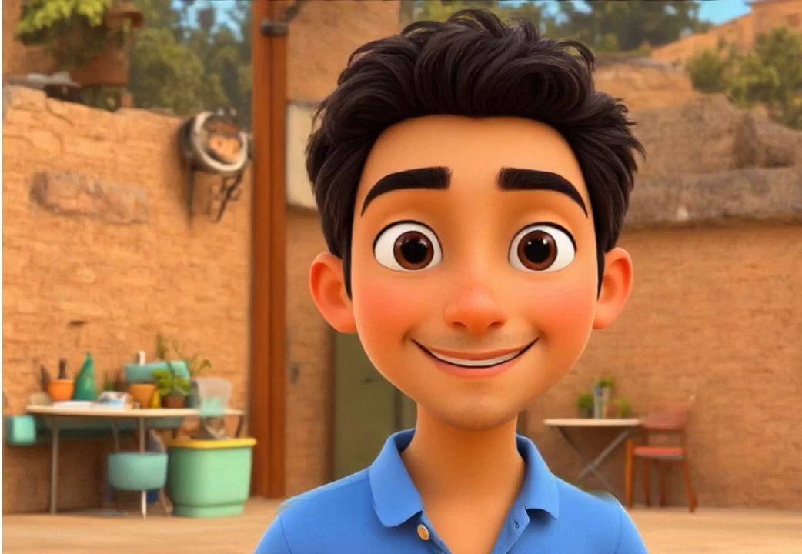

Slide 16

3. Listen and complete each sentence with ONE word.
01
While camping, we have a lot of time for __________.
games
When we go camping, there is plenty of time for games with friends.

Slide 17
3. Listen and complete each sentence with ONE word.
When camping near the beach, we can build __________.
02
sandcastles
If we camp near a beach, we can build sandcastles.

Slide 18
3. Listen and complete each sentence with ONE word.
We can have dinner by an _________ fire.
03
open
In the evening, we can have dinner by an open fire.

Slide 19
3. Listen and complete each sentence with ONE word.
At the campsite, there is no television or ___________.
04
computer
While we go camping, there is no television or computer.

Slide 20
05
3. Listen and complete each sentence with ONE word.
Name one thing we should bring along when camping
____________________________________________________.
food / water / a sleeping bag / a compass / some insect cream.
Don't forget to bring important things, like food and water, a sleeping bag, a compass, and some insect cream.

Slide 21
04
Writing

Slide 22
4. Writing complete sentences to make a passage describing community activities.
1. We join community activities once a month.
1. we / join / community activities / once a month.
2. Last month we planted trees in the park.
2. last month / we / plant / trees / park.
3. We dug holes to put young trees in.
3. we / dig / holes / put / young trees / in.
4. Then we watered them for two or three weeks.
4. then / we / water / them / two or three weeks.
5. Now trees are growing very well.
5. now / trees / grow / very well.
6. They make the park greener and air fresher.
6. they / make / park / greener / air / fresher.

Slide 23
What have you revised today?
A. Reading about ance
B. Speaking about community service
B. Speaking about community service
C. Listening for specific information about camping outside
C. Listening for specific information about camping outside
D. Writing about one’s hobby

Slide 24
HOMEWORK
Review the vocabulary and grammar points of unit 1-2-3
Prepare for the mid-term test

Slide 25
Thank you!

