Slide 1

WELCOME TO OUR CLASS!
Presented by: ………………

Slide 2
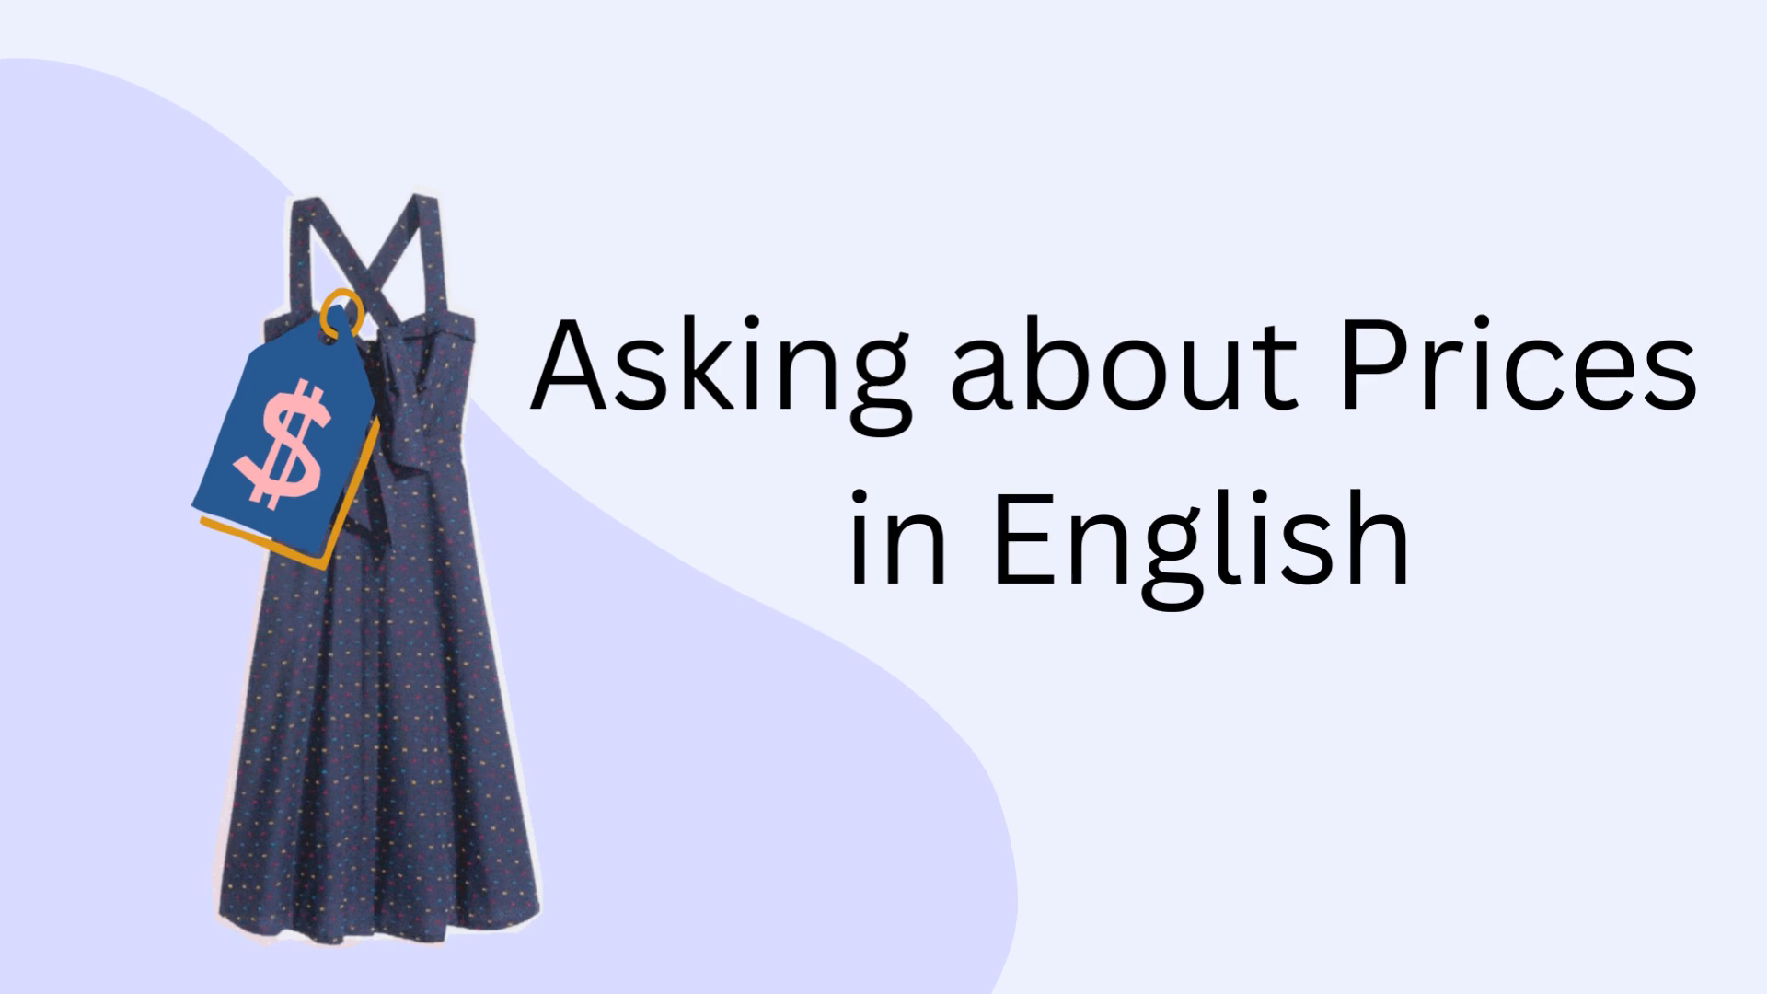
What is the video about?

Slide 3
Unit 5.
Food and Drink
Lesson 4. Communication

Slide 4

Objectives
By the end of this lesson, Ss will be able to:
Use lexical items related to the favourite food and drink in everyday life.
Understand and use ways to ask and answer about prices in English.

Slide 5
Everyday English
Asking and answering about the prices.

Slide 6

1. Listen and read the conversation.
1. Pay attention to the questions and answers.
Can you mark the question word and answer way about price?
Mark: How much is a bottle of mineral water?
Mi: It's 5,000 dong.
Mark: And how much are two kilos of apples?
Mi: They're 50,000 dong.
Mark: How much is a bottle of mineral water?
Mi: It's 5,000 dong.
Mark: And how much are two kilos of apples?
Mi: They're 50,000 dong.

Slide 7
2. Work in pairs. Ask and answer about the prices of the food and drink on the menu.
LY'S RESTAURANT Breakfast Menu
Food
bowl of beef noodle soup | 30,000 dong
bowl of eel soup | 35,000 dong
toast | 20,000 dong
Drink
glass of milk | 9,000 dong
bottle of mineral water | 8,000 dong
cup of green tea | 5,000 dong
Example:
A: How much is a bowl of beef noodle soup?
B: It’s 30,000 dong.

Slide 8
Do you have any favorite food or drink?

Slide 9
3. Listen to the conversation and answer the following questions.
3. Underline the keywords.
1
What's Nam's favourite food?
What's Nam's favourite food?
2
What's his favourite drink?
What's his favourite drink?
3
What foreign food does he like?
What foreign food does he like?
4
What food does he want to try?
What food does he want to try?
5
What food can he cook?
What food can he cook?

Slide 10
Check the answers
1
What's Nam's favourite food?
What's Nam's favourite food?
Peter: What's your favourite food, Nam?
Nam: It's spring rolls.
Spring rolls

Slide 11
Check the answers
2
What's his favourite drink?
What's his favourite drink?
Peter: What's your favourite drink?
Nam: I like lemonade.
Lemonade

Slide 12
Check the answers
3
What foreign food does he like?
What foreign food does he like?
Peter: Interesting. What foreign food do you like?
Nam: Mmm, I like apple pie and pancakes.
Apple pie and pancakes

Slide 13
Check the answers
4
What food does he want to try?
What food does he want to try?
Peter: How about new food? Is there anything that you've never had, but would like to try?
Nam: Certainly. I'd love to try hu tieu in Ho Chi Minh City.
Hu tieu (in HCM city)

Slide 14
Check the answers
What food can he cook?
5
What food can he cook?
Peter: I'd like to give it a try too. What can you cook?
Nam: Let me think... I cook omelettes, rice, and spring rolls.
Omelettes, rice, and spring rolls

Slide 15
Look at the answers again
1
Spring rolls
2
Lemonade
3
Apple pie and pancakes
4
Hu tieu (in HCM city)
Omelettes, rice, and spring rolls
5

Slide 16
4. Work in groups. Interview two of your friends aout their favourite food and drink.
Questions | Student 1 | Student 2
1. What's your favourite food?
2. What's your favourite drink?
3. What food or drink do you want to try?
4. What foreign food or drink do you like?
5. What can you cook?

Slide 17
4. Work in groups. Interview two of your friends aout their favourite food and drink.
Now report your results to the class.
Example:
I interviewed Minh about his favourite food and drink. Minh's favourite food is beef noodles soup. His favourite drink is fruit juice. He wants to try spaghetti. His favourite foreign food is Korea Kimbap. He can cook omelette and noodles.

Slide 18

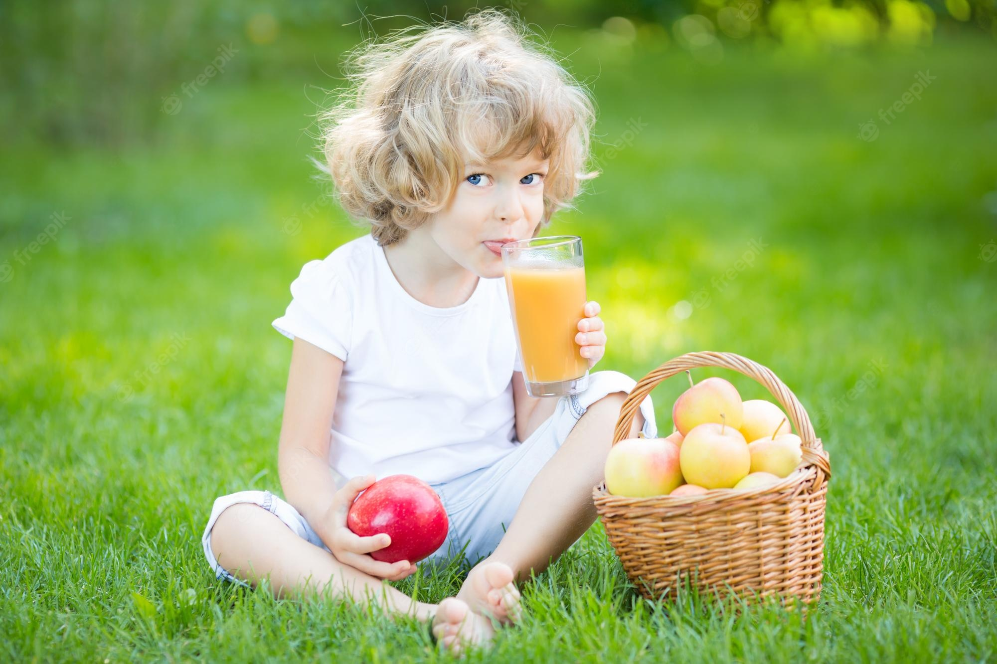
RECAP
Circle the best answer.
1. What is the price of a kilo of beef?
A. How much is a kilo of beef?
B. How many is a kilo of beef?
C. How much are a kilo of beef?
2. What’s her favourite drink?
A. I like lemonade.
B. She likes apple juice.
C. She likes coke.
1. What is the price of a kilo of beef?

Slide 19
Thank you!

