Slide 1
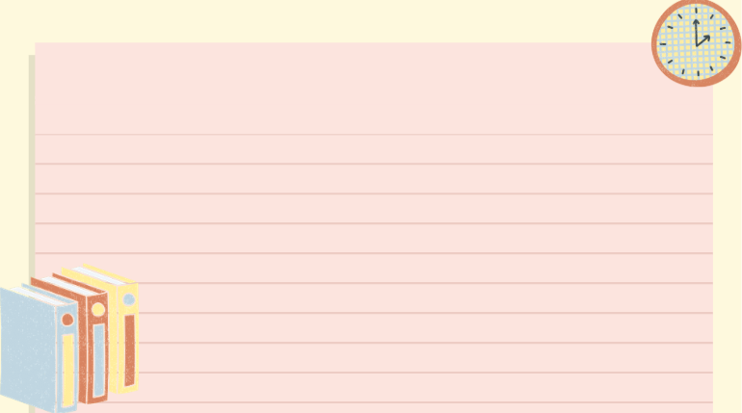
WELCOME TO
OUR CLASS!
Presented by: ………………..

Slide 2


START
What’s behind the wall?
BRICKS DOWN

Slide 3
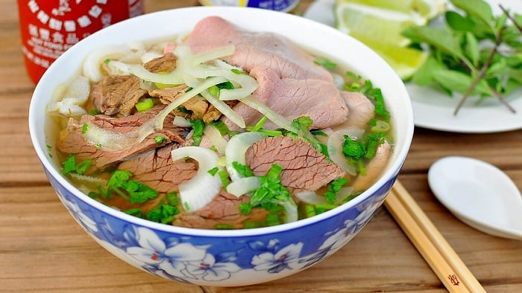
Pho
NEXT
CHECK
Click on the bricks

Slide 4
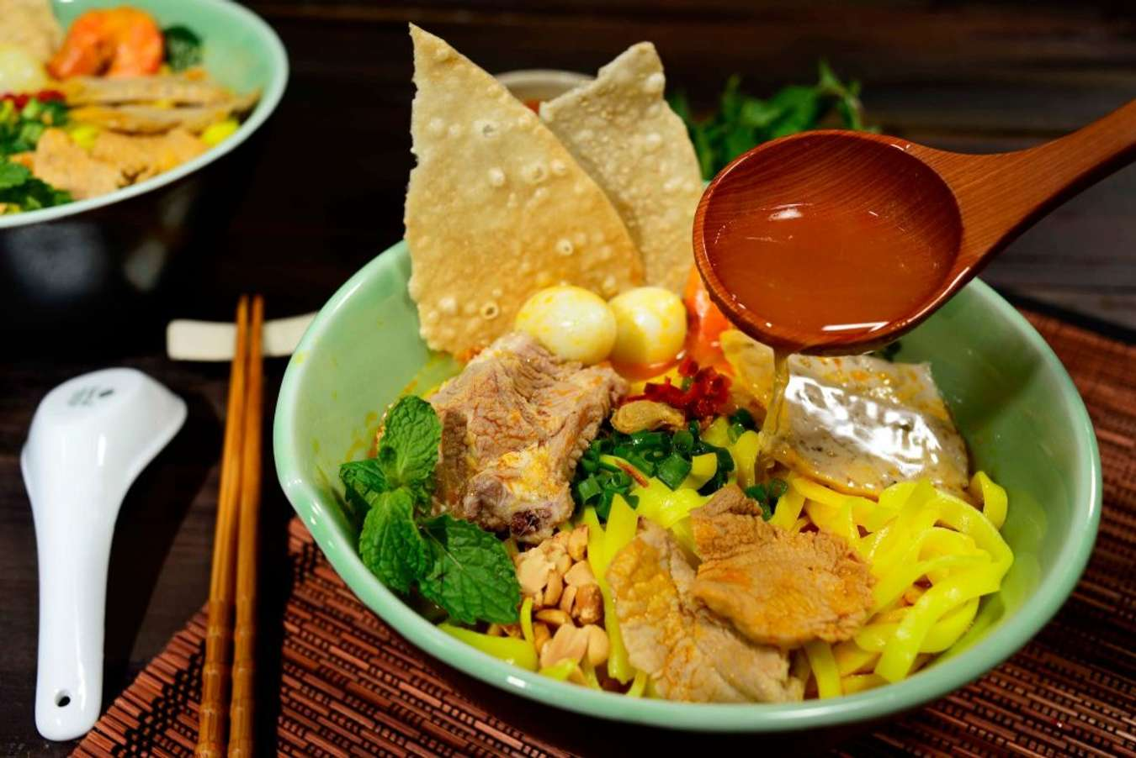
Mi Quang
NEXT
CHECK
Click on the bricks

Slide 5
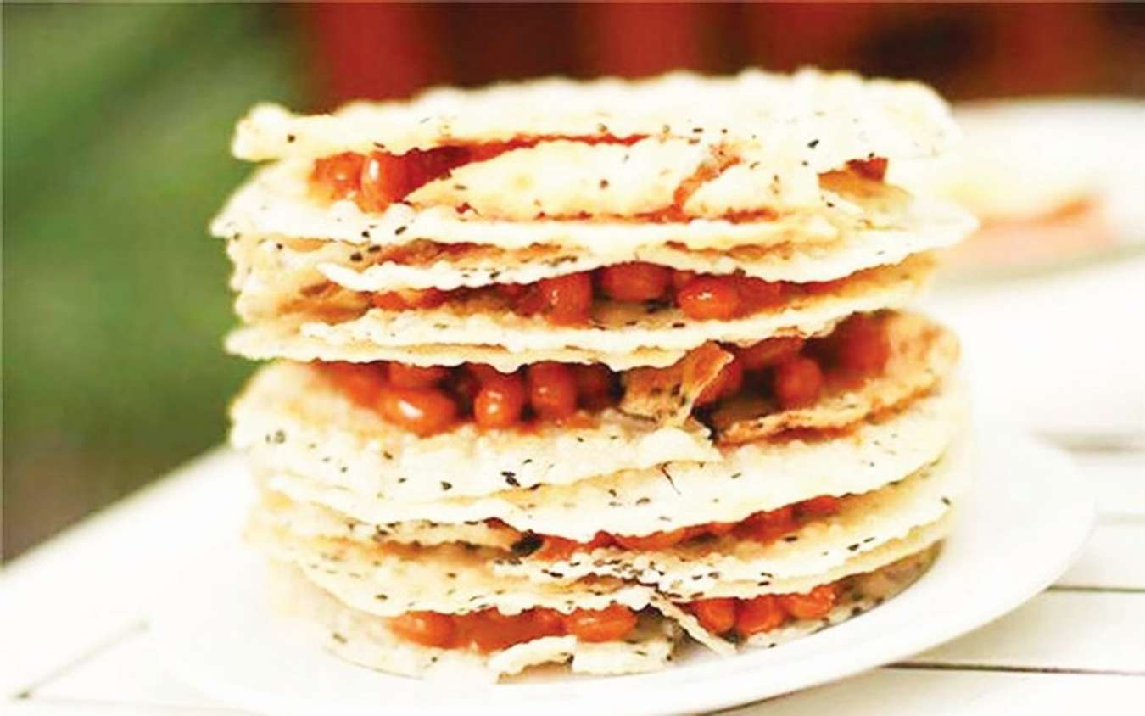
Kẹo cu đơ
NEXT
CHECK
Click on the bricks

Slide 6
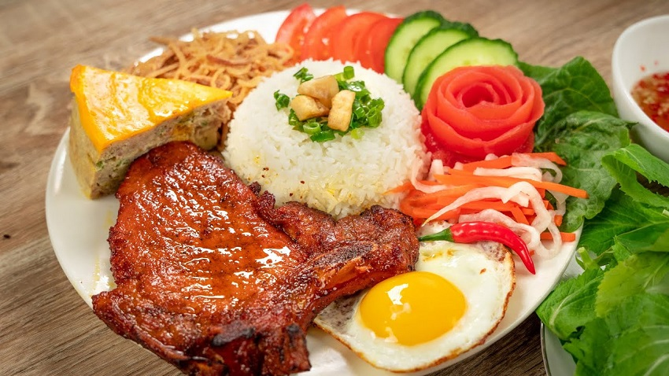
Com Tam
NEXT
CHECK
Click on the bricks

Slide 7
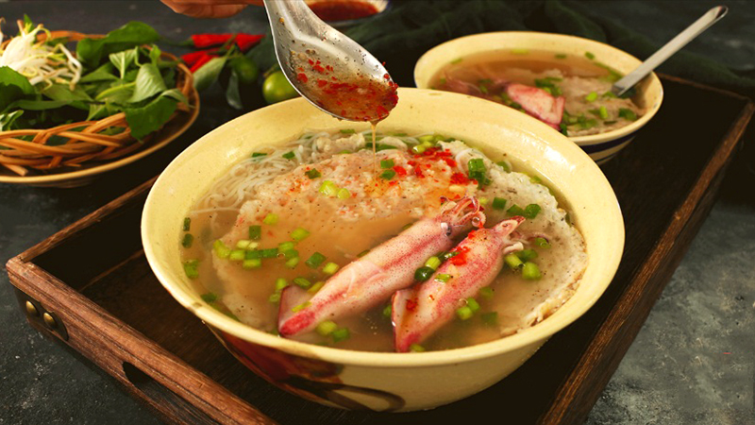
Bun quay Phu Quoc
NEXT
CHECK
Click on the bricks

Slide 8
Unit 5:
Food and drink
Lesson 7: Looking back

Slide 9
Objectives
Review the vocabulary and grammar of Unit 5

Slide 10
Pronunciation
/ɒ/ | /ɔ:/
Job, box, clock, watch, bottle, got, holiday, long, lost, wrong, sorry, shop, quality, want, wash, what
Ball, all, talk, autumn, launch, law, saw, dawn, caught, bought, warm, born, corner, door, floor, more, pour, board

Slide 11
01
Vocabulary

Slide 12

1. Add the words and phrases you have learnt in the correct columns. Compare with your partner's. Who has more words and phrases? Add any that you did not write
Dishes | Ingredients | Units of measurement
pancakes | flour | gram (g)

Slide 13
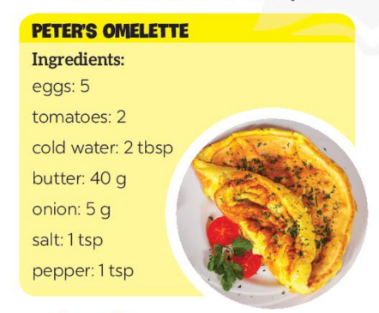
2. Read the recipe and write sentences as in the example.
Example: We need two tablespoons of cold water.
Suggested answers:
We need 5 eggs.
We need 2 tomatoes.
We need 2 tablespoons of cold water.
We need 40 grams of butter.
We need 5 grams of onion.
We need 1 teaspoon of salt.
We need a teaspoon of pepper.

Slide 14
02
Grammar

Slide 15

Do the quiz

Slide 16
3. Complete the sentences. Write some, any, much, or a lot of/ lots of.
1. I have to go to the market now. There isn't _________ food for our dinner.
2. Would you like _________ sugar for your coffee?
3. There are ______________ trees in our village, so the air here is very fresh.
4. I'm very busy, I have ______________ things to do today.
5. We didn't have _________ beef left, so we had _________ fish for lunch.

Slide 17
3. Complete the sentences. Write some, any, much, or a lot of/ lots of.
1. I have to go to the market now. There isn't _________ food for our dinner.
Any: dùng trong câu phủ định, + N không đếm được
2. Would you like _________ sugar for your coffee?
Would you like some…….? → cấu trúc mời
any
some

Slide 18
3. Complete the sentences. Write some, any, much, or a lot of/ lots of.
3. There are ______________ trees in our village, so the air here is very fresh.
a lot of/ lots of + N đếm được /Không đếm được
4. I'm very busy, I have ______________ things to do today.
a lot of/ lots of + N đếm được /Không đếm được
5. We didn't have _________ beef left, so we had _________ fish for lunch.
Any: dùng trong câu phủ định, + N không đếm được
Some: dùng trong câu khẳng định, + N đếm được/ không đếm được
a lot of/ lots of
a lot of/ lots of
any
some

Slide 19
4. Make questions with How many/ How much for the underlined words in the following sentences. Example: Minh has three apples.
How many apples does Minh have?
1. There are six bottles of juice in the fridge.
How many bottles of juice are there in the fridge?
2. I need some butter for my pancakes.
How much butter do you need for your pancakes?
3. We have only one bottle of fish sauce.
How many bottles of fish sauce do you/ we have?
4. We need ten chairs for the party.
How many chairs do you/ we need (for the party)?
5. She put a lot of sugar in her lemonade.
How much sugar did she put in her lemonade?
How many + danh từ đếm được số nhiều
How much + danh từ không đếm được /số ít
How many + danh từ đếm được số nhiều
How many + danh từ đếm được số nhiều
How much + danh từ không đếm được /số ít

Slide 20
Wrap-up
https://g.co/gemini/share/7361adc6dc12

Slide 21
Homework
Review the vocabulary and grammar of Unit 5
Do the exercise in the workbook
Prepare for the next lesson

Slide 22
Thank you!

