Slide 1

Hello every one !!!

Slide 2

Game: List some common dishes that your family often eats in daily meals.
Breakfast
Lunch
Dinner
Bread
Fried rice
Beef noodles
rice
Fish
- Vegetables
- ……
rice
Meat
- Vegetables
- ……

Slide 3


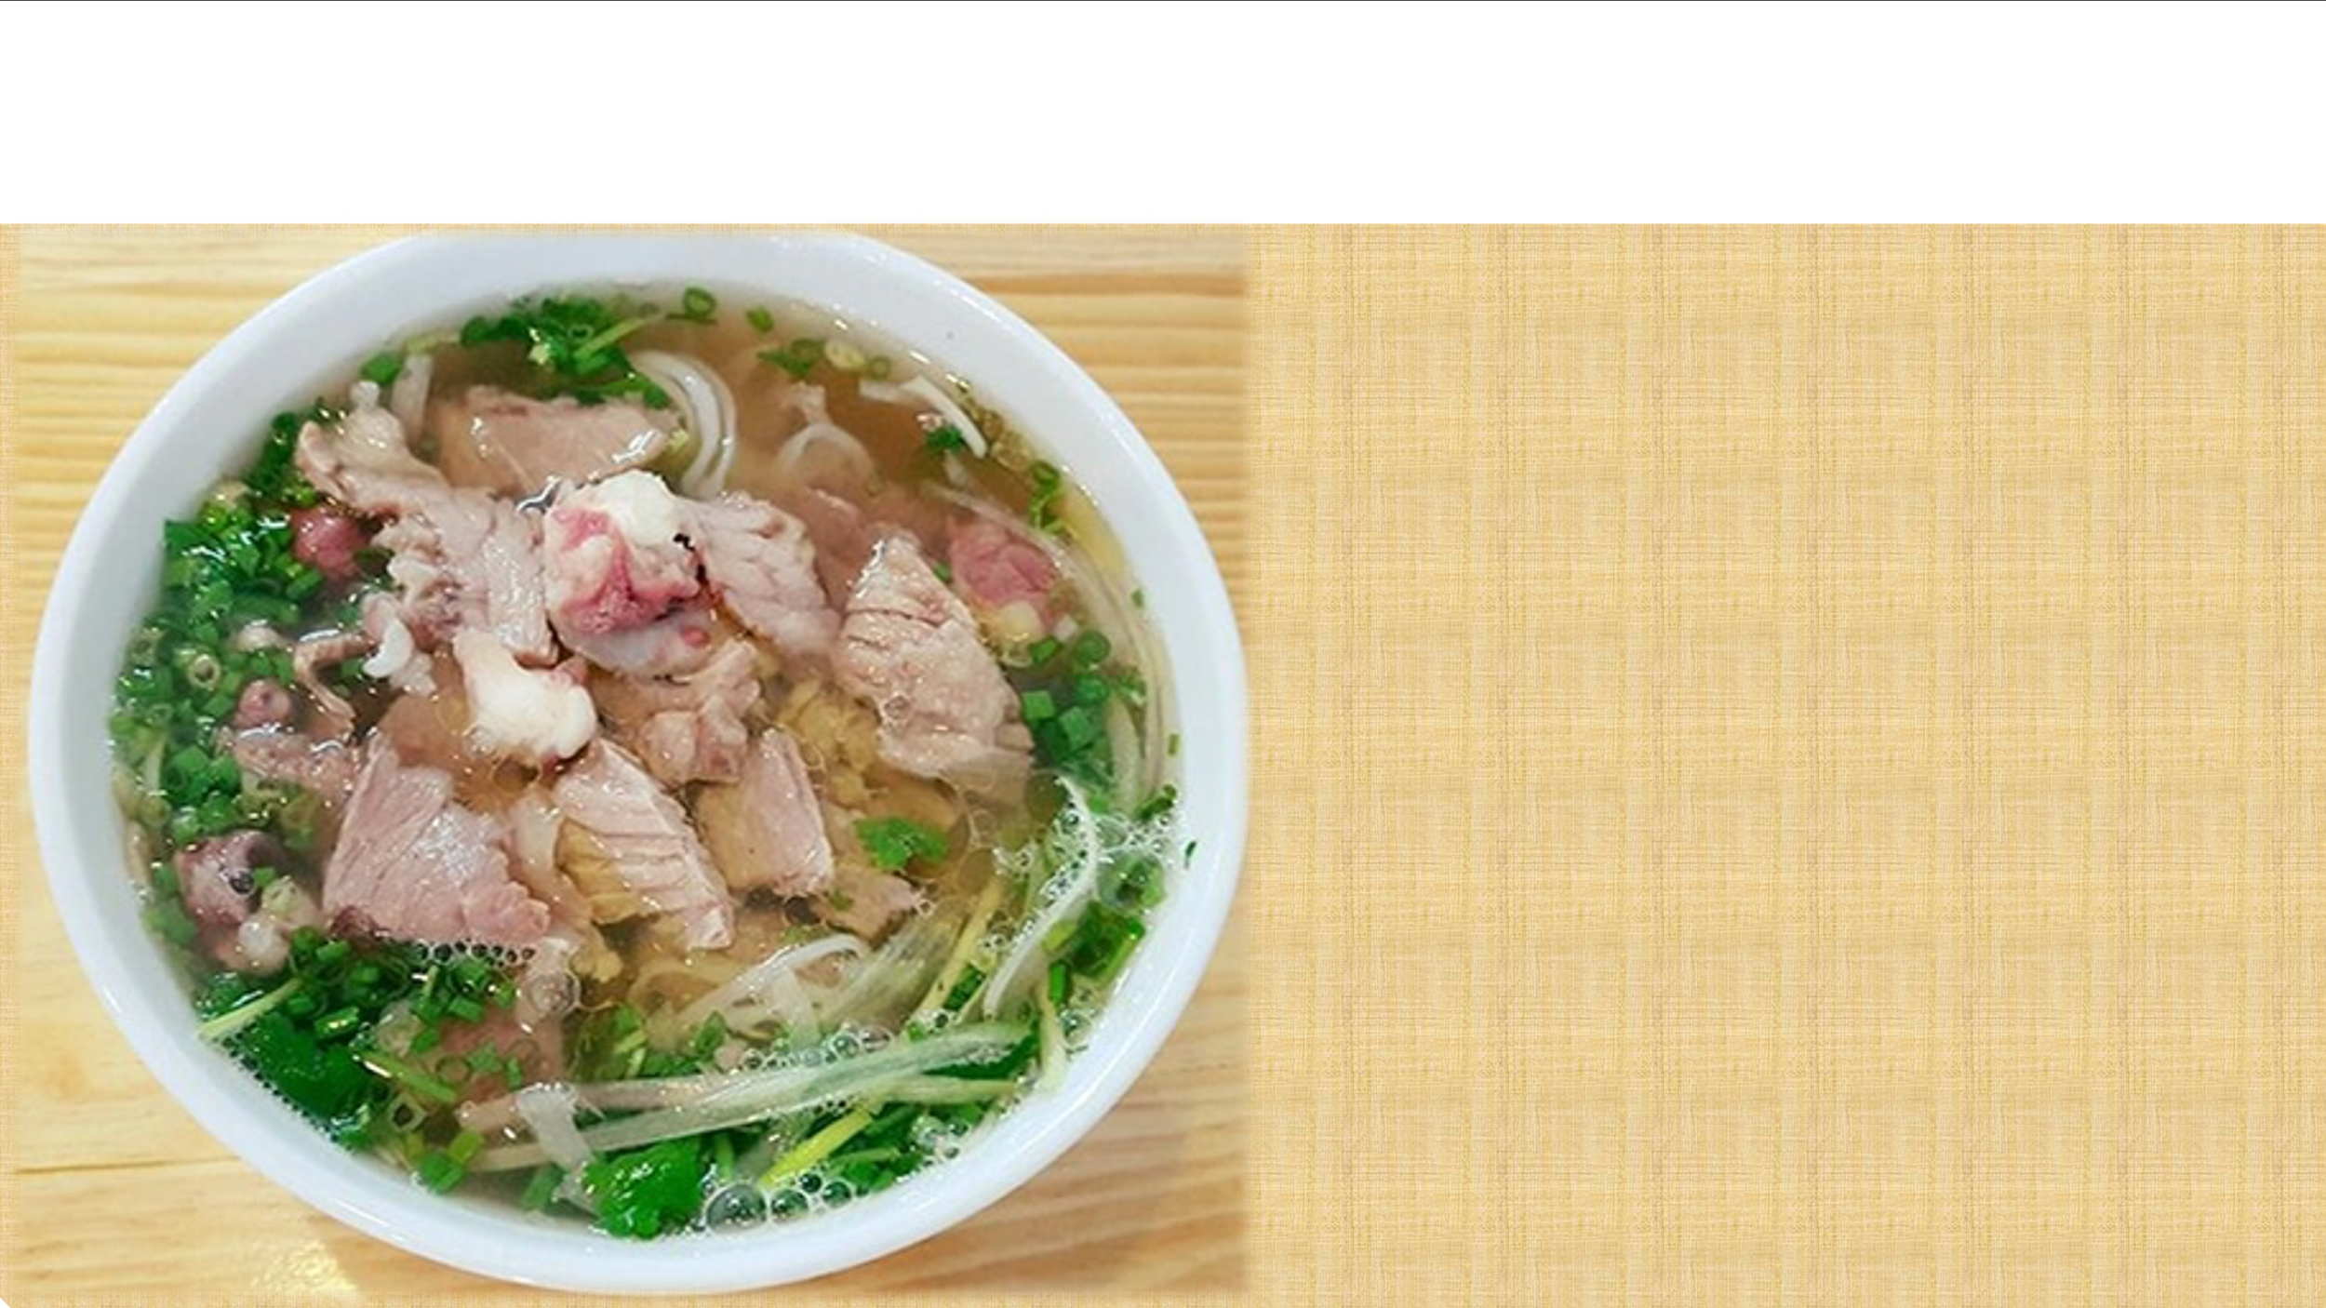

Unit
5
FOOD AND DRINK
Lesson 5: SKILLS 1

Slide 4

Task1: Work in pairs. Discuss the following questions
Is pho popular in your neighbourhood?
2. When can we have pho?
3. What are the main ingredients of pho?
Yes, it is/ No, it isn’t
We have it in the morning.
The main ingredients of pho are noodles
and beef or chicken,…..

Slide 5

I. READING
1
Read Phong's blog. Match the underlined words in the text with their meanings.
Pho is a special kind of traditional Vietnamese dish. Its main ingredients are rice noodles and slices of beef or chicken. It is one of the most common dishes you will find in Viet Nam. People enjoy pho at all times of the day, even for a late night snack. Pho has a very special taste. The rice noodles are made from the best kind of rice. There are two main kinds of pho: pho bo (beef noodle soup) and pho ga (chicken noodle soup). The broth for pho is made by stewing beef or chicken bones for a long time in a big pot. The meat (beef and chicken) served with pho is boneless and cut into thin slices ... It's really delicious!
Tell me about a popular dish in your area!
Posted by Phong on Feb 22 at 5:30 p.m.
1. snack
a. cooking something slowly, often in water
d. a small meal, usually eaten in a hurry
2. taste
b. the flavour of something
b. the flavour of something
c. soup made by boiling bones, meat, etc, and vegetables in water
c. soup made by boiling bones, meat, etc, and vegetables in water
3. broth
4. stewing
a. cooking something slowly, often in water
d. a small meal, usually eaten in a hurry
5. boneless
e. without bones
e. without bones

Slide 6
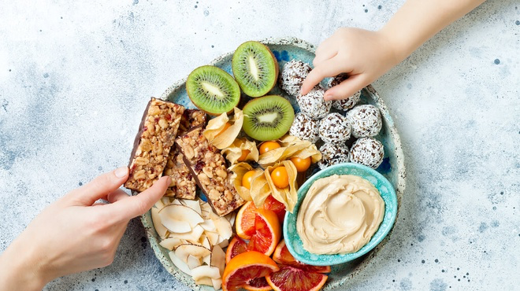
* Checking vocabulary
- snack (n):
/snæk/
đồ ăn vặt

Slide 7
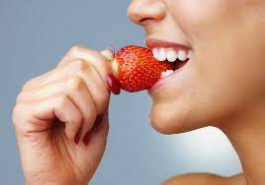
* Checking vocabulary
- taste (v):
/teɪst/
nếm thử

Slide 8
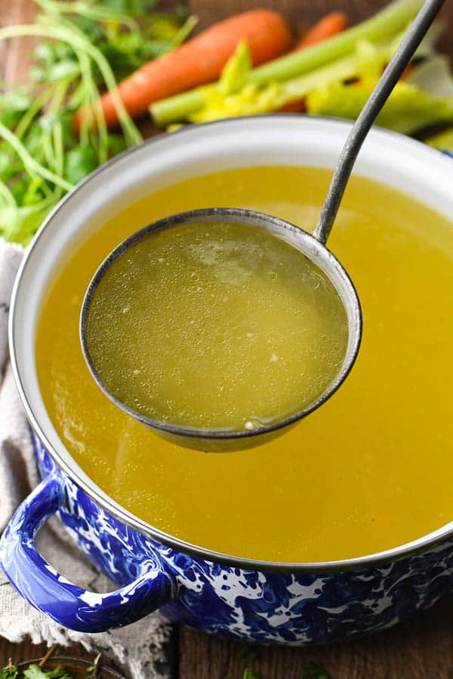
* Checking vocabulary
- broth(n):
/brɒθ/
nước dùng, nước canh

Slide 9
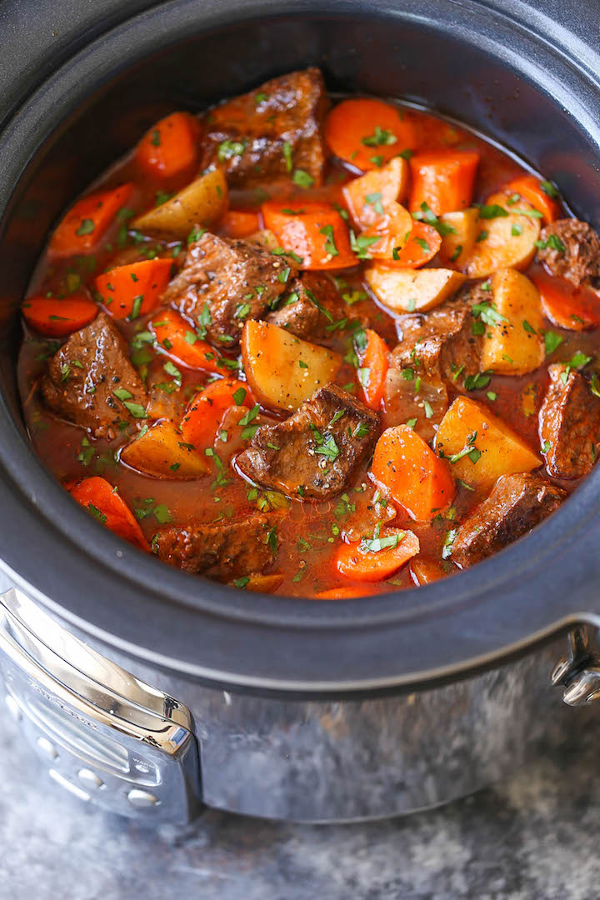
* Checking vocabulary
- stew (v):
/stju:/
hầm, ninh

Slide 10
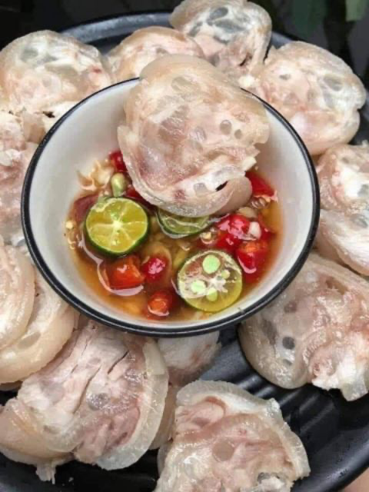
* Checking vocabulary
- boneless(adj):
/ˈbəʊnləs/
không xương

Slide 11
3
Read Phong’s blog again and circle the correct answer A, B or C.
1. The text is mainly about _____.
A. pho, a popular dish in Viet Nam
B. popular dishes in Viet Nam
C. different ways to cook pho
2. Pho is made mainly with _____.
A. rice noodles and beef or chicken
B. rice, pork, and vegetables
C. fish, shrimp, and noodles
3. We enjoy pho _____.
A. only for breakfast
B. for lunch and dinner
C. at any time of the day
4. To make noodles for pho, we use _____.
A. a variety of sticky rice
B. the best kind of rice
C. eggs and rice flour
5. The broth for pho is made by _____.
A. slowly cooking beef or chicken bones
B. cooking beef or chicken with fish sauce
C. boiling potatoes and chicken bones for a long time

Slide 12

Choose the best answer

Slide 13

3
Read Phong’s blog again and circle the correct answer A, B or C.
Pho is a special kind of traditional Vietnamese dish. Its main ingredients are rice noodles and slices of beef or chicken. It is one of the most common dishes you will find in Viet Nam. People enjoy pho at all times of the day, even for a late night snack. Pho has a very special taste. The rice noodles are made from the best kind of rice. There are two main kinds of pho: pho bo (beef noodle soup) and pho ga (chicken noodle soup). The broth for pho is made by stewing beef or chicken bones for a long time in a big pot. The meat (beef and chicken) served with pho is boneless and cut into thin slices ... It's really delicious!
Tell me about a popular dish in your area!
1. The text is mainly about _____.
A. pho, a popular dish in Viet Nam
B. popular dishes in Viet Nam
C. different ways to cook pho
5
4
1
3
2
Posted by Phong on Feb 22 at 5:30 p.m.

Slide 14
3
Read Phong’s blog again and circle the correct answer A, B or C.
Pho is a special kind of traditional Vietnamese dish. Its main ingredients are rice noodles and slices of beef or chicken. It is one of the most common dishes you will find in Viet Nam. People enjoy pho at all times of the day, even for a late night snack. Pho has a very special taste. The rice noodles are made from the best kind of rice. There are two main kinds of pho: pho bo (beef noodle soup) and pho ga (chicken noodle soup). The broth for pho is made by stewing beef or chicken bones for a long time in a big pot. The meat (beef and chicken) served with pho is boneless and cut into thin slices ... It's really delicious!
Tell me about a popular dish in your area!
2. Pho is made mainly with _____..
A. rice noodles and beef or chicken
B. rice, pork, and vegetables
C. fish, shrimp, and noodles
5
4
1
3
2
Posted by Phong on Feb 22 at 5:30 p.m.

Slide 15
3
Read Phong’s blog again and circle the correct answer A, B or C.
Pho is a special kind of traditional Vietnamese dish. Its main ingredients are rice noodles and slices of beef or chicken. It is one of the most common dishes you will find in Viet Nam. People enjoy pho at all times of the day, even for a late night snack. Pho has a very special taste. The rice noodles are made from the best kind of rice. There are two main kinds of pho: pho bo (beef noodle soup) and pho ga (chicken noodle soup). The broth for pho is made by stewing beef or chicken bones for a long time in a big pot. The meat (beef and chicken) served with pho is boneless and cut into thin slices ... It's really delicious!
Tell me about a popular dish in your area!
3. We enjoy pho _____.
A. only for breakfast
B. for lunch and dinner
C. at any time of the day
5
4
1
3
2
Posted by Phong on Feb 22 at 5:30 p.m.

Slide 16
3
Read Phong’s blog again and circle the correct answer A, B or C.
Pho is a special kind of traditional Vietnamese dish. Its main ingredients are rice noodles and slices of beef or chicken. It is one of the most common dishes you will find in Viet Nam. People enjoy pho at all times of the day, even for a late night snack. Pho has a very special taste. The rice noodles are made from the best kind of rice. There are two main kinds of pho: pho bo (beef noodle soup) and pho ga (chicken noodle soup). The broth for pho is made by stewing beef or chicken bones for a long time in a big pot. The meat (beef and chicken) served with pho is boneless and cut into thin slices ... It's really delicious!
Tell me about a popular dish in your area!
4. To make noodles for pho, we use _____.
A. a variety of sticky rice
B. the best kind of rice
C. eggs and rice flour
5
4
1
3
2
Posted by Phong on Feb 22 at 5:30 p.m.

Slide 17
3
Read Phong’s blog again and circle the correct answer A, B or C.
Pho is a special kind of traditional Vietnamese dish. Its main ingredients are rice noodles and slices of beef or chicken. It is one of the most common dishes you will find in Viet Nam. People enjoy pho at all times of the day, even for a late night snack. Pho has a very special taste. The rice noodles are made from the best kind of rice. There are two main kinds of pho: pho bo (beef noodle soup) and pho ga (chicken noodle soup). The broth for pho is made by stewing beef or chicken bones for a long time in a big pot. The meat (beef and chicken) served with pho is boneless and cut into thin slices ... It's really delicious!
Tell me about a popular dish in your area!
5. The broth for pho is made by ___ .
A. slowly cooking beef or chicken bones
B. cooking beef or chicken with fish
sauce
C. boiling potatoes and chicken bones
for a long time
5
4
1
3
2
Posted by Phong on Feb 22 at 5:30 p.m.

Slide 18
3
Read Phong’s blog again and circle the correct answer A, B or C.
1. The text is mainly about _____.
A. pho, a popular dish in Viet Nam
B. popular dishes in Viet Nam
C. different ways to cook pho
2. Pho is made mainly with _____.
A. rice noodles and beef or chicken
B. rice, pork, and vegetables
C. fish, shrimp, and noodles
3. We enjoy pho _____.
A. only for breakfast
B. for lunch and dinner
C. at any time of the day
4. To make noodles for pho, we use _____.
A. a variety of sticky rice
B. the best kind of rice
C. eggs and rice flour
5. The broth for pho is made by _____.
A. slowly cooking beef or chicken bones
B. cooking beef or chicken with fish sauce
C. boiling potatoes and chicken bones for a long time

Slide 19
II. SPEAKING
4
Make notes about a popular food and drink in your area. Think about its main
ingredients, how often and when you have it.
1
main
ingredients
How often?
a popular food and drink in your area
When?
Where?

Slide 20
4
1
. Think about its main ingredients, how often and when you have it.
Food or drink | Ingredients | How often and when | Where
Beef rice noodles | rice noodle, beef, broth | in the morning | At home, at the food stall.
bread | Pork, fried eggs, pate, cucumber, green onion, chili sauce,.. | Anytime of the day. Especially in breakfast | bakery

Slide 21
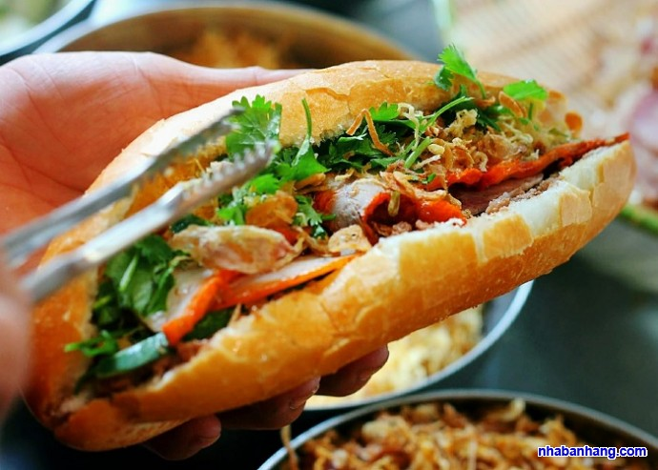
5
Work in groups of 3 or 4.
Take turns to talk about a popular food or drink in your area.
1
There are many delicious dishes in Vietnam, but one of the popular dishes in my area is Banh Mi . Banh Mi called “ Sandwich or hamburgers ” is the most popular street food in Vietnam because of its convenience, and deliciousness . Its ingredients such as pork, fried eggs, pate, cucumber, green onion, butter, and chili sauce. Vietnamese Sandwich is served as an ideal breakfast and light snack. People can buy this dish very easily on the Vietnamese streets.

Slide 22
* CONSOLIDATION
In this lesson, we have learn to:
Read for specific information about food and drink
Talk about popular food in the area.

Slide 23


homework
- Do exercises in the workbook.
- Prepare lesson 6 ( skills 2)

Slide 24




Slide 25
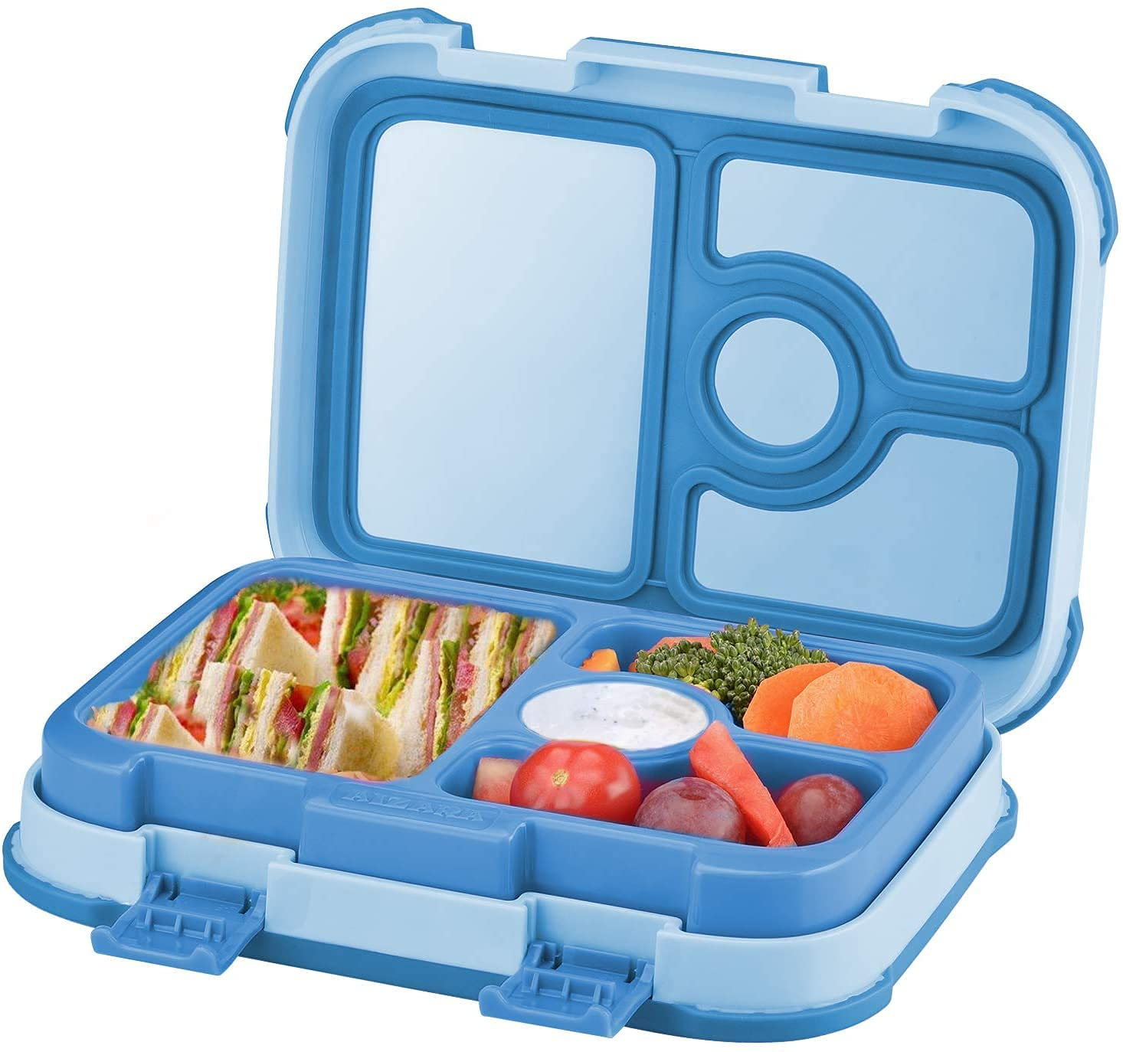
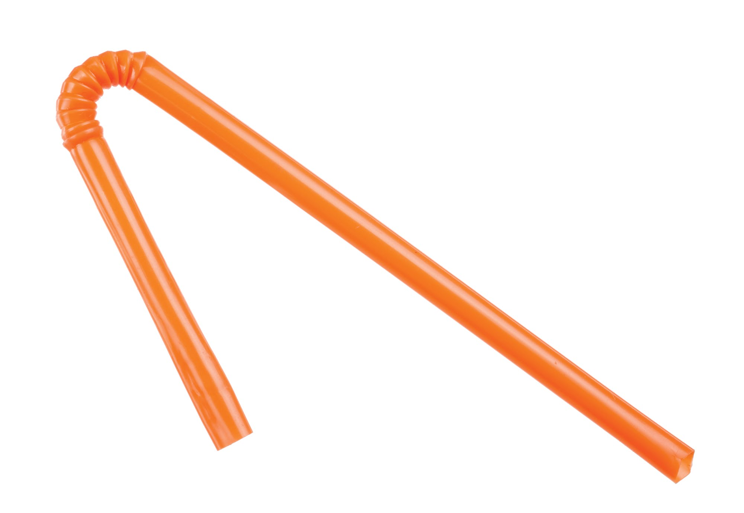
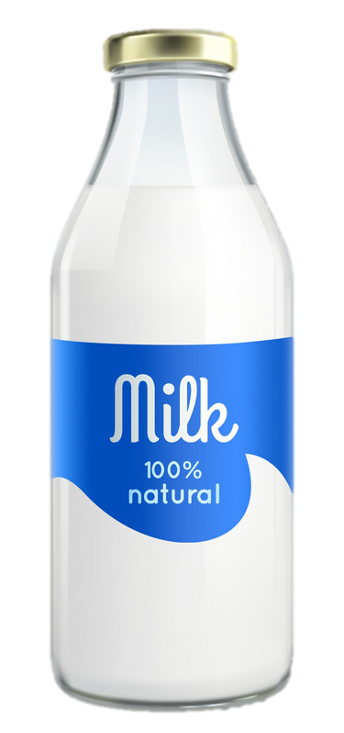
MINI GAME
Lunch time
Open your lunchbox.
Take out a sandwich.
Unwrap the sandwich.
Take a bite of the sandwich. Mmmm it's good.
Open your milk container.
Put in the straw.
Drink some milk.
Eat the rest of your sandwich.
Drink the rest of the milk
Wipe your face with your napkin.
Close your lunchbox.
Stand up.
Clean up the table.
Take the garbage to the garbage can.
Look at the clock. It's time for lunch.
Stand up.
Get your lunchbox
Line up.
Go to the lunchroom.
Sit down.

Slide 26
