Slide 1


GOOD MORNING
EVERYONE !!!

Slide 2

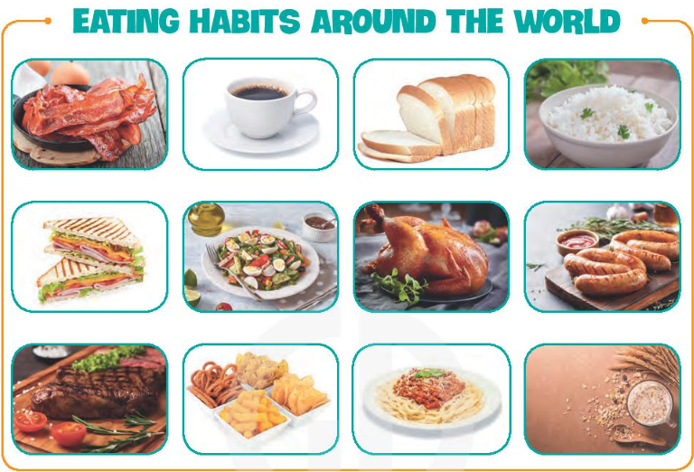

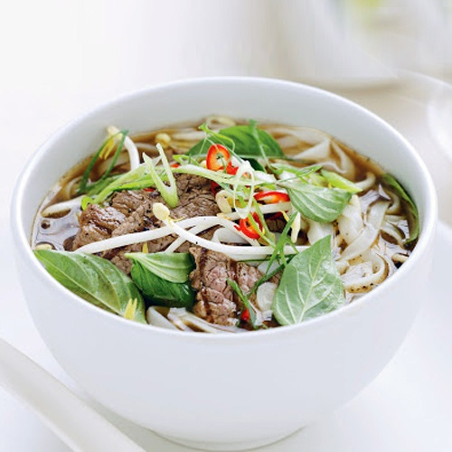
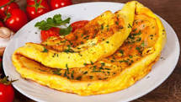
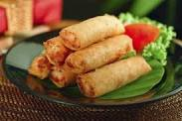

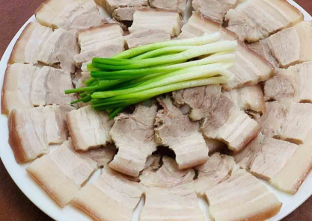
* Game : Kim’s game
* Look at the pictures in 15 seconds and write the names of the food and drink
Kim’s Game

Slide 3
Rice
roasted
chicken
coffee
Kim’s Game
omelette
Beef noodles
lemonade
Spring roll
Boiled pork

Slide 4



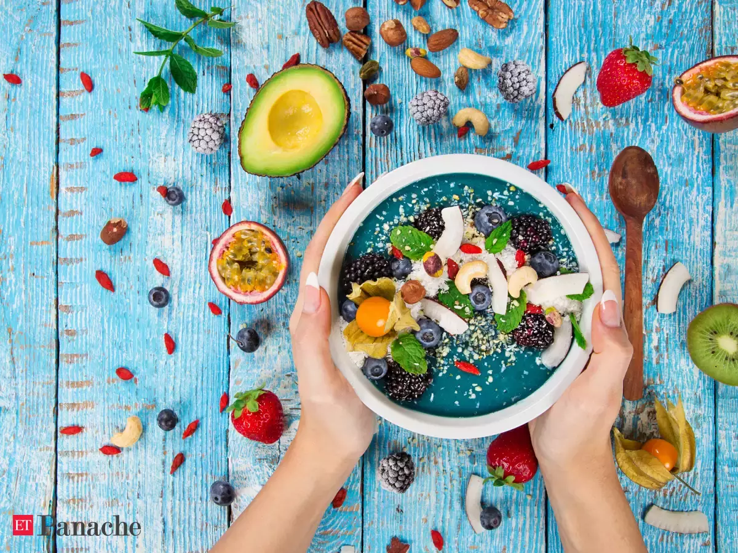

Unit
5
FOOD AND DRINK
Lesson 6: SKILLS 2

Slide 5

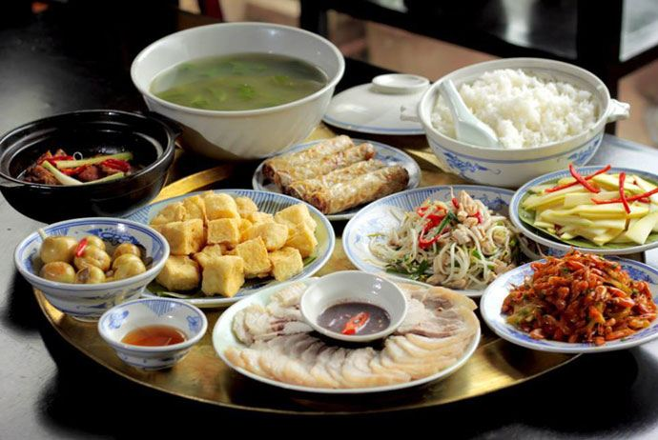
* Vocabulary
- meal (n):
/mɪəl/
bữa ăn

Slide 6
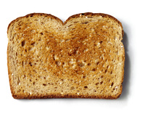
- toast (n):
/təʊst/
bánh mì nướng

Slide 7
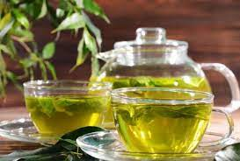
- Green tea(n):
/ɡriːn ˈtiː/
trà xanh

Slide 8
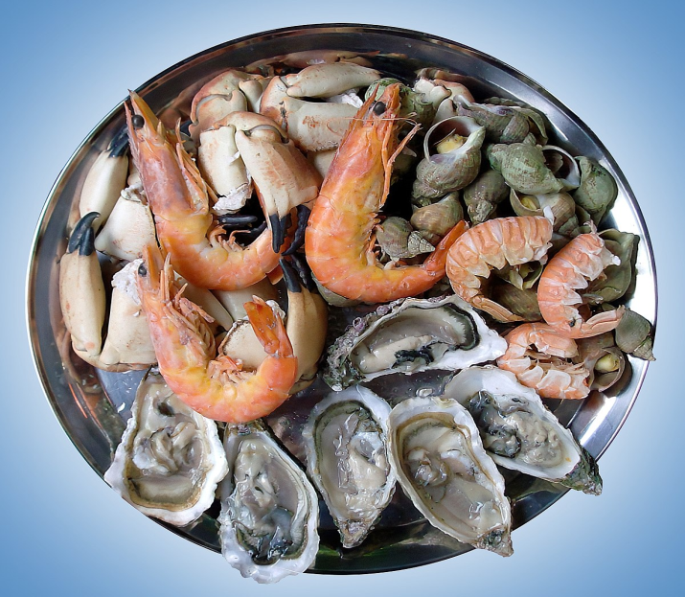
- seafood (n):
/ˈsiːfuːd/
hải sản

Slide 9
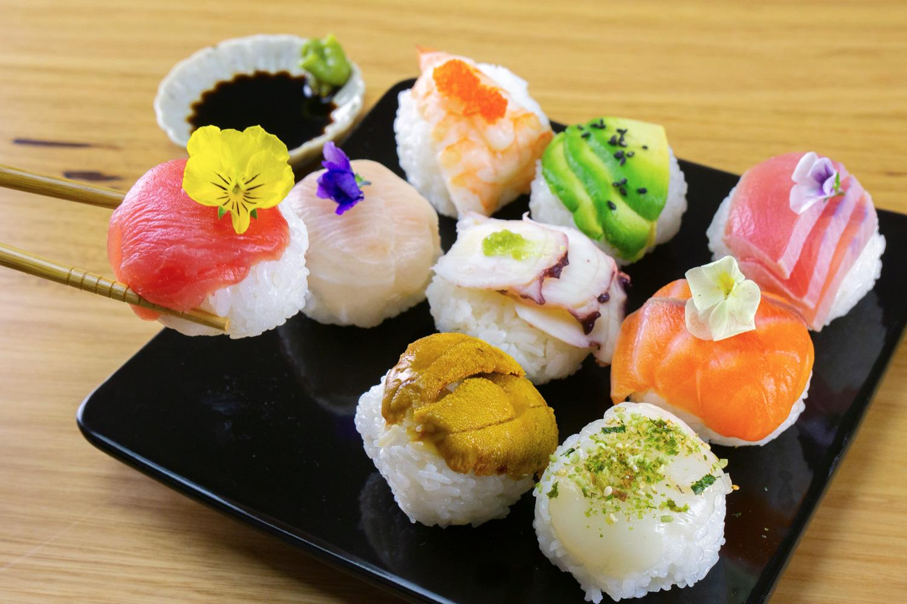
- Fabulous (n)
/ˈfæbjələs/
rất tuyệt vời

Slide 10
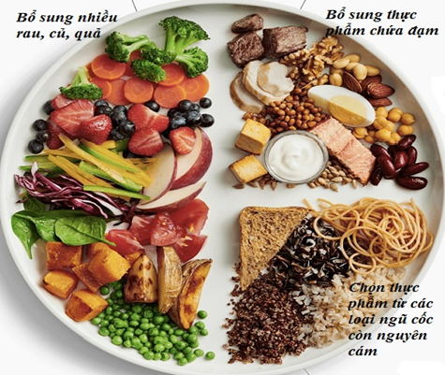
- healthy (n):
tốt cho sức khoẻ
/ˈhelθi/

Slide 11
* Vocabulary :
1. meal /mɪəl/: bữa ăn
2. toast /təʊst/ : bánh mì nướng
3. green tea /ɡriːn ˈtiː / : trà xanh
4. seafood /ˈsiːfuːd/: hải sản
5. fabulous /ˈfæbjələs/: tuyệt vời
6. healthy /ˈhelθi/: khoẻ mạnh

Slide 12

* Checking vocabulary:
- : bữa ăn
- : bánh mì nướng
- : trà xanh
- : hải sản
- : tuyệt vời
- : khoẻ mạnh
meal /mɪəl/
toast /təʊst/
green tea /ɡriːn ˈtiː /
seafood /ˈsiː fuːd/
fabulous /ˈfæbjələs/
healthy /ˈhelθi/

Slide 13

I. LISTENING
1
Work in groups. Discuss the following questions.
1. What time do people in your area often have breakfast, lunch, and dinner?
2. What do they often have for breakfast, lunch, and dinner?
→ They usually have breakfast at 6.30 a.m. They usually have lunch at 11 p.m. They usually have dinner at 7 p.m.
→ They eat a light breakfast with many kind of foods like pho, bread and milk. They eat rice with many dishes such as fish, meat, or vegetables for lunch or dinner

Slide 14

2
Listen to Minh talking about the eating habits in his area. Circle the food and drink you hear.
eel soup | cakes | green tea
coffee | toast

Slide 15
3
Listen again and tick True (T) or False (F).
 | T | F
1. People in Minh's area often have four meals a day.
2. Most of them have lunch at home.
3. Lunch is the main meal of the day in his area.
4. People in his neighbourhood often have rice, fresh vegetables, and seafood or meat for dinner.
5. After dinner, they often have some fruit and green tea.
F
T
F
T
T
Audio script

Slide 16
People in my area often have three meals a day: breakfast, lunch and dinner. For breakfast, we usually have pho or eel soup with bread. Sometimes we have instant noodles or xoi (sticky rice). Lunch often starts at 11:30 a.m. Most of us have lunch at home. We often have rice, fish, meat, and vegetables. Dinner is the main meal of the day. It's also the time when family members gather at home, so it takes a bit longer than the other meals. It often starts at around 7:30 p.m. We usually have rice with a lot of fresh vegetables and seafood or meat. We normally talk about everyday activities during the meal. Then we have some fruit and green tea. I think the food in my area is fabulous. It's very healthy and delicious.

Slide 17
II. WRITING
4
Make notes about the eating habits in your area.
 | Time | Food and drink
Breakfast
Lunch
Dinner
+ What time do they have breakfast, lunch and dinner?
+ What food and drink do they have then?

Slide 18
II. WRITING
4
Make notes about the eating habits in your area.
 | Time | Food and drink
Breakfast | At about 6.30am | Bread or sticky rice, beef noodles
Lunch | 11.30am | Rice, meat, vegetable
Dinner | 7pm | Rice , Fish, vegetable, soup

Slide 19
5
Write a paragraph of about 70 words about the eating habits in your area. Use the information in 4 to help you.
People in our area usually eat breakfast at 6.30 am and they often have bread or sticky rice. They have meat and vegetable for lunch at 11.30 am. They have fish, vegetable, soup for dinner at 7pm

Slide 20
* CONSOLIDATION
1
WRAP-UP
In this lesson, we have learnt to:
listen for specific information about eating habits
write a paragraph about eating habits in the area.

Slide 21

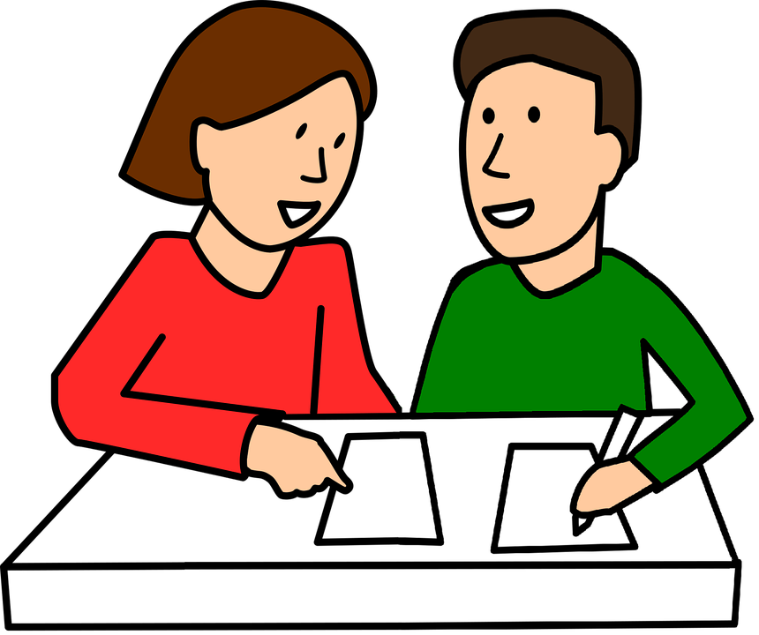
* HOMEWORK
Write a paragraph about your eating habits and upload on the drive link given.
- Prepare “ Looking back and project.

Slide 22

Thank you!
Goodbye!

Slide 23
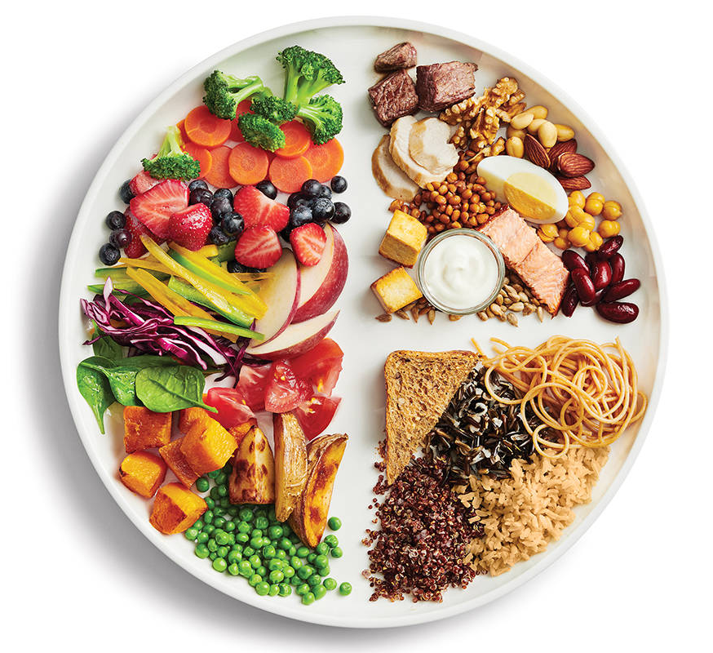
MINI GAME
Our eating habits
In your groups, talk about:
What you ate and drank yesterday
Who had healthy diets

