Slide 1

WELCOME TO OUR CLASS!
Presented by: ......

Slide 2
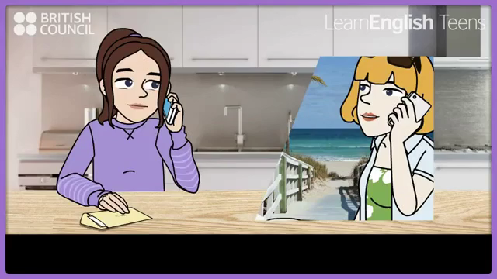
Watch video and complete the phrases.
1. ______ college
2. ______ Christmas
3. ______ December
4. ______ summer
5. ______ Tuesday
6. ______the early evening
7. ______ 5 o’clock
8. ______ half past four
9. ______ Moscow
10. ______ Monday evening
11. ______ midnight
12. ______a few minutes
AT
AT
IN
IN
ON
IN
AT
AT
IN
ON
AT
IN
CAN YOU ADD MORE?

Slide 3
Unit 6. A visit to a school
…., December …..^{th} 20..
Lesson 3. A Closer Look 2

Slide 4
Objectives
By the end of the lesson, students will be able to use the prepositions of time and place.

Slide 5

Prepositions of time
01

Slide 6
Preposition of time
IN
in 2020
We use in for longer periods (e.g months/ years/ seasons).
in December
in the morning in summer
ON
on Monday
on January 18th
We use on for days and dates.
on Chrismas Day
on Saturday night
AT
at six o’clock
We use at for the time of day.
at noon
at break time at the weekend(s)
at Christmas at the moment/at present

Slide 7

1. Complete the sentences, using suitable prepositions of time.
1. In England, schools usually starts ______ 9 a.m. and finish ______ 4 p.m.
2. They built our school a long time ago, maybe ______ 1990.
3. We are going to visit Thang Long Lower Secondary School ______ January.
4. The school year usually begins ___________ September 5th every year.
5. The children like playing badminton and football _________ their break time.

Slide 8
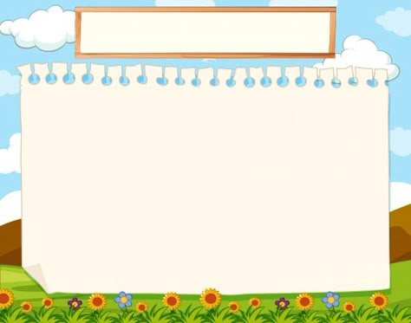


1. In England, schools usually starts ______ 9 a.m. and finish ______ 4 p.m.
at
9 a.m.
at
4 p.m.

Slide 9

2. They built our school a long time ago, maybe ______ 1990.
in
1990.

Slide 10
3. We are going to visit Thang Long Lower Secondary School ______ January.
in
January.

Slide 11
4. The school year usually begins ___________ September 5th every year.
on
September 5th

Slide 12
5. The children like playing badminton and football _________ their break time.
at
break time.

Slide 13
Look at the answers again.
at
1. In England, schools usually starts ______ 9 a.m. and finish ______ 4 p.m.
2. They built our school a long time ago, maybe ______ 1990.
3. We are going to visit Thang Long Lower Secondary School ______ January.
4. The school year usually begins ___________ September 5th every year.
5. The children like playing badminton and football _________ their break time.
at
in
in
on
at

Slide 14
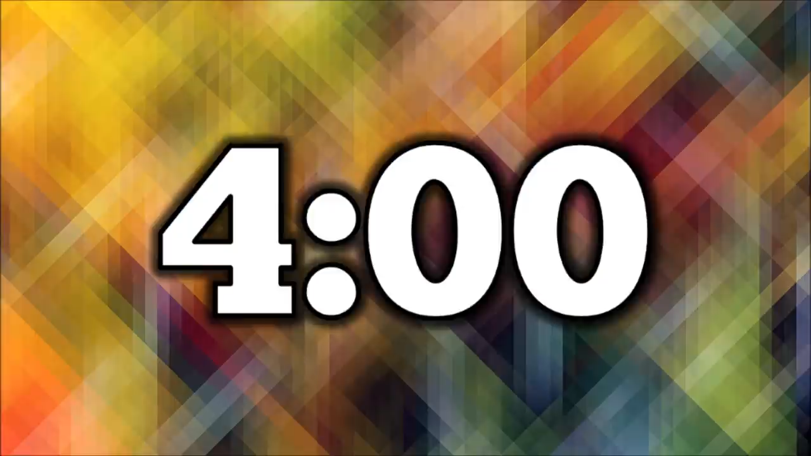
2. Work in pairs. Ask and answer the questions about your school.
1. When does your school year start?
2. When do you have English lessons?
3. When do you usually celebrate Teachers’ Day?
4. When are you going to finish the school year?

Slide 15
Prepositions of place
02

Slide 16
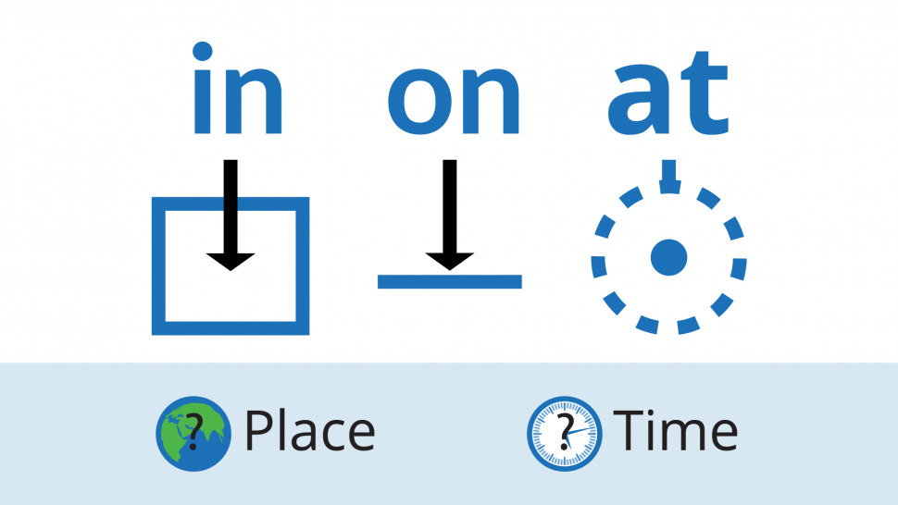
Preposition of place

Slide 17
Preposition of time
IN
in the classroom
in means inside something/ a place.
in the school garden
in the play ground
ON
on the board
on means on the surface of something.
on the wall
on the second floor
AT
at home
at school
at uses for a certain point.
at work

Slide 18
3. Complete the sentences with at, in, or on.
1. Her classroom is ___ the third floor of that building.
2. When I’m at school, my parents are ___ work.
3. Look! The students are playing football ___ the classroom.
4. My little sister usually has lunch ___ school.
5. The most beautiful posters are ___ the wall ___ the staffroom.

Slide 19
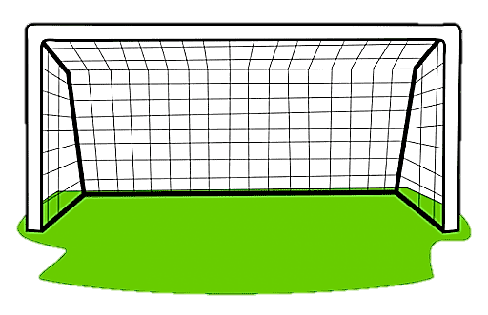
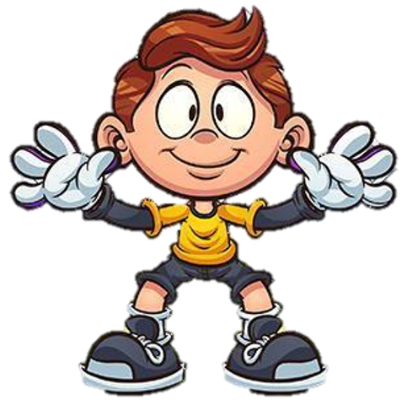

1. Her classroom is ___ the third floor of that building.
A. in
B. on
C. at

Slide 20
2. When I’m at school, my parents are ___ work.
A. in
B. on
C. at

Slide 21
3. Look! The students are playing football ___ the classroom.
A. in
B. on
C. at

Slide 22
4. My little sister usually has lunch ___ school.
A. at
B. on
C. in

Slide 23
5. The most beautiful posters are ___ the wall ___ the staffroom.
A. at / in
B. in / on
C. on / in

Slide 24
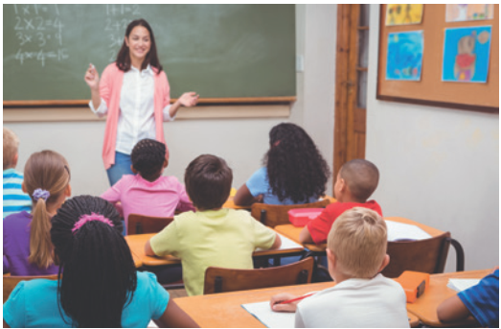
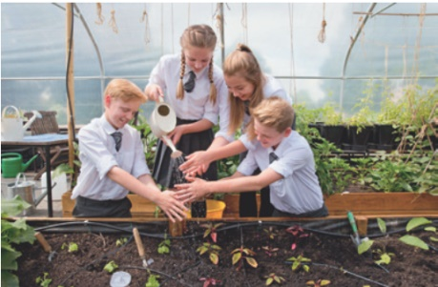
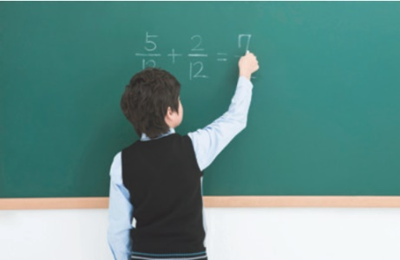
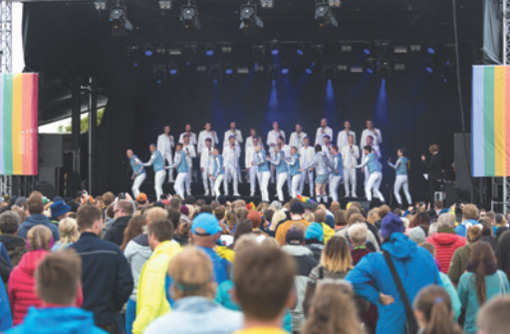
4. Work in pairs. Look at the pictures and answer the questions.
1. Where does Mrs Hien teach maths?
2. Where do the students water the flowers?
3. Where is the boy writing?
4. Where do they sing English songs on Teachers’ Day?

Slide 25
4. Work in pairs. Look at the pictures and answer the questions.
1. Where does Mrs Hien teach Maths?
At school.
In the classroom.
2. Where do the students water the flowers?
➔ In the school garden.

Slide 26
4. Work in pairs. Look at the pictures and answer the questions.
3. Where is the boy writing?
➔ On the board.
4. Where do they sing English songs on Teachers’ Day?
➔ On the stage.

Slide 27
5. Complete the passage with at, on, or in. Discuss which prepositions express time and which ones express place.
Tom’s mother is at home, but she is not (1) _______ the kitchen. She usually waters the vegetables in the garden (2) _______
the morning.
Tom’s father is (3) _______ work, but he isn’t in his office at the moment. It is lunch break and he is (4) _______ a travel agent’s, looking at holiday brochures.
Tom is usually at school this time, but he has a bad cold today. He has nothing to do but lying (5) _______ the sofa and looking at the posters (6) _______ the wall.
in
the kitchen
in
the morning
at
work
at
a travel agent’s
on
the sofa
on
the wall

Slide 28

Choose the best answer.
1. What grammar have you learnt today?
A. Preposition of time.
B. Preposition of place.
C. Both A and B

Slide 29
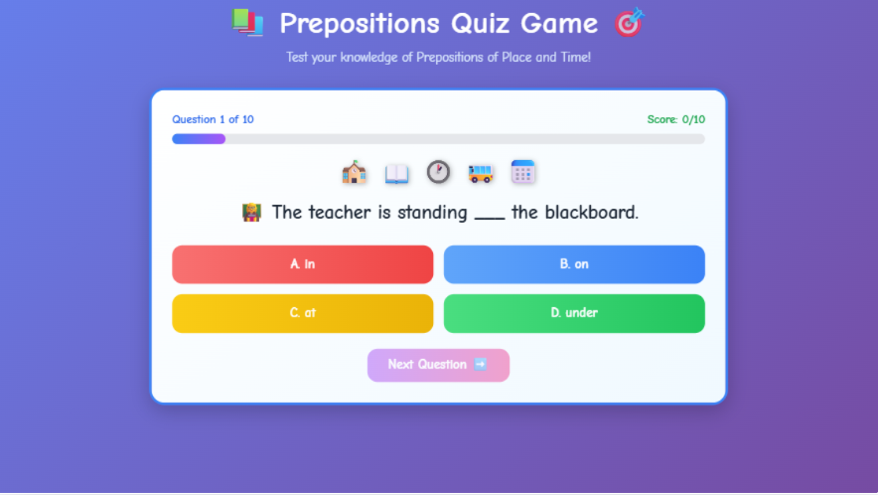
DO A QUIZ ON LINK:
https://english6unit5.my.canva.site/interactive-quiz-on-prepositions-for-grade-7

Slide 30
HOMEWORK
Review the preposition of time and place
Do more exercise on this grammar
Prepare for the next lesson

Slide 31
Thank you!

