Slide 1

WELCOME TO OUR CLASS!
Presented by:…………….

Slide 2

Let’s do A QUIZ

Slide 3
Unit 6: A visit to a school
Lesson 7: Looking back

Slide 4
Pronunciation
/tʃ/ | /dʒ/
Cheap, chicken, each, natural, choose, check, champion, catch, watch, question, picture, actual, match, kitchen
Job, jam, jacket, jeans, enjoy, just, gentle, gene, geography, age, college, damage, manage, change

Slide 5
Vocabulary

Slide 6
1. Find the words and phrases from this unit that match these definitions.
well-known
( Nổi tiếng)
1. known by many people
2. buildings, services, equipment, etc. at a school
3. an exam taken to enter a school
4. intelligent and / or talented students
5. extra activities that students do at school
(school) facilities
(Cơ sở vật chất)
an entrance exam
( thi đầu vào)
gifted students
(Học sinh ưu tú)
outdoor activities
( Các hoạt động ngoài trời)

Slide 7
2. Complete the sentences with the words and phrases in Task 1.
The school is free for _________________ who pass some exams.
The students in the school find _______________ useful and enjoyable.
Chu Van An Lower Secondary School is famous for its intelligent students and modern ______________.
Students have to pass a difficult _______________ to attend that school.
The most ____________ teacher of Van Mieu – Quoc Tu Giam was Chu Van An.
gifted students
outdoor activities
(school) facilities
entrance exam
well-known

Slide 8
Grammar

Slide 9
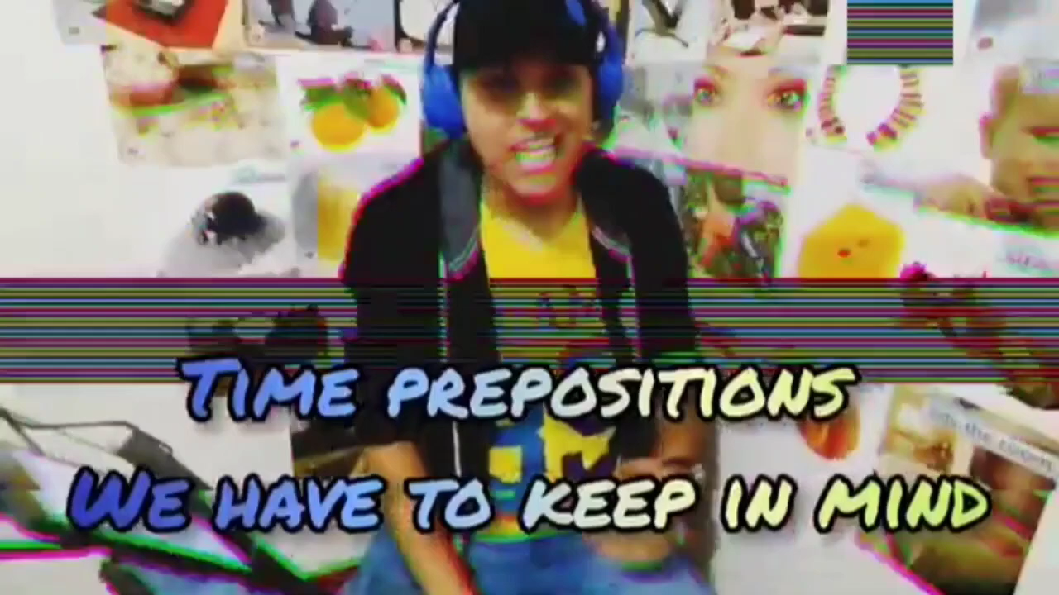
The song is about….

Slide 10
Grammar
Prepositions of time:
In: Ta đặt “in” trước các từ chỉ thời gian dài như: năm, tháng, tuần, mùa, …
VD: in summer, in 1980, in this week, in 1945s, in the morning, in May, ….
On: Ta đặt “on” trước những từ chỉ những ngày trong tuần, hoặc một dịp nào đó.
VD: on Sunday, on this occasion, on this opportunity, on my birthday, on 6 March,…
At: Ta đặt “at” trước từ chỉ mốc thời gian rất ngắn cụ thể như giờ giấc trong ngày.
VD: At the moment, at 5 o’clock, at time , at sunset, at bedtime, at night, ….

Slide 11
Grammar
2. Prepositions of place:
In: Ta đặt “in” trước từ chỉ khu vực địa lý rộng lớn, hoặc từ chỉ vị trí lọt lòng, ở trong lòng một cái gì đó.
VD: in the bed, in a box, in New York, in Asia, in this house, in the North of VietNam,…
On: Ta đặt “on” trước từ chỉ đồ vật để chỉ vị trí tiếp xúc trên mặt phẳng của đồ vật đó.
VD: on table, on the left, on the bus, ….
At: Ta đặt “at” trước từ chỉ nơi chốn để chỉ vị trí một cách chung chung.
VD: at home, at school, at work, ….

Slide 12
3. Complete the sentences with appropriate prepositions of place or time.
The members of the club clean the school playground ___ Saturday mornings.
The students have to sit for the final exam ___ June.
Chu Van An Lower Secondary School is one of the most famous schools ___ Ha Noi.
The school canteen is ___ the second floor.
Which subjects do you like to study ___ school?

Slide 13
3. Complete the sentences with appropriate prepositions of place or time.
The members of the club clean the school playground ___ Saturday mornings.
2. The students have to sit for the final exam ___ June.
on
On: thường được sử dụng khi nói tới thứ trong tuần, ngày kèm tháng, ngày tháng năm và các ngày cụ thể.
in
In: thường được sử dụng khi nói về buổi trong ngày, khoảng thời gian, tháng, năm cụ thể, các mùa, thế kỷ và những thời kỳ dài

Slide 14
3. Complete the sentences with appropriate prepositions of place or time.
3. Chu Van An Lower Secondary School is one of the most famous schools ___ Ha Noi.
4. The school canteen is ___ the second floor.
5. Which subjects do you like to study ___ school?
in
In: dùng với không gian có biên giới (thành phố, đất nước)
on
On: Dùng để diễn tả 1 vật ở trên 1 vật khác. Giữa chúng có sự tiếp xúc với nhau.
at
At: dùng khi nói về 1 vị trí tương đối

Slide 15
4. Read the passage and fill in the gaps with prepositions of time or place.
Tom is a student (1) ______ a private school in the suburbs of Manchester. He lives with his parents (2) ______ a small house near his school. He usually studies at school (3) ______ the mornings. (4) ______ Monday and Thursday afternoons, he joins different outdoor activities with his schoolmates. He sings (5) ______ the Little Bees’ Club on Tuesdays and Fridays. He goes to the cinema with his friends (6) ______ the weekend. He finds his studies and outdoor activities enjoyable.
at
a private school
in
a small house
in
the mornings
On
Monday
in
the Little Bees’ Club
at
the weekend

Slide 16
HOMEWORK
Review the vocabulary and grammar of unit 6
Prepare for the first-term exam

Slide 17
Thank you!
See you next time.

