Slide 1

Review 2
Lesson 1. Language

Slide 2
Pronunciation
Can you give me example?
01
02
03
/i/ & /i:/
/t/ & /d/
/s/ & / ∫/

Slide 3

1. Listen and circle the word with the different underlined sound.
1.
A
seat
B
wonders
C
desert
/siːt/
/ˈwʌndərz/
/ˈdezət/
2.
A
cheap
B
teach
C
bread
/tʃiːp/
/tiːtʃ/
/bred/
3.
A
sugar
B
some
C
sure
/ˈʃʊɡə(r)/
/sʌm/
/ʃʊə(r)/
excuse
between
4.
A
B
C
cathedral
/ɪkˈskjuːs/
/bɪˈtwiːn/
/kəˈθiːdrəl/
5.
A
modern
B
crowded
C
celebrate
/ˈmɒdn/
/ˈkraʊdɪd/
/ˈselɪbreɪt/

Slide 4
Vocabulary
Places in the neighbourhood
My neighbourhood
Adjectives describe the places in the neighbourhood
Things in nature
Natural wonders of Vietnam
Travel items
Our Tet holiday
Things and activities at Tet

Slide 5
2. Match the words in the box (a –h) next to their opposites (1 – 8).
a. short
b. noisy
c. low
d. small
e. boring
f. hot
g. sad
h. cheap
1.
big
5.
long
2.
happy
6.
expensive
3.
cold
7.
high
4.
quiet
8.
interesting

Slide 6
3. Choose the correct word/phrase for each definition.
1. A place where a large amount of water falls from a high place.
waterfall
lake
2. A thing which helps you to ﬁnd directions.
backpack
compass
3. A building where people go and see valuable art or old things.
theatre
museum
4. To tell someone you want them to be happy or successful.
wish
hope
5. Children receive it in red envelopes at Tet.
lucky money
new clothes

Slide 7
Grammar
Comparative and Superlative
Countable and Uncountable nouns
should and shouldn’t
will and won’t
some/ any for amount.

Slide 8
4. Complete the sentences with the correct answer A, B, or C.
1. _______ long rivers of the world begin from the Himalayas.
A. any B. Some C. A
2. Sue’s drawings are more colourful ________ her teacher’s.
A. most B. as C. than
3. You _______ buy a ticket to enter the zoo. It’s not free.
A. mustn’t B. don’t C. must
4. Do you know_________English songs for children?
A. any B. a few C. some
5. The USA has ________ natural wonders.
A. many B. much C. a little

Slide 9

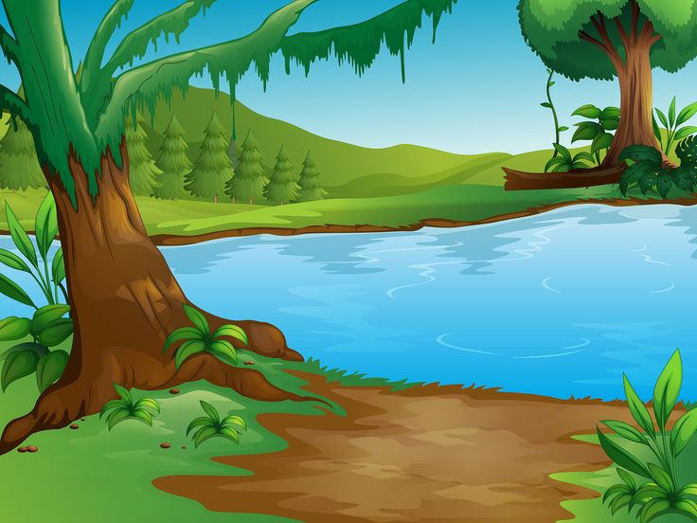

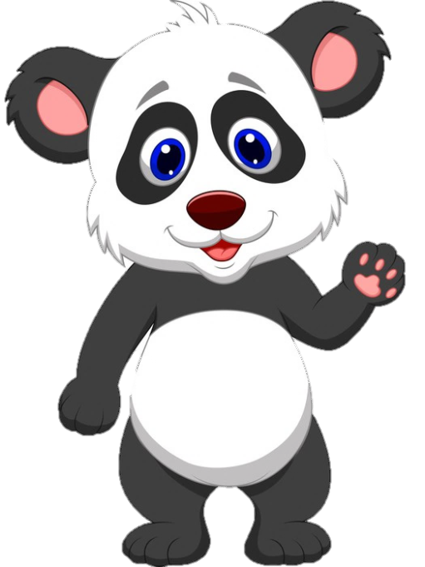

Who is faster?

Slide 10



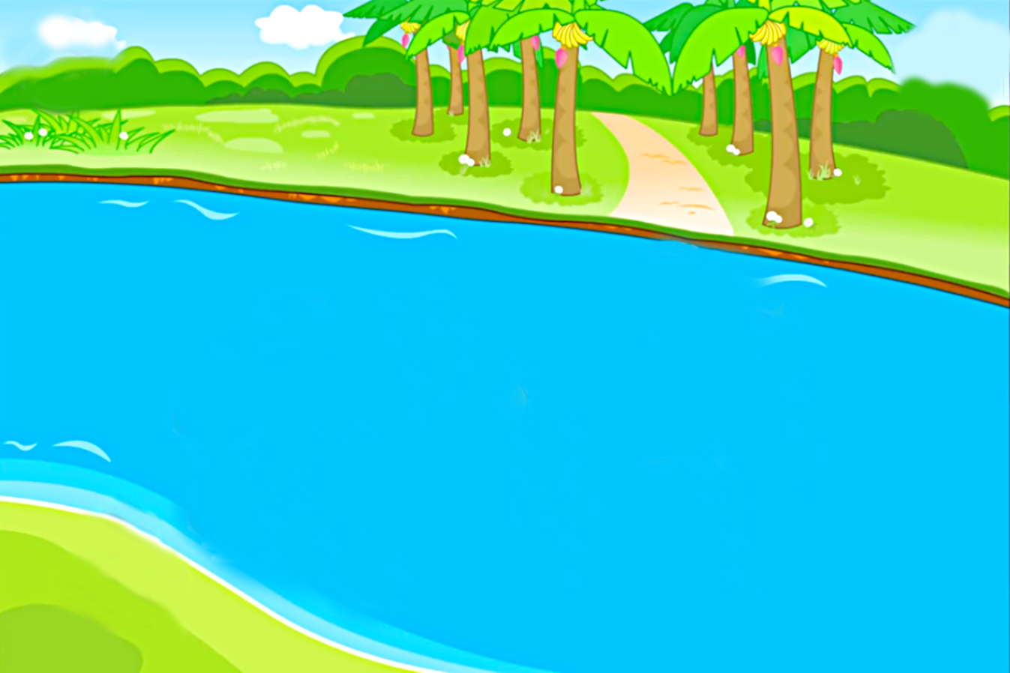

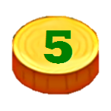






CHÚC MỪNG
CHÚC MỪNG
Notes:
Nhấn vào khỉ và gấu để di chuyển đến số câu hỏi
Nhấn vào số dưới chân con vật để di chuyển tới slide câu hỏi
Nhấn vào phím mũi tên để chuyển đến bài tiếp theo

Slide 11
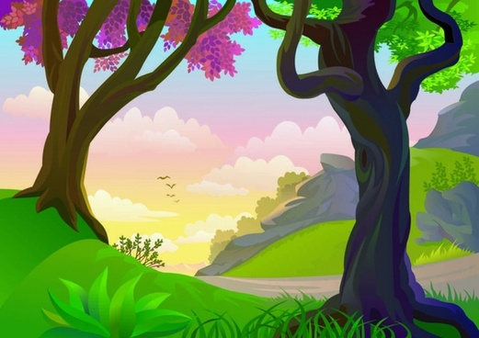
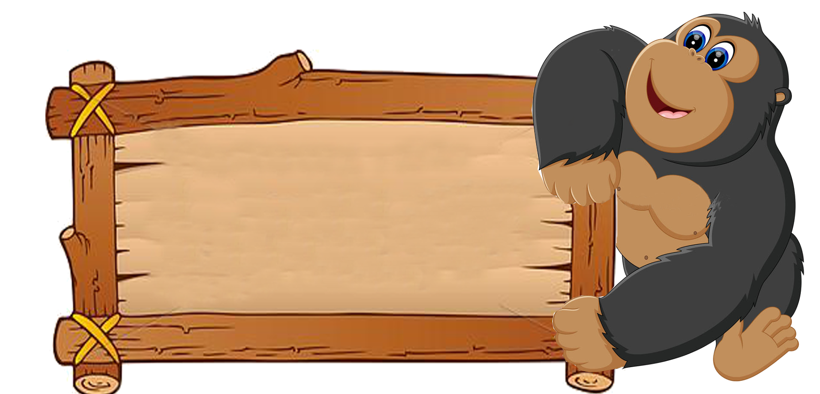
B. some
1. ______long rivers of the world begin from the Himalayas.
A.
B.
Some
A
Any
C.

Slide 12
C. than
2. Sue’s drawings are more colourful_________her teacher’s.
A.
most
B.
as
C.
than

Slide 13
C. must
3. You______buy a ticket to enter the zoo. It’s not free.
A.
mustn’t
C.
must
B.
don’t

Slide 14
A. any
4. Do you know____English songs for children?
A.
any
C.
some
B.
a few

Slide 15
A. many
5. The USA has_______natural wonders.
B.
C.
a little
A.
much
many

Slide 16


B. some
1. ___long rivers of the world begin from the Himalayas.
A.
B.
Some
Any
C.
A

Slide 17
C. than
2. Sue’s drawings are more colourful_____her teacher’s.
A.
B.
as
most
C.
than

Slide 18
C. must
3. You______buy a ticket to enter the zoo. It’s not free.
B.
C.
must
don’t
A.
mustn’t

Slide 19
A. any
4. Do you know___English songs for children?
A.
any
C.
some
B.
a few

Slide 20
A. many
5. The USA has____natural wonders.
A.
B.
much
many
C.
a little

Slide 21
5. Complete the sentences with should or shouldn’t
When you get help from somebody, you
say “Thank you!”.
1.
should
shouldn’t
2.
You ask people for lucky money. It’s not good
behavior.
shouldn’t
3.
You make noise when you are eating.
should
4.
Before you visit a natural wonder, you
learn about it.
5.
should
What I do if I get lost?

Slide 22
WRAP-UP
What 3 topics have you practiced today?
What knowledge have you reviewed in this lesson?
My neighbourhood
Natural wonders of Vietnam
Our tet holiday
Should and Shouldn’t
Comparative adjectives
Present simple
Some and Any

Slide 23
Thank you!

