Slide 1


WELCOME TO OUR CLASS!
Presented by: ……………………

Slide 2
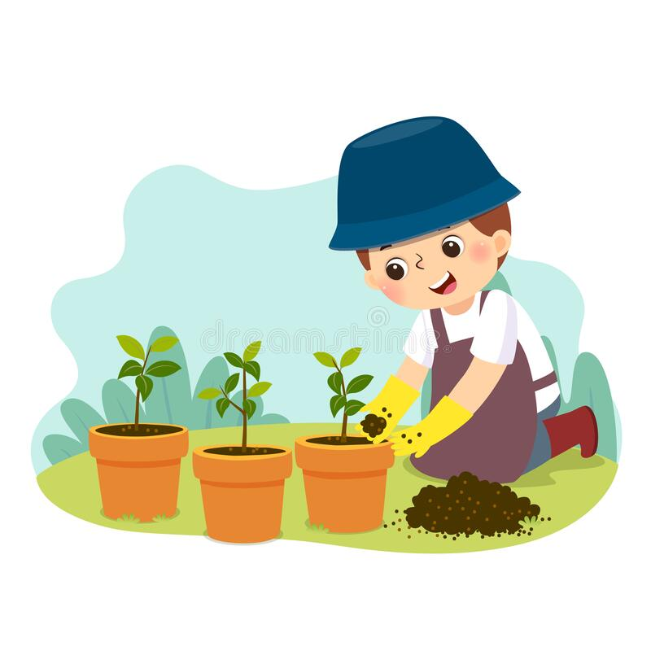
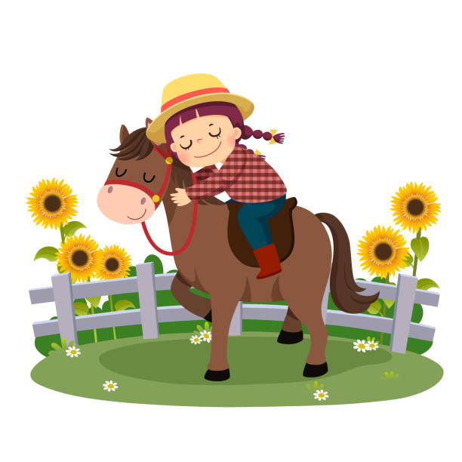
Look at the pictures and guess the topic

Slide 3

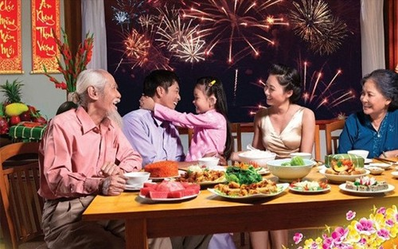
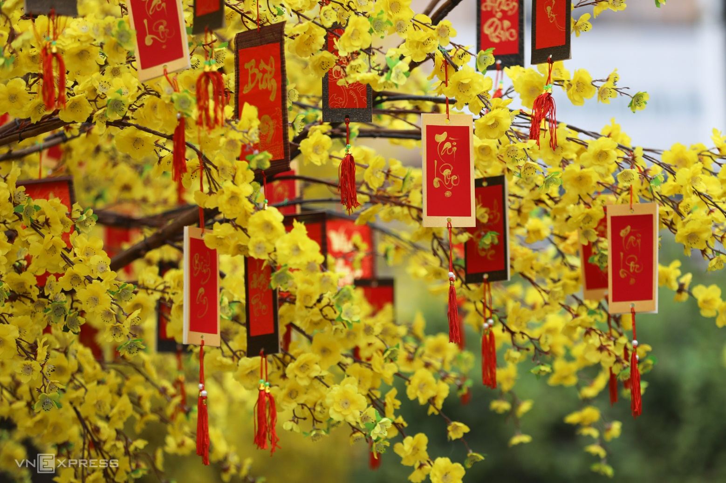
What is the topic?
Our Tet holiday

Slide 4
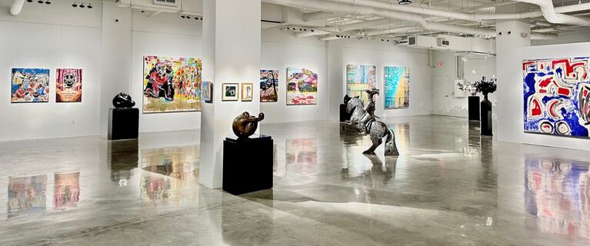
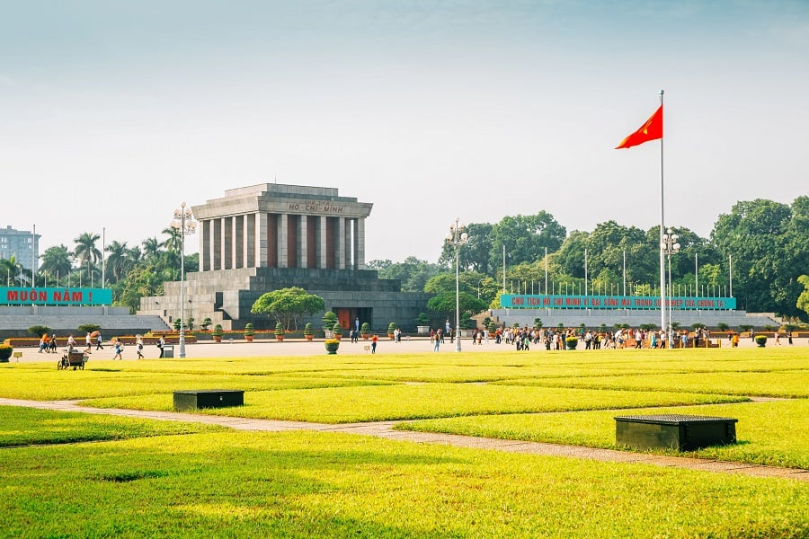
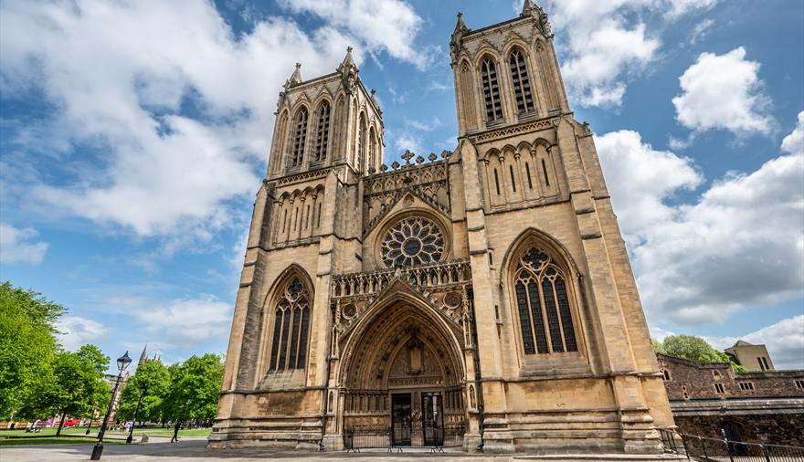
What is the topic?
My neighbourhood

Slide 5
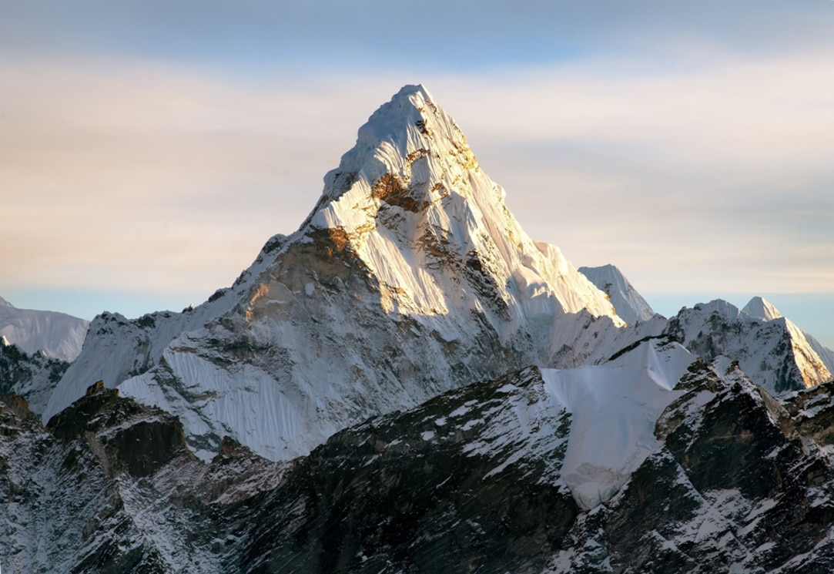
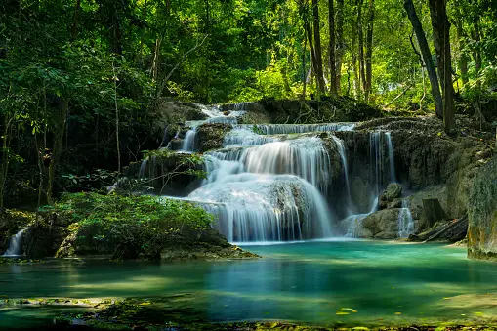
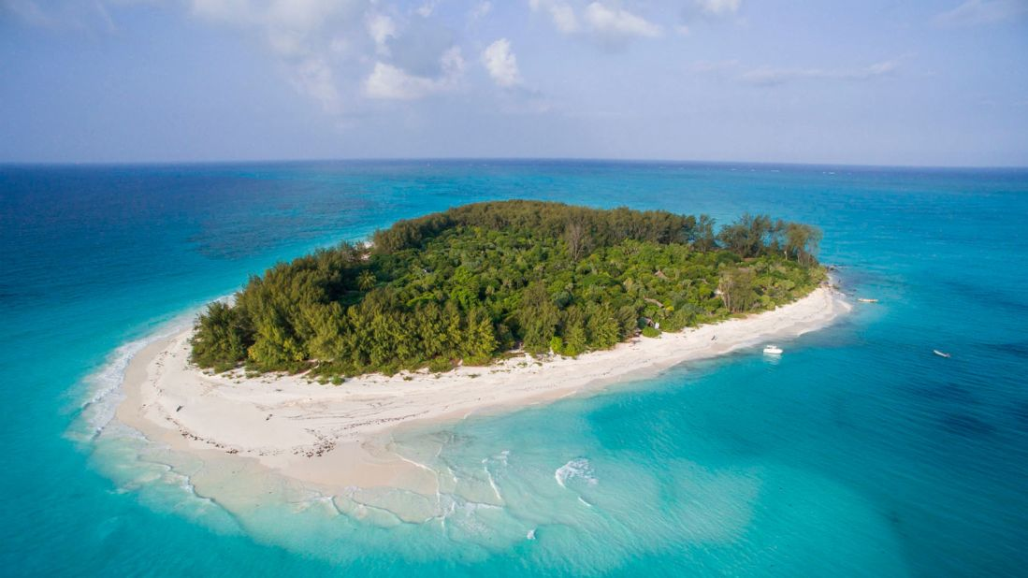
What is the topic?
Natural wonders of Vietnam

Slide 6
REVIEW 2
Lesson 2: Skills

Slide 7
Objectives
READING
SPEAKING
LISTENING
WRITING
Read for general and specific information about Singapore.
Ask and answer about which place your partner wants to visit and why.
Listen to a travel agent about Mai’s family trip to Singapore.
Write a paragraph to describe where you live.

Slide 8

READING
STRESS

Slide 9

1. Read the passage and match the headings (A, B, C) with the paragraphs.
A. Family
B. Nature
C. Culture
There are many parks in this country. You can visit them,
and enjoy beautiful plants and flowers, or do outdoor
activities: cycling or boating. You can also go to the zoo to
see animals in real life.
1
Go to places like Chinatown and Little India to learn about
the people and cultures of China and India. There you can
see how they live, try their food, and buy souvenirs. There
are festivals too. They attract a lot of visitors.
2
Families looking for exciting activities for both children and
adults should go to Sentosa. There are so many things for you
to see and to do there, so you will never get bored.
3

Slide 10
2. Read the passage and choose the correct answers A, B or C.
1. You can find beautiful plants and flowers in _________.
A. a park B. Chinatown C. Sentosa 2. You can see different kinds of animals in real life in a _________.
A. zoo B. park C. town
3. You can ______ in places like Chinatown.
A. watch animals B. watch festivals C. do outdoor activities
4. ______ has interesting activities for both children and parents. A. Little India B. The zoo C. Sentosa

Slide 11


Slide 12













Enemies will kill you! Lose all points!
1 point
Double your points
2 points
Steal other team’s points.
3 points
Lose all points!
4 points
5 points

Slide 13

A
B
C
D
E
F

Slide 14


Check your answer
1. You can find beautiful plants and flowers in _________.
A. a park
B. Chinatown
C. Sentosa
There are many parks in this country. You can visit them, and enjoy beautiful plants and flowers, or do outdoor activities: cycling or boating. You can also go to the zoo to see animals in real life.

Slide 15


Slide 16
Check your answer
2. You can see different kinds of animals in real life in a _________.
A. zoo
B. park
C. town
There are many parks in this country. You can visit them, and enjoy beautiful plants and flowers, or do outdoor activities: cycling or boating. You can also go to the zoo to see animals in real life.

Slide 18
Check your answer
3. You can ______ in places like Chinatown.
A. watch animals
B. watch festivals
C. do outdoor activities
Go to places like Chinatown and Little India to learn about the people and cultures of China and India. There you can see how they live, try their food, and buy souvenirs. There are festivals too. They attract a lot of visitors.

Slide 20
Check your answer
4. ______ has interesting activities for both children and parents. A. Little India
B. The zoo
C. Sentosa
Families looking for exciting activities for both children and
adults should go to Sentosa. There are so many things for you to see and to do there, so you will never get bored.

Slide 22


Slide 25

Steal other team’s points.

Slide 26
Double your points.

Slide 27
Lose all points.

Slide 28
Look at the answers again.
1. You can find beautiful plants and flowers in _________.
A. a park B. Chinatown C. Sentosa 2. You can see different kinds of animals in real life in a _________.
A. zoo B. park C. town
3. You can ______ in places like Chinatown.
A. watch animals B. watch festivals C. do outdoor activities
4. ______ has interesting activities for both children and parents. A. Little India B. The zoo C. Sentosa

Slide 29
SPEAKING
Visit Singapore

Slide 30

3. Work in pairs. Read the passage “Visit Singapore” again and make a list of the places.
PLACES
ACTIVITIES
- The zoo
- See the animals…
- The park
- Enjoy beautiful and plants, do outdoor activities…
- Chinatown or Little India
- Learn about people and cultures of China and India….

Slide 31

3. Take turns to ask and find out which place your partner wants to visit and why.
QUESTIONS
ANSWERS
Which place do you want to visit?
The zoo
Why do you want to visit it?
I want to see the animals.

Slide 32
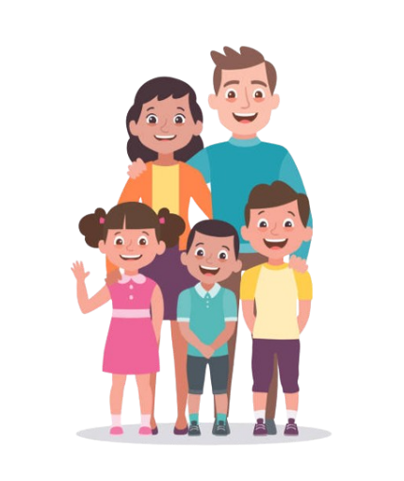
LISTENING
Mai’s family
A travel agent about their trip to Singapore.

Slide 33

LISTENING
4. Listen and tick ✓ True (T) or False (F)
1. Mai's visit to Singapore is four days.
will go
2. They won't go to the National Park.
3. The visit to Sentosa takes a full day.
4. The Sea Aquarium is a zoo for fish.
5. The Light and Sound Show is the afternoon.
evening

Slide 34
WRITING
MY NEIGHBOURHOOD

Slide 35
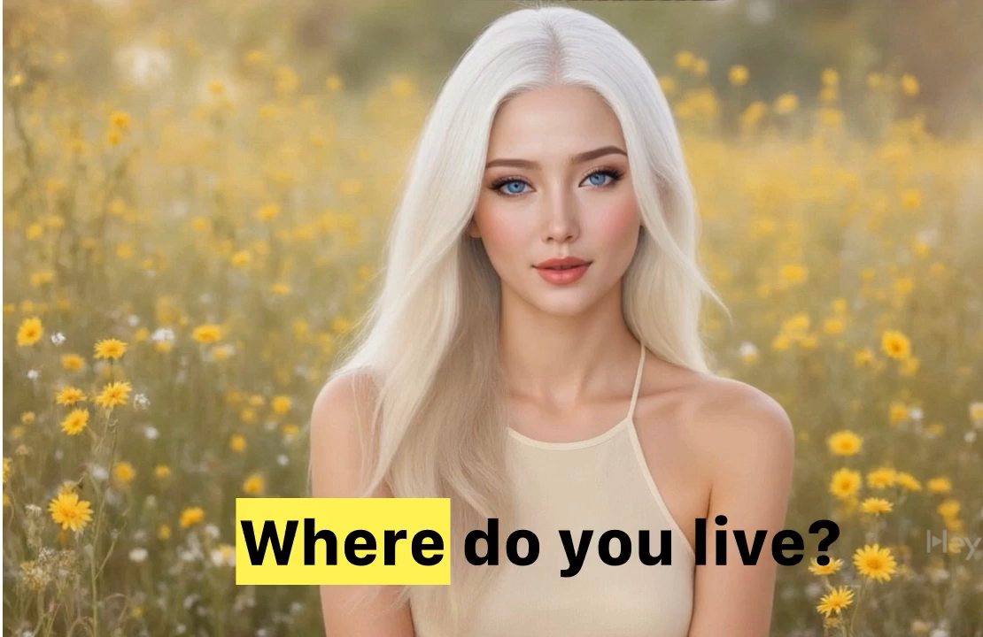
Answer the questions

Slide 36
5. Complete this paragraph to describe the place you live.
I live in (1)__________. Life is very (2)__________here.
There is / are (3)__________ (places) in my
neighbourhood. At weekends, my friends and I often go to (4)__________where we can (5)__________ (activities). That’s our favourite place.
1. Where do you live? 2. How is life here?
3. What are there in your neighbourhood?
4. Where do you often go at weekends?
5. What can you do there?

Slide 37
Sample writing
I live in Vung Tau city. Life is very peaceful here. There are many interesting places in my neighbourhood like beaches, parks, supermarkets, restaurants and games centres.
At weekends, my friends and I often go to the beaches where we can swim, sunbathe and play underwater games. That’s our favourite place.

Slide 38
WRAP - UP
What have we learnt in this lesson?
Practice 4 skills using lexical items learnt in Units 4-5-6

Slide 39

THANK YOU

