Slide 1


Slide 2
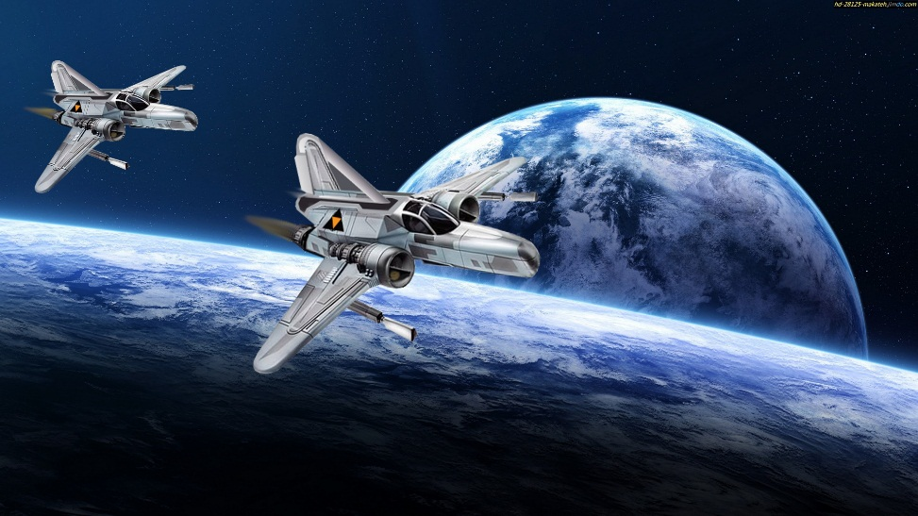
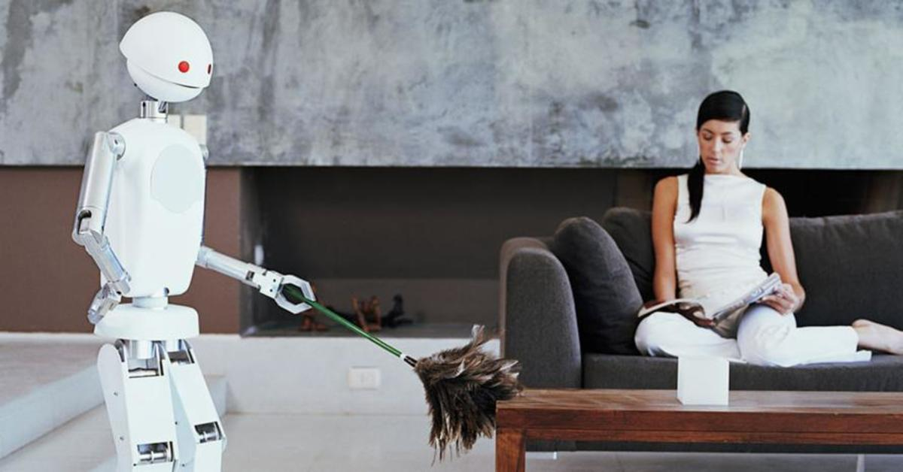
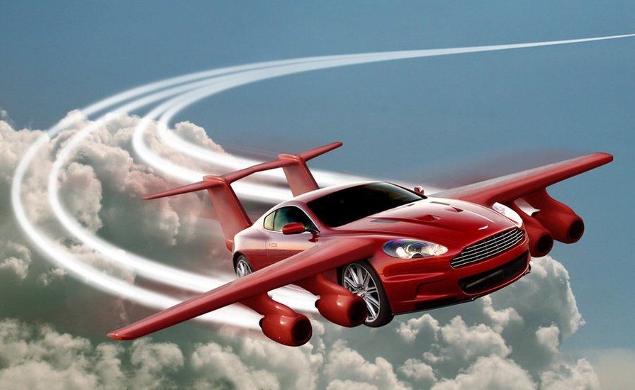
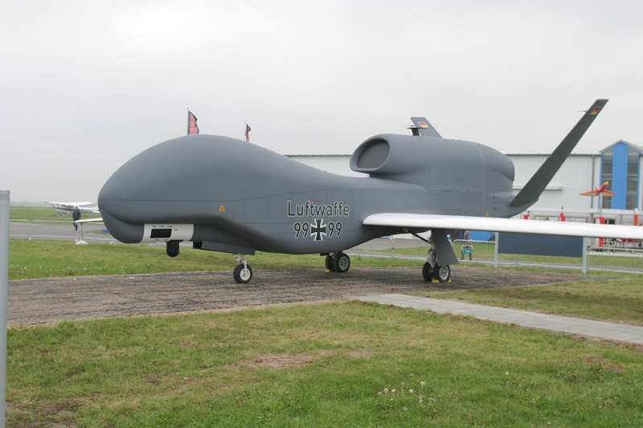
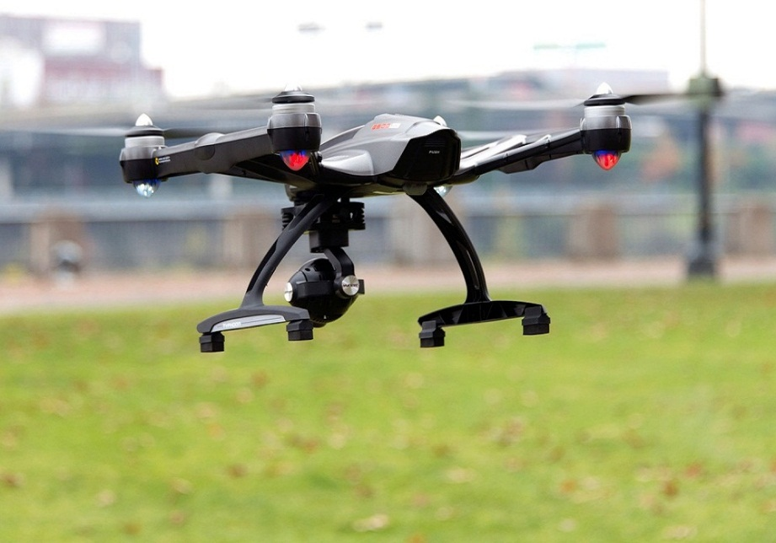
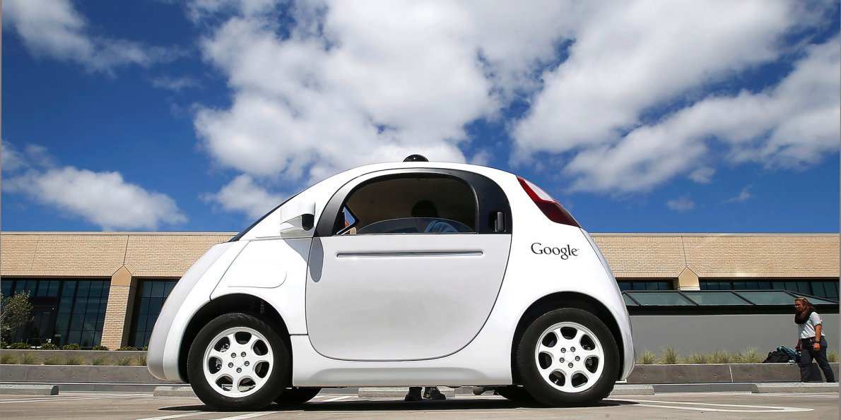
FLYING CAR
SPACESHIP
ROBOT
SMART CAR
DRONES
FLYING CAMERA

Slide 3



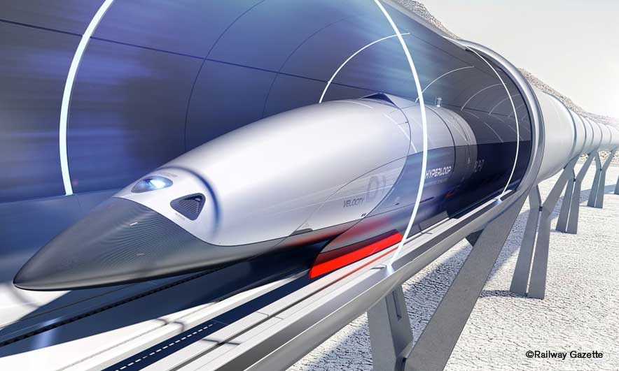
Unit
11
TRAVELLING IN THE FUTURE
LESSON 1: GETTING STARTED
I hope we will have a hyperloop! soon!
Unit
HOBBIES

Slide 4
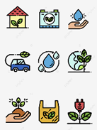
PRESENTATION
eco – friendly (a)
/ˈiː.kəʊˌfrend.li/
thân thiện với môi trường

Slide 5

PRESENTATION
fume (n)
/fjuːm/
khói

Slide 6

PRESENTATION
hyperloop (n)
/ˈhaɪ.pərluːp/
hệ thống giao thông tốc độ cao
System of tube (n.p)
/ˈsɪs.təm əv tʃuːb/

Slide 7

PRESENTATION
teleporter (n)
/ˈtel.ɪ.pɔː.tər/
phương tiện di chuyển tức thời

Slide 8

PRESENTATION
campsite (n)
/ˈkæmp.saɪt/
địa điểm cắm trại

Slide 9
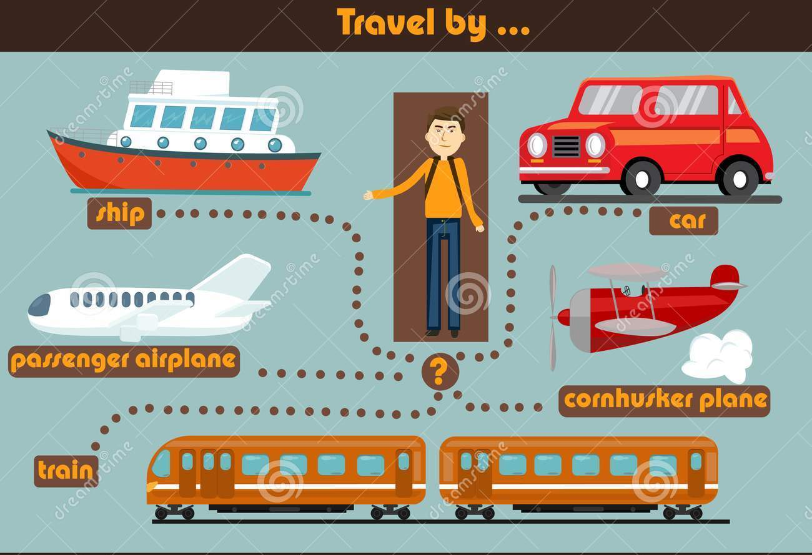
PRESENTATION
Mode of travel (n.p)
/məʊd əv ˈtræv.əl/
Phương thức đi lại

Slide 10
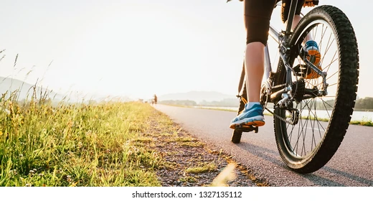
PRESENTATION
pedal (v)
/ˈped.əl/
Đạp (xe)

Slide 11
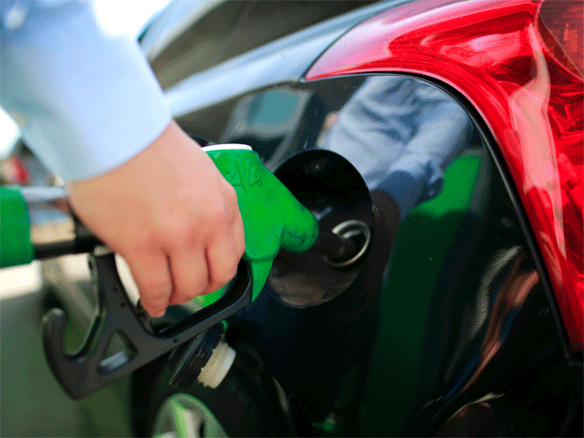
PRESENTATION
Run on (v.p)
/rʌn ɒn /
Chạy bằng (nhiên liệu..)

Slide 12
PRESENTATION
It’s a pity/ What a pity!
Thật tiếc!

Slide 13
LISTEN AND READ
1
1. Listen and read. What are Ann and Minh talking about?
A. Travelling by teleporter
B. Future modes of travel
C. Being in a traffic jam

Slide 14

2. LISTEN AND READ : I hope we will have a hyperloop soon!
Minh: Oh, another traffic jam.
Ann: How will we get to the campsite on time now?
Minh: I don’t know. It’s a pity that we don’t have a hyperloop now!
Ann: What’s a hyperloop?
Minh: It’s a system of tubes. You can go from one place to another in just minutes.
Ann: Amazing! Even faster than a flying car!
Minh: Yes, and there are no traffic jams.
Ann: Will it pollute the environment?
Minh: No. There will be no fumes, and it’s totally safe.
Ann: Like a teleporter?
Minh: A teleporter is also fast, safe and eco-friendly. But it’s a different mode of travel.
Ann: So when we travel in hyperloops, we won’t have to worry about bad weather, right?
Minh: Right.
Ann: Sounds great! I hope we’ll have them soon.

Slide 15
LISTEN AND READ
1
1. Listen and read. What are Ann and Minh talking about?
A. Travelling by teleporter
B. Future modes of travel
C. Being in a traffic jam

Slide 16
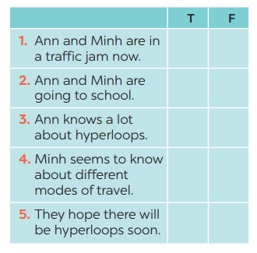

PRACTICE
3
Read the conversation again and tick T (True) or F (False).
→ Ann: How will we get to the campsite on time now?
→ Ann: What’s a hyperloop?

Slide 17
PRACTICE
4
Find the words and phrases that describe the means of transport in the conversation and write them in the correct columns.
Hyperloop | Teleporter
a system of tubes
Faster than a flying car
No traffic jams
No fumes
safe
Fast
Safe
Eco - friendly

Slide 18


PRODUCTION
4
Quiz

Slide 19
PRODUCTION
4
1. It has two wheels and you pedal it.
2. It has four wheels. It runs on petrol or
electricity, and can carry up to eight
passengers.
3. It carries many passengers and runs
on tracks.
4. It sails on the sea. It needs wind to sail.
5. It travels in space. It can even carry
people to the moon.
Quiz

Slide 20
CONSOLIDATION
1
WRAP-UP
TRAVELLING IN THE FUTURE
Topic of the unit
Vocabulary

Slide 21

WARM-UP: CHATTING
+ How do people in the video travel?
+ What do you think about the traffic in the video?
+ What do you think about traffic in the future?

Slide 22
CONSOLIDATION
HOMEWORK
Prepare the vocabulary for the next lesson: A closer look 1.

Slide 23


