Slide 1


Slide 2



Unit
11
TRAVELLING IN THE FUTURE
LESSON 2: A CLOSER LOOK 1
VOCABULARY
PRONUNCIATION
Unit
HOBBIES

Slide 3

PRESENTATION
bamboo - copter (n)
/bæmˈbuːˈkɒp.tər/
chong chóng tre

Slide 4
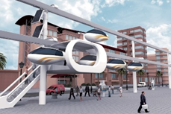
PRESENTATION
skyTran (n)
/skaɪtræn/
hệ thống tàu điện trên không

Slide 5
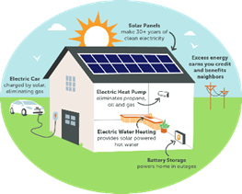
PRESENTATION
solar - powered (a)
/ˌsəʊ.lə -ˈpaʊər/
chạy bằng năng lượng mặt trời

Slide 6

PRESENTATION
(to) sail
/seɪl/
lướt buồm

Slide 7
PRESENTATION
New words | Pronunciation | Meaning
1. bamboo - copter (n) | /bæmˈbuːˈkɒp.tər/ | chong chóng tre
2. skyTran (n) | /skaɪtræn/ | hệ thống tàu điện trên không
3. solar- powered (a) | /ˌsəʊ.lə -ˈpaʊər/ | chạy bằng năng lượng mặt trời
4. (to) sail | /seɪl/ | lướt buồm

Slide 8

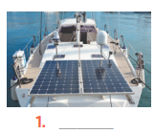
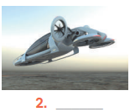
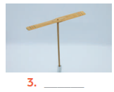
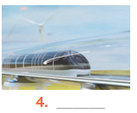
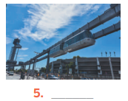
VOCABULARY
1
Write the words or phrases under the correct pictures. Then listen, check, and repeat.
flying car bamboo – copter hyperloop skyTran solar – powered ship
solar – powered ship
flying car
bamboo - copter
hyperloop
skyTran

Slide 9

VOCABULARY
2
Write words or phrases from 1 in the correct columns.
flying car bamboo – copter hyperloop skyTran solar – powered ship
skyTran
hyperloop
bamboo- copter
flying car
solar – powered ship

Slide 10
VOCABULARY
3
1
Complete the sentences, using the words from the box.
eco- friendly fly ride bamboo – copter hyperloop
1. Travelling by ________________ is simple. You just put it on and fly away.
2. People will soon ______________ in flying cars instead of driving normal cars.
3. It will be fun to ______________ a skyTran to work.
4. Travelling by ________________ will be faster than by airplane.
5. Solar-powered ships are ____________. They will not cause pollution.
bamboo - copter
fly
ride
hyperloop
eco- friendly

Slide 11

PRONUNCIATION
SENTENCE STRESS

Slide 12


PRONUNCIATION

Slide 13
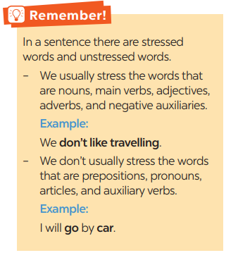
PRONUNCIATION

Slide 14
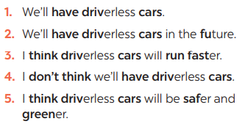

PRONUNCIATION
4
Listen to the sentences and repeat. Pay attention to the bold syllables.

Slide 15
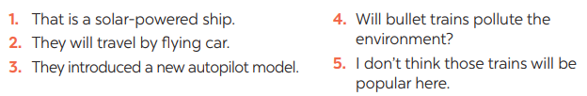
PRONUNCIATION
Listen to the sentences and repeat. How many stresses are there in each sentence?
5

Slide 16
CONSOLIDATION
1
WRAP-UP
VOCABULARY
PRONUNCIATION

Slide 17
CONSOLIDATION
2
HOMEWORK
Practice saying the sentences at home.

Slide 18


