Slide 1
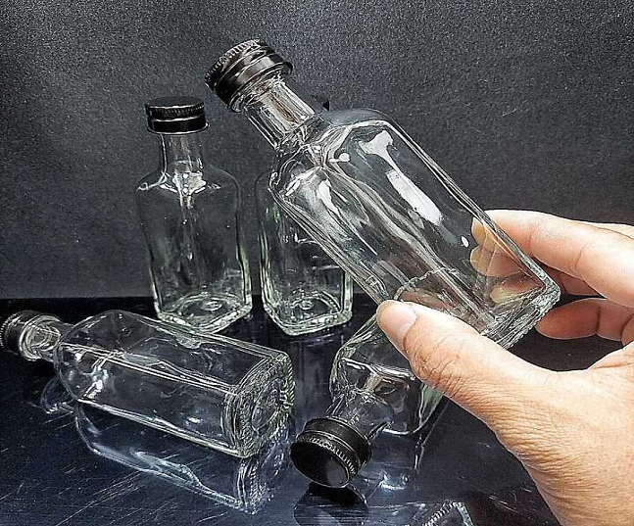
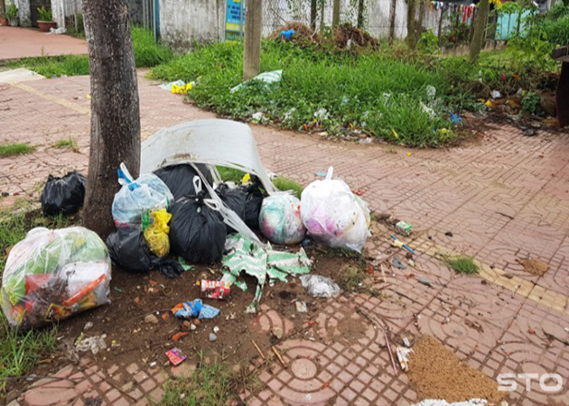
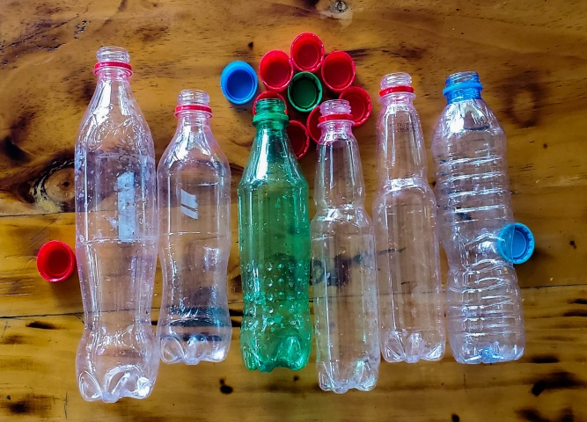

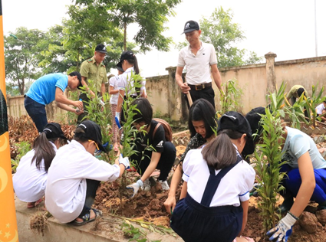
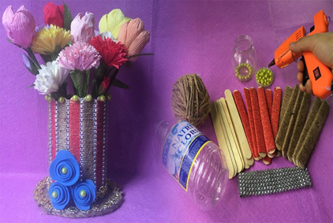
* Warm up:
Crossword puzzle
1
A
R
T
I
C
L
E
S
G | L | A | S | S
2
P | A | P | E | R
3
P | L | A | S | T | I | C
4
R | U | B | B | I | S | H
5
R | E | C | Y | C | L | E
6
W | A | L | K
7
T | R | E | E
8
R | E | U | S | E
K
1. The bottles are made of ………………
2. I need ……..and a pen to write a letter.
3. The bottle is made of ………………
4. we should reduce the amount of ………... that we use every day.
5. What icon is this?
6. My house is near the school so I often………. to school
7. We plant green …………in the school yard.
8. We often …… old bottles to make flower vases.

Slide 2




Slide 3


LESSON 3:
Grammar
- Articles
- First conditional

Slide 4

I. Grammar 1
* Articles
* There are two kinds of articles in English.
1. Indefinite article: a/ an
2. Definite article: the
1. Indefinite article: a/ an
+ We use a/an with singular countable nouns when we are talking about them in general.
Example: An ant is a tiny animal.
+ after the verbs to be and to have.
Example: I'm a student. / I have an eraser.
* a + consonant sound Eg: a bag , a pen,…
* an+ vowel sound (u, e, o,a,i) ( uể oải)
Eg. an apple. an island,…
2. Definite article: the
+ We use the with singular or plural nouns when we already know them or when they are mentioned for the second time.
Example: The bike in front of her house is nice.
+ with nouns which are unique. Example: The air is dirty.

Slide 5

Write a or an.
an
1. ___ egg
2. ___ friend
3. ___ sink
4. ___ arm
5. ___ mouth
6. ___ onion
7. ___ umbrella (một cái ô/ cây dù)
8. ___ classmate (một người bạn học cùng lớp)
a
a
an
a
an
an
a

Slide 6
Write a or an.
____ mouth
___ egg
5.
a
1.
an
___ friend
a
an
2.
6.
____ onion
___ sink
____ umbrella
3.
a
7.
an
an
a
4.
___ arm
8.
____ classmate

Slide 7

Write a / an or the .
1. My father is ......... doctor.
2. ..............Sun keeps........ Earth warm.
3. ............ dolphin is intelligent animal.
4. I have ............. orange shirt too.
5. My brother likes blue pen, not......... red one.

Slide 8
Write a / an or the .
a
1. My father is …….doctor.
2. …… Sun keeps....……Earth warm.
3. ….. dolphin is ...... intelligent animal.
4. I have …… orange shirt too.
5. My brother likes ..…… blue pen, not ….. red one.
The
the
A
an
an
the
the

Slide 9

PRODUCTION
Choose the best answer

Slide 10


5
4
1
1. I want ______ cup of tea.
3
2
a. a
b. an
c. the

Slide 11
5
2. I need someone who can play _____guitar, I'll sing a song now.
2. I need someone who can play……… guitar, I'll sing …… song now.
4
1
3
2
a. the - an
b. the - the
c. the - a

Slide 12
5
3. ___ sky is very clear tonight.
I can see a lot of stars..
4
1
3
2
a. The
b. A
c. An

Slide 13
5
4. He has ______ unusual name.
4
1
3
2
b. the
b. a
c. an

Slide 14
5
5. They have a son and ….. daughter. _____ daughter is very kind.
4
1
3
2
a. A - an
b. A - a
c. A - the

Slide 15
5
6. My mother is ______ professional athlete.
4
1
3
2
a. the
b. a
c. an

Slide 16
B. First conditional sentence type 1
(Câu điều kiện loại 1)
Cách dùng
Câu điều kiện loại 1 dùng để diễn tả những sự việc có thể sẽ xảy ra ở hiện tại hoặc trong tương lai.
2. Cấu trúc
If + S + V(thì HTĐ) …, S + will + V(thì TLĐ)….
= S + will + V(thì TLĐ)...if S + V (thì HTĐ)….
If you use less paper, you will save a lot of trees.
Ex1:
If you don’t finish the homework, the teacher will punish you.
Ex2:

Slide 17

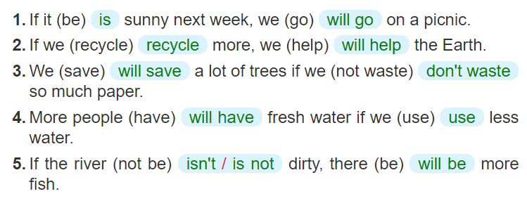
Write the correct form of each verb in brackets.

Slide 18

Combine each pair of sentences below to make a first conditional sentence.
1.
The air isn’t fresh. People cough.
If the air isn't fresh, people will cough.
2.
The water is dirty. A lot of fish die.
If the water is dirty, a lot of fish will die.
3.
We cut down trees in the forest. There are more floods.
If we cut down trees in the forest, there will be more floods.
4.
There is too much noise. People don’t sleep.
If there is too much noise, people will not / won't sleep.
5.
There is no water. Plants die.
If there is no water, plants will die.

Slide 19
* Extra exercise:
Make the first conditional
1.If I (finish)………a bottle of water, I (put).… …… .it into the recycling bin.
2. Many fishes (die)…..…….. if the river (be)…...polluted.
3. People (help)…………..the environment if they (walk) …….or cycle more.
4.If my brother (smoke) ………. in public, I (remind)… ………. him not to do that again.
5.People's health (be) ………. better if the air (be) ….. cleaner.
finish
will put
will die
is
will help
walk
smokes
will remind
will be
is

Slide 20


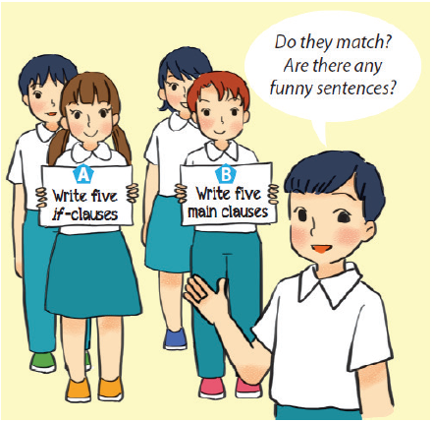
Fun matching
Work in groups, A and B.
Group A secretly writes five if-clauses on a sheet of paper.
Group B secretly writes five main clauses on another sheet of paper.
Match the if-clauses with the main clauses.
Do they match? Are there any funny sentences?

Slide 21
* Homework
- Learn new words by heart.
- Practise the exercises again.
- Prepare: Communication

Slide 22

Thank you!
Have a nice day!

