Slide 1

Welcome to our class

Slide 2

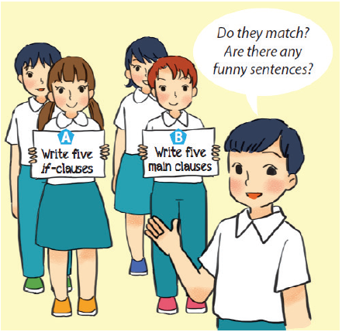

Fun matching
Work in groups, A and B.
Group A secretly writes five if-clauses on a sheet of paper.
Group B secretly writes five main clauses on another sheet of paper.
- Match the if-clauses with the main clauses.
- Do they match?
- Are there any funny sentences?

Slide 3



LESSON 4:

Slide 4



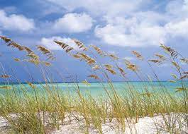
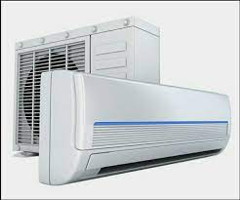



* Vocabulary
- Warning (n) /ˈwɔː.nɪŋ/:
- do a survey /ˈsɜːveɪ/ :
- Breeze (n) /briːz/:
- Air conditioner (n)
- Throw away (v):
- Decorate (v):
- Turn on (v):
Lời cảnh báo
làm một cuộc khảo sát
Làn gió nhẹ lướt qua
Điều hòa
Vứt đi , quẳng đi
Trang trí
Bật lên

Slide 5

* Checking Vocabulary
- Warning (n):
- do a survey :
- Breeze (n) :
- Air conditioner (n)
- Throw away (v):
- Decorate (v):
- Turn on (v):
Lời cảnh báo
làm một cuộc khảo sát
Làn gió nhẹ lướt qua
Điều hòa
Vứt đi , quẳng đi
Trang trí
Bật lên

Slide 6


Listen and read the dialogue between Mi and Mike. Pay attention to the highlighted sentences.
Mi: You are giving the goldfish too much food.
Don’t do that.
Mike: Why?
Mi: If you give them too much food, they will die.
Mike: I see. Thank you.

Slide 7

Work in pairs. Student A is watering ﬂowers in the garden. Student B is giving some warnings. Act out the dialogue. Remember to use the highlighted language in 1.
Example:
A: You are giving too much water to the flowers.
B: Why?
A:
B: I see. Thank you.
Don’t water them too much!
If you give them too much water, they will die.

Slide 8


The 3Rs Club in your school is doing a survey. Answer the following questions by choosing A, B, or C.
A survey on ways to go green

Slide 9
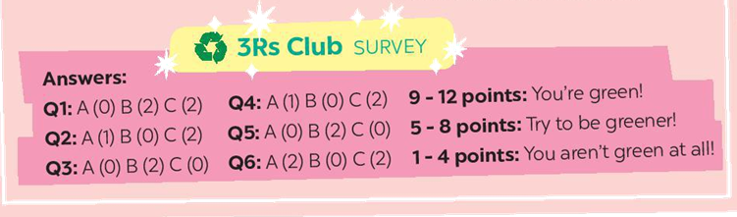
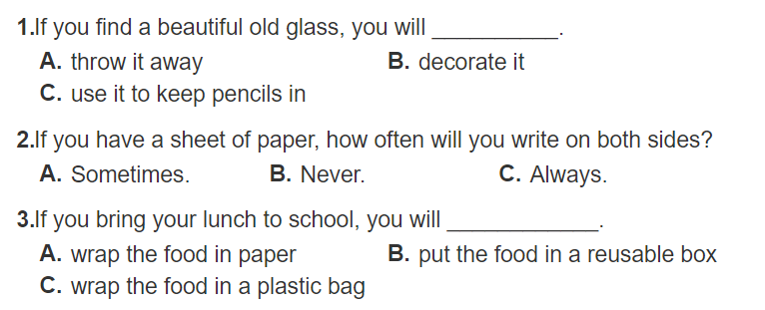

Slide 10
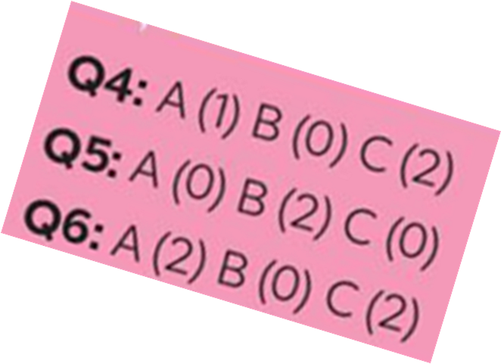
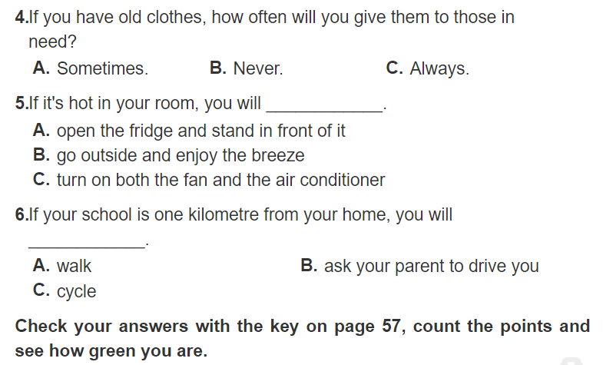

Slide 11

Check your answers with the key on page 57, count the points and see how green you are.
9-12 points: You’re green!
5-8 points: Try to be green!
1-4 points: You aren’t green at all!
* Answer key:
Q1: A(0) B(2) C(2)
Q2: A(1) B(0) C(2)
Q3: A(0) B(2) C(0)
Q4: A(1) B(0) C(2)
Q5: A(0) B(2) C(0)
Q6: A(2) B(0) C(2)

Slide 12

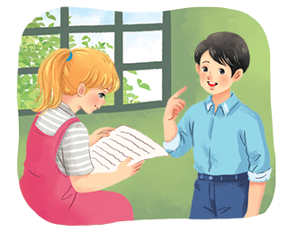
Interview a classmate, using the questions in 3. Compare your answers. How many different answers do you have?
Example:
A: What’s your answer to Question 1?
B: It’s A. What’s your answer?
...
Notes:
City landmarks phải ở trên mục 3

Slide 13
A: What’s your answer to Question 1?
B: It’s C. What’s your answer?
A: My answer is A. What’s your answer to Question 2?
B: It’s C. What’s your answer?
A: Oh, me too. What’s your answer to Question 3?
B: It’s B. What’s your answer?
A: Well, I choose A.

Slide 14
HOMEWORK
- Learn by heart new words
- Do more exercises in Workbook.

