Slide 1



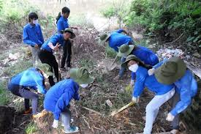
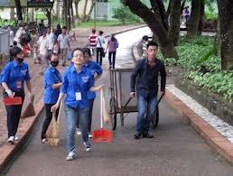
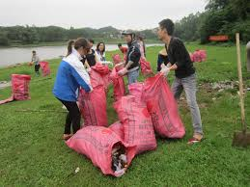

Slide 2
UNIT 11: OUR GREENER WORLD
Lesson 1: GETTING STARTED

Slide 3
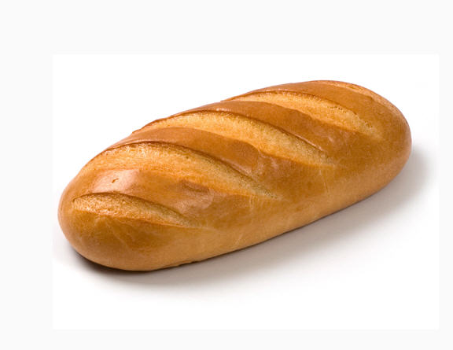
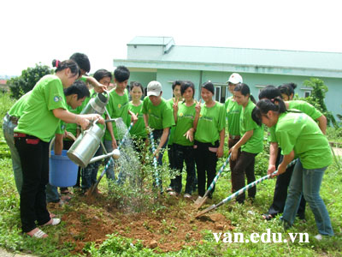
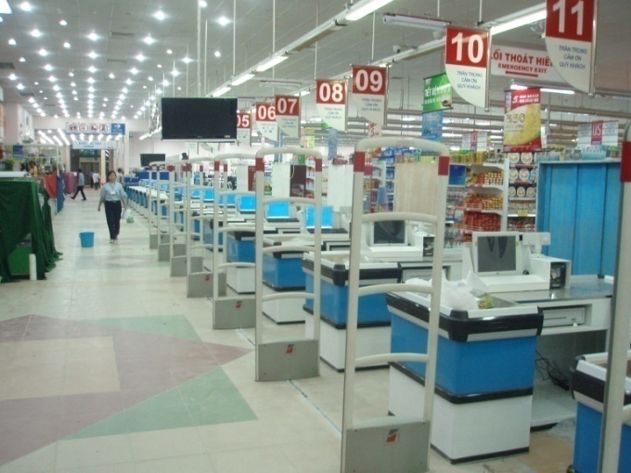

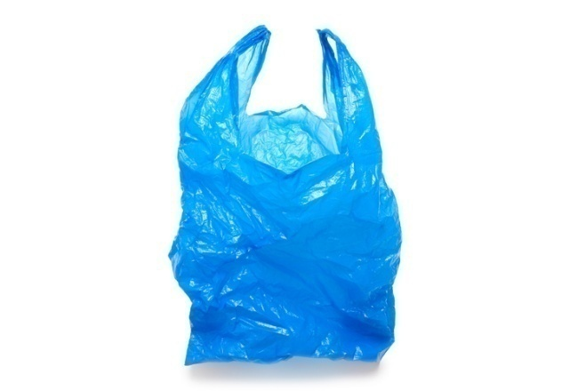
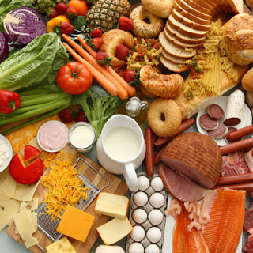
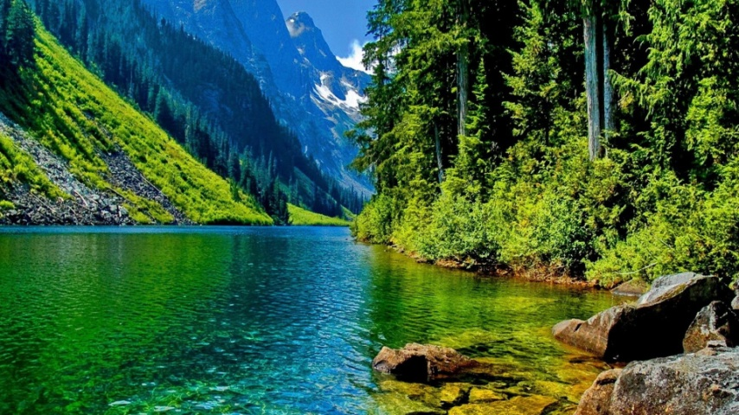
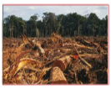
New words
- A loaf of bread (n) :
Một ổ bánh mì
Environment (n) :
→ Environmental (adj) :
Môi trường
Thuộc về môi trường
Natural (adj ) :
→ Nature (n) :
Thuộc tự nhiên
Thiên nhiên
- Materials (n) :
Nguyên liệu
- Check-out (n) :
Quầy tính tiền
Reuse (v) :
→ Reusable (adj) :
Tái sử dụng
Có thể tái sử dụng
- Deforestation (n) :
Sự phá rừng
- Plastic bag (n) :
Túi nilon

Slide 4
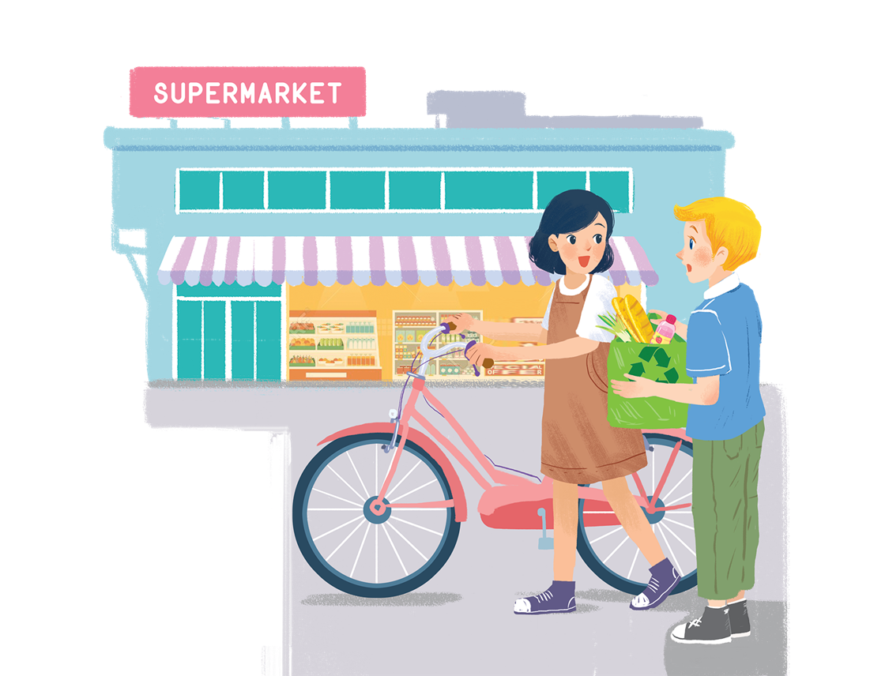
UNIT 11: OUR GREENER WORLD
Section 1: GETTING STARTED
*Guessing:
?1: Who are they?
?2: Where are they?
?3: What they might be talking about?

Slide 5
2
Plastic bag
1
deforestation
3
Reusable bag
4
Check-out
5
Materials

Slide 6




Listen and read.
Let’s go green!

Slide 7
Let’s go green!
Mi: Hi, Nick.
Nick: Hello, Mi.
Mi: You’ve bought a lot of things.
Nick: Yes. We’re going on a picnic tomorrow.What are you doing at the supermarket, Mi?
Mi: I’m buying some eggs. Hey, what’s this?
Nick: It’s a reusable shopping bag.
Mi: Do you always use it?
Nick: Yes. It’s better than a plastic one.If we all use this kind of bag, we will help the environment.
Mi: I see. I’ll buy one for my mum. Where can I buy one?
Nick: At the check-out. By the way, you’re also green. You’re cycling.
Mi: You’re right. If more people cycle, the air will be cleaner. Right?
Nick: Yes. Oh, it’s 5 o’clock already. I have to go now. See you later.
Mi: See you, Nick. Bye.

Slide 8

Read the conversation again. Complete the following sentences. Use no more than three words in each blank.
a picnic tomorrow.
Nick is going on
1.
_______ tomorrow.
2.
_______.
The green shopping bag is better than the
plastic one.
the check-out.
3.
People can buy green bags at
_______.
4.
Mi wants to buy
a reusable bag for her mum.
_______ bag for her mum.
she’s cycling.
5.
Nick thinks that Mi is green because
_______.

Slide 9
Let’s go green!
Mi: Hi, Nick.
Nick: Hello, Mi.
Mi: You’ve bought a lot of things.
Nick: Yes. We’re going on a picnic tomorrow.What are you doing at the supermarket, Mi?
Mi: I’m buying some eggs. Hey, what’s this?
Nick: It’s a reusable shopping bag.
Mi: Do you always use it?
Nick: Yes. It’s better than a plastic one.If we all use this kind of bag, we will help the environment.
Mi: I see. I’ll buy one for my mum. Where can I buy one?
Nick: At the check-out. By the way, you’re also green. You’re cycling.
Mi: You’re right. If more people cycle, the air will be cleaner. Right?
Nick: Yes. Oh, it’s 5 o’clock already. I have to go now. See you later.
Mi: See you, Nick. Bye.

Slide 10

Based on the ideas in the conversation, match the first half of the sentence in column A with its second half in column B.
A
1. Green bags are better
2. The air will be cleaner
3. If people use reusable bags for shopping.
B
b. than plastic bags.
c. if more people cycle.
a. they will help the environment.
B
a. they will help the environment.
b. than plastic bags.
c. if more people cycle.

Slide 11

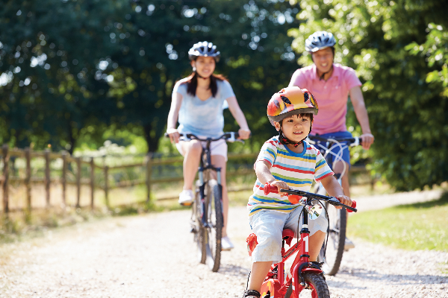
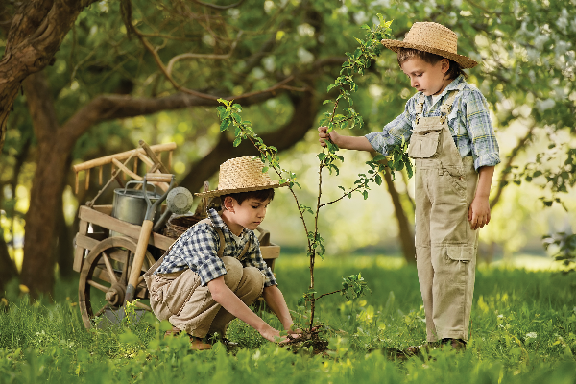
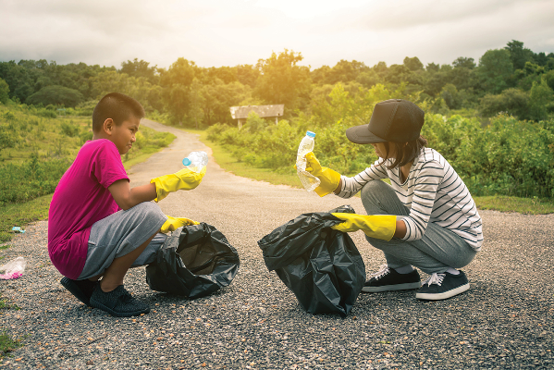
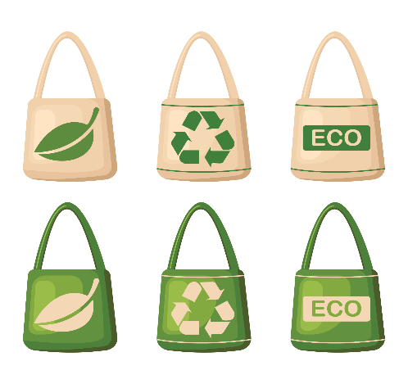
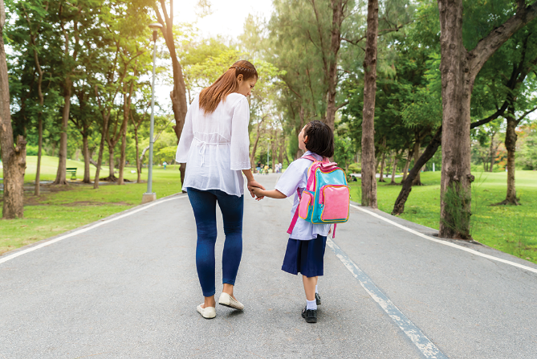
Match the pictures with the ways to help the environment.
1
2
3
4
5

Slide 12
a.
planting trees and flower
picking up rubbish
planting trees and flower
walking to school
picking up rubbish
d.
walking to school
a.
b.
d.
using reusable bags when shopping
e.
using reusable bags when shopping
b.
c.
cycling
e.
c.
cycling
1
2
3
a.
planting trees and flower
b.
picking up rubbish
c.
cycling
4
5
e.
using reusable bags when shopping
d.
walking to school

Slide 13


Find someone who ... Work in groups. Ask and answer to find someone who does the things in 4.
A: Do you plant trees?
B: No, I don’t.
A: Do you pick up rubbish?
B: Yes, I do.

Slide 14
Find someone who ... Work in groups. Ask and answer to find someone who does the things in 4.
Find someone who… | Names
uses reusable bags
cycles
walks to school
picks up rubbish
plants trees

Slide 15

Go to the Internet and
search for 3Rs – Go green
to understand more
about the topic.

