Slide 1



Minh Duc secondary school
WARMLY WELCOME ALL THE TEACHERS TO THE ENGLSH LESSON OF CLASS 6… !

Slide 2
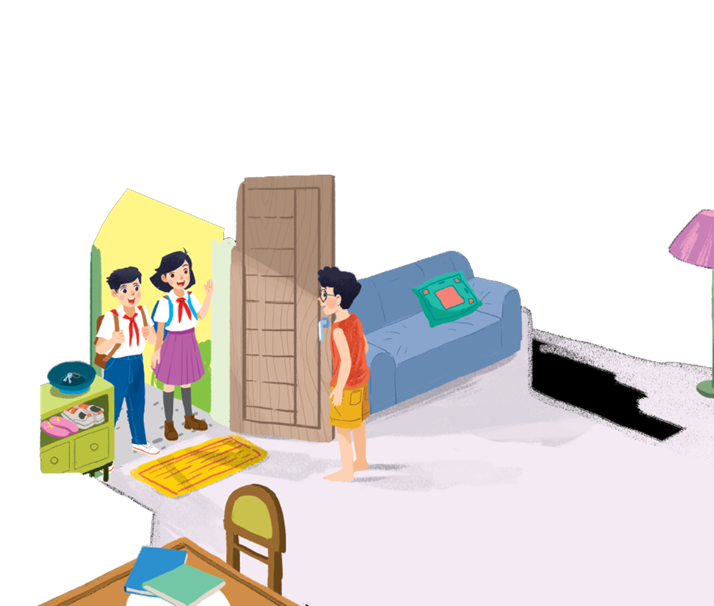
UNIT 1: MY NEW SCHOOL
Period 2 - Lesson 1: GETTING STARTED

Slide 3
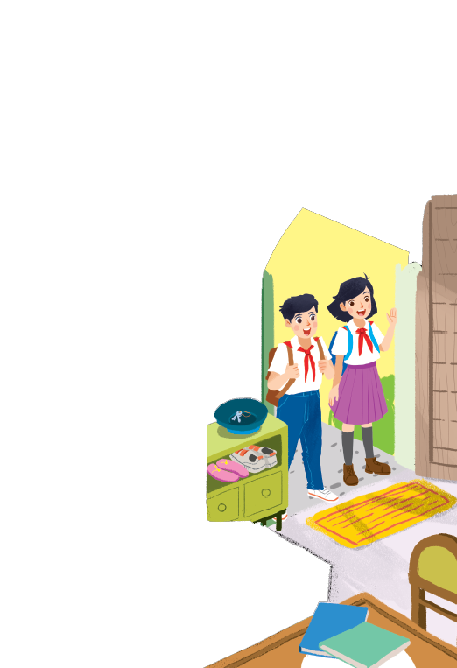
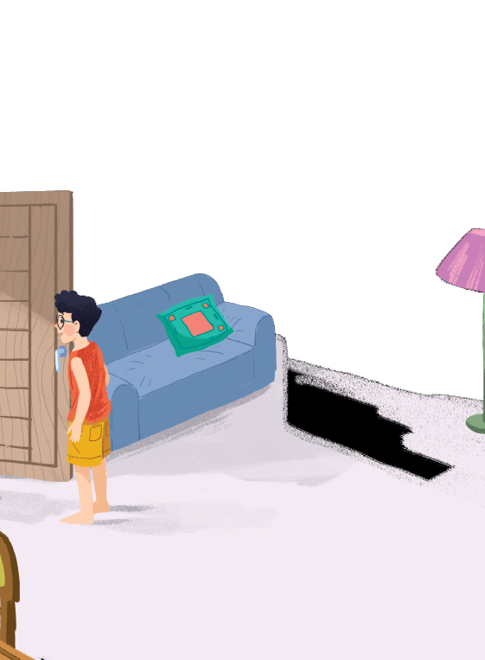

1. How many people are there in the picture? Who are they?
Where are they?
What are the students carrying on their backs?
Where are they going to go?
Are they happy? Why?
Notes:
Thiếu tên bài đọc.

Slide 4


How many people are there in the picture?
Who are they?
3 people. They are 2 boys and 1 girl.
They’re carrying their school bags.
What are the students carrying on their backs?
Where are they going to go?
They’re going to go to school.
Yes, because it is a special day.
Are they happy? Why?
Where are they?
They’re at one of the boys’ house.

Slide 5

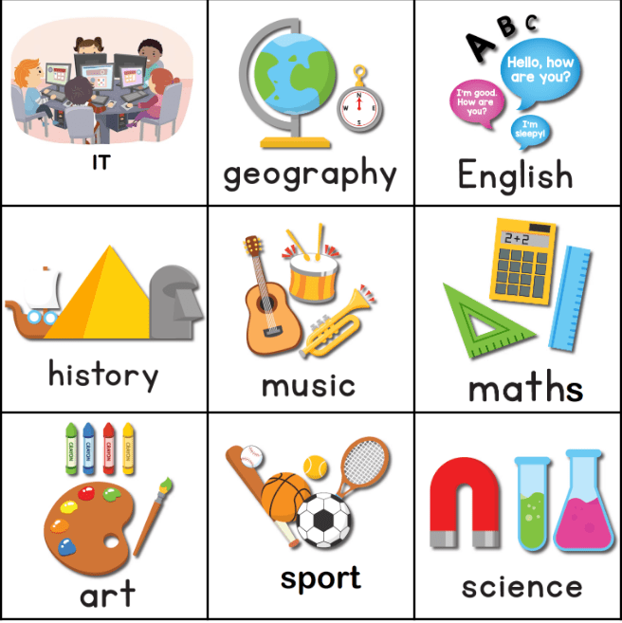
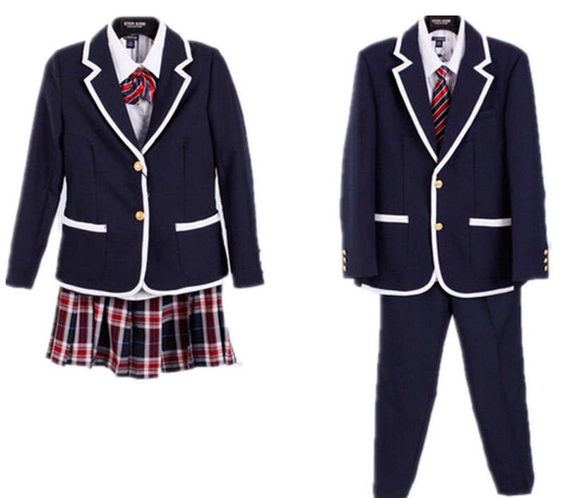
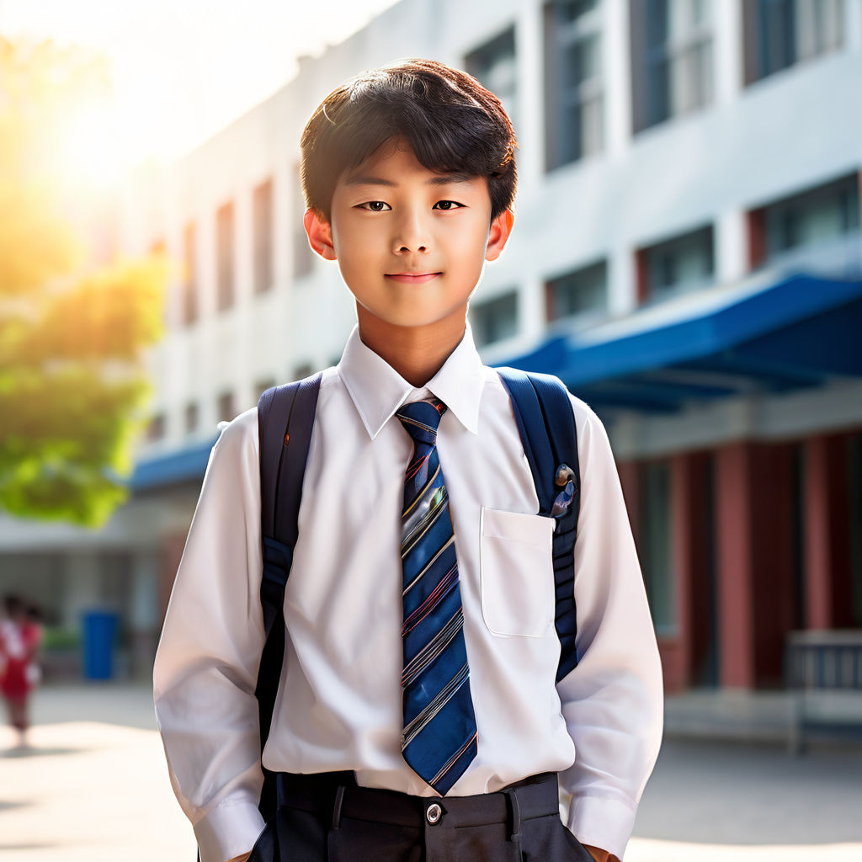
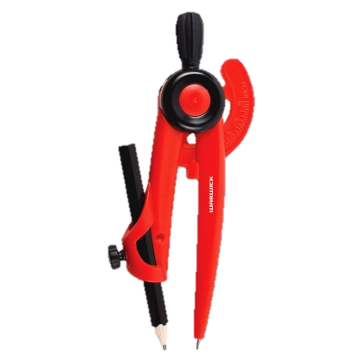
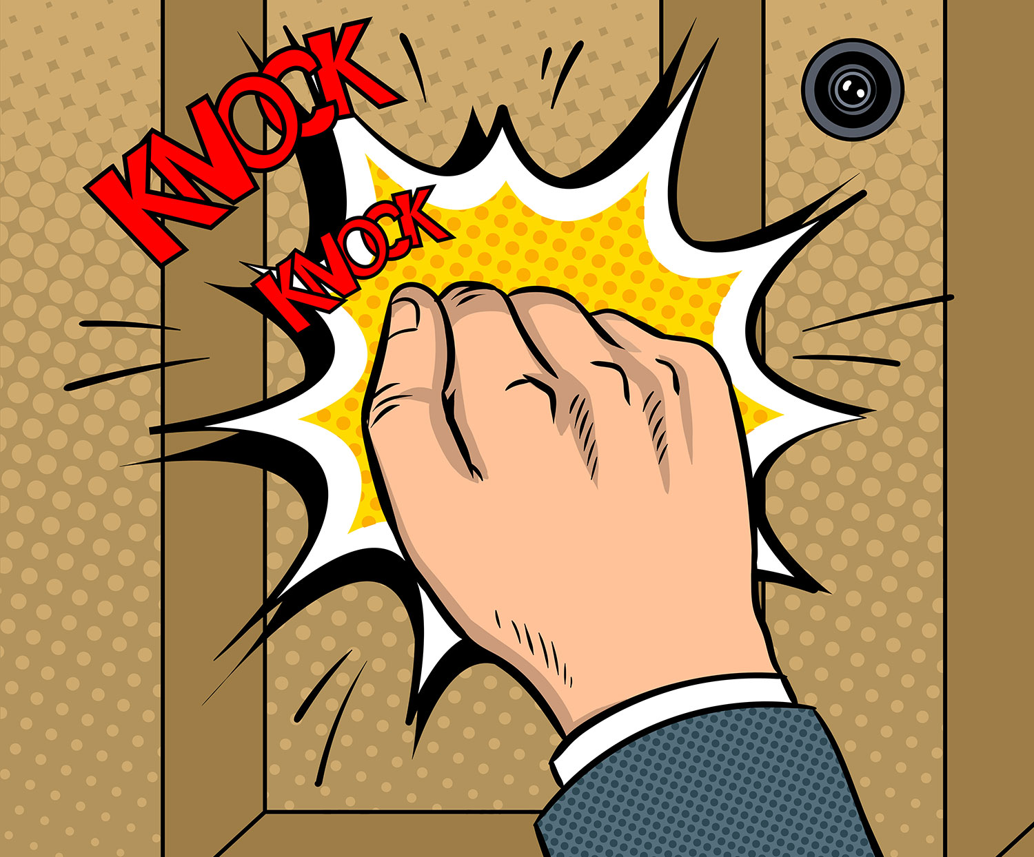
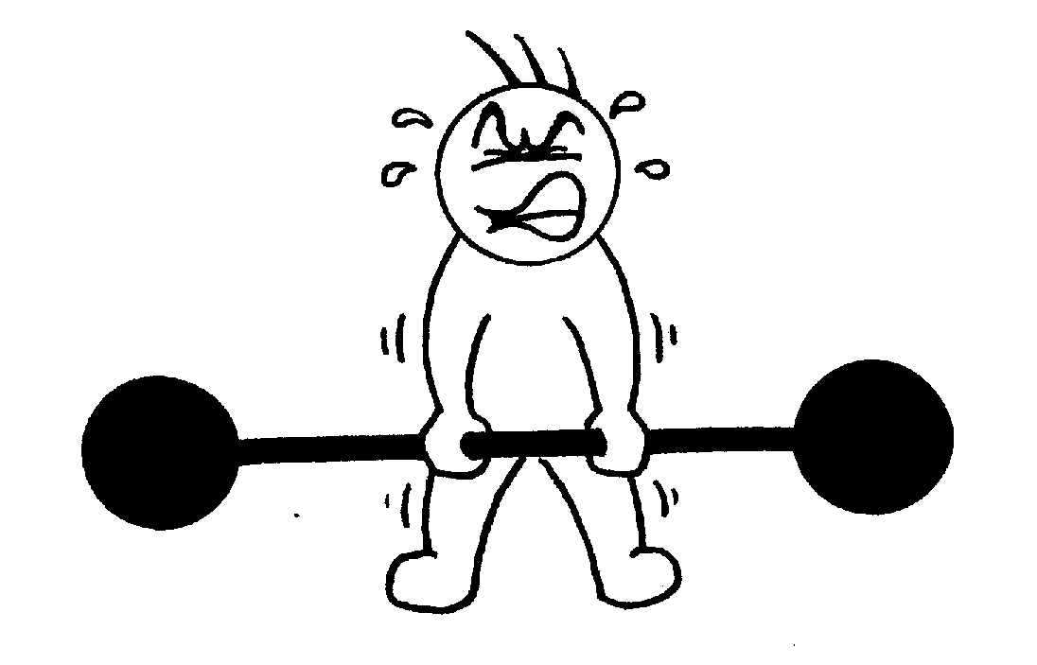
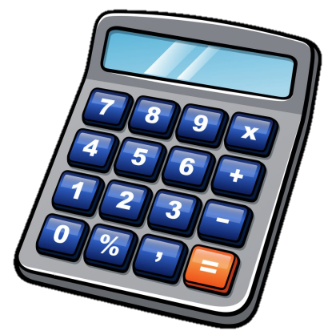
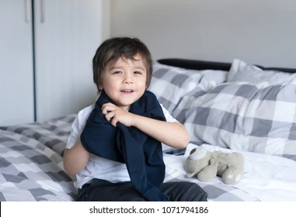
I. Vocabulary
‘compass (n)
knock (v)
‘heavy (a)
‘subject (n)
smart (a)
uniform (n)
put on (v)
‘calculator (n)
compa
gõ (cửa)
nặng
môn học
bảnh bao, sáng sủa
đồng phục
mặc vào
máy tính bỏ túi

Slide 6



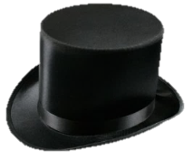


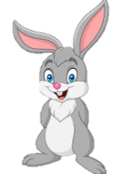
What and Where
compass
subject
knock
smart
heavy
uniform
put on
calculator

Slide 7


II. LISTEN AND READ
A special day
(Loud knock)
Phong: Hi, Vy.
Vy: Hi, Phong. Are you ready?
Phong: Just a minute.
Vy: Oh, this is Duy, my new friend.
Phong: Hi, Duy. Nice to meet you.
Duy: Hi, Phong. I live near here, and we go to the same school!
Phong: Good. Hmm, your school bag looks heavy.
Duy: Yes! I have new books, and we have new subjects to study.
Phong: And a new uniform, Duy! You look smart!
Duy: Thanks, Phong. We always look smart in our uniforms.
Phong: Let me put on my uniform. Then we can go.

Slide 8
Read the conversation again and tick () T (true) or F (false)
2
 |  | T | F
1. | Vy, Phong, and Duy go to the same school.
2. | Duy is Phong’s friend.
3. | Phong says Duy looks smart in his uniform.
4. | They have new subjects to study
5. | Phong is wearing a school uniform.
✓
Duy: Hi, Phong. I live near here, and we go to the same school!
✓
Vy: Oh, this is Duy, my new friend.
✓
Phong: And a new uniform, Duy! You look smart!
✓
Duy: Yes! I have new books, and we have new subjects to study.
✓
Phong: Let me put on my uniform. Then we can go.

Slide 9
Write ONE word from the box in each gap.
3
go
subjects
has
wear
uniforms
Students their uniforms on Monday.
1.
wear
has
2.
Vy a new friend, Duy.
- Do Phong, Vy, and Duy to the same school?
3.
go
- Yes, they do.
uniforms
4.
Students always look smart in their .
5.
- What do you like to study?
subjects
- I like to study English and history.

Slide 10
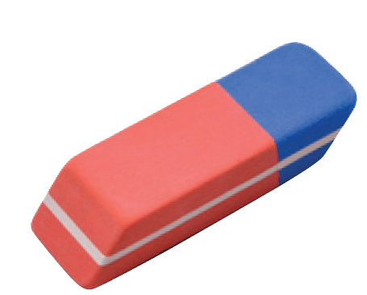
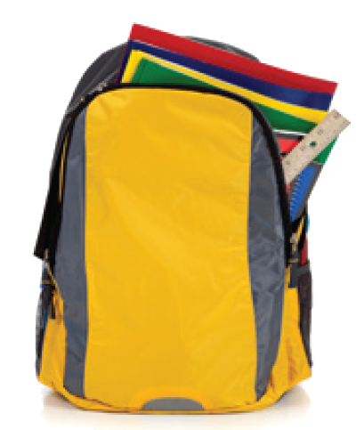
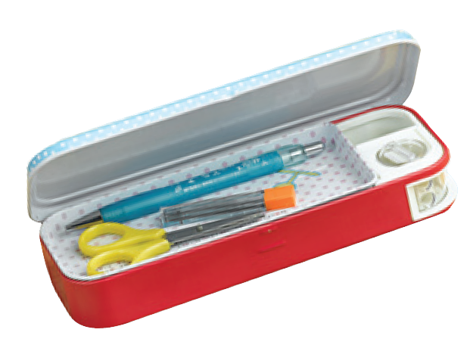
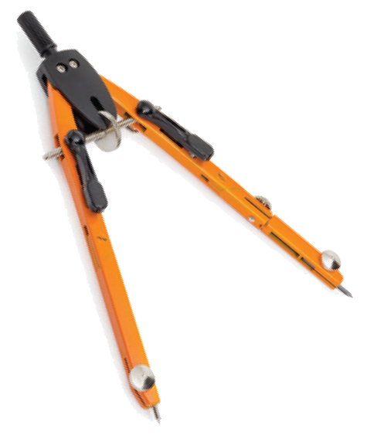
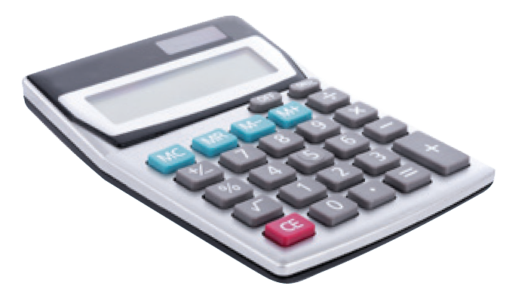
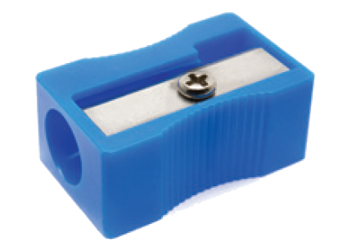
Match the word with the school things. Then listen and repeat.
4
pencil sharpener
4
compass
1
school bag
2
calculator
5
rubber
3
pencil case
6

Slide 11
Match the word with the school things. Then listen and repeat.
4
school bag
rubber
4
1
compass
pencil case
2
5
pencil sharpener
calculator
3
6

Slide 12

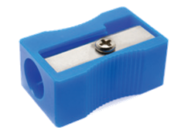
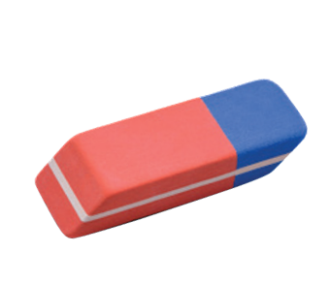
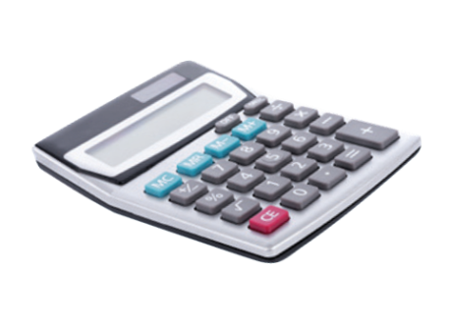
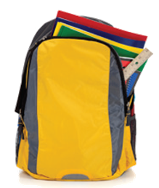
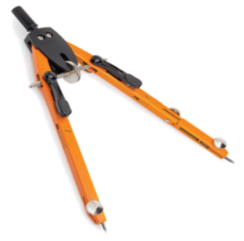
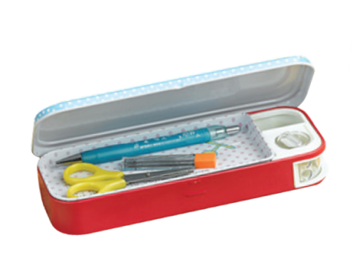
12
12
12
12
12
12
12
12
12
12
12
0
⋅
A
12
B
➢
8
7
6
5
4
3
2
1
10
9
8
7
6
5
4
3
2
1
0
8
7
6
5
4
3
2
1
Pelmanism
Score
0
9
9
9
9
9
9
9
9
9
9
9
3
3
3
3
3
3
3
3
3
3
3
9
3
.
6
6
6
6
6
6
6
6
6
6
6
6
1
5
9
school bag
2
6
10
rubber
3
7
11
compass
pencil case
4
8
pencil sharpener
12
calculator

Slide 13
Look around the class. Write the names of the things you see in your notebook.
5
table,
desks,
notice board,
pictures

Slide 14


III. HOME ASSIGNMENT
Make sentences using each of the new words learned.
Prepare the next lesson: A closer look 1

Slide 15

THANK YOU FOR YOUR ATTENTION!

