Slide 1
Unit 1
Skills 1

Slide 2
vocabulary

Slide 3
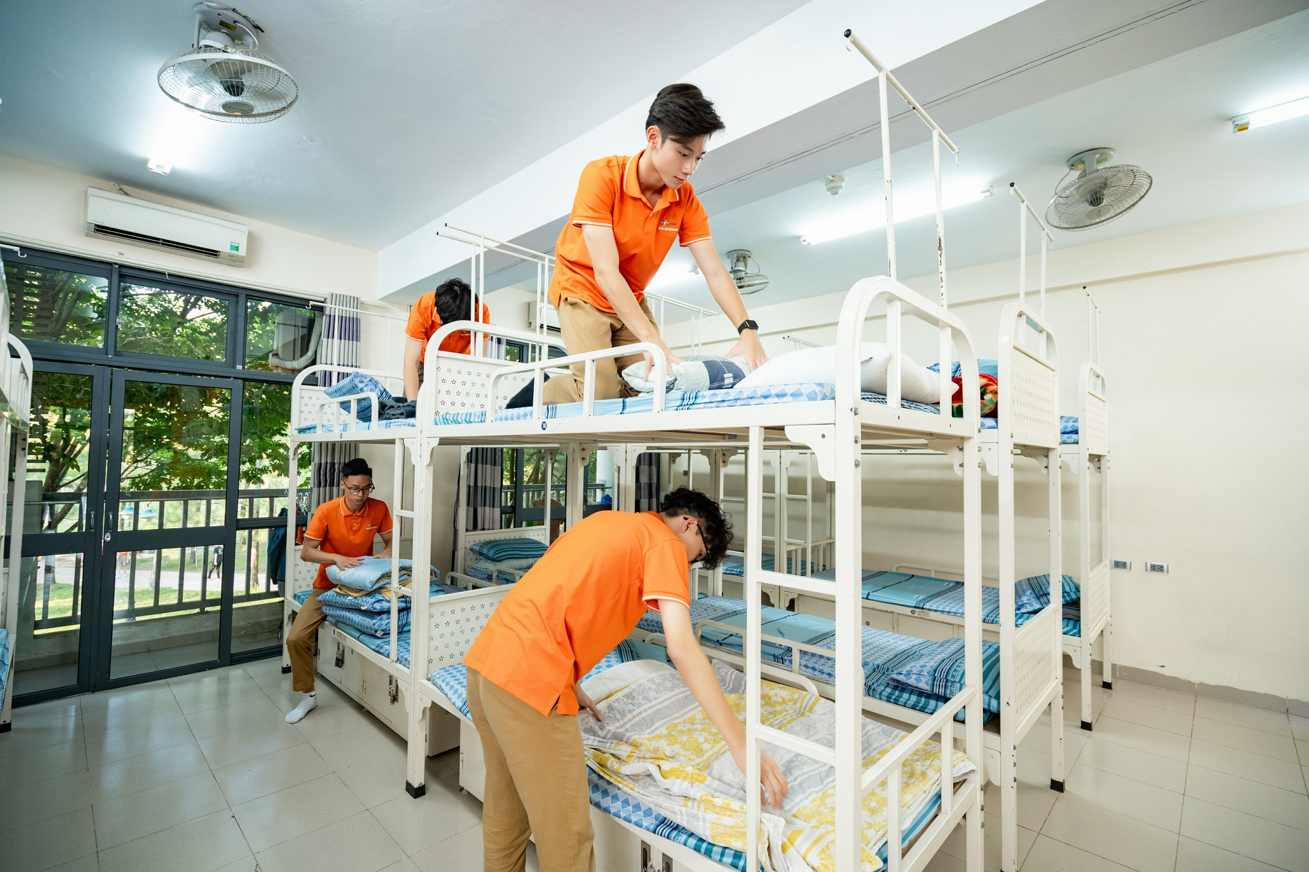

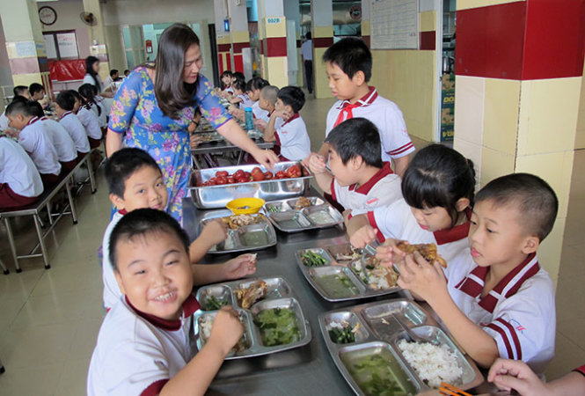
vocabulary
Boarding school
Trường nội trú
(n)
/ˈbɔːdɪŋ ˌskuːl/

Slide 4
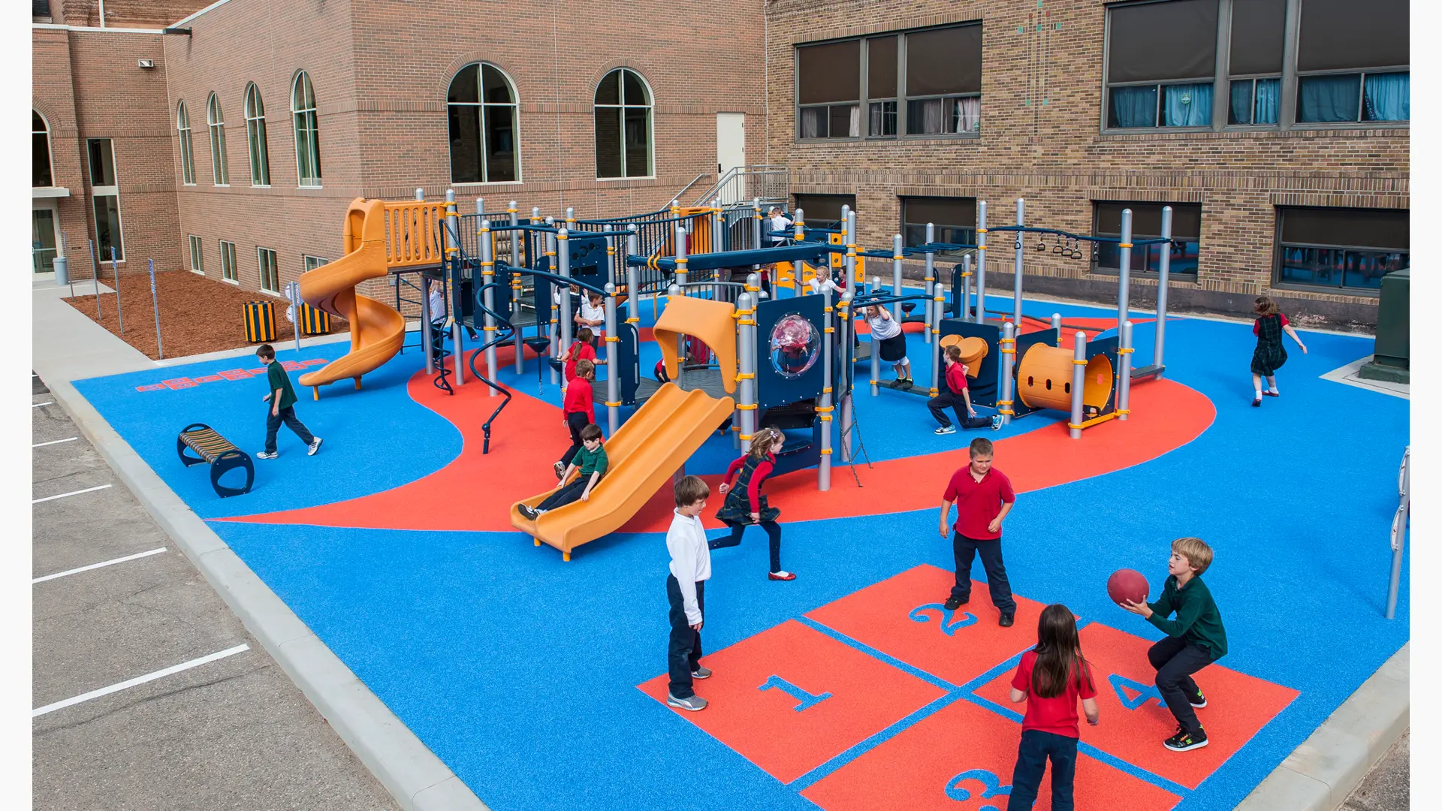
vocabulary
Playground
Sân chơi
(n)
/ˈpleɪɡraʊnd/

Slide 5

vocabulary
International
(adj)
/ˌɪntəˈnæʃən.əl/
Quốc tế

Slide 6
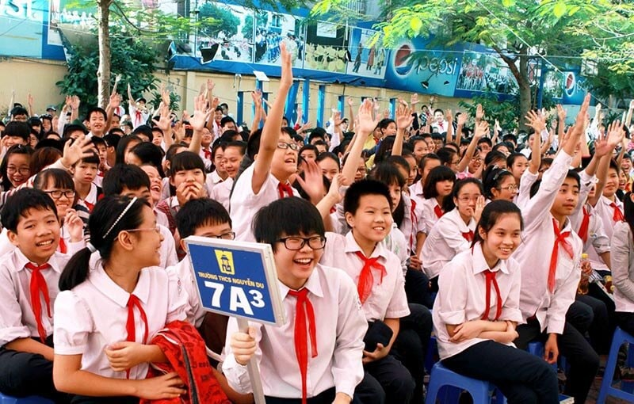

vocabulary
Secondary school
Trường cấp hai
(n)
/ˈsɛkəndəri skuːl/

Slide 7

vocabulary
Art club
(n)
/ɑːt klʌb/
CLB mỹ thuật

Slide 8

vocabulary
Library
Thư viện
(n)
/ˈlaɪbrəri/

Slide 9
vocabulary
- boarding school (n) : trường nội trú
- playground (n): sân chơi
- international (adj): quốc tế
- secondary school (n): trường trung học
- art club (n): công lạc bộ mỹ thuật
- library (n): thư viện

Slide 10
READING

Slide 11
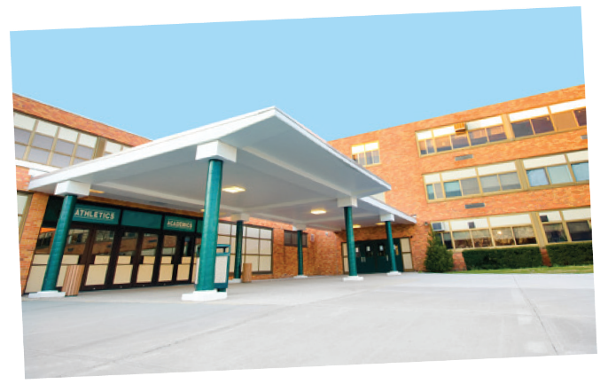
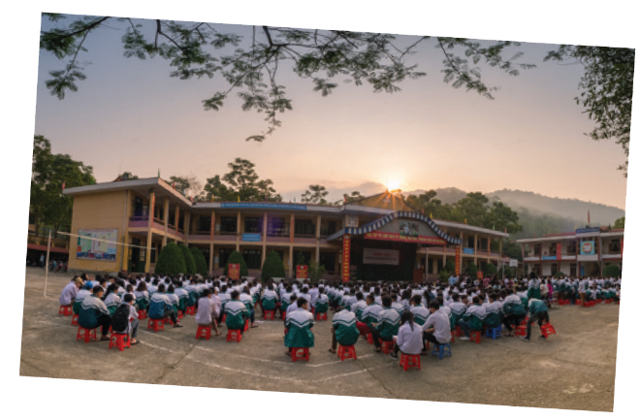


Slide 12


Look at the pictures and quickly read the passages. Match 1-3 with A-C.
Sunrise is a boarding school in Sydney. Students study and live there. About 1,200 boys and girls go to Sunrise. It has students from all over Australia. They study subjects like maths, science and English.
An Son is a lower secondary school in Bac Giang. It has only 8 classes. There are mountains and green fields around the school. There is a computer room and a library. There is also a school garden and a playground.
Dream is an international school. Here students learn English with English-speaking teachers. In the afternoon, they join many interesting clubs. They play sports and games. Some students do paintings in the art club.

Slide 13
1. Sunrise
A. a school in Bac Giang
C. a boarding school in Sydney
2. An Son
B. an international school
A. a school in Bac Giang
3. Dream
C. a boarding school in Sydney
B. an international school

Slide 14

Read the passages again and complete these sentences.
boarding
Students live and study in a school. They only go
home at weekends.
1.
Sydney
Sunrise is a school in .
2.
mountains and green fields
There are
around An Son School.
3.
4.
Dream school
has an art club.
At Dream School, students learn English with
5.
English-speaking teachers.

Slide 15

Answer the questions.
1.
Which school is a boarding school?
→ Sunrise.
2.
Where is An Son School?
→ It is in Bac Giang.
3.
Is there a school garden in An Son School?
→ Yes. There is.
4.
What do Dream School students do in the afternoon?
→ They join many interesting clubs.

Slide 16
SPEAKING

Slide 17

Which school in 1 would you like to go to? Why or Why not? Complete the table.
Name of school | Reasons you like it | Reason you don’t like it
AN SON SCHOOL
Has mountains around
Only has 8 classes
Then discuss your choice with a friend.
Example:
A: Which school would you like to go to?
B: I’d like to go to Dream School.
A: Why?
B: Because I’d like to paint in the art club.

Slide 18
THANK YOU!
Learn vocabulary
Review the Simple Present Tense
+ Form (công thức)
+ Uses (cách dùng)
+ How to do (cách chia thì)

