Slide 1

WELCOME TO OUR CLASS
Teacher: Pham Thi Hong Thu

Slide 2
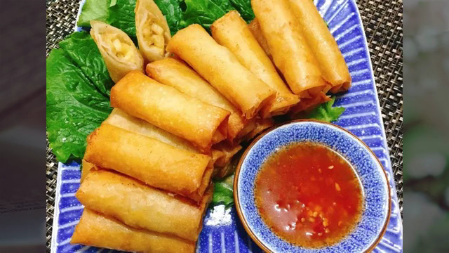

Slide 3
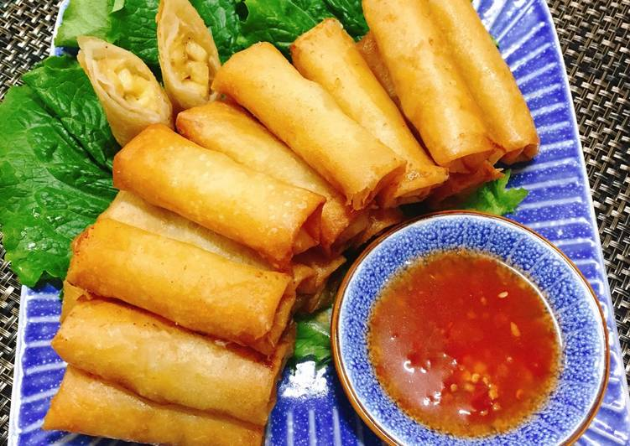
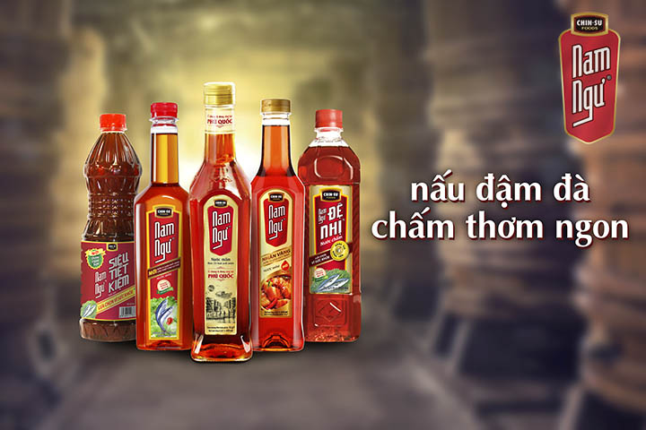
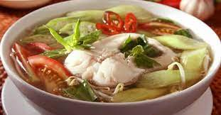
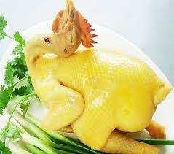
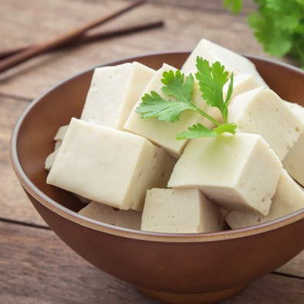
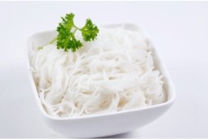
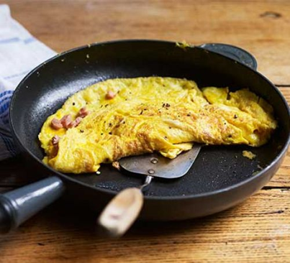
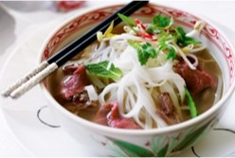

Spring rolls
Fish sauce
Fish soup
chicken
tofu
noodles
Fried eggs
Beef noodle (soup)
Green tea

Slide 4

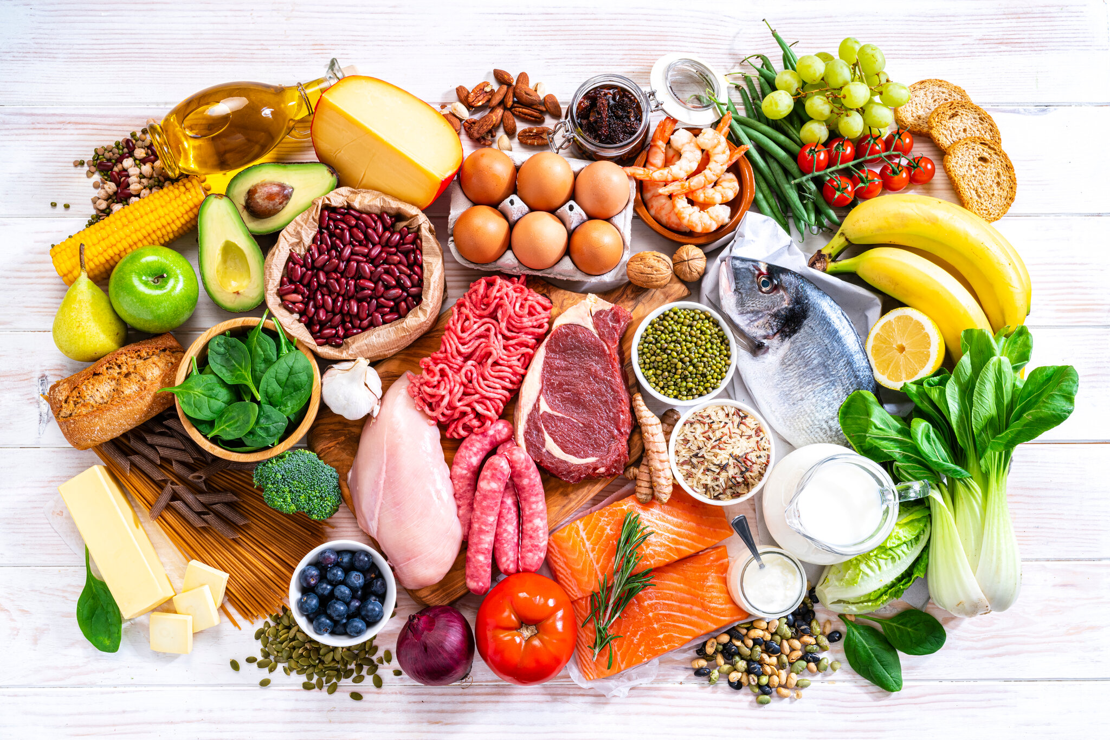
UNIT 5. FOOD AND DRINK
Lesson 1. Getting started

Slide 5

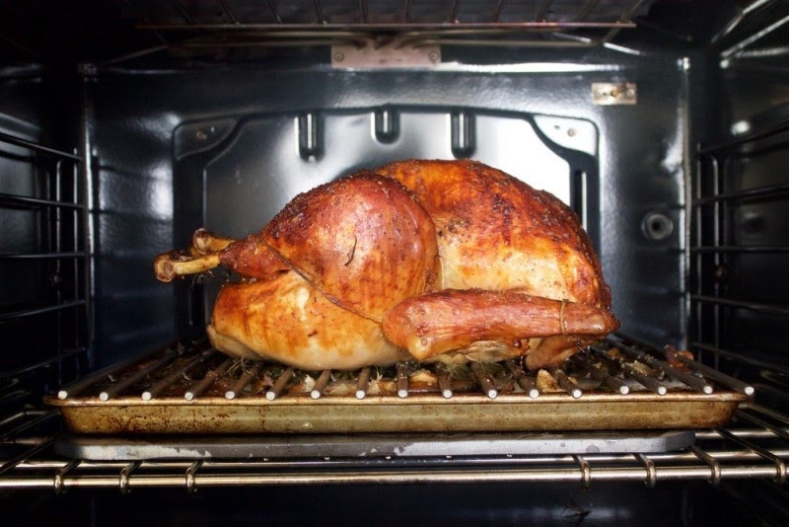
I. VOCABULARY
- roast (v):
quay, nướng (thịt..)
/rəʊst/

Slide 6
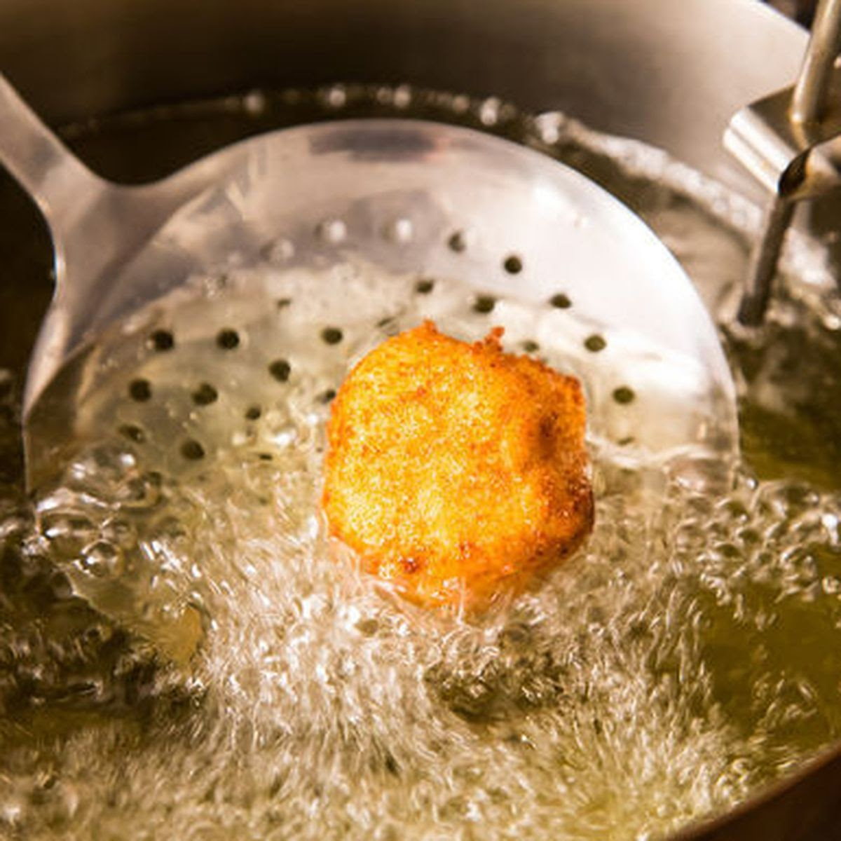
- fry (v):
rán
/fraɪ/

Slide 7
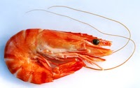
-shrimp (n):
/ʃrɪmp/
con tôm

Slide 8
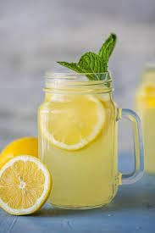
- lemonade (n):
nước chanh
/leməˈneɪd/

Slide 9
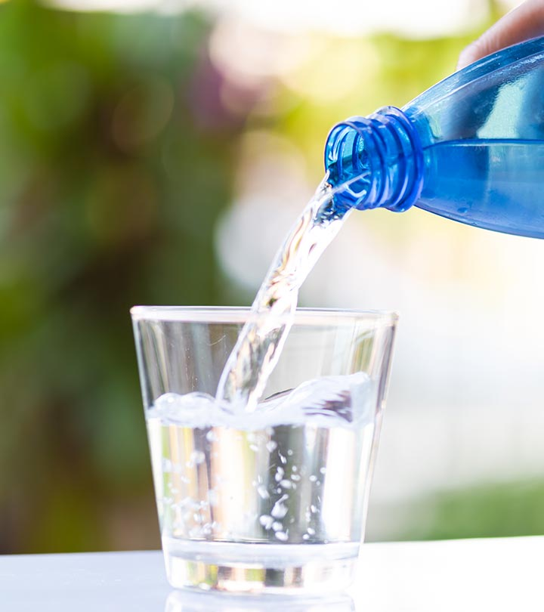
- Mineral water (n):
/ˈmɪnərəl/ /ˈwɔːtə/
Nước khoáng

Slide 10
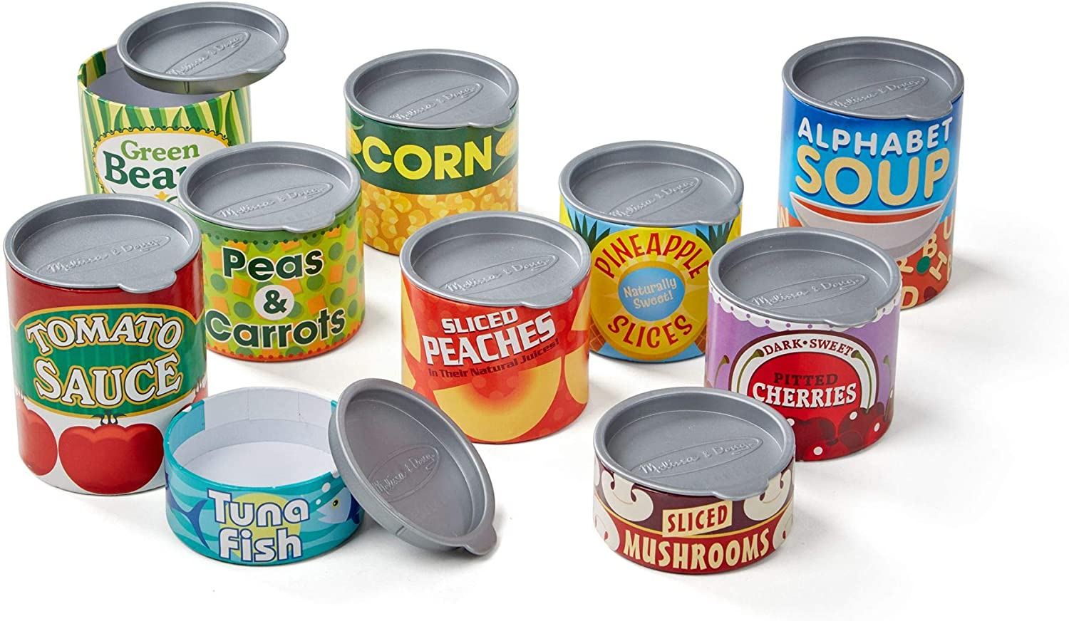
- can (n):
lon
/ kæn /

Slide 11
I. VOCABULARY
New words | Pronunciation | Meaning
- roast | /rəʊst/ | quay, nướng (thịt..)
- fry | /fraɪ/ | rán
- shrimp | /ʃrɪmp/ | con tôm
- lemonade | /leməˈneɪd/ | nước chanh
- mineral water | /ˈmɪnərəl/ /ˈwɔːtə/ | khoáng (chất)
- can | / kæn/ | lon

Slide 12
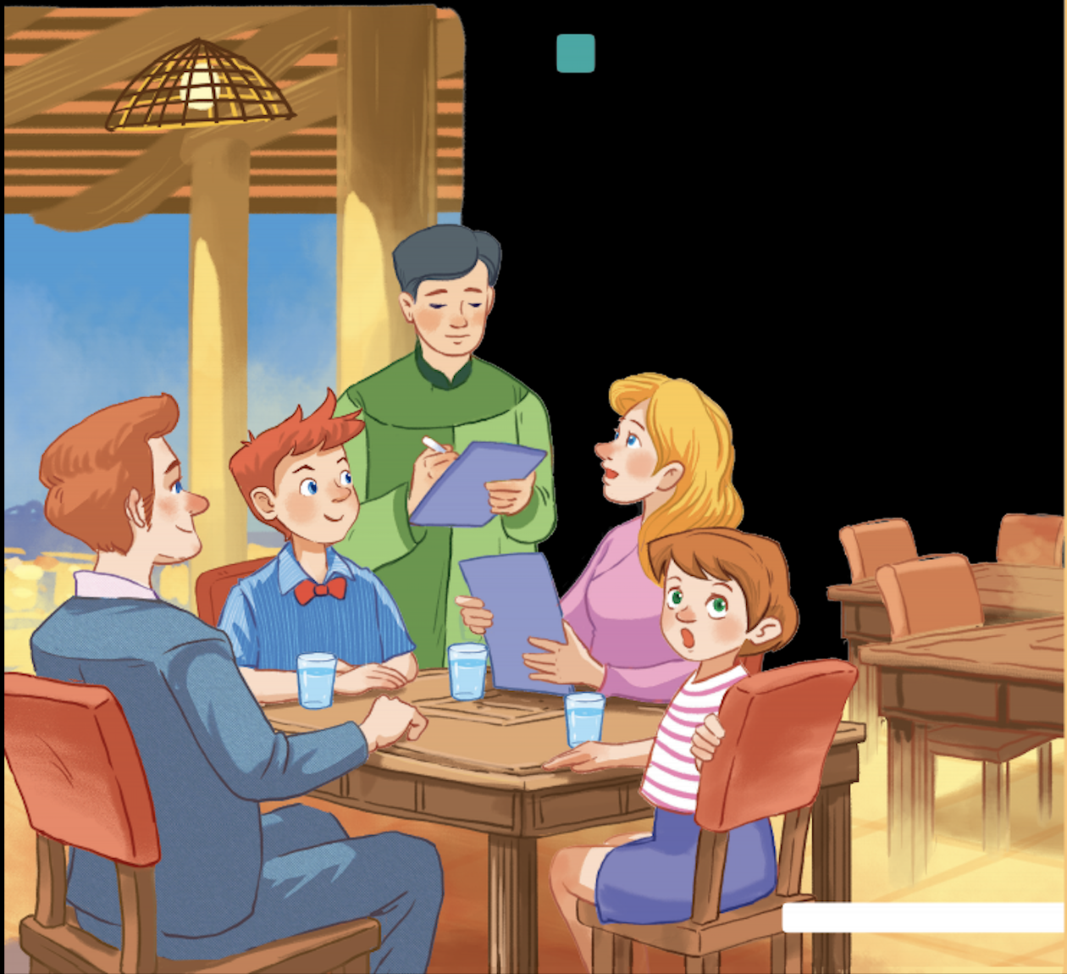
1
Listen and read.
- Where is Mark's family?
- What are they doing?

Slide 13
1
Listen and read.
Waiter: Good evening. What can I get you today?
Mark's mum: We'd like rice with some pork cooked in fish sauce. Oh, could we also have an order of roast chicken and fried vegetables?
Mark: And I'd like some fried tofu and spring rolls too.
Waiter: OK. Would you like any canh? It's a kind of Vietnamese soup. We often have it with rice.
Mark's dad: Let me see ... I think we'll try some canh.
Waiter: With shrimp or fish?
Mark's dad: With shrimp, please.
Waiter: Would you like anything to drink? We have a lot of drinks: juice, lemonade, green tea, mineral water, ...
Mark's mum: Mineral water for me, green tea for my husband, and juice for my children.
Waiter: What kind of juice would you like?
Mark's sister: Do you have winter melon juice?
Waiter: Let me see. Er, yes. How many cans would you like?
Mark's sister: One ... No, wait, two please. By the way, how much is a can of winter melon juice?
Mark: The menu says it's 10,000 dong.
Waiter: That's right. I'll be right back with your order.

Slide 14
2
Look at the pictures and answer the questions
What is Mark's family doing?
A. Ordering food for dinner.
B. Preparing for their dinner.
C. Talking about their favourite food.

Slide 15
3
Find the words and phrases about food and drink in the conversation and write them in the correct columns.
rice
Waiter: Good evening. What can I get you today? Mark's mum: We'd like rice with some pork cooked in fish sauce. Oh, could we also have an order of roast chicken and fried vegetables?
Mark: And I'd like some fried tofu and spring rolls too.
Waiter: OK. Would you like any canh? It's a kind of Vietnamese soup. We often have it with rice.
Mark's dad: Let me see ... I think we'll try some canh.
Waiter. With shrimp or fish?
Mark's dad: With shrimp, please.
Waiter: Would you like anything to drink? We have a lot of drinks: juice, lemonade, green tea, mineral water, ...
Mark's mum: Mineral water for me, green tea for my husband, and juice for my children.
Waiter: What kind of juice would you like?
Mark's sister: Do you have winter melon juice?
Waiter: Let me see. Er, yes. How many cans would you like?
Mark's sister: One ... No, wait, two please. By the way, how much is a can of winter melon juice?
Mark: The menu says it's 10,000 dong.
Waiter: That's right. I'll be right back with your order.
Food | Drink
pork
fish sauce
roast chicken
fried vegetables
rice
pork
fish sauce
juice
lemonade
fried tofu
spring rolls
roast chicken
canh
green tea
fried vegetables
mineral water
fried tofu
spring rolls
winter melon juice
fish
canh (soup)
shrimp
shrimp
fish
lemonade
mineral water
green tea
juice
winter melon juice

Slide 16
4
Read the conversation again and tick (✓) T (True) or F (False).
Waiter: Good evening. What can I get you today? Mark's mum: We'd like rice with some pork cooked in fish sauce. Oh, could we also have an order of roast chicken and fried vegetables?
Mark: And I'd like some fried tofu and spring rolls too.
Waiter: OK. Would you like any canh? It's a kind of Vietnamese soup. We often have it with rice.
Mark's dad: Let me see ... I think we'll try some canh.
Waiter: With shrimp or fish?
Mark's dad: With shrimp, please.
Waiter: Would you like anything to drink? We have a lot of drinks: juice, lemonade, green tea, mineral water, ...
Mark's mum: Mineral water for me, green tea for my husband, and juice for my children.
Waiter: What kind of juice would you like?
Mark's sister: Do you have winter melon juice?
Waiter: Let me see. Er, yes. How many cans would you like?
Mark's sister: One ... No, wait, two please. By the way, how much is a can of winter melon juice?
Mark: The menu says it's 10,000 dong.
Waiter: That's right. I'll be right back with your order.
a Vietnamese
restaurant
1. Mark's family is at a Vietnamese restaurant.
2. Mark wants fried tofu and beef for dinner.
3. They don't order canh.
4. Mark's mum wants mineral water.
5. His mum doesn't allow her children to drink juice during dinner.
TRUE
Mark
fried tofu
spring rolls
Vietnamese
Mark
fried tofu
beef
FALSE
we'll try some canh
don't order canh
FALSE
mum
mineral water
mum
Mineral water
juice for my
TRUE
children
mum
doesn't allow
drink
juice
FALSE

Slide 17
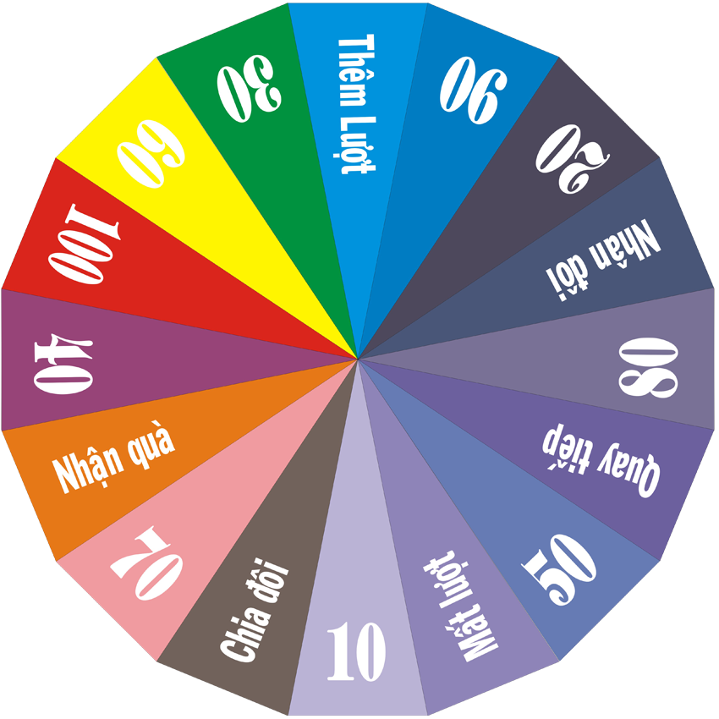


01
02
03
04
05
06
Enter

Slide 18
* Ask your partner about his or her favorite food and drink.
What's your favourite food?
→ It's spring rolls

Slide 19
* Ask your partner about his or her favorite food and drink.
What's your favourite food?
→ It’s beef noodle (soup)

Slide 20
* Ask your partner about his or her favorite food and drink.
What's your favourite food?
→ It’s fried eggs

Slide 21

* Ask your partner about his or her favorite food and drink.
What's your favourite drink ?
→ It’s lemonade

Slide 22
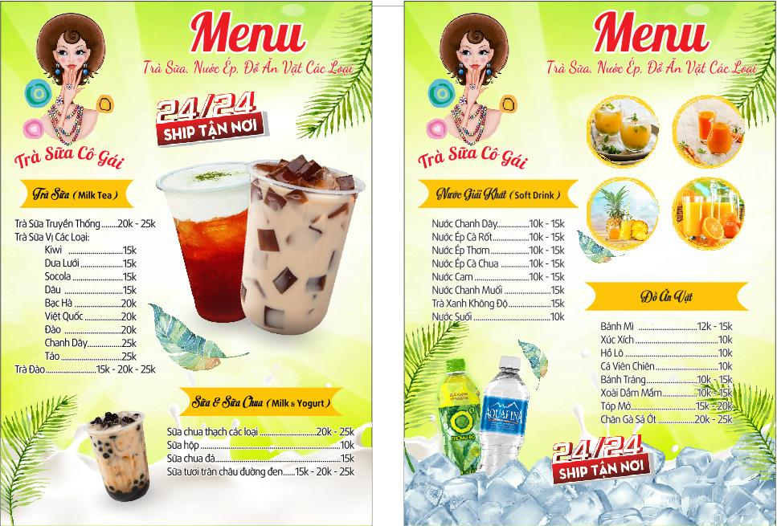
* Ask your partner about his or her favorite food and drink.
What's your favourite drink ?
→ It’s milk tea

Slide 23
* Ask your partner about his or her favorite food and drink.
What's your favourite food?
→ It’s chicken

Slide 24


Home assignments
- Talk about your favourite food (for a minute)
- Do the exercises in the workbook .

Slide 25

Goodbye!
See you again
Thank you!
Have a nice day!

