Slide 1

WELCOME TO OUR CLASS
Teacher: Pham Thi Hong Thu

Slide 2


Slide 3


Slide 4
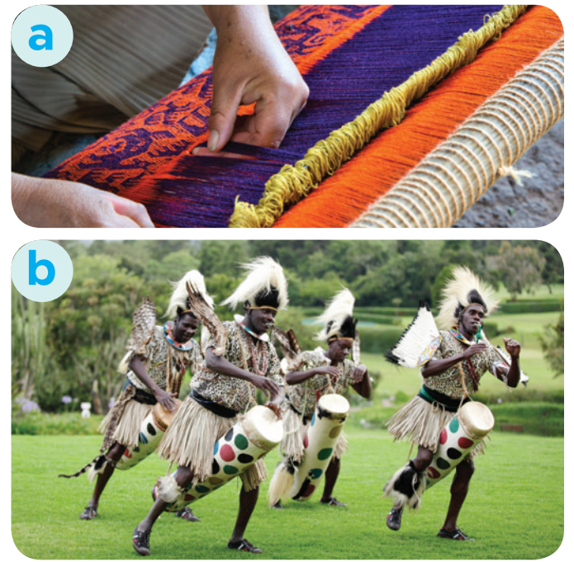
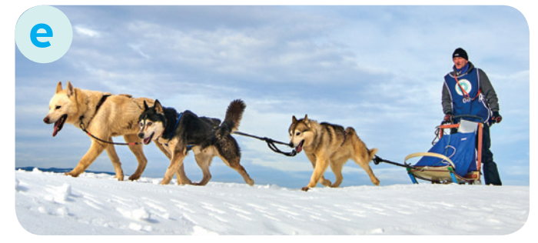

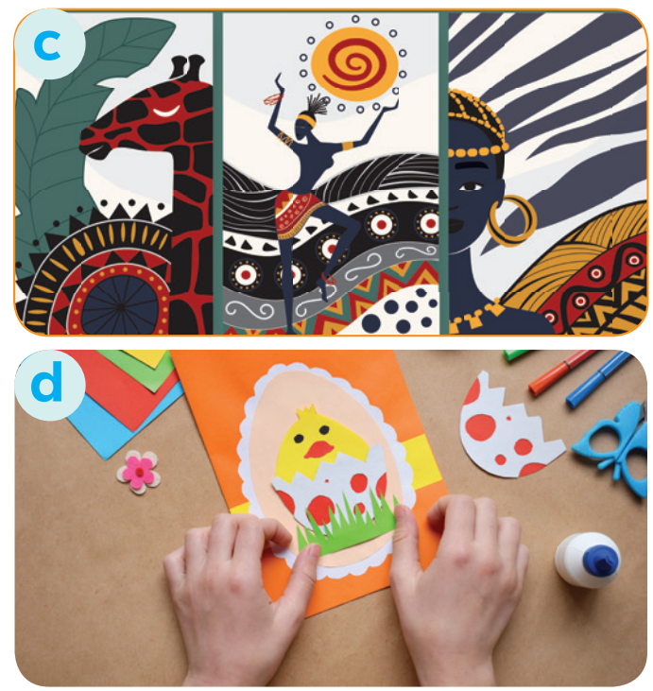
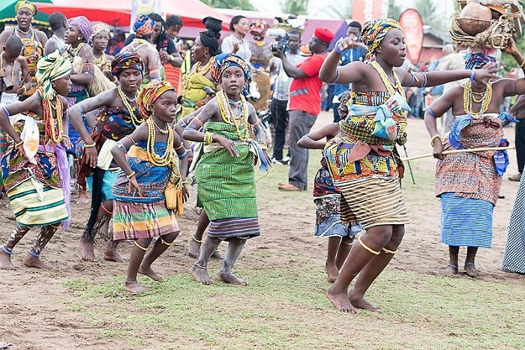
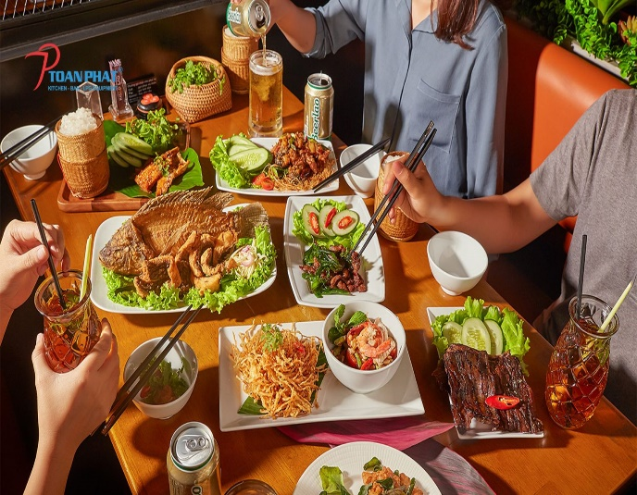

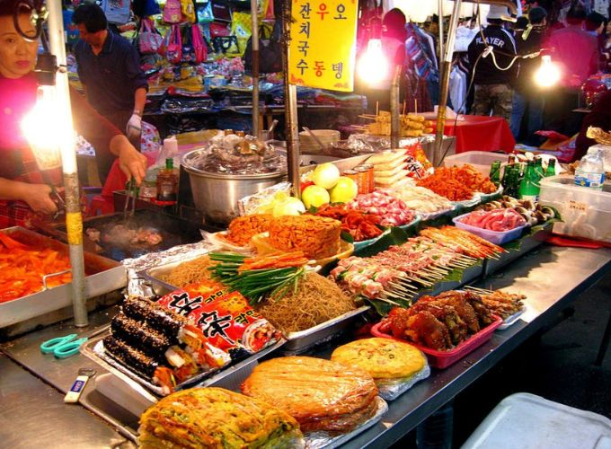
* WARM-UP:
weaving
dogsled
making crafts
native art
tribal dance
food in restaurants
greeting
street food

Slide 5
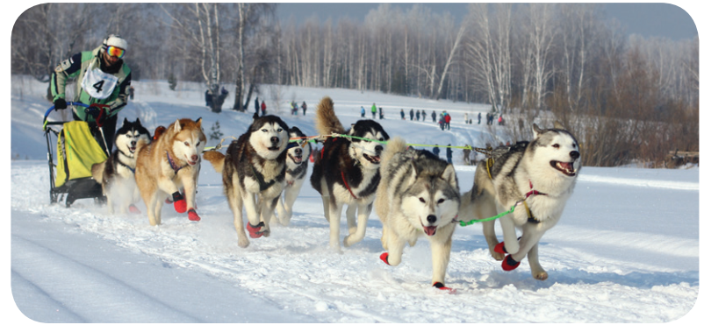
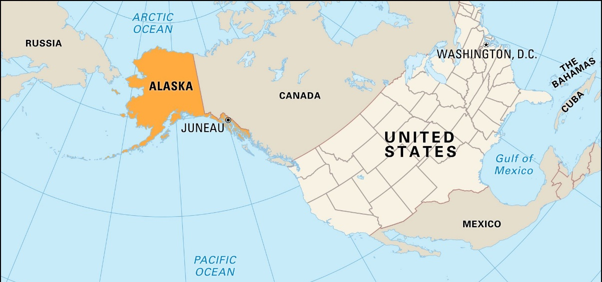
Location?
Climate?
Native people?
Language?
Cuisine?
Culture?

Slide 6
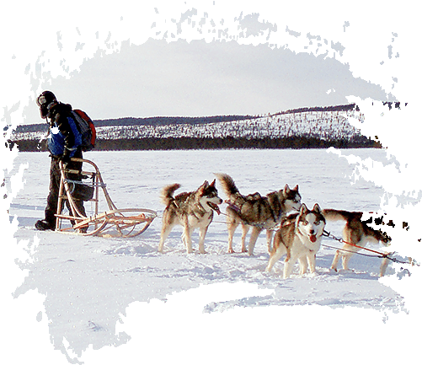
UNIT 6: LIFESTYLES
LESSON 5: SKILLS 1
1

Slide 7
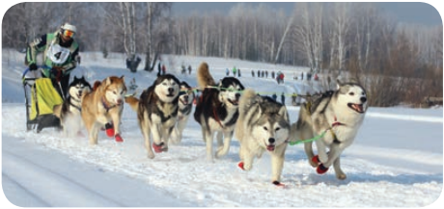
I. READING
Alaska

Slide 8
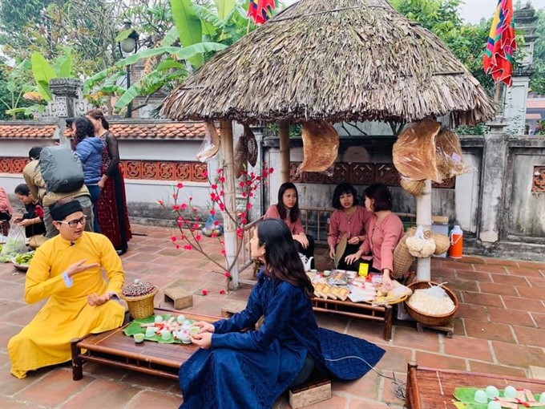

1. VOCABULARY
maintain (v)
﻿/meɪnˈteɪn/
duy trì, gìn giữ

Slide 9
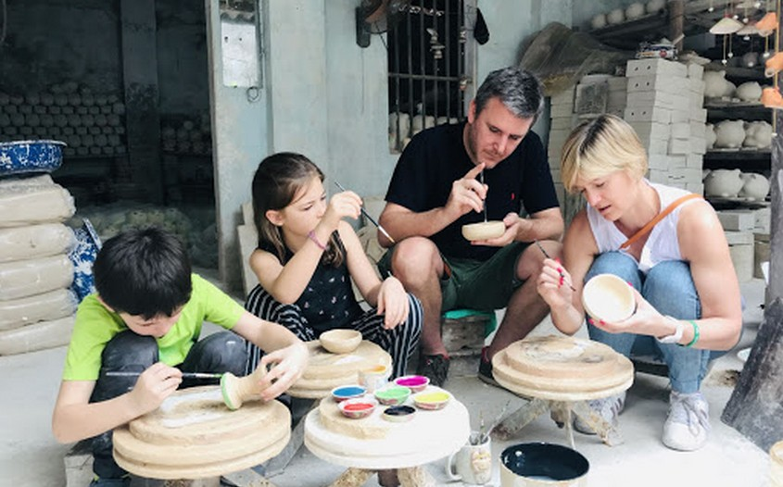
1. VOCABULARY
experience (v)
﻿/ɪkˈspɪəriəns/
trải nghiệm

Slide 10
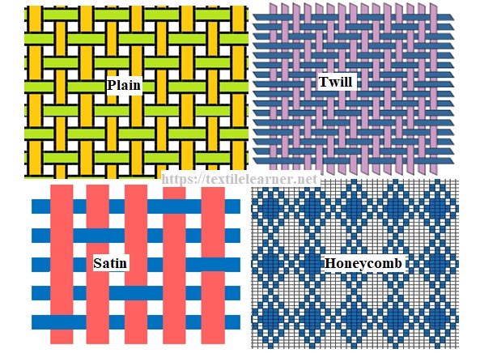
1. VOCABULARY
style (n)
﻿/﻿staɪl/
phong cách

Slide 11
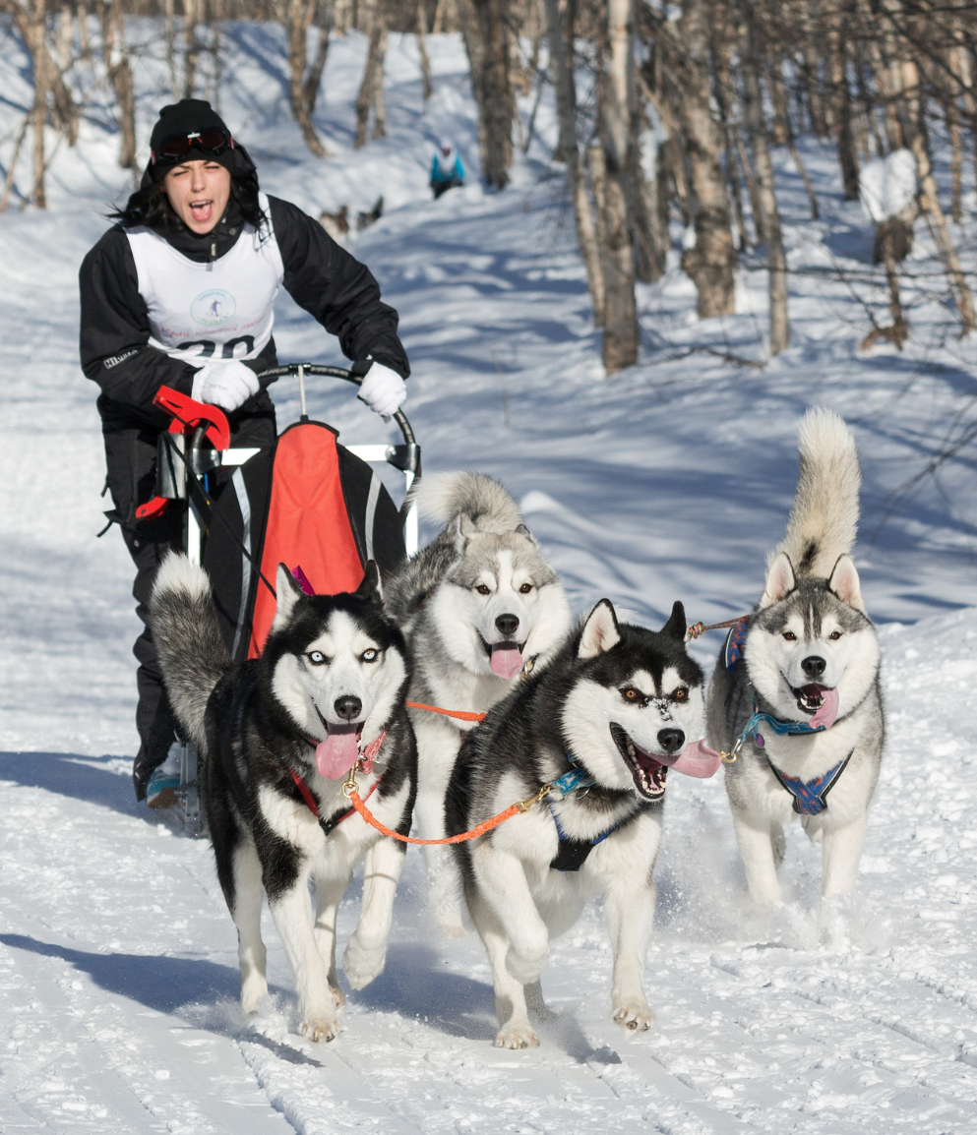
1. VOCABULARY
musher (n)
﻿/﻿﻿ˈmʌʃə/
người điều khiển xe trượt tuyết chó kéo

Slide 12


1. VOCABULARY
- performance (n)
/pəˈfɔːməns/
buổi/ màn biểu diễn

Slide 13
* Checking vocab
Vocabulary | Pronunciation | Meaning
 | ﻿/meɪnˈteɪn/ | ﻿duy trì, gìn giữ
 | ﻿/ɪkˈspɪəriəns/ | ﻿trải nghiệm
 | /﻿staɪl/ | phong cách
 | ﻿/ˈmʌʃə/ | ﻿người điều khiển xe trượt tuyết chó kéo
 | /pəˈfɔːməns/ | Buổi/ màn biểu diễn
1. maintain (v)
2. experience (v)
3. style (n)
4. musher (n)
5. performance (n)

Slide 14
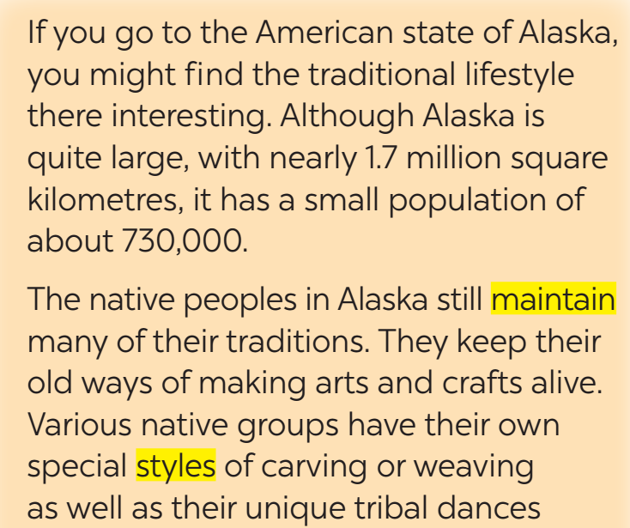
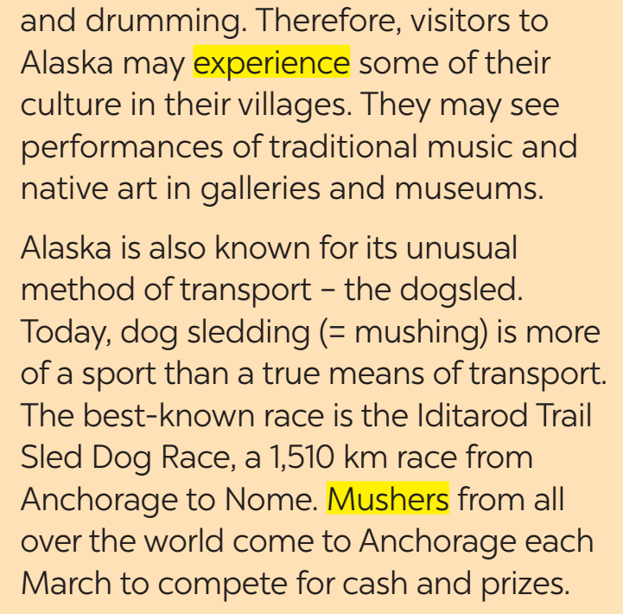
2
Read the text and check your answers.

Slide 15
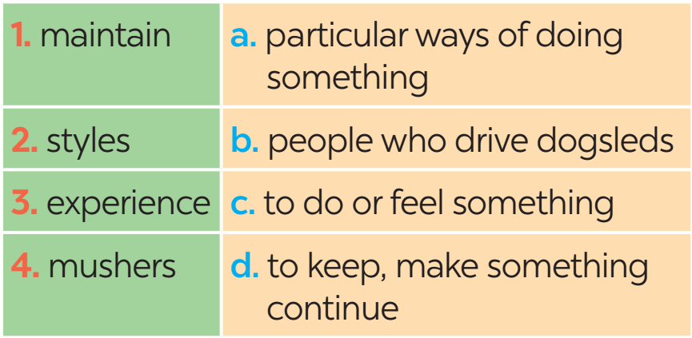
2
Match the highlighted words in the text with their meanings.

Slide 16
3
Read the text again and answer the questions.
﻿1. What is the population of Alaska?
﻿2. Who have special styles of carving or weaving?
3. Where can we find the culture of the native peoples in Alaska?
﻿4. How long is the Iditarod Trail Sled Dog Race?
5. Is the Iditarod Trail Sled Dog Race an international competition?

Slide 17

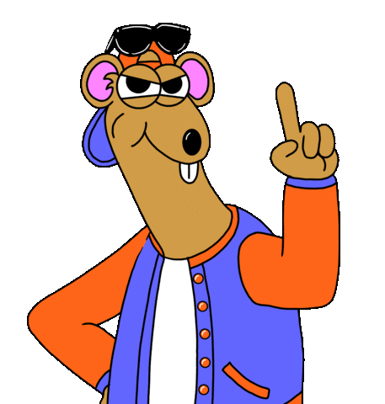


Lucky Spin
30
20
40
10
A gift
A gift
1
2
60
70
3
4
5
Turn

Slide 18
Question 1
What is the population of Alaska?
It is about 730,000 / 730 thousand.
Back

Slide 19
Question 2
Who have special styles of carving or weaving?
Various native groups have their own
special styles of carving or weaving
Back

Slide 20
Question 3
Where can we find the culture
of the native peoples in Alaska?
We can find it in their villages
Back

Slide 21
Question 4
How long is the Iditarod Trail Sled Dog Race?
It is 1,510 km (long).
Back

Slide 22
Question 5
Is the Iditarod Trail Sled
Dog Race an international competition?
Yes, it is.
Back

Slide 23
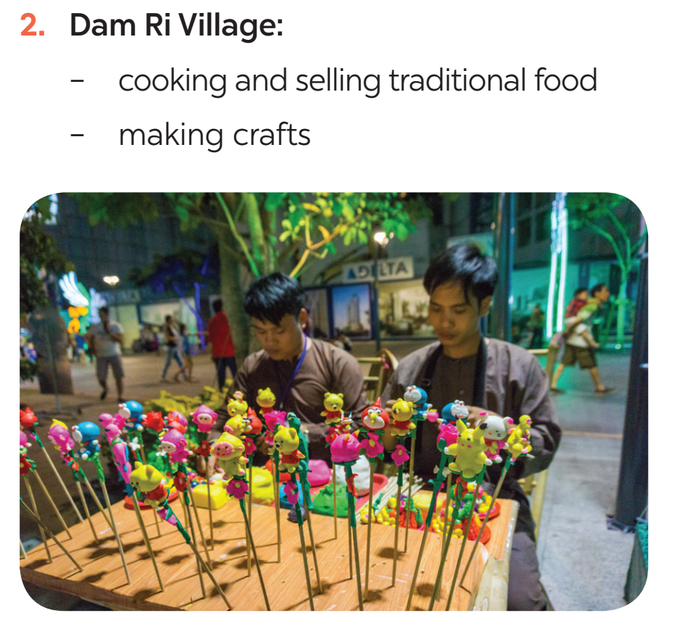
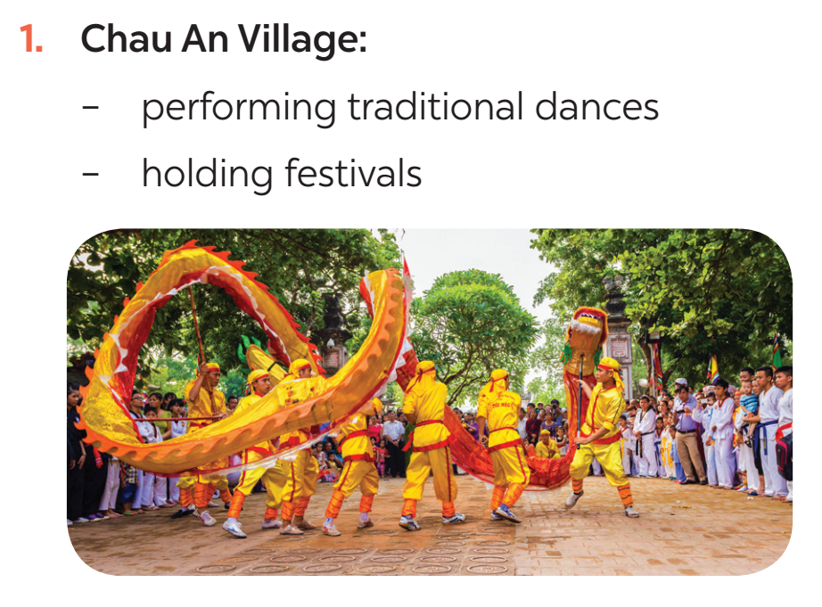
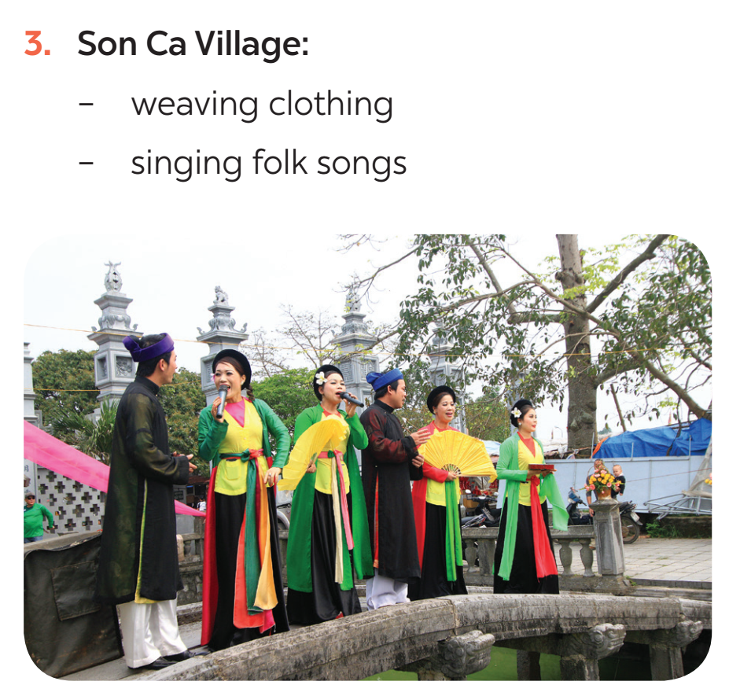
II. SPEAKING
4
Work in pairs. Look at the pictures and use the cues to talk about what people in some places do to maintain their traditional lifestyle.

Slide 24
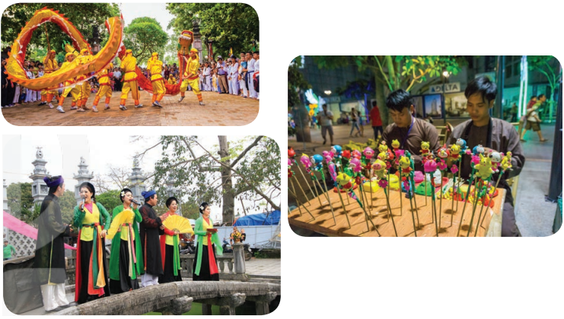

4
Work in pairs. Look at the pictures and use the cues to talk about what people in some places do to maintain their traditional lifestyle.
Chau An Village:
- performing traditional dances
- holding festivals
A: What / people / Chau An Village / do / maintain / their traditional lifestyle?
B: They / perform / traditional dances. They also ……...
A: What do people in Chau An Village do to maintain their traditional lifestyle?
B: They perform traditional dances. They also hold festivals.

Slide 25
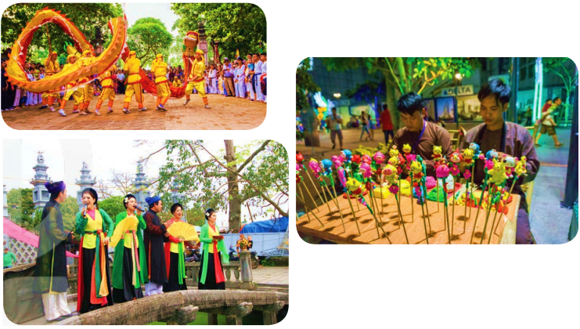
4
Work in pairs. Look at the pictures and use the cues to talk about what people in some places do to maintain their traditional lifestyle.
2. Dam Ri Village
- cooking and selling traditional food
- making crafts
A: What / people / Dam Ri Village / do / maintain / their traditional lifestyle?
B: They / cook / sell / traditional food. They also ……….
A: What do people in Dam Ri Village do to maintain their traditional lifestyle?
B: They cook and sell traditional food. They also make crafts.

Slide 26

4
Work in pairs. Look at the pictures and use the cues to talk about what people in some places do to maintain their traditional lifestyle.
3. Son Ca Village
weaving clothing
singing folk songs
A: What / people / Son Ca Village / do / maintain / their traditional lifestyle?
B: They / weave clothing. They also …………..
A: What do people in Son Ca Village do to maintain their traditional lifestyle?
B: They weave clothing. They also sing folk songs.

Slide 27

*CONSOLIDATION
What have we learnt in this lesson?
Read about Alaska
Talk about ﻿how people in their area maintain traditional lifestyles

Slide 28

* Homework
-Talk about how people in your area maintain their traditional lifestyle.
- Prepare new lesson: Unit 6: Skills 2

