Slide 1

* Checking the previous lessons:
This is my house. There …
This is my house. There …

Slide 2
UNIT 2: MY HOUSE
LESSON 6. SKILLS 2
I. Listening

Slide 3


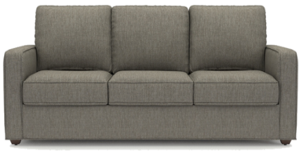
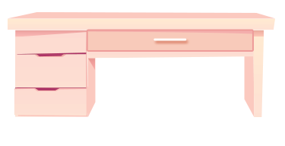

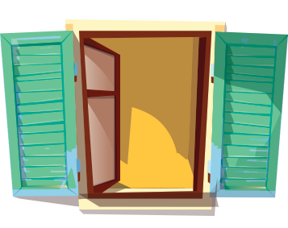
Look at the pictures. Name each of them. Guess if they are mentioned in the listening text.
3
1
2
sofa
sofa
bookshelf
desk
5
4
clock
window

Slide 4

* Now listen and check your guesses.
Things are mentioned in the text | ANSWER
bookshelf
sofa
desk
clock
window
GUESS





Slide 5

Listen to Mai talking about her house. Tick () T (True) or F (False).
 |  | T | F
1. | There are four people in Mai’s family.
2. | Mai’s house has seven rooms.
3. | The living room is next to the kitchen.
4. | In her bedroom, there’s a clock on the wall.
5. | She often listens to music in her bedroom.

There are three people in Mai’s family.

Mai’s house has six rooms.



She often reads books in her bedroom.
T

Slide 6

AUDIO SCRIPT
My name's Mai. I live in a town house in Ha Noi. I live with my parents. There are six rooms in our house: a living room, a kitchen, two bedrooms, and two bathrooms. I love our living room the best because it's bright. It's next to the kitchen. I have my own bedroom. It's small but beautiful. There's a bed, a desk, a chair, and a bookshelf. It also has a big window and a clock on the wall. I often read books in my bedroom.

Slide 7
II. WRITING

Slide 8

Answer the questions.
1.
Where do you live?
I live in a small house in the countryside
2.
How many rooms are there in your house? What are they
There are 5 rooms in my house. Living room, two bedrooms,….
3.
Which room do you like the best in your house? Why?
I like the living room best because I can watch TV with my parents and my younger sister.

Slide 9


Write an email to Mira, your pen friend. Tell her about your house. Use the answers to the questions in 3.
To: mira@webmail.com
Subject: My house
Hi Mira,
Thanks for you email. Now I’ll tell you about my house.
What about you? Where do you live? Tell me in your next email.
All the best,

Slide 10
Write an email to Mira, your pen friend. Tell her about your house. Use the answers to the questions in 3.
To: mira@webmail.com
Subject: My house
Hi Mira,
Thanks for you email. Now I’ll tell you about my house.
What about you? Where do you live? Tell me in your next email.
All the best,

Slide 11
Writing Tip - How to write an e-mail to a friend
Subject
To: mira@webmail.com
Subject: My house
Greeting
Hi Mira,
Introduction
Thanks for you email,…….
I live with my parents and younger brother in a town house, It's big. There are six rooms,…..
Body
Dear / Hi / Hello...)
What about you? Where do you live? Tell me in your next e-mail.
Best wishes
Conclustion

Slide 12
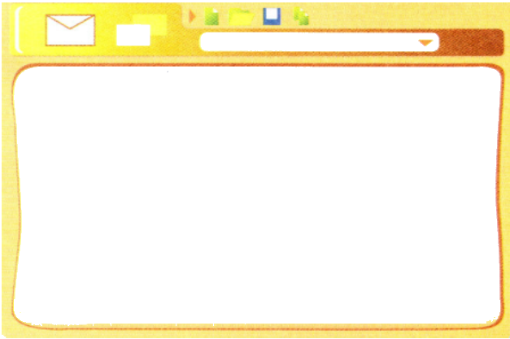
* Write an email to Mira, your pen friend. Tell her about your house.
From: Huong@fastmail.com
To: Mira@quickmail.com
Subject: My house.
Hi Mira,
Thank for your email. Now, I’ll tell you about my house. I live with my parents and younger brother in a town house. It's big. There are six rooms: a living room, a kitchen, two bedrooms and two bathrooms. I like the living room best because I can watch TV with my parents and younger brother together.
What about you? Where do you live? Tell me in your next e-mail.
Best wishes,
Mi.

Slide 13
HOME ASSIGNMENTS
- Rewrite the email.
- Be ready for looking back and project

