Slide 1


Slide 2
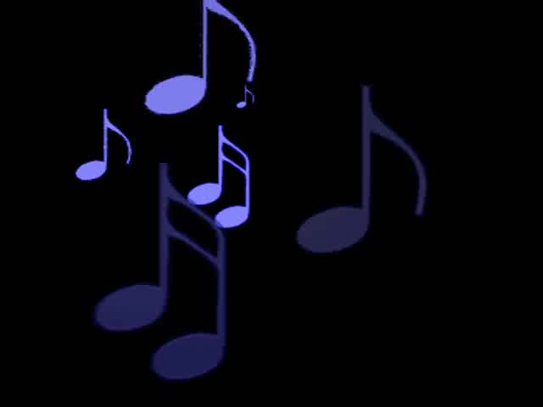
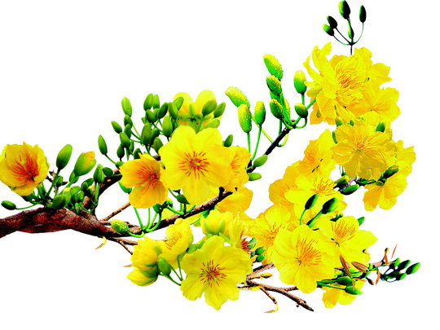
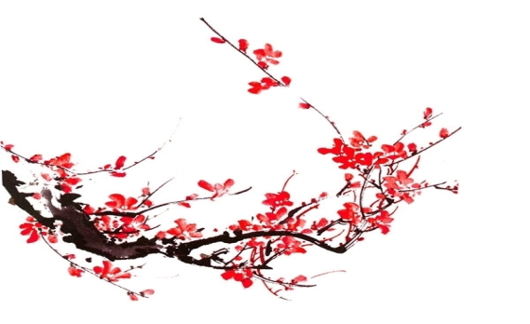

Slide 3
MATCHING
Countries
Activities
1. Japan
a. put 12 grapes in the mouth
b. ring bells 108 times
2. The USA
c. throw coins into a river
3. Spain
d. Throw water on other people
4. Romania
e. -Watching firework and c elebrating parties and special events
5. Thailand

Slide 4


UNIT 6:
OUR TET HOLIDAY
LESSON 5

Slide 5


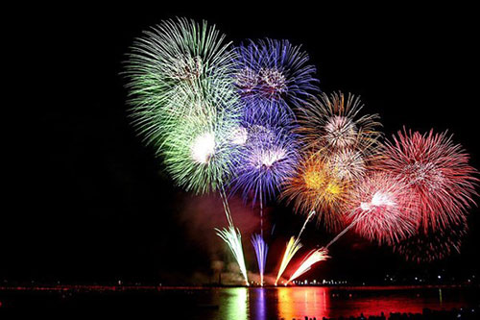
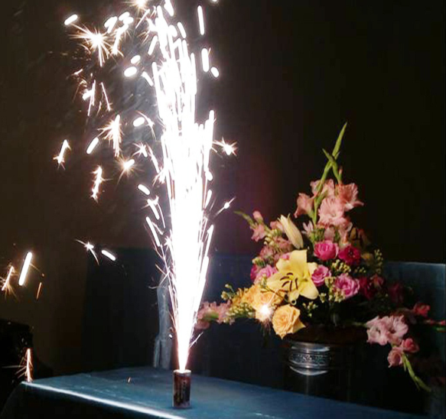
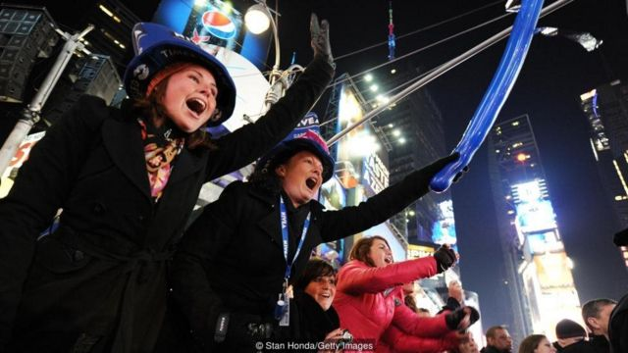
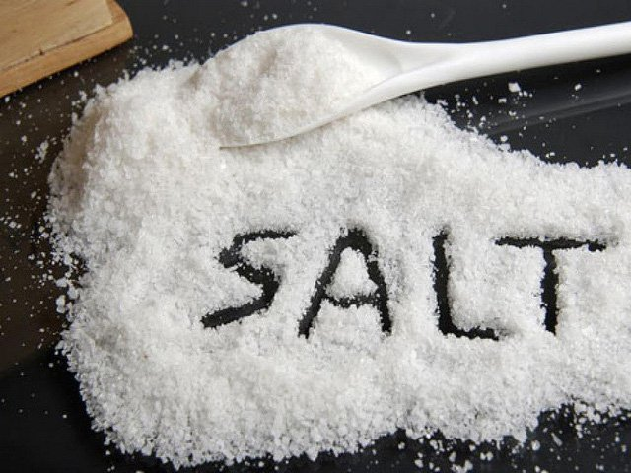
I. Reading
VOCABULARY
- strike midnight
: điểm nửa đêm
- light up (v):
: chiếu sáng, thắp sáng
- cheer (v):
: reo hò
- custom (n):
: phong tục
- enough (deter):
: đủ đầy
- salt (n)
: muối
- cry sound (phrn)
: tiếng khóc, tiếng kêu
- poor (adj))
# rich
: nghèo nàn

Slide 6
* Checking vocab
What and Where
light up
strike
midnight
custom
desert
cheer
enough
poor
cry sound

Slide 7
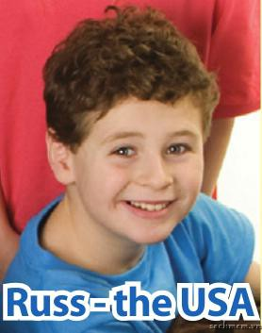
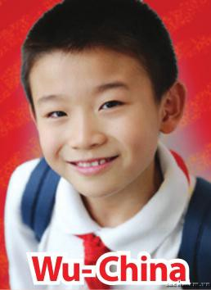
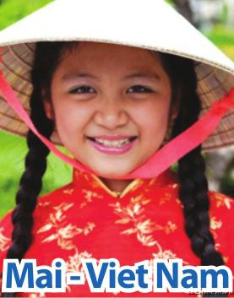
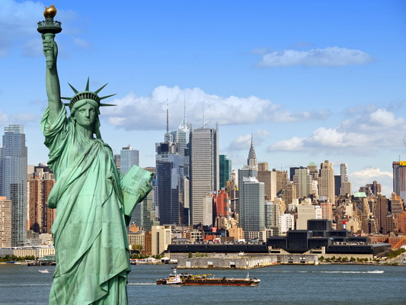
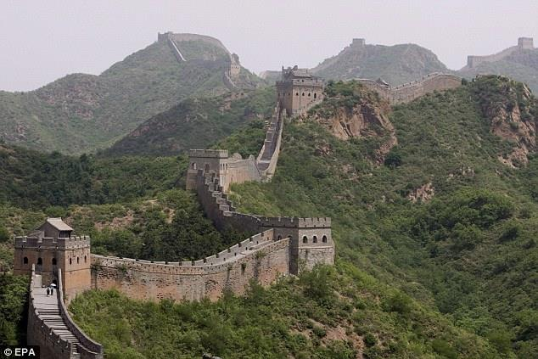
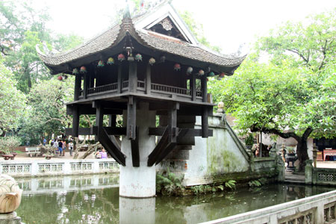
I. Reading
1. Children in different countries are talking about their New Year.
1. What is his/ her name?
2. Where is he/ she from?
1
2
3

Slide 8

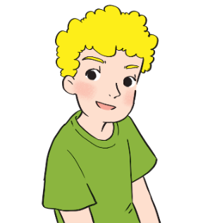
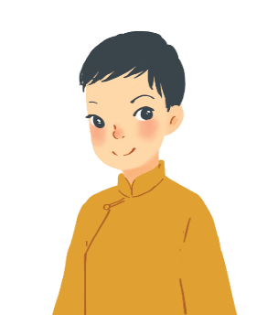
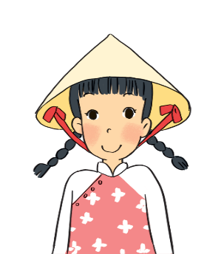
I. Reading
Read the passages and decide who says sentences 1 – 5.
A
I often go to Times Square with my parents to welcome the New Year. When the clock strikes midnight, colourful fireworks light up the sky. Everybody cheers and sings.
Russ – the USA
B
On New Year’s Day, we dress beautifully and go to our grandparents’ houses. We wish them Happy New Year and they give us lucky money. Then we go out and have a day full of fun.
Wu - China
c
I learn some customs about Tet from my parents. People give rice to wish for enough food and buy salt to wish for good luck. Dogs are lucky animals but cats are not. A cat’s cry sounds like "poor" in Vietnamese.
Mai – Viet Nam

Slide 9
A. Russ
B. Wu
C. Mai
Statements | Who
1. Dogs are lucky animals. | C
2. We welcome the New Year at Times Square.
3. Children get lucky money.
4. We give rice to wish for enough food.
5. Children fress beautifully.
A
B
C
B

Slide 10
* Post reading.
GAME: LUCKY NUMBER
1.Who does Russ often go to Times Square to welcome the New Year?
2. What do everybody do when the clock strikes midnight
in the USA?
3. What does Wu do On New Year’s Day?
4. Does Wu go out and have a day full of fun ?
5. Where does Mai learn some customs about Tet from?
6. Are cats lucky animals in Viet Nam?
with his parents .
Everybody cheers and sings.
dress beautifully and go to his grandparents’ houses.
Yes, he does..
Her parents.
No. they aren’t . (Dogs are lucky animals.)

Slide 11



Test your memory!
Tick () the things which appear in the passages, and cross (×) the ones which don’t.
a. Lucky money
e. A day full of fun


b. A cat’s cry
f. Decorating the
house


c. fireworks
g. Saying wishes


d. Cheering and
singing
h. Visiting relatives



Slide 12

II. Speaking
Work in groups. These are some activities from the reading passages in 1. Tell your group if you do them during Tet.
Example:
go to Times Square to welcome the New Year
I don’t go to Time Square to welcome the New Year.
1. watch fireworks on New Year’s Eve
2. sing when the New Year comes
3. get lucky money
I often go out and have fun with my friends at Tet.
I dress beautifully On New Year’s Day .
I don’t watch fireworks on New Year’s Eve.
……………………….
4. go out and have fun
5. dress beautifully
6. buy salt for happiness

Slide 13

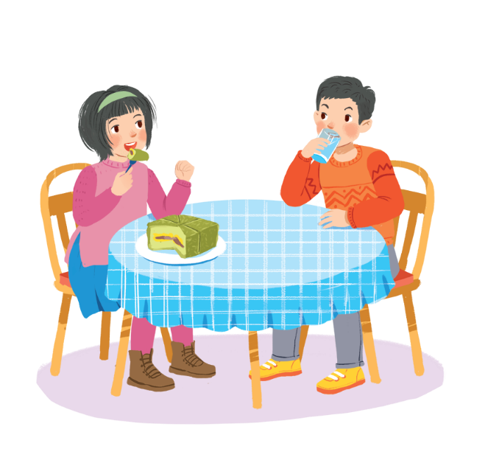
Work in groups. Read the list and discuss what you should or shouldn’t do at Tet.
break things
make a wish
dress beautifully
say “have fun!” to friends
help decorate our houses
play games all night
invite friends home
ask for lucky money
play loud music
Example 1:
Hey, you shouldn’t eat all that banh chung!
A: We should dress beautifully at Tet.
B: I agree. Should we ask for lucky money?
C: No, we shouldn’t.
A: Should we break things at Tet.
B: No, we shouldn’t. We should make a wish.
C: yes, I agree.

Slide 14
* Post speaking.
Give visit stay be have
Complete the conversations with the provided words / sentences.
Then practise speaking them.
Phong: When shall we (1)……………. our grandparents, Dad?
Dad: On the second day of Tet.
Phong: Hurrah! Will we (2)……………. long?
Dad: For two days. Do you (3)………………………. any plans?
Phong: Yeah … I’ll (4)………….my cousins a surprise.
Dad: Good. We will (5)……………….. busy but happy.

Slide 15
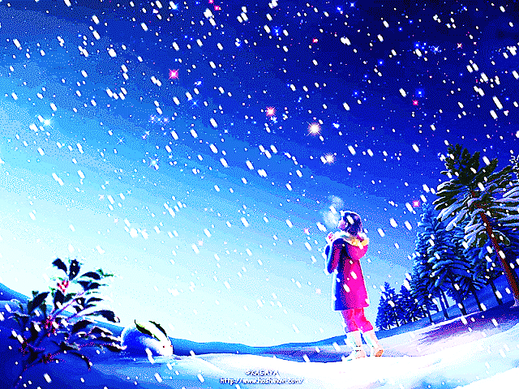
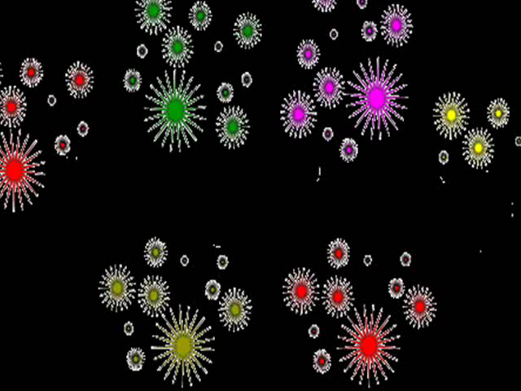
Thank for attending ours!
Good bye for now!

