Slide 1

Hello every one !!!

Slide 2



Unit
10
ENERGY SOURCES
LESSON 6: SKILLS 2

Slide 3
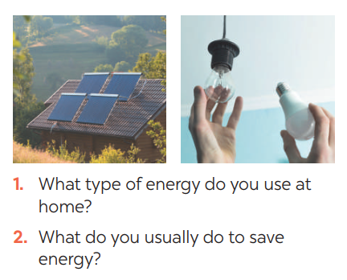
I. LISTENING
1
Work in pairs. Answer the questions
1. → solar energy
2 → turn off the tap while brushing your teeth, use paper fan, use low energy light bulbs, turn off the lights when going out,…

Slide 4

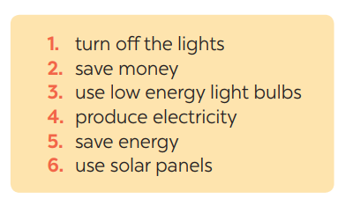
2
Listen and circle the phrases you hear

Slide 5


3
Listen again and tick T (True) or F (False) for each sentence
 | T | F
1. Mr Lam says we use energy for cooking, heating and lighting.
2. Linh always turns off the lights when going out.
3. Linh turns off electrical appliances when not using them.
4. Minh uses low energy light bulbs at his house.
5. Minh uses solar energy to cook meals.





Audio Script:

Slide 6
Mr Lam: As you know we use energy for cooking, heating and lighting. But it's not cheap. So how can we save energy at home? Linh, what do you do to save electricity?
Linh: Well, I always turn off the lights before going to bed. I have some electrical appliances, such as a TV, a CD player, ... I turn them off when I don't use them. I think it helps us save electricity.
Mr Lam: You're right. What about you, Minh?
Minh: Well, we use low energy light bulbs at my house. We always turn them off when leaving the room. We use solar panels to warm water too. It's cheap and clean.
Mr Lam: Sounds interesting. And how about you, ...?

Slide 7
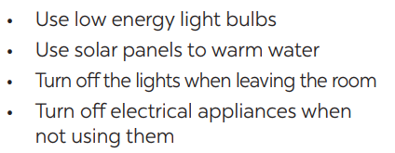

II/ WRITING
4
Work in pairs. Read some ways to save energy at home. Choose three ways and write them in your notebook.
1. Recycle plastic bags and glass bottles
2. Tum off the lights when leaving the room
3. Turn off electrical appliances when not using them

Slide 8
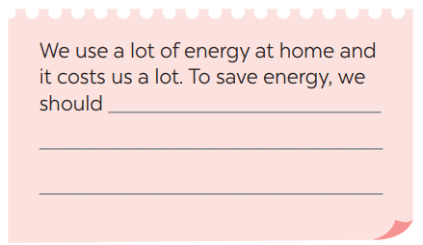
5
Write a paragraph of about 70 words about how you save energy at home.

Slide 9
5
Write a paragraph of about 70 words about how you save energy
at home.
We use a lot of energy at home and it costs us a lot. To save energy, we should use low energy light bulbs in all rooms. We need to turn off electrical appliances such as lights, TVs, fans when we do not use them. We should also put solar panels on the roof of our houses to heat water.

Slide 10
We use a lot of energy at home and it costs us a lot. To save energy, we should try making use of natural light more instead of keep the lights unnecessarily in the morning and afternoons. Moreover, we should unplug your electrical gadgets when not in use. These devices consume at least 10% of electricity even when inactive. Therefore, unplug them to save electricity. Most importantly, installing solar panels can help you excessively. They are very economical and help in saving a lot of energy. This can help in getting cheap electricity and protect the environment.

Slide 11

* CONSOLIDATION
In this lesson, we have learnt to:
use the lexical items related to the topic Energy sources
listen for main ideas and specific information about the topic how to save energy at home.
write a paragraph of about 70 words about how you save energy at home.

Slide 12
* Homework
Learn new words by heart.
Practise the exercises again.
Prepare for the next lesson: Looking back & Project

