Slide 1

ENGLISH 8
Hello everyone !!!

Slide 2

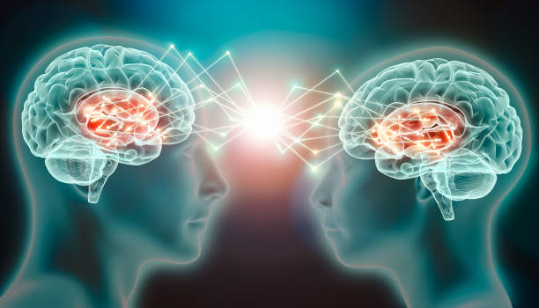
Unit
10
COMMUNICATION IN THE FUTURE
LESSON 5: SKILLS 1

Slide 3
* WARM-UP
1
Work in pairs. List as many ways of communication as you can.
Example: meeting face to face, sending letters, chatting online, etc….
COMMUNICATION
meeting face-to-face, sending letters, sending emails, texting, chatting online, sending voice messages, making phone calls, making group calls, having video calls, etc.

Slide 4
I. READING

Slide 5

* VOCABULARY
telepathy (n)
/təˈlepəθi/
thần giao cách cảm

Slide 6
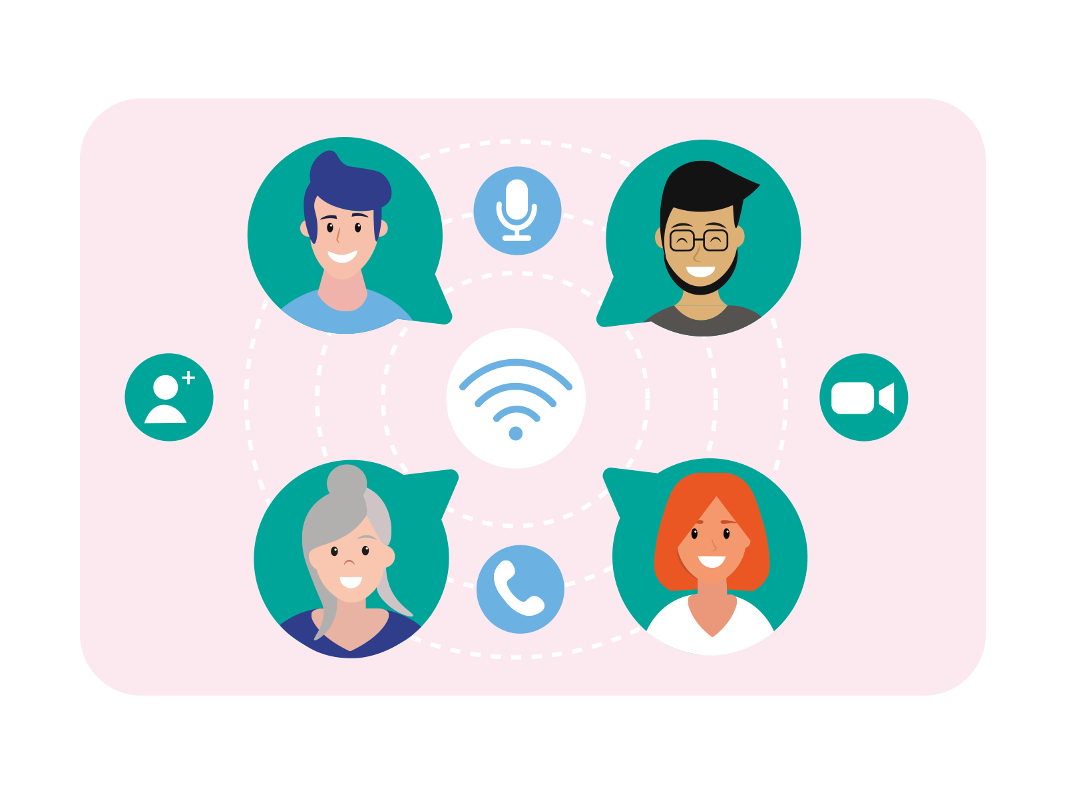
* VOCABULARY
keep in contact (v)
/kiːp ɪn kənˈtækt/
giữ liên lạc

Slide 7

* VOCABULARY
thought (n)
/θɔːt/
suy nghĩ

Slide 8
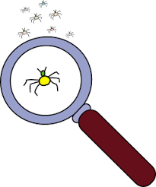
* VOCABULARY
tiny (a)
/ˈtaɪni/
nhỏ bé

Slide 9
* VOCABULARY
New words | Pronunciation | Meaning
1. telepathy (n) | /təˈlepəθi/ | thần giao cách cảm
2. keep in contact (v) | /kiːp ɪn kənˈtækt/ | giữ liên lạc
3. thought (n) | /θɔːt/ | suy nghĩ
4. tiny (a) | /ˈtaɪni/ | nhỏ bé

Slide 10
* Checking vocab
New words | Meaning
- | giữ liên lạc
- | nhỏ bé
- | suy nghĩ
- | thần giao cách cảm
keep in contact (v)
tiny (a)
thought (n)
telepathy (n)

Slide 11
I. READING
2
Read an interview with two students, Minh and Tom. Then tick the speaker of each sentence.
TELEPATHY
MC: Hi everyone. Today, I'll ask some members of the Technology Club to predict how people will communicate in the future. Let’s meet Minh and Tom.
Minh & Tom: Hi everyone.
MC: Minh and Tom, how do you and your friends keep in contact?
Minh: Well, we mostly text each other. We also send voice messages.
Tom: I often see my friends in person, but sometimes we call via the Internet.
MC: Do you think these ways of communication will still be popular in 50 years?
Tom: Not really. We'll use more advanced ways, like telepathy. We'll pass our thoughts to another person without talking and...
MC: Hold on. I think only a very few people may have this ability.
Minh: Yes, but in the future, everyone will be able to use telepathy. We'll wear a tiny device to catch our thoughts and send them to other people.
MC: Cool! But will there be any problems with telepathy?
Tom: Hmm, telepathy devices can “read” one’s mind, so bad people might take advantage of it to control someone else.

Slide 12

I. READING
2
Read an interview with two students, Minh and Tom. Then tick the speaker of each sentence.
Who says that…? | Minh | Tom
1. he sends voice messages to friends
2. he calls his friends by using the Internet
3. everyone will be able to use telepathy in the future
4. people need a small device to send their thoughts to others
5. bad people can make use of telepathy to harm others

Slide 13
3
Read the interview again. Choose the correct answer A, B, or C.
1. What is the interview mainly about?
A. One way of future communication.
B. Voice chats and online calls.
C. Problems of telepathy.
2. Which way of communication below is NOT mentioned in the interview?
A. Meeting face to face
B. Writing an email
C. Telepathy

Slide 14
3
Read the interview again. Choose the correct answer A, B, or C.
3. According to Tom, telepathy means ______.
A. making phone calls via the Internet
B. talking on tiny devices
C. communicating by thoughts
4. The MC says that ______.
A. telepathy is perfect
B. not all people can do telepathy
C. she disagrees with Minh’s opinion

Slide 15
3
Read the interview again. Choose the correct answer A, B, or C.
5. What does the MC think may be a problem with telepathy?
A. People won’t want to meet each other.
B. Telepathy devices can be expensive.
C. Some people won’t want to talk anymore.

Slide 16

II. SPEAKING

Slide 17
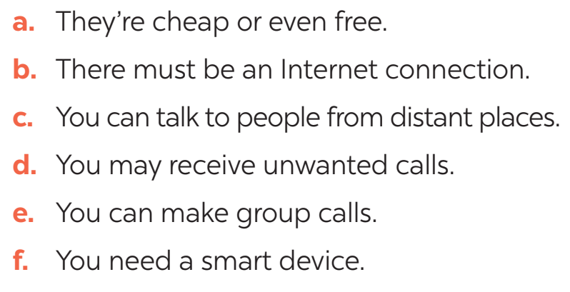
4
Work in pairs. Read the following ideas about online calls. Put the ideas in the correct column.
Advantages | Disadvantages
a
b
c
d
e
f

Slide 18
5
Work in groups. Choose a way of communication and discuss its advantages and disadvantages. Then report your answers to the class.
- To start a talk about advantages and disadvantages:
+ I think there are both advantages and disadvantages of online calls.
- To introduce the advantages:
+ In terms of the advantages / good points, ...
+... can be beneficial in many ways. First, ...
- To introduce the disadvantages:
+ However, ... has some drawbacks. For example, ...

Slide 19
5
Work in groups. Choose a way of communication and discuss its advantages and disadvantages. Then report your answers to the class.
* Model speech
I think there are both advantages and disadvantages of online calls. Online communication makes life more accessible because it can help people learn and develop. It is also worth admitting that online communication is helpful because it contributes to the fact that ordinary people have access to information that they did not previously know. In addition to that, online communication has also participated in enriching the research field. Irrespective of the information above, it is impossible to ignore the fact that online communication can imply some drawbacks. The possible disadvantages include the “lack of security, Internet addiction, information overload, and loss of social contacts”.

Slide 20
5
Work in groups. Choose a way of communication and discuss its advantages and disadvantages. Then report your answers to the class.
* Model speech
I think there are both advantages and disadvantages of online calls. Internet calls are cheap or even free. Many social networks provide free calls for people to communicate. Online calls help us to communicate with people that are really far away from us, for example, our relatives or our Internet friends. Moreover, you can create group calls when you are in need of hosting a conference or a family meeting. However, online calls also have drawbacks. You can’t make online calls unless you have Internet connection. Also, you need a smart device to perform a call. Sometimes, you may get unwanted calls from the person you don’t know.

Slide 21

* CONSOLIDATION
* What have we learnt in this lesson?
read about telepathy
talk about future communication

Slide 22

* Homework
Do exercises in the workbook.
Prepair lesson 6 – Skills 2

Slide 23


Thank you!
Goodbye!

