Slide 1

WELCOME TO OUR CLASS!
Teacher: …..

Slide 2
Watch a video and try to remember activities

Slide 3
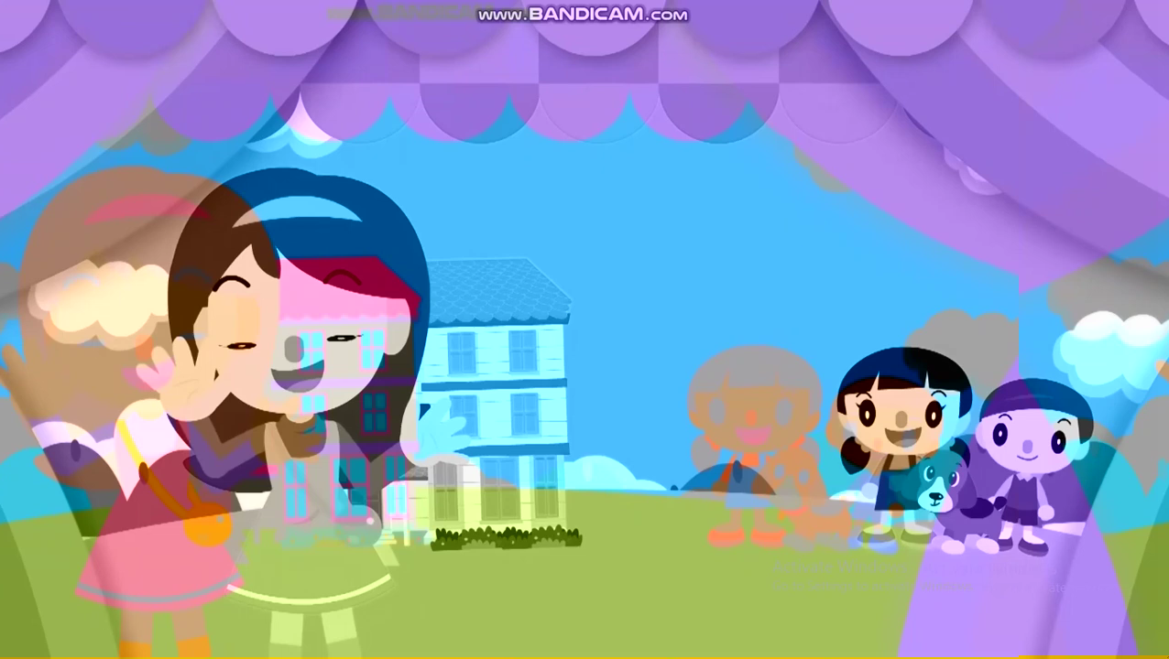
Free time activities

Slide 4
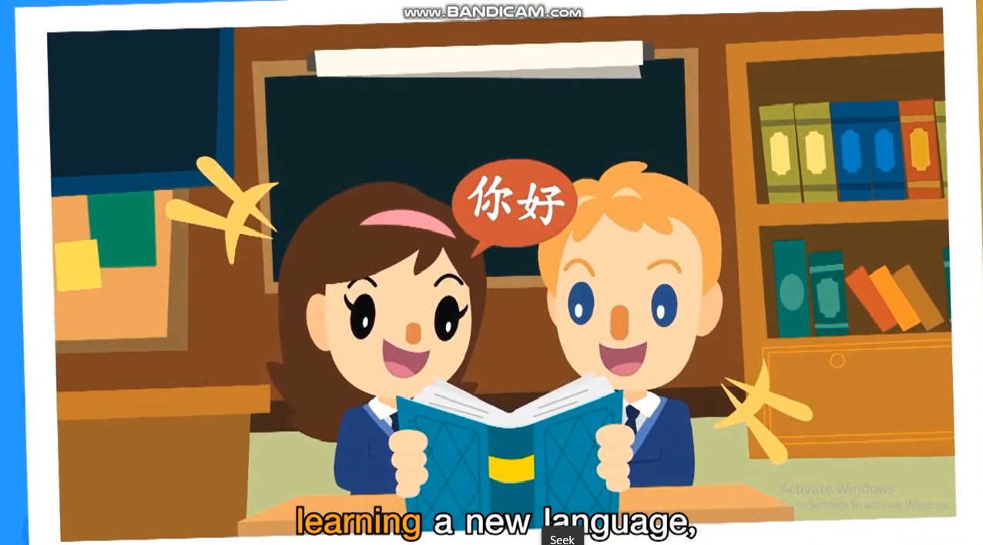
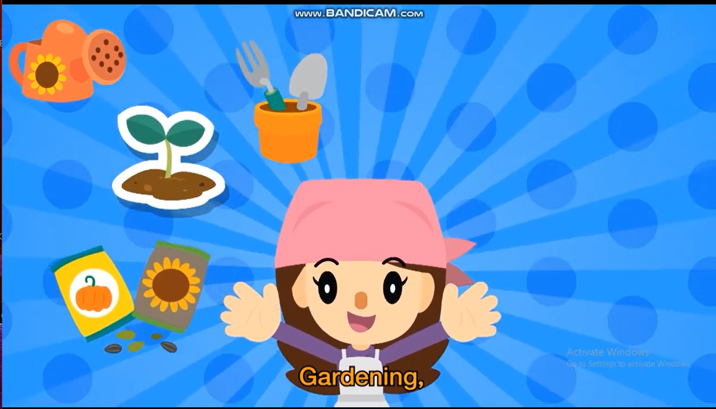
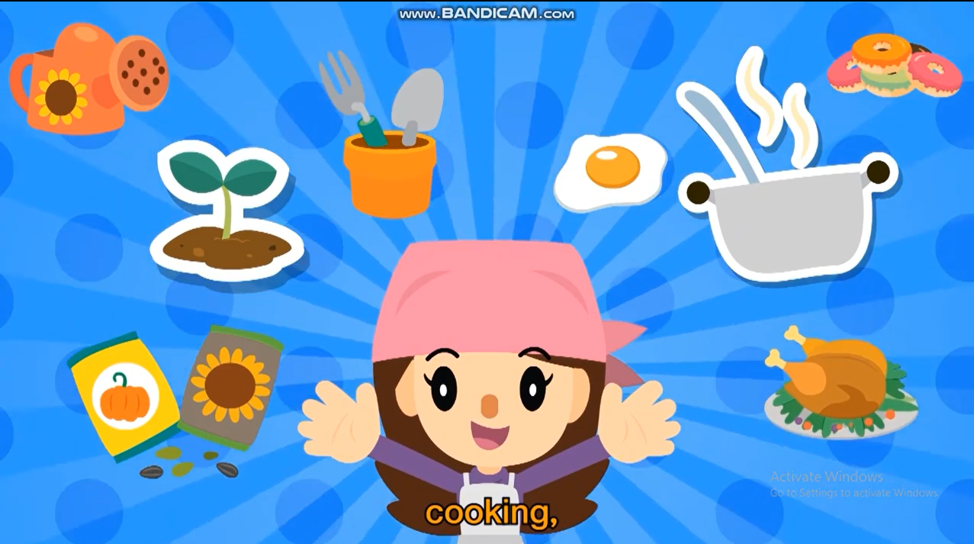


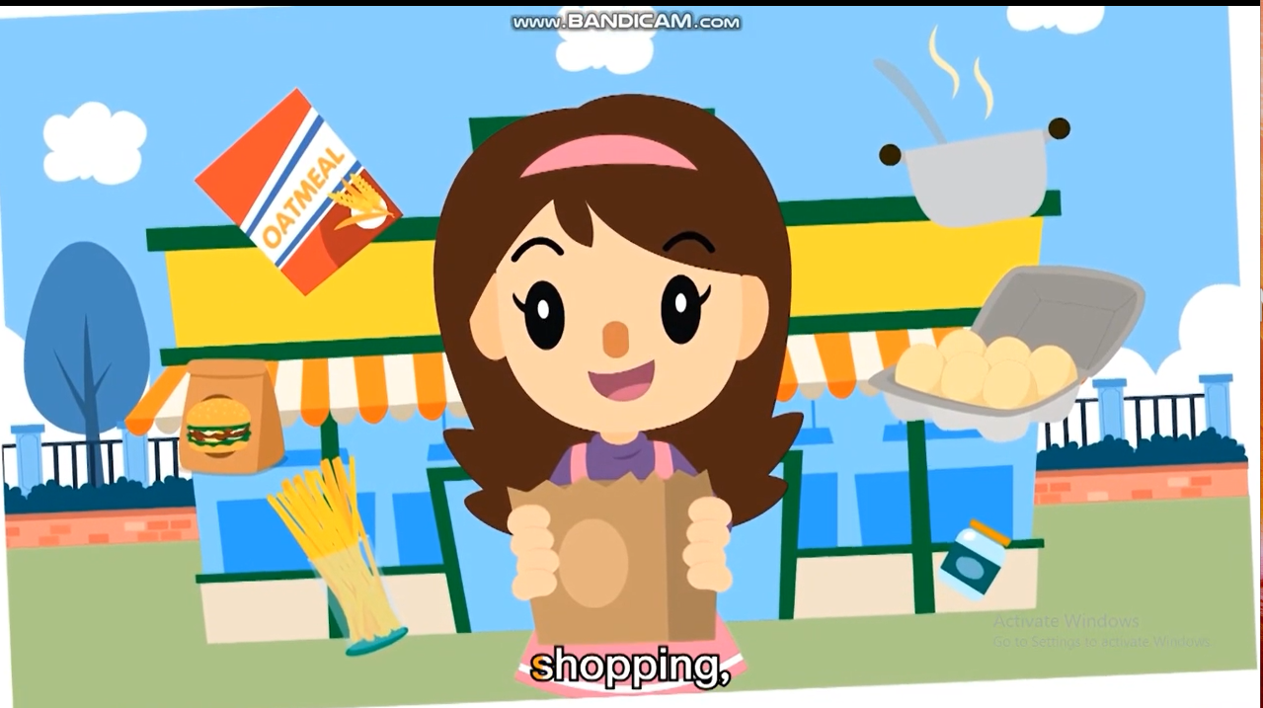
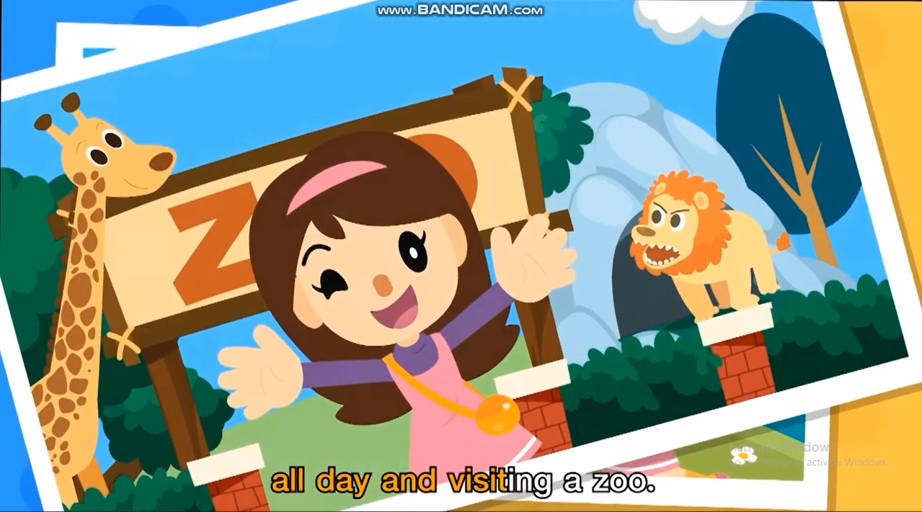
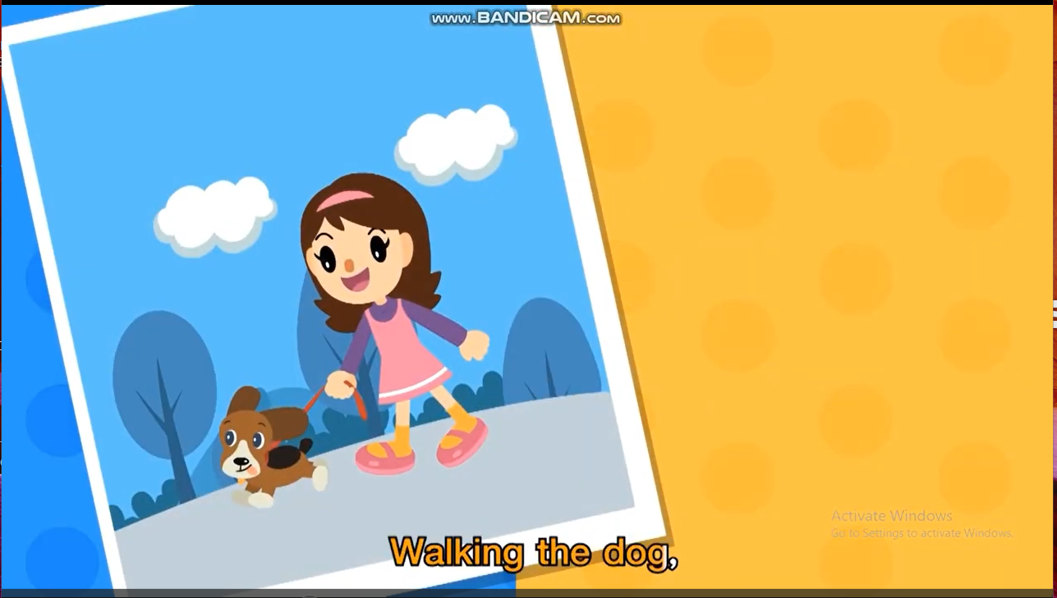

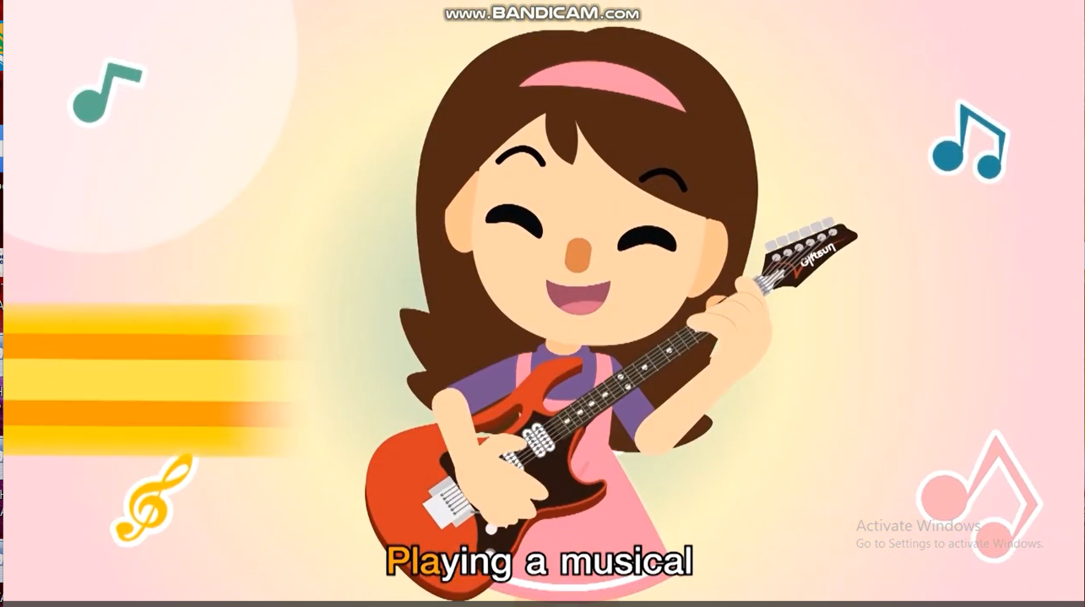
Let’s check your answers.

Slide 5
Unit 1:
LEISURE TIME
Lesson 1: Getting Started

Slide 6
VOCABULARY

Slide 7
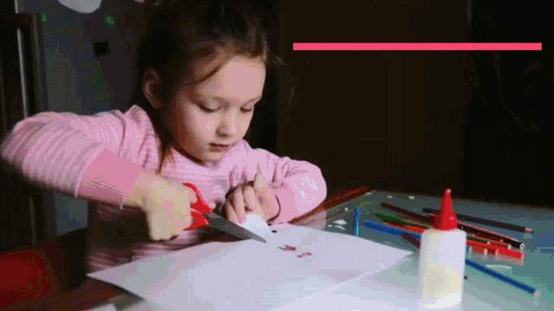

Vocabulary
DIY (n)
(do-it-yourself)
/ˌdiːaɪˈwaɪ/
hoạt động tự làm ra

Slide 8
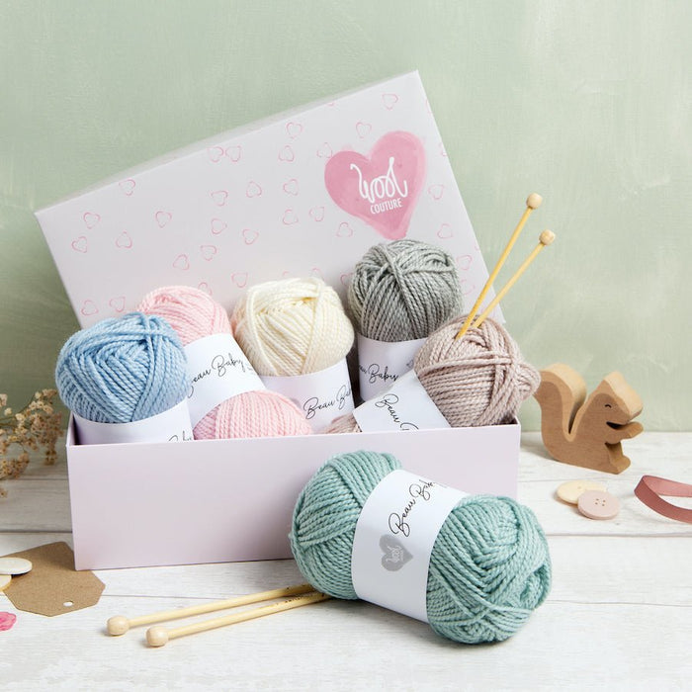
Vocabulary
knitting kit (n)
/ˈnɪtɪŋ kɪt/
bộ dụng cụ đan len

Slide 9
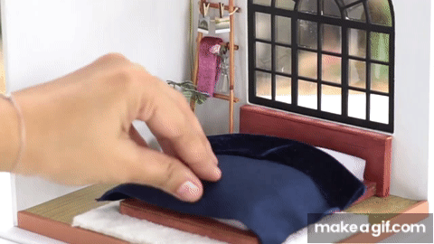
Vocabulary
dollhouse (n)
/ˈdɒlhaʊs/
nhà búp bê

Slide 10
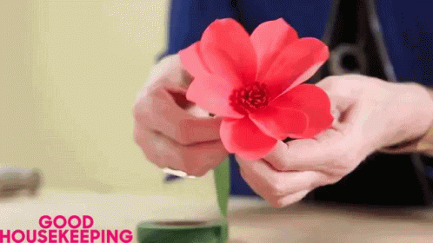
Vocabulary
make paper flowers (v.phr)
/meɪk 'peɪpər 'flaʊərz/
làm hoa giấy

Slide 11
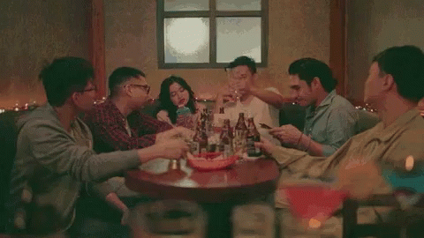
Vocabulary
hang out (phr)
/hæŋ aʊt/
đi chơi, tụ tập

Slide 12
Vocabulary
New words | Pronunciation | Meaning
1. DIY (n) | /ˌdiːaɪˈwaɪ/ | tự tay làm
2. knitting kit (n) | /ˈnɪtɪŋ kɪt/ | bộ dung cụ đan len
3. dollhouse (n) | /ˈdɒlˌhaʊs/ | nhà búp bê
4. make paper flowers (v.phr) | /meɪk 'peɪpər 'flaʊərz/ | làm hoa giấy
5. hang out (v) | /hæŋ aʊt/ | đi chơi

Slide 13
LISTENING & READING

Slide 14

Tom
Trang

Slide 15

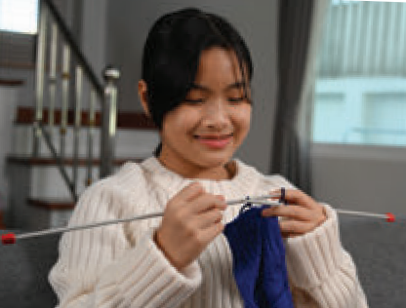
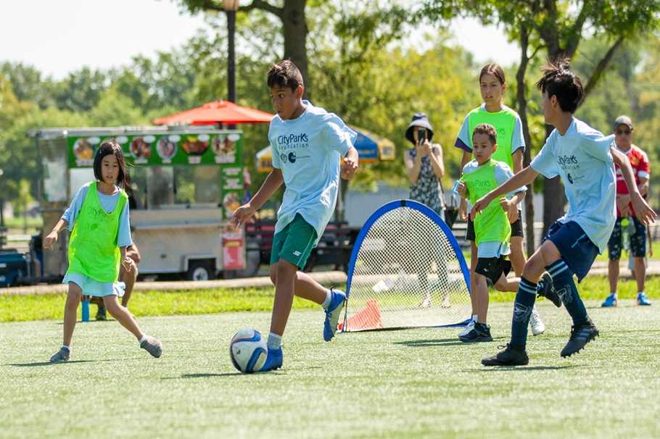
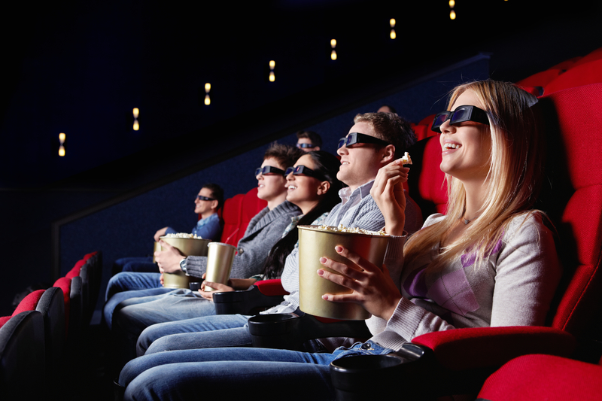

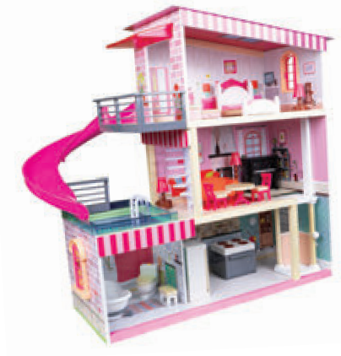
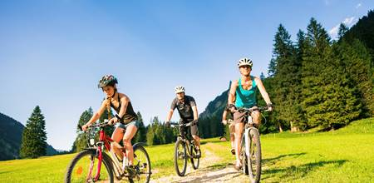
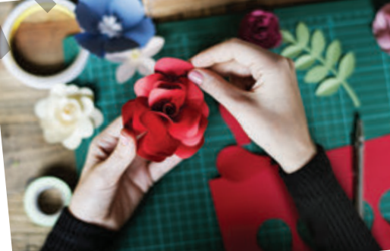
What do they do in their free time?
play sport in the park
go to the cinema
knitting
building dollhouses
making paper flowers
go cycling

Slide 16
LISTEN.
Tom: Hi, Trang. Surprised to see you. What brings you here?
Trang: Oh, hello Tom. I’m looking for a knitting kit.
Tom: A knitting kit? I didn’t know you like knitting.
Trang: Actually, I’m keen on many DIY activities. In my leisure time, I love knitting, building dollhouses, and making paper flowers.
Tom: I see. So, you like spending time on your own.
Trang: Yes. What do you do in your free time?
Tom: I’m a bit different. I usually hang out with my friends. We go to the cinema, go cycling, or play sport in the park.
Trang: You love spending free time with other people, don’t you?
Tom: That’s right. By the way, would you like to go to the cinema with me and
Mark this Sunday? There’s a new comedy at New World Cinema.
Trang: Yes, I’d love to. Can I ask Mai to join us?
Tom: Sure. Let’s meet outside the cinema at 9 a.m.

Slide 17
LISTEN.
Tom: Hi, Trang. Surprised to see you. What brings you here?
Trang: Oh, hello Tom. I’m looking for a knitting kit.
Tom: A knitting kit? I didn’t know you like knitting.
Trang: Actually, I’m keen on many DIY activities. In my leisure time, I love knitting, building dollhouses, and making paper flowers.
Tom: I see. So, you like spending time on your own.
Trang: Yes. What do you do in your free time?
Tom: I’m a bit different. I usually hang out with my friends. We go to the cinema, go cycling, or play sport in the park.
Trang: You love spending free time with other people, don’t you?
Tom: That’s right. By the way, would you like to go to the cinema with me and
Mark this Sunday? There’s a new comedy at New World Cinema.
Trang: Yes, I’d love to. Can I ask Mai to join us?
Tom: Sure. Let’s meet outside the cinema at 9 a.m.

Slide 18
Let’s check your answer
play sport in the park
go to the cinema
go cycling
building dollhouses
making paper flowers
knitting

Slide 19
2. Read the conversation again and complete the sentences.
1. Trang is looking for a ____________.
2. She likes doing DIY in her ____________.
3. Tom loves spending his free time with ___________.
4. Tom and his friends usually _________ together.
5. Tom, Mark, Trang, and Mai are going to see a comedy this _______.

Slide 20
Check your answer
1. Trang is looking for a __________.
knitting kit
Tom: Hi, Trang. Surprised to see you. What brings you here?
Trang: Oh, hello Tom. I’m looking for a knitting kit.

Slide 21
Check your answer
2. She likes doing DIY in her ____________.
leisure time
Trang: Actually, I’m keen on many DIY activities. In my leisure time, I love knitting, building dollhouses, and making paper flowers.

Slide 22
Check your answer
3. Tom loves spending his free time with ____________.
other people
Trang: You love spending free time with other people, don’t you?
Tom: That’s right.

Slide 23
Check your answer
4. Tom and his friends usually _________ together.
hang out
Tom: I’m a bit different. I usually hang out with my friends.

Slide 24
Check your answer
5. Tom, Mark, Trang, and Mai are going to see a comedy this ____________.
Sunday
Tom: That’s right. By the way, would you like to go to the cinema with me and Mark this Sunday? There’s a new comedy at New World Cinema.
Trang: Yes, I’d love to. Can I ask Mai to join us?

Slide 25
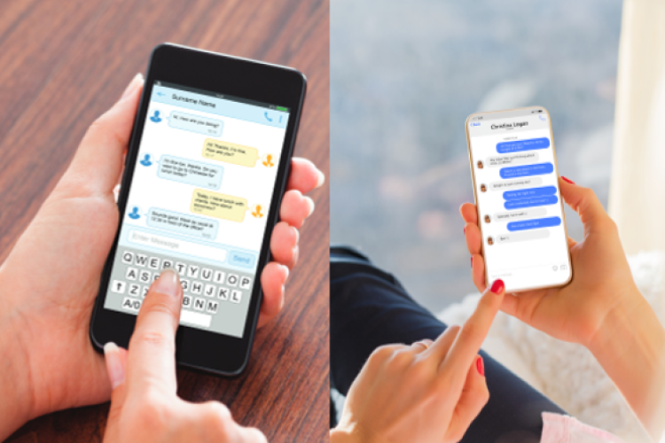
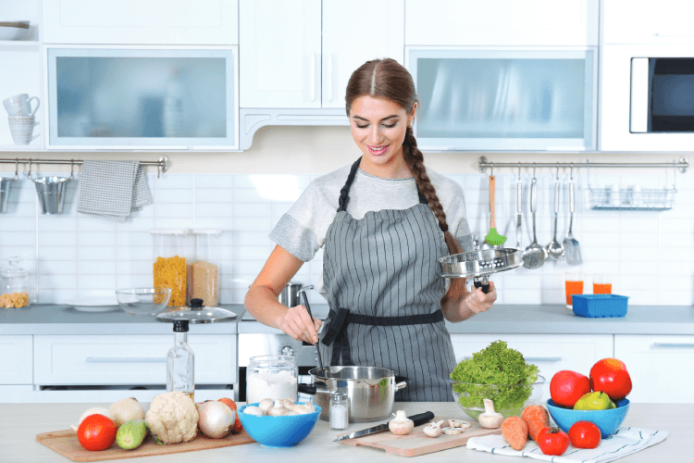
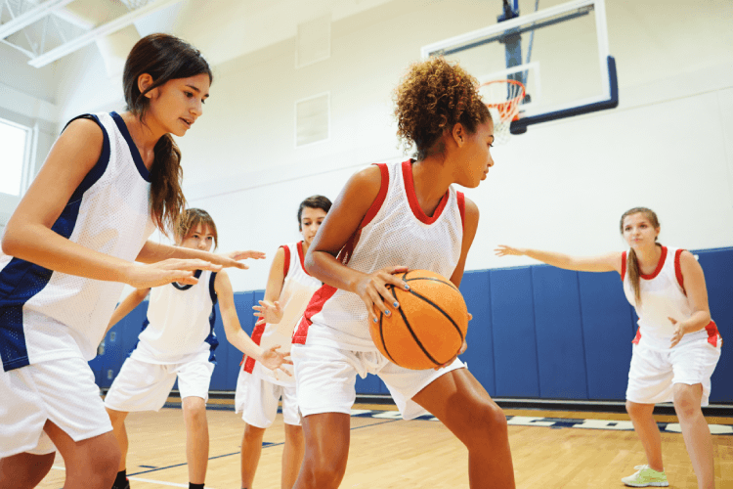
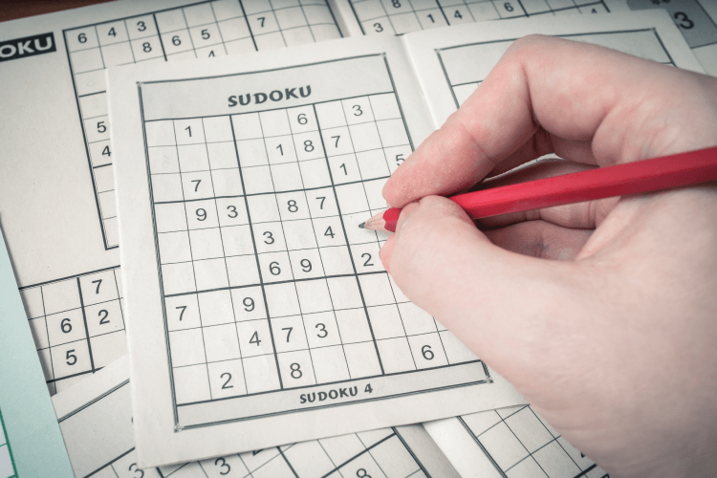
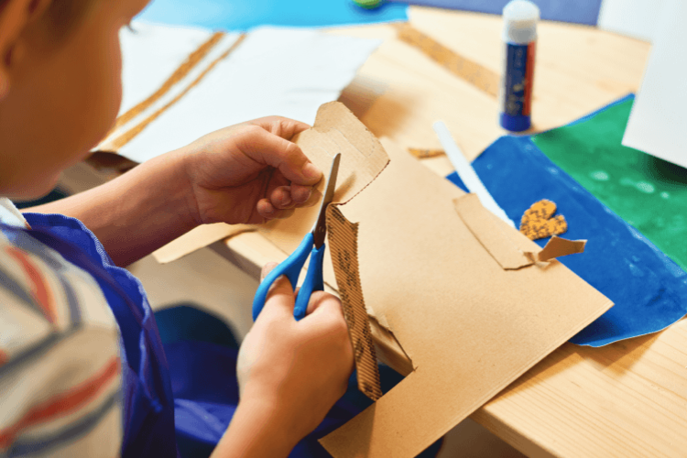

3. Match the activities with the correct pictures
playing sport
messaging friends
surfing the net
doing DIY
cooking
doing puzzles

Slide 26


Bee & beehive

Slide 27
cooking

Slide 28
playing sport

Slide 29
surfing the net

Slide 30
messaging friends

Slide 31
doing puzzles

Slide 32
doing DIY

Slide 33

Look at the answers again.
messaging friends
cooking
playing sport
doing puzzles
doing DIY
surfing the net

Slide 34

4. Read the phrases and guess which activities in 3 are described.
doing DIY
messaging friends
doing puzzles
playing sport
surfing the net
cooking
1. improve memory, a mental exercise:
2. save money, increase creativity:
3. improve physical health, make friends:
4. keep in touch, be relaxed:
5. learn something about IT, computer skills:

Slide 35
GUESS THE SECRET WORD
- There are 4 clues for each secret word.
- The less clue you open, the more point you get.

Slide 36









Example:
reduce stress
relax
improve memory
widen your knowledge

Slide 37

reading book

Slide 38
a mental exercise
Increased IQ
improve memory
better problem-solving skills

Slide 39
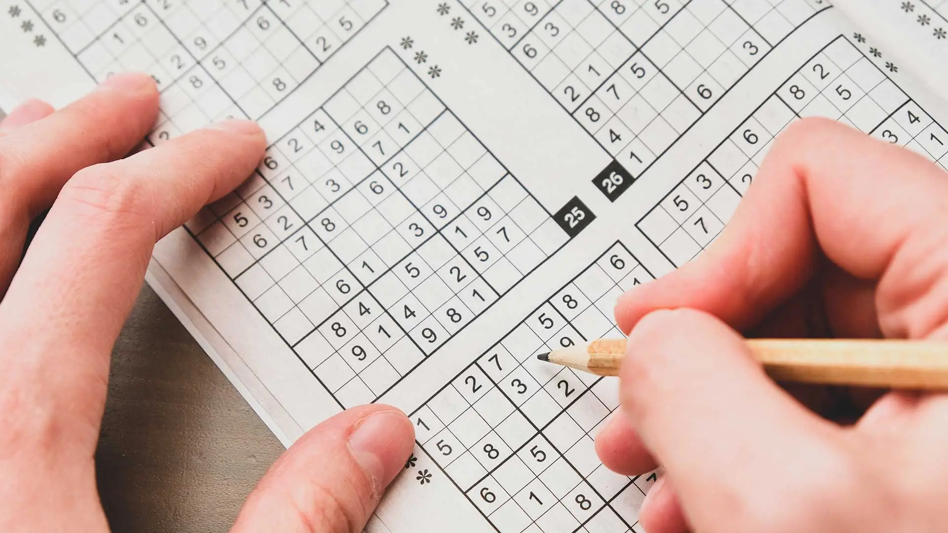
doing puzzle

Slide 40
increase creativity
save money
spend more time with others
work with your hands

Slide 41

doing DIY

Slide 42

better sleep
make friends
improve physical health
healthier heart

Slide 43


playing sport

Slide 44
keep in touch
be relaxed
improve interpersonal relationships
develop social skills

Slide 45

messaging friends

Slide 46
online shopping
computer skills
get the information easily and quickly
learn something about IT

Slide 47

surfing the net

Slide 48
Listen and remember the activity you hear

Slide 49
Wrap - up
What have we learnt in this lesson?
✓ identify the topic of the unit
✓ use lexical items related to leisure activities

Slide 50
HOME ASSIGNMENTS
Read the conversation again
Write each word in 2 lines and make one example sentence with each word.
Do Ex A2(P.3), B1,3 (P.4) in workbook.

Slide 51
Thank You!

