Slide 1
UNIT 1: LEISURE TIMES
SKILLS 1

Slide 2
KIM’S GAME
- 2 GROUPS
I will show the activity that you can do in your leisure time
You need to remember the activity in 1m and write down them
- Each correct answer gets 1 flower
- Which one who gets the highest point is the winner

Slide 3
Reading books
1 minute to remember
Doing yoga
Hang out
Make paper flowers
Travelling
Skiing
Knitting
Gardening

Slide 4
Time’s up
KIM’S GAME

Slide 5
More activities that you can do in your leisure time
Unit 1 – Leisure Time
Skilss 1
Reading & Speaking

Slide 6
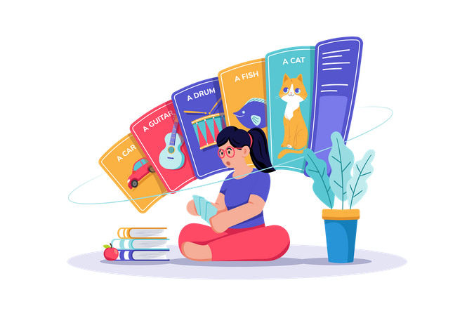
Vocabulary

Slide 7
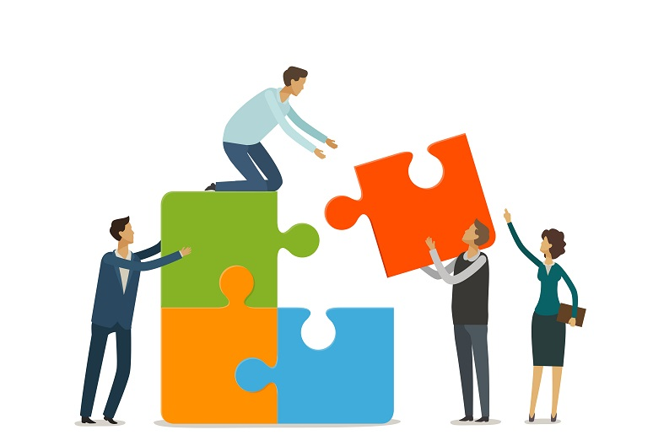

Vocabulary
connect (v)
/kəˈnekt/
kết nối

Slide 8
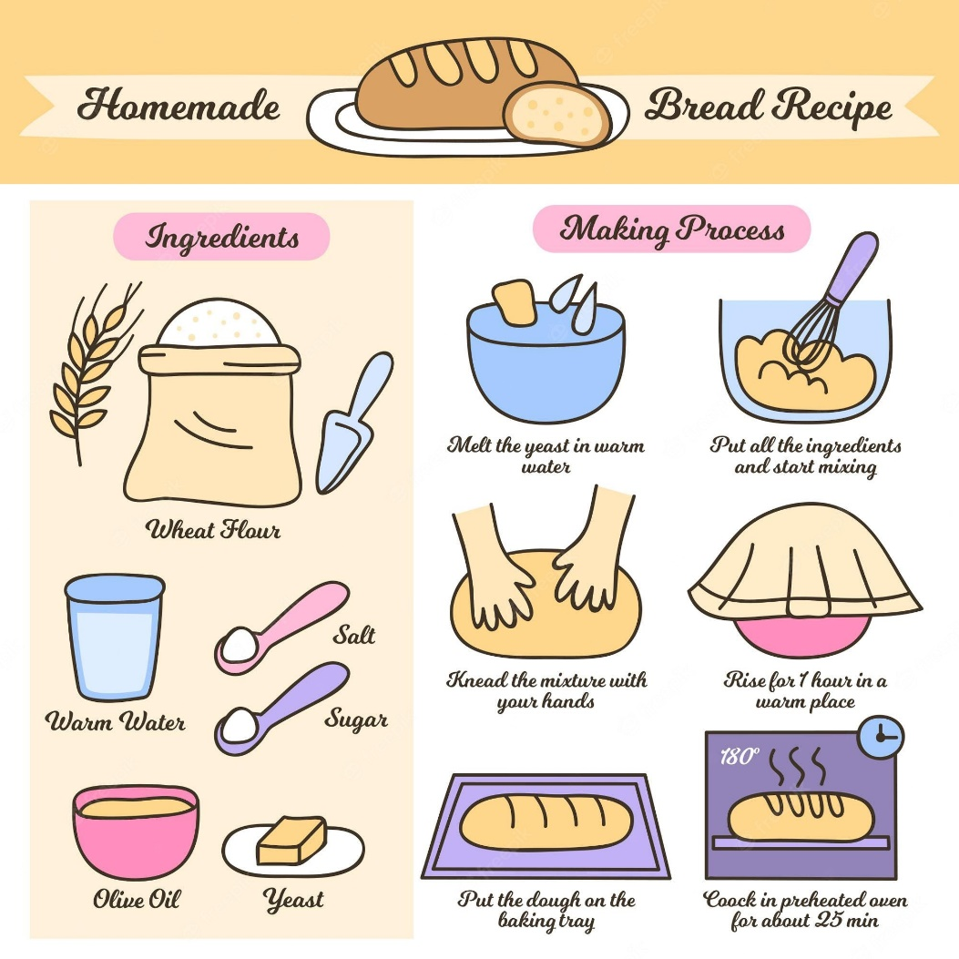
Vocabulary
recipe (n)
/ˈresɪpi/
công thức

Slide 9
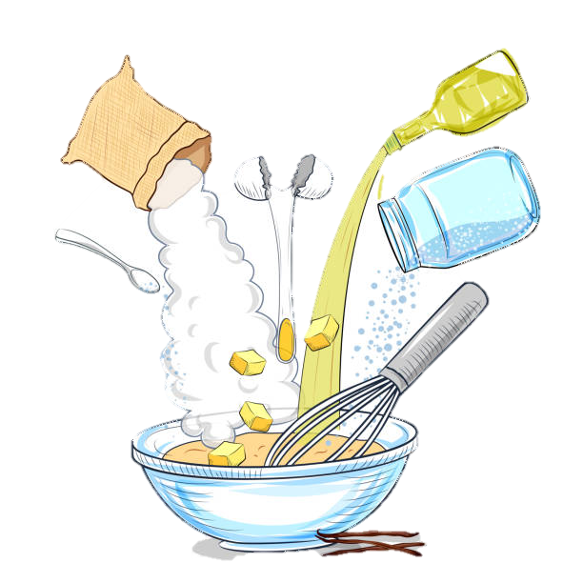
Vocabulary
ingredient (n)
/ɪnˈɡriːdiənt/
nguyên liệu

Slide 10
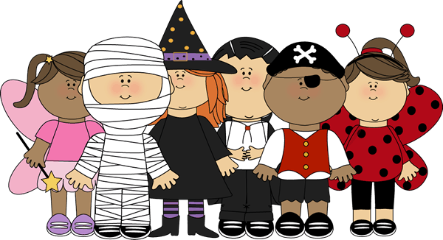
Vocabulary
costume (n)
trang phục
/ˈkɒstʃuːm/

Slide 11
Vocabulary
New words | Pronunciation | Meaning
1. connect (v) | /kəˈnekt/ | kết nối
2. recipe (n) | /ˈresɪpi/ | công thức
3. ingredient (n) | /ɪnˈɡriːdiənt/ | nguyên liệu
4. costume (n) | /ˈkɒstʃuːm/ | trang phục

Slide 12
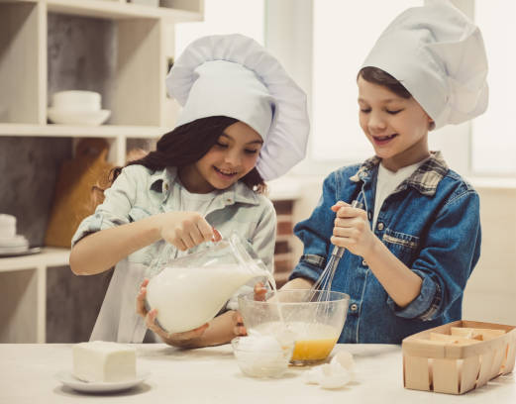
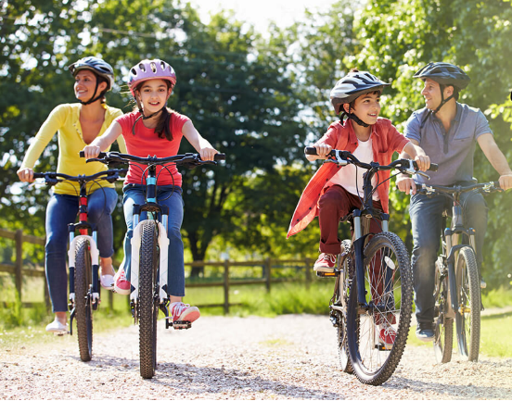
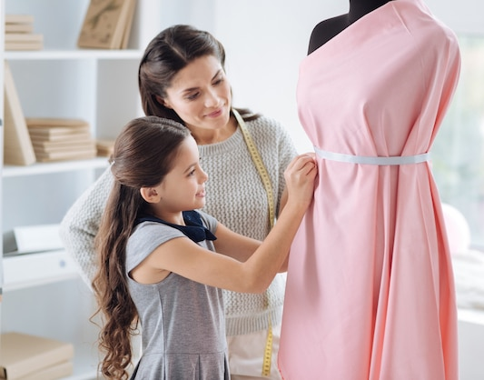
1 Look at the pictures.
What activities can you see?
cooking
riding a bike/ cycling
making a dress

Slide 13
Reading

Slide 14
2. Read about Trang’s leisure activities. Choose the correct answer.
Some teenagers enjoy spending free time with their friends. Others prefer doing leisure activities with their family members. I love spending time with my family because it’s a great way to connect with them.
At the weekend, we usually go for a bike ride. We cycle to some nearby villages to enjoy the fresh air. We take photos and look at them later. My big brother and I are also into cooking. My brother looks for easy recipes. After that, we prepare the ingredients and cook. Sometimes the food is good, but sometimes it isn’t; nevertheless, we love whatever we cook. The leisure activity I like the most is doing DIY projects with my mum. She teaches me to make my own dresses and doll clothes. On special occasions, we make special dresses together. Once I won the first prize in a costume contest at my school.

Slide 15
Read about Trang’s leisure activities.
Choose the correct answer.
2
1. The text is about Trang’s leisure activities ______.
A. in the past B. with her friends C. with her family
2. The word “connect” is closest in meaning to ______.
A. join with something
B. better understand someone
C. speak to someone by phone

Slide 16
3
Read the text again and answer the questions.
1. What does Trang do with her family members at the weekend?
2. Who looks for recipes when Trang and her brother cook?
3. Which leisure activity does she love the most?
4. What does Trang’s mum teach her to do?
5. What did she win?

Slide 17
3
Read the text again and answer the questions.
1. What does Trang do with her family members at the weekend?
→ She goes for a bike ride, cooks, and does DIY projects.
At the weekend, we usually go for a bike ride. We cycle to some nearby villages to enjoy the fresh air. We take photos and look at them later. My big brother and I are also into cooking. My brother looks for easy recipes. After that, we prepare the ingredients and cook. Sometimes the food is good, but sometimes it isn’t; nevertheless, we love whatever we cook. The leisure activity I like the most is doing DIY projects with my mum. She teaches me to make my own dresses and doll clothes. On special occasions, we make special dresses together. Once I won the first prize in a costume contest at my school.
2. Who looks for recipes when Trang and her brother cook?
3. Which leisure activity does she love the most?
4. What does Trang’s mum teach her to do?
5. What did she win?

Slide 18
3
Read the text again and answer the questions.
2. Who looks for recipes when Trang and her brother cook?
→ Her brother does.
At the weekend, we usually go for a bike ride. We cycle to some nearby villages to enjoy the fresh air. We take photos and look at them later. My big brother and I are also into cooking. My brother looks for easy recipes. After that, we prepare the ingredients and cook. Sometimes the food is good, but sometimes it isn’t; nevertheless, we love whatever we cook. The leisure activity I like the most is doing DIY projects with my mum. She teaches me to make my own dresses and doll clothes. On special occasions, we make special dresses together. Once I won the first prize in a costume contest at my school.
3. Which leisure activity does she love the most?
4. What does Trang’s mum teach her to do?
5. What did she win?

Slide 19
3
Read the text again and answer the questions.
3. Which leisure activity does she love the most?
→ She loves doing DIY projects with her mum the most.
At the weekend, we usually go for a bike ride. We cycle to some nearby villages to enjoy the fresh air. We take photos and look at them later. My big brother and I are also into cooking. My brother looks for easy recipes. After that, we prepare the ingredients and cook. Sometimes the food is good, but sometimes it isn’t; nevertheless, we love whatever we cook. The leisure activity I like the most is doing DIY projects with my mum. She teaches me to make my own dresses and doll clothes. On special occasions, we make special dresses together. Once I won the first prize in a costume contest at my school.
5. What did she win?

Slide 20
3
Read the text again and answer the questions.
4. What does Trang’s mum teach her to do?
→ Her mum teaches her to make her own dresses and doll clothes.
At the weekend, we usually go for a bike ride. We cycle to some nearby villages to enjoy the fresh air. We take photos and look at them later. My big brother and I are also into cooking. My brother looks for easy recipes. After that, we prepare the ingredients and cook. Sometimes the food is good, but sometimes it isn’t; nevertheless, we love whatever we cook. The leisure activity I like the most is doing DIY projects with my mum. She teaches me to make my own dresses and doll clothes. On special occasions, we make special dresses together. Once I won the first prize in a costume contest at my school.

Slide 21
3
Read the text again and answer the questions.
5. What did she win?
→ She won the first prize in a costume contest at her school.
At the weekend, we usually go for a bike ride. We cycle to some nearby villages to enjoy the fresh air. We take photos and look at them later. My big brother and I are also into cooking. My brother looks for easy recipes. After that, we prepare the ingredients and cook. Sometimes the food is good, but sometimes it isn’t; nevertheless, we love whatever we cook. The leisure activity I like the most is doing DIY projects with my mum. She teaches me to make my own dresses and doll clothes. On special occasions, we make special dresses together. Once I won the first prize in a costume contest at my school.

Slide 22
Speaking

Slide 23
4
Work in groups. Take turns to ask and answer the questions. Record your friends’ answer in the table below.
1. What leisure activities do you usually do with your family?
2. Which one do you like the most? Why?
3. How do you feel when you spend time with your family members?
Friends’ name | Questions 1 | Questions 2 | Questions 3

Slide 24
Work in groups. Take turns to ask and answer the questions.
Record your friends’ answer in the table below.
4
1. What leisure activities do you usually do with your family?
- We usually play badminton.
2. Which one do you like the most? Why?
- The leisure activity I like the most is riding bike because it’s good for my health.
3.How do you feel when you spend time with your family members?
- I feel happy.

Slide 25
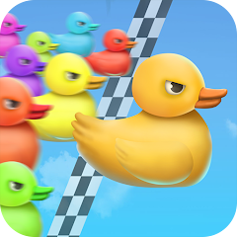
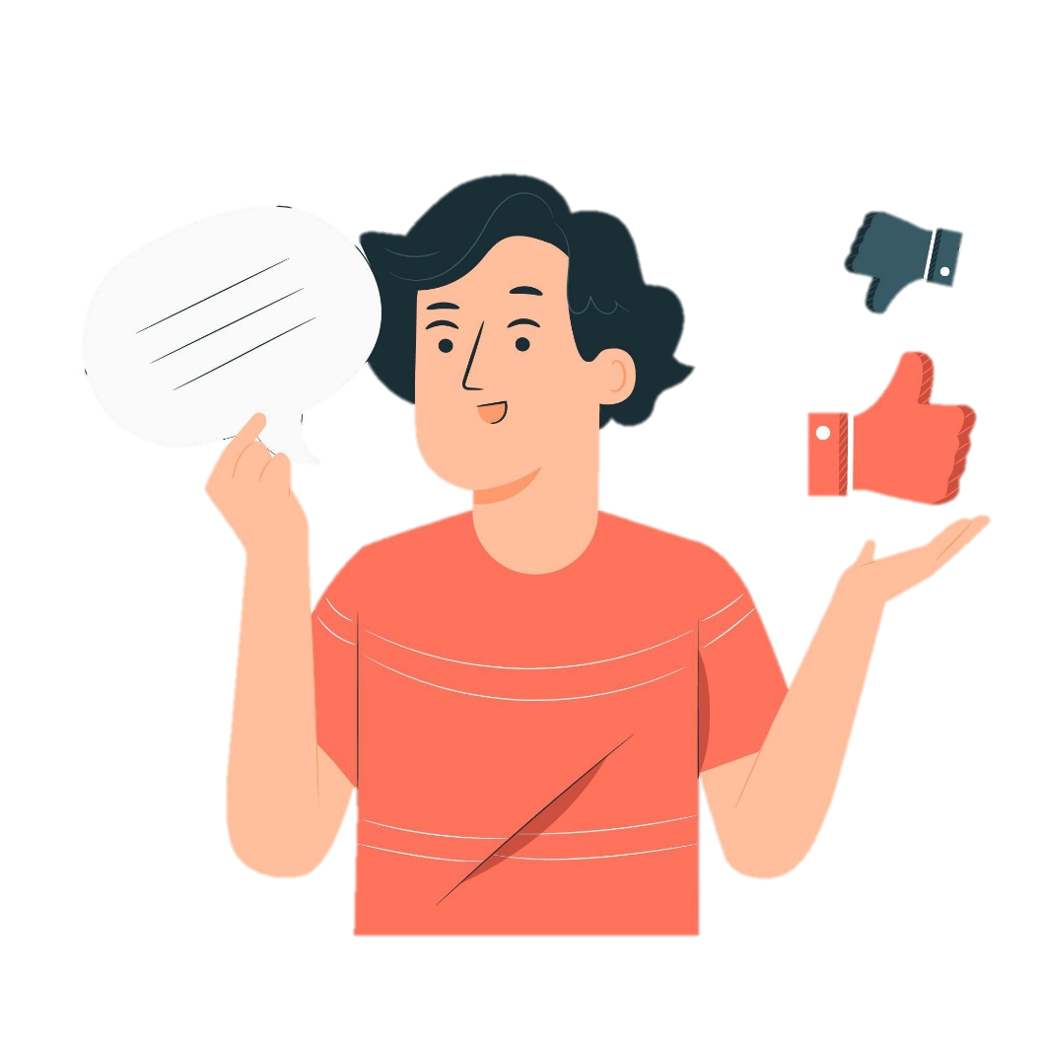
Game: Duck Race
5
Report your group members’ answers to the class.
What activities are the most common?
The most common
activities is …

Slide 26
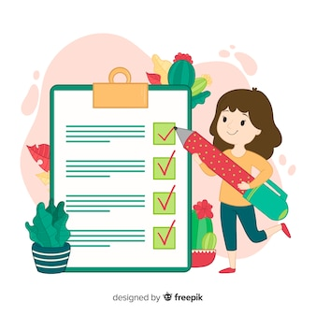
What have you learnt today?
read about teen’s leisure activities
talk about friends’ leisure activities

Slide 27
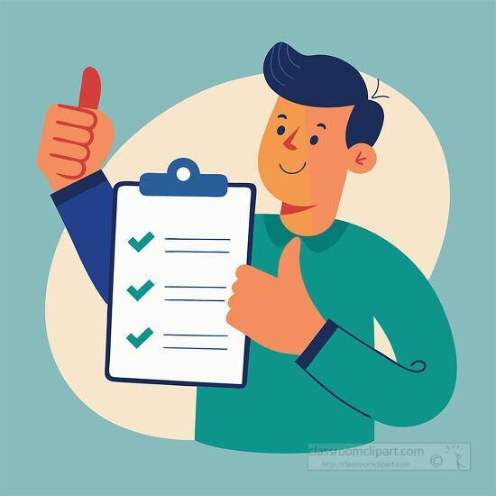
Homework
Learn the new vocabulary
Practice report about Leisure activities
Pre-Read the next lesson: Looking Back

Slide 28


