Slide 1

WELCOME TO OUR CLASS!
Teacher: …………

Slide 2

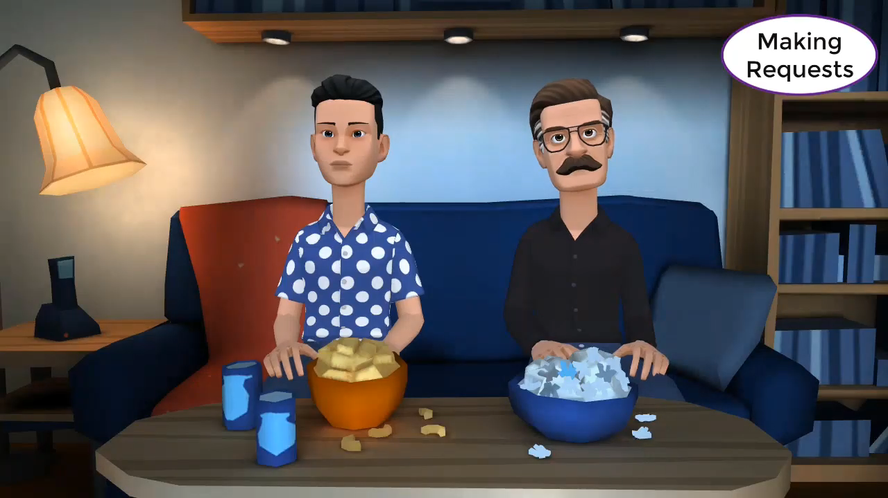
Watch a video and complete the sentences.
Could
1.______ you give me 60$?
2._____________lending me your pink shirt?
3.__________________ lend me your scooter?
Do you mind
I wonder if you could

Slide 3
………, October ….., 202….
Unit 3: TEENAGERS
Lesson 4: Communication

Slide 4
01
Everyday English
Making request

Slide 5



1. Listen and read the dialogues below. Pay attention to the highlighted sentences.
Student: Can you tell me more about the music club, please?
School club leader: Certainly. It meets on Mondays and Thursdays.
Student: Could you show me the way to the college, please?
Teacher: Certainly. Go past this block, then turn left. It is on your right-hand side there.

Slide 6
Making requests | Examples
- Can you…, please? - Could you…(, please)? | - Can you tell me more about the music club, please? - Could you tell me the time it meets?

Slide 7
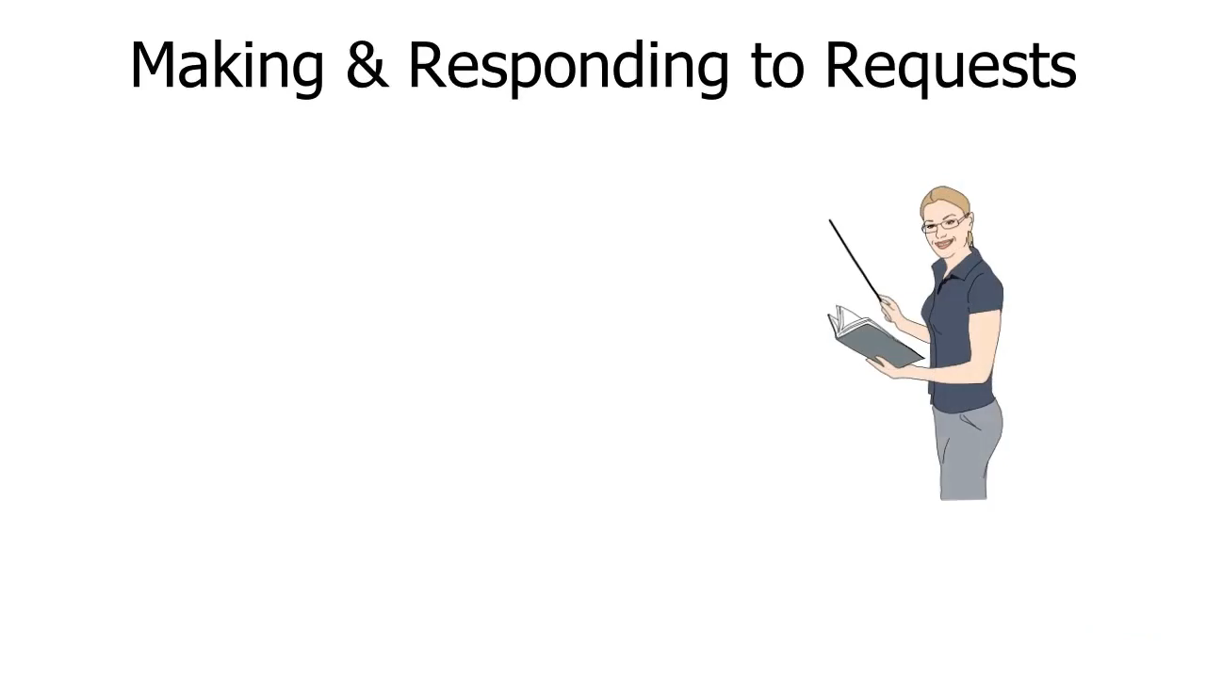
Find more…

Slide 8
Making requests | Accepting a request  | Refusing a request x
- Could you + Vo…, please? - Can you + Vo…., please? - Will you + Vo…..? - Is there any chance you could + Vo….? - Could you possible + Vo……? I wonder if you could possibly + Vo…? - Do you mind + Ving…? - Would you mind + Ving…..? | Yes, sure. Sure. Yes, of course. Certainly yes. With pleasure. Sure, don’t worry. Sure, no problem. | Oh, sorry, I can’t. I just can’t, I am sorry. I am afraid, but I can’t. Certainly not

Slide 9


2. Work in pairs. Make similar conversations, using the cues below.
Ask to borrow a book from your classmate.
Example:
A: Can you lend me your book that you finished reading, please?
B: Sure.

Slide 10

2. Work in pairs. Make similar conversations, using the cues below.
- Request some advice on how to do your science project.
Example:
A: Could you tell me how to start a science project?
B: Oh, sorry. I can’t.

Slide 11

2. Work in pairs. Make similar conversations, using the cues below.
Ask to borrow a book from your classmate.
- Request some advice on how to do your science project.

Slide 12
02
SOCIAL MEDIA POPULAR AMONG TEENS

Slide 13
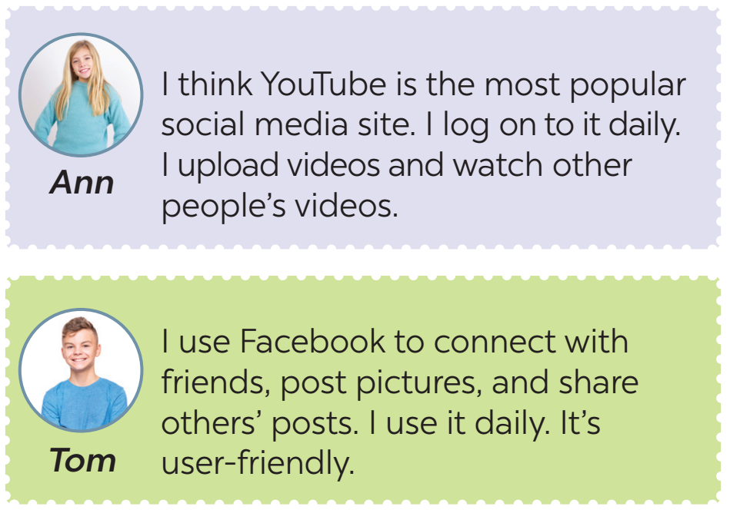
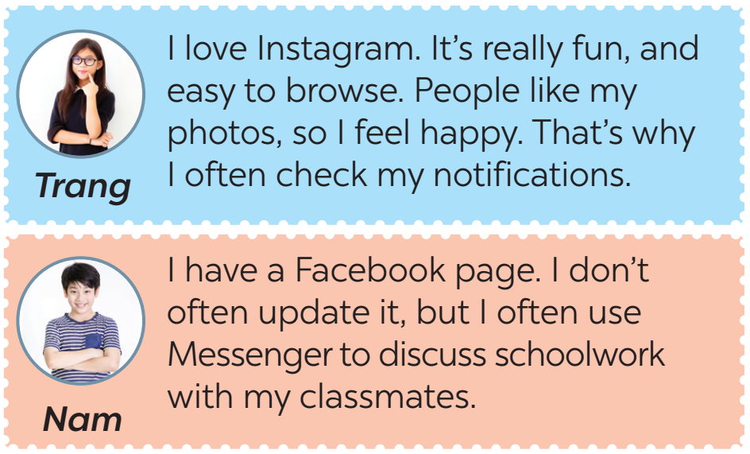
Let’s meet some teenagers

Slide 14
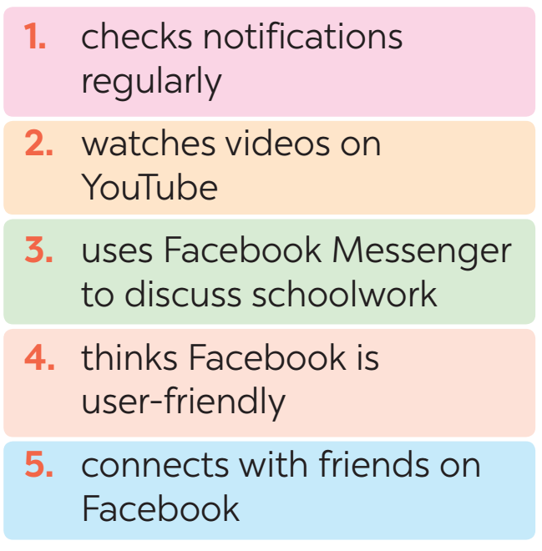
3. Read some posts on a forum about different social media and match the names of the posters with their activities.

Slide 15





LUCKY WHEEL
30
20
1
2
3
40
10
50
80
4
5
6
60
70
PLAY
Notes:
CLICK PLAY ĐỂ QUAY, CLICK VÒNG QUAY ĐỂ DỪNG QUAY.
CLICK TRÁI TIM VÀNG ĐỂ CHUYỂN SLIDE XEM CÂU TL.

Slide 16

Check your answers
2. watches videos on YouTube

Slide 17
Check your answers
5. connects with friends on Facebook
4. thinks Facebook is user-friendly

Slide 18
Check your answers
1. check notifications regularly

Slide 19
Check your answers
3. uses Facebook Messenger to discuss schoolwork

Slide 20


Slide 22
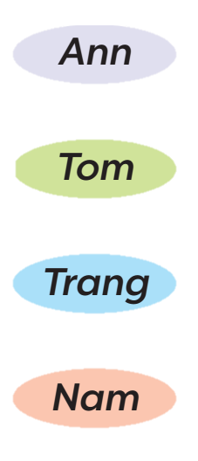
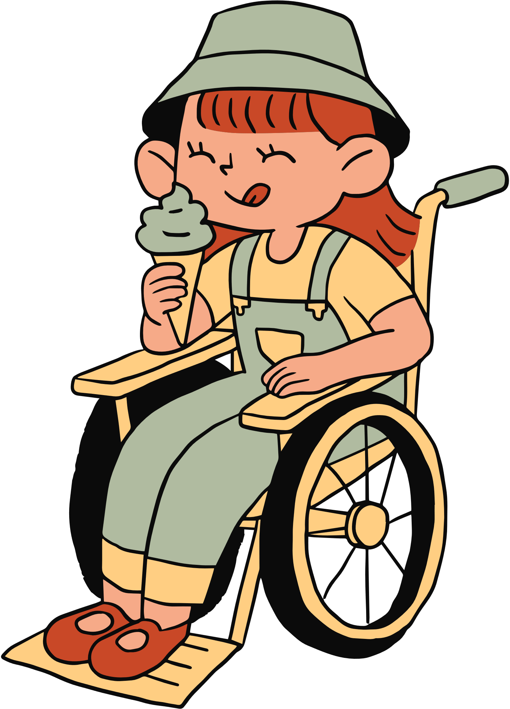
Look at the answers again.

Slide 23
4. Work in pairs. Ask and answer questions about what social media the teens in 3 use, why, and how often they use them.
What social media does Ann use?
She uses YouTube
What does she use it for?
She uploads her videos and watch other people’s videos.
How often does she use it?
Every day.

Slide 24

4. Work in pairs. Ask and answer questions about what social media the teens in 3 use, why, and how often they use them.
A: What social media does …….. use?
B: ....................
A: What does …….. use it for?
B: …………….
A: How often does …. use it?
B: ……….

Slide 25
How about you?

Slide 26
5. Work in groups. Discuss the following questions:
What social media do you use?
What do you use it for?
How often do you use it?
Report your group’s results to the class.

Slide 27
WRAP -UP
Retell 2 ways of making requests
List some popular social media among teens.

Slide 28
WRAP -UP
What would you say when you want somebody “tell you the time”?
A. Can you tell me the time, please?
B. Could you tell me the time?
C. I want to know the time.
What information have you talked about social media?
A. What social media you use
B. How often you use it
C. Who you use it with
D. What you use it for

Slide 29
HOMEWORK
Practice making request in real situation
Prepare for the next lesson: Skills 1

Slide 30
THANK YOU!

