Slide 1



Welcome to our class!
Teacher: Huong Giang

Slide 2
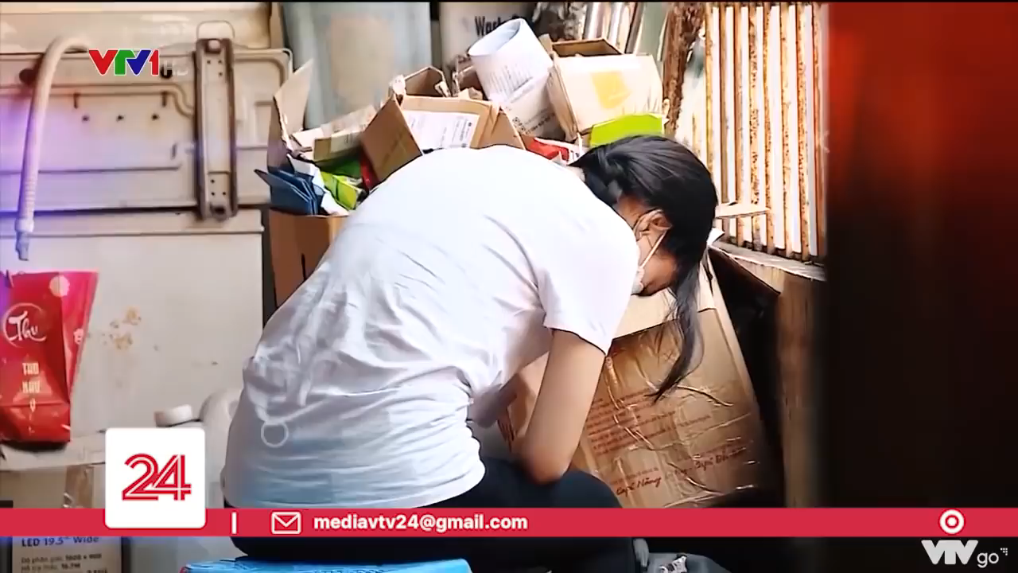
How do you think about the problem in the video?

Slide 3

RULE:
- Work in 4 teams.
- In 2 minutes, write down on the posters as many types of pressure as possible
- The group with the most correct answers will be the winner.
Suggested answers:
Pressure from parents
Pressure from work
Pressure from schoolwork
Pressure from friends
Exam pressure
Pressure to get into gifted/ high schools
Pressure of getting higher marks
….

Slide 4
Unit 3: TEENAGERS
Lesson 6: Skills 2

Slide 5
VOCABULARY

Slide 6
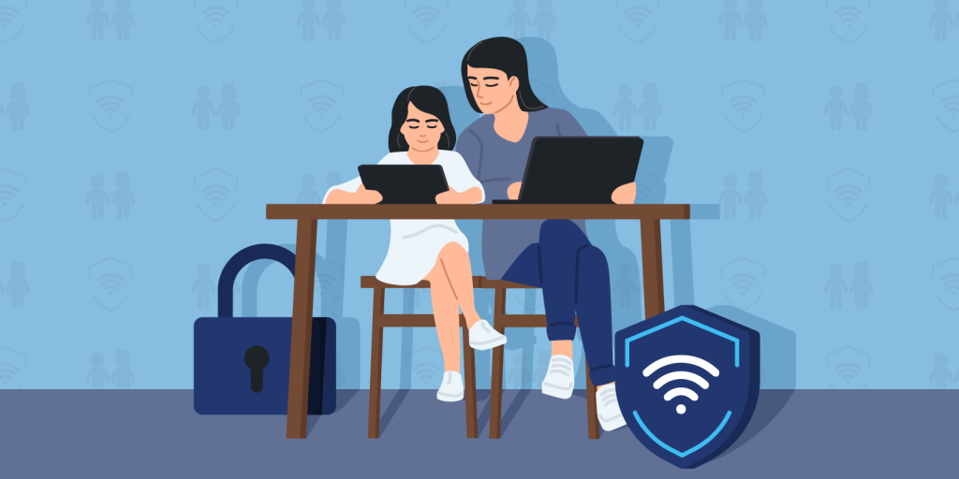

VOCABULARY
parental (adj)
/pəˈrentl/
liên quan tới bố mẹ, thuộc bố mẹ

Slide 7

VOCABULARY
peer (n)
/pɪə(r)/
người ngang hàng, bạn đồng lứa

Slide 8
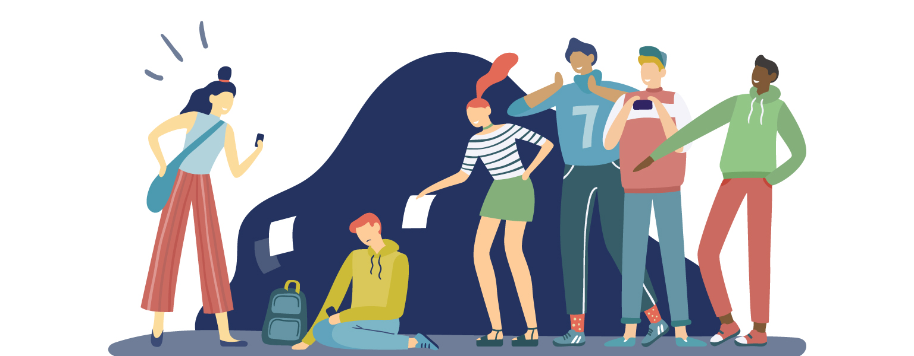
VOCABULARY
bully (v)
/ˈbʊli/
bắt nạt

Slide 9
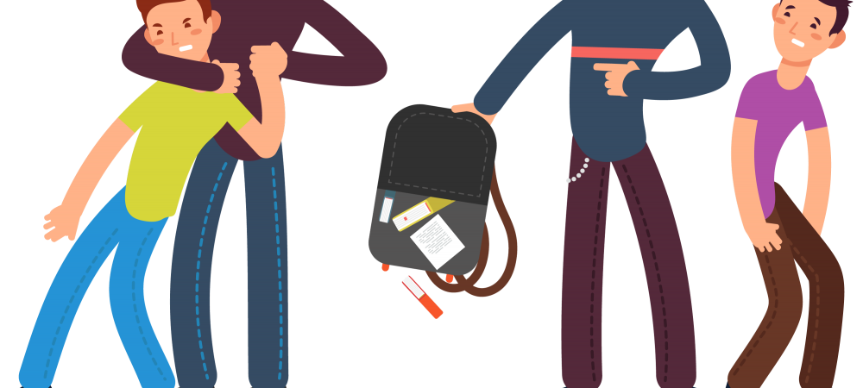
VOCABULARY
bullying (n)
/ˈbʊliɪŋ/
sự bắt nạt

Slide 10
VOCABULARY
- parental (adj) | /pəˈrentl/ | liên quan tới bố mẹ, thuộc bố mẹ
- peer (n) | /pɪə(r)/ | người ngang hàng, bạn đồng lứa
- bully (v) | /ˈbʊli/ | bắt nạt
- bullying (n) | /ˈbʊliɪŋ/ | sự bắt nạt

Slide 11
LISTENING

Slide 12

1. Which types of pressure below do you think teens face?
parental pressure
pressure from work
pressure from schoolwork
pressure from their clubs

Slide 13
2. Listen to a conversation and choose the correct answer to each question.
1. How many students are talking?
One.
Two.
Three.
2. What are they discussing?
Their class forum.
Their stress.
Their community activities.

Slide 14
3. Listen to the conversation again and fill each blank with ONE word.
Problems | Solutions
Minh has pressure from his (1)________. | Minh should tell his parents about his interests and (2) __________.
Ann is unhappy about her (3) _____________. | Ann should feel (4)________ about her body.
Mi doesn’t get on with her (5)________. | She should (6) ______ to her mum.

Slide 15
3. Listen to the conversation again and fill each blank with ONE word.
Problems | Solutions
Minh has pressure from his (1)________. | Minh should tell his parents about his interests and (2) __________.
parents
abilities
Minh: I'm tired of trying to meet my parents’ expectations. They want me to study well and be good at many things, so they send me to many classes like maths, English, piano, and karate.
Ann: Why don't you tell them your interests and abilities, Minh?

Slide 16
3. Listen to the conversation again and fill each blank with ONE word.
Problems | Solutions
Ann is unhappy about her (3) _____________. | Ann should feel (4)________ about her body.
good
body/ weight
Minh: You look fit, Ann. You should feel good about your body.
Ann: Are you kidding, Mi? I still need to lose a few more kilos.

Slide 17
3. Listen to the conversation again and fill each blank with ONE word.
Problems | Solutions
Mi doesn’t get on with her (5)________. | She should (6) ______ to her mum.
talk
sister
Mi: Actually, I don't get on with my sister. She is jealous of anything I have and always starts arguments. So I had to talk to my mum...

Slide 18
Look at the answers again
Problems | Solutions
Minh has pressure from his (1)________. | Minh should tell his parents about his interests and (2) __________.
Ann is unhappy about her (3) _____________. | Ann should feel (4)________ about her body.
Mi doesn’t get on with her (5)________. | She should (6) ______ to her mum.
parents
abilities
good
body / weight
talk
sister

Slide 19
WRITING

Slide 20
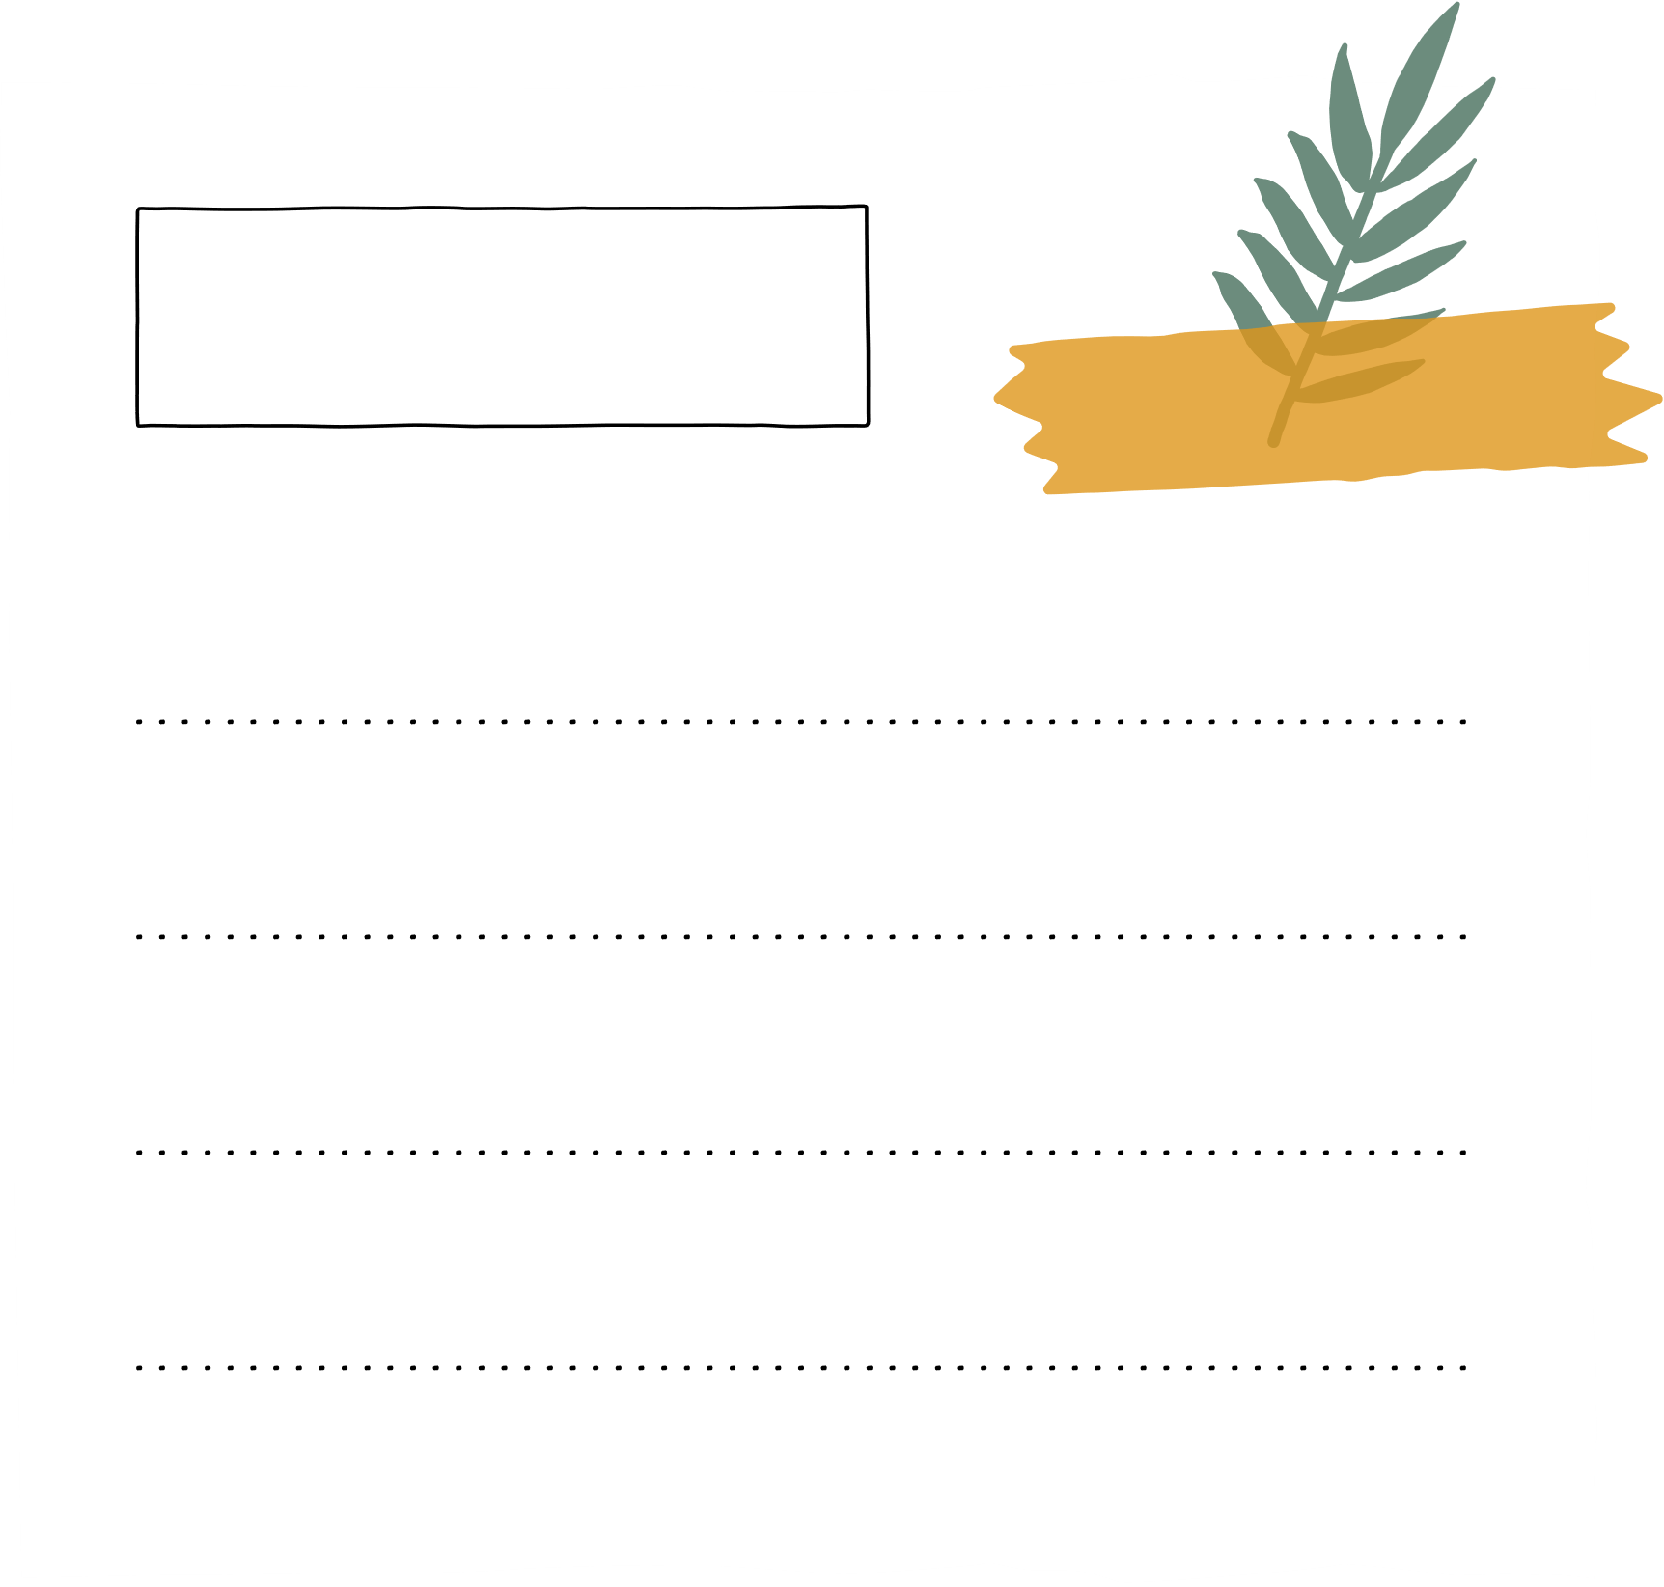
4. Match the causes of teen stress with the possible solutions. There may be more than one solution to a problem.
Causes of teen stress
Possible solutions
1. peer pressure
2. too much schoolwork
A. avoiding bullies wherever possible
spending too much
time on social media
B. staying calm and relaxed
C. turning off smartphones
4. bullying
D. talking to teachers

Slide 21

4. Match the causes of teen stress with the possible solutions. There may be more than one solution to a problem.
Possible solutions
Causes of teen stress
B. staying calm and relaxed
1. peer pressure
D. talking to teacher

Slide 22


4. Match the causes of teen stress with the possible solutions. There may be more than one solution to a problem.
Possible solutions
Causes of teen stress
B. staying calm and relaxed
D. talking to teacher
2. too much schoolwork

Slide 23

4. Match the causes of teen stress with the possible solutions. There may be more than one solution to a problem.
Causes of teen stress
Possible solutions
spending too much
time on social media
C. turning off smartphones

Slide 24

4. Match the causes of teen stress with the possible solutions. There may be more than one solution to a problem.
Causes of teen stress
Possible solutions
4. bullying
A. avoiding bullies wherever possible
B. staying calm and relaxed
D. talking to teachers

Slide 25
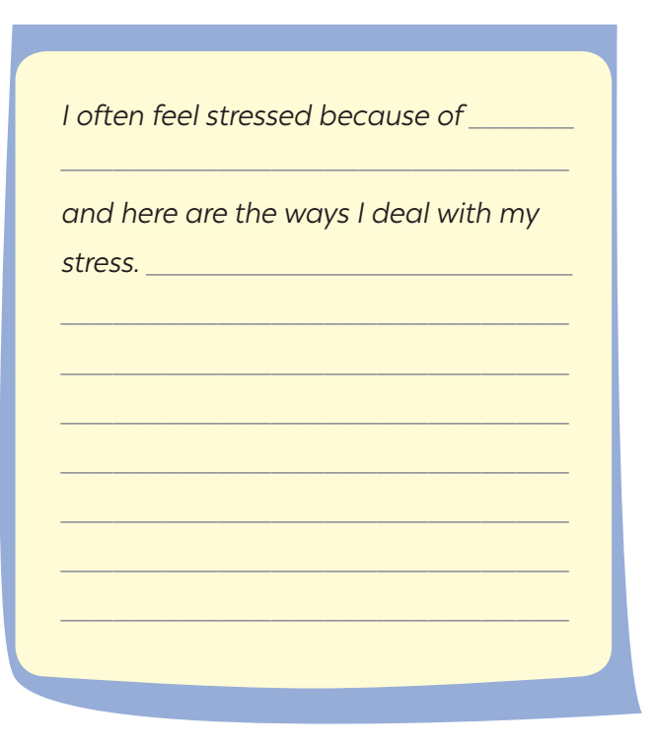
5. Write a paragraph (80 - 100 words) about the cause(s) of your stress and offer solutions.

Slide 26
Suggested answer:
I often feel stressed because of my schoolwork, my parents, and my friends. There is so much homework to do in the evening. And my parents are also complaining about why I can’t be as good a student as those I have never met. My classmates are excellent, they’re not only intelligent but also energetic, and they achieve a lot of achievement. To deal with my stress, I divide my schoolwork into parts to do. That way reduces my tired feeling after finishing my homework. I ignore my parents’ complaints and focus on my own goals. I also ask my friends for tips about how to become excellent like them. I feel motivated after receiving so much useful advice from my friends.

Slide 27
Wrap-up
What have we learned in this lesson?
Tell the whole class about their stress and what they often do to deal with stress.

Slide 28
Thank you!

