Slide 1


WELCOME TO OUR CLASS
Presented by Huong Giang

Slide 2
Look at the pictures and guess the topic.

Slide 3



What is the topic?
Teenagers

Slide 4
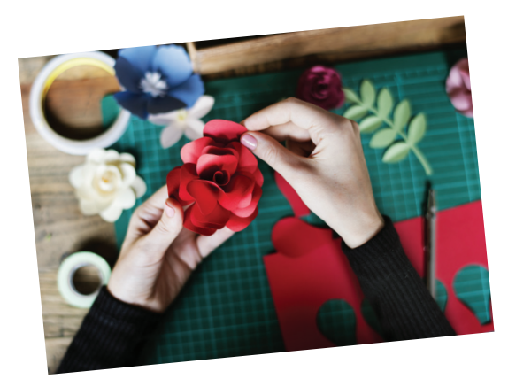

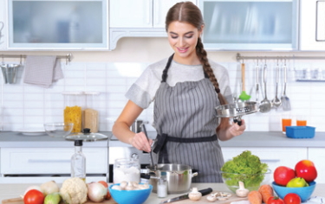
What is the topic?
Leisure time

Slide 5
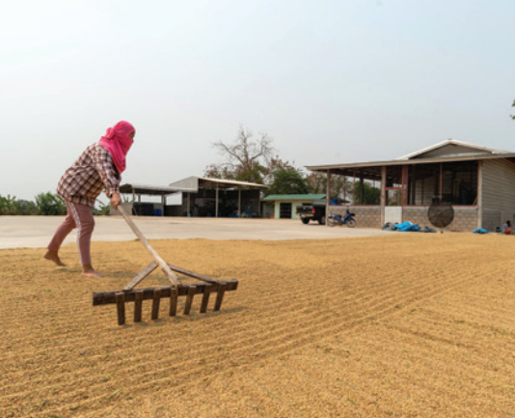
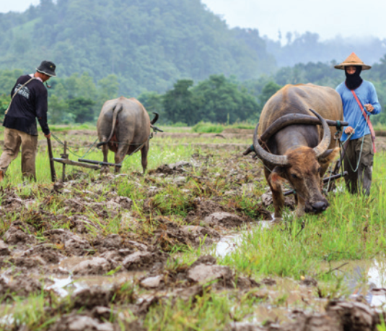
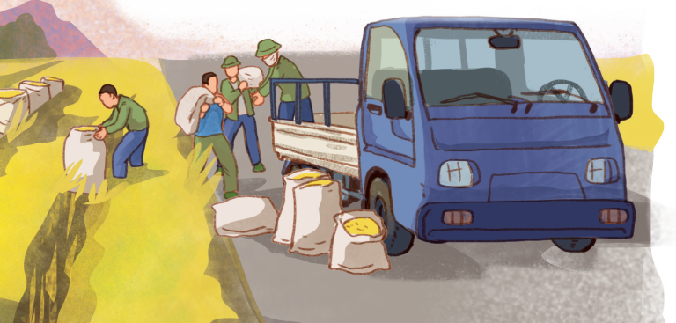
What is the topic?
Life in the countryside

Slide 6
REVIEW 1
UNITS 1-2-3
Lesson 1: Language

Slide 7
PRONUNCIATION
Sounds: /ʊ/ and /u:/
Sounds: /ə/ and /i/
Sounds: /ʊə/ and /ɔɪ/

Slide 8

1. Circle the word whose underlined part is pronounced differently from the others.
/kuːl/
/fʊt/
/kʊk/
1. A. good B. cool C. foot D. cook
2. A. June B. rude C. truth D. put
3. A. village B. buffalo C. cottage D. shortage
4. A. ensure B. insure C. picture D. surely
5. A. avoid B. doing C. choice D. join
/gʊd/
/dʒuːn/
/ruːd/
/ truːθ/
/pʊt/
/ˈvɪlɪdʒ/
/ˈbʌfələʊ/
/ˈkɒtɪdʒ/
/ˈʃɔːtɪdʒ/
/ɪnˈʃʊə(r)/
/ɪnˈʃʊə(r)/
/ˈpɪktʃə(r)/
/ˈʃʊəli/
/əˈvɔɪd/
/ˈduːɪŋ/
/tʃɔɪs/
/dʒɔɪn/

Slide 9
VOCABULARY
UNIT 1:
Leisure activities
Expressions about likes and dislikes
UNIT 2:
Life in the countryside
UNIT 3:
Teen school clubs, teens’ use of social media, and teen stress

Slide 10
2. Choose the correct answer A, B or C.
1. Mi is ______ gardening in her free time.
A. in B. into C. to
2. Mai is interested ______ building websites for her friends.
A. of B. with C. in
be into: thích
be interested in: thú vị với
3. Minh is not fond of ______ puzzles because he thinks it takes a lot of time.
A. making B. doing C. building
4. I’m not keen on ______ our class photos to the forum.
A. uploading B. surfing C. messaging
5. While I was ______ some websites, I saw an advertisement about a resort.
A. creating B. browsing C. uploading
do puzzles
upload photos
browse websites

Slide 11
3. Complete the sentences with the words from the box.
bully trained hospitable pressure focus
1. People in my village are very ________________ to all visitors.
2. Parents in our village don’t put much ___________ on their children to do well at school.
3. In my school, we can __________ on study and play, and do not have to worry about bullies.
4. The best __________ player in our chess club will not be able to join the competition.
5. If a boy uses his strength to frighten weaker peers, he is a _________.

Slide 12

LUCKY CIRCLE
1
2
3
4
5
6

Slide 13

3. Complete the sentences with the words from the box.
bully trained hospitable pressure focus
1. People in my village are very ________________ to all visitors.
hospitable

Slide 14
3. Complete the sentences with the words from the box.
bully trained hospitable pressure focus
2. Parents in our village don’t put much ___________ on their children to do well at school.
pressure

Slide 15
3. Complete the sentences with the words from the box.
bully trained hospitable pressure focus
focus
3. In my school, we can __________ on study and play, and do not have to worry about bullies.

Slide 16
3. Complete the sentences with the words from the box.
bully trained hospitable pressure focus
trained
4. The best __________ player in our chess club will not be able to join the competition.

Slide 17
3. Complete the sentences with the words from the box.
bully trained hospitable pressure focus
5. If a boy uses his strength to frighten weaker peers, he is a _________.
bully

Slide 18
LUCKY NUMBER

Slide 19
Look at the answers again
1. People in my village are very hospitable to all visitors.
2. Parents in our village don’t put much pressure on their children to do well at school.
3. In my school, we can focus on study and play, and do not have to worry about bullies.
4. The best-trained player in our chess club will not be able to join the competition.
5. If a boy uses his strength to frighten weaker peers, he is a bully.

Slide 20
GRAMMAR
UNIT 1:
Verbs of liking / disliking + gerunds
Verbs of liking / disliking + to-infinitives
UNIT 2:
Comparative forms of adverbs
UNIT 3:
Simple sentences and compound sentences

Slide 21
4. Choose the correct answers A, B or C
1. Mai dislikes ______ her pictures to Facebook. She prefers not to show them to others.
A. to upload B. uploading C. upload
2. We enjoy ______ photos of different types of scenery, so we took a camera with us.
A. taking B. to take C. take
3. She did the puzzles ______ than I did, so I won the competition.
A. slowly B. slower C. more slowly
4. Tom worked ______ than Mi; therefore, he got better results in the exams.
A. hardly B. harder C. more hard
5. Now they all chat with each other ______ than before because they have smartphones.
A. more frequently B. frequent C. frequently

Slide 22
5. Underline the correct bold word in each sentence.
1. Minh is interested in painting, so / but yesterday he decided to join the arts and crafts club. 2. Life in the city seems to be more comfortable, otherwise / but I prefer life in the countryside.
3. She tries to focus more on her studies; therefore / otherwise, she won’t pass her exams. 4. During harvest time, farmers have to get up earlier, and / so they have to work harder. 5. Parents now have higher expectations of their children; therefore / so, children are under more pressure than before.

Slide 23

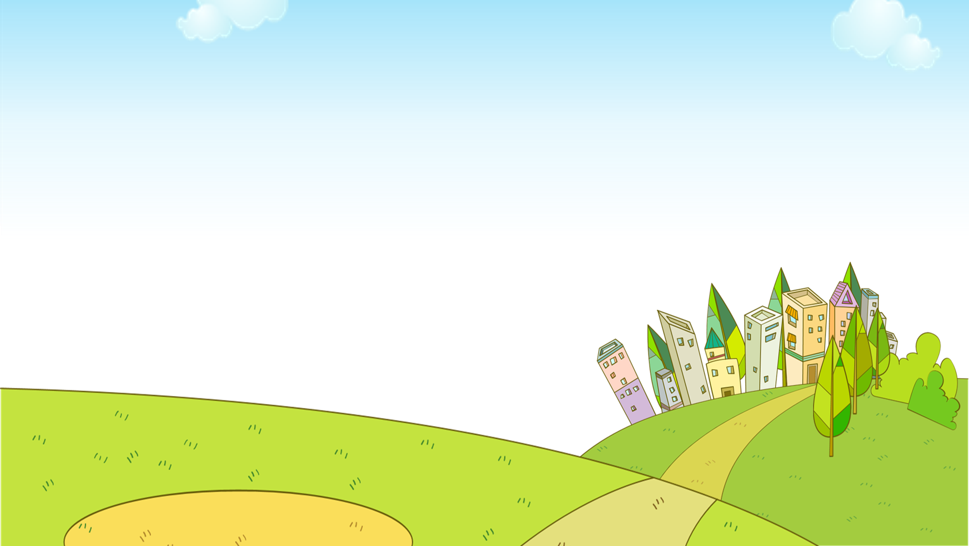


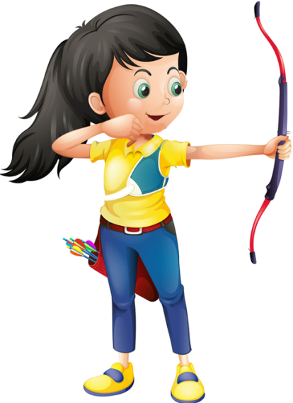
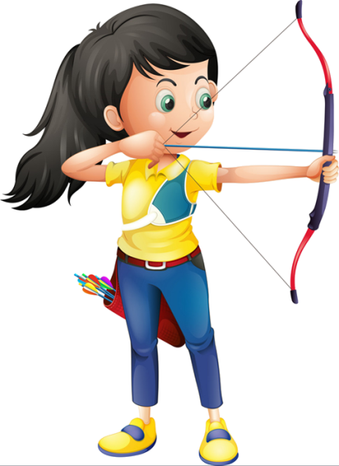



Ms Huyền Phạm
0936.082.789

Slide 24

1. Minh is interested in painting, ________ yesterday he decided to join the arts and crafts club.
so
but
Ms Huyền Phạm
0936.082.789

Slide 25
2. Life in the city seems to be more comfortable, ________ I prefer life in the countryside.
otherwise
but
Ms Huyền Phạm
0936.082.789

Slide 26
3. She tries to focus more on her studies; _____, she won’t pass her exams.
therefore
otherwise
Ms Huyền Phạm
0936.082.789

Slide 27
4. During harvest time, farmers have to get up earlier, ______ they have to work harder.
and
so
Ms Huyền Phạm
0936.082.789

Slide 28
5. Parents now have higher expectations of their children; _________, children are under more pressure than before.
therefore
so
Ms Huyền Phạm
0936.082.789

Slide 29
Look at the answers again
1. Minh is interested in painting, so yesterday he decided to join the arts and crafts club. 2. Life in the city seems to be more comfortable, but I prefer life in the countryside.
3. She tries to focus more on her studies; otherwise, she won’t pass her exams. 4. During harvest time, farmers have to get up earlier, and they have to work harder. 5. Parents now have higher expectations of their children; therefore, children are under more pressure than before.

Slide 30
Wrap - up
What have we learnt in this lesson?
Pronunciation in Units 1-2-3
Vocabulary of Units 1-2-3
Grammar of Units 1-2-3

Slide 31
Thank you!

