Slide 1

LOOK & GUESS THE TOPIC
FILMS

Slide 2



UNIT 8
Films
Lesson 1: Getting started

Slide 3
OBJECTIVES
After this lesson, students will be able to:
01
02
Have an overview about the topic Films
use lexical items related to the topic:
+ types of films
+ adjectives describing films

Slide 4

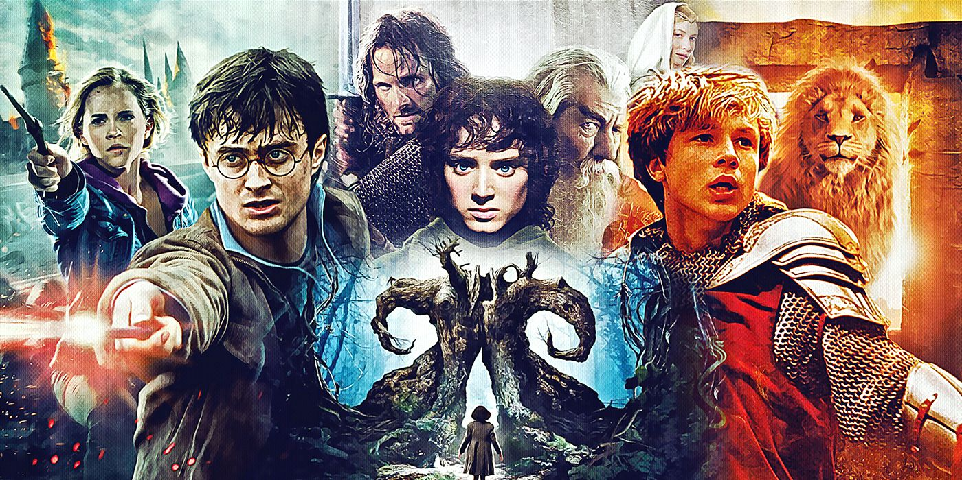
Vocabulary
fantasy (n) /ˈfæntəsi /
phim viễn tưởng

Slide 5
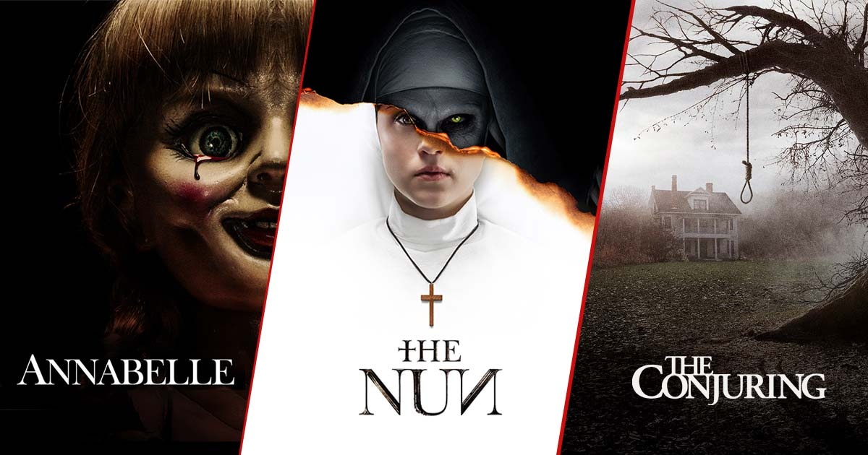
Vocabulary
horror film (n) /'hɒrə fɪlm/
phim kinh dị

Slide 6

Vocabulary
documentary (n) /dɒkjʊˈmentəri/
phim tài liệu

Slide 7
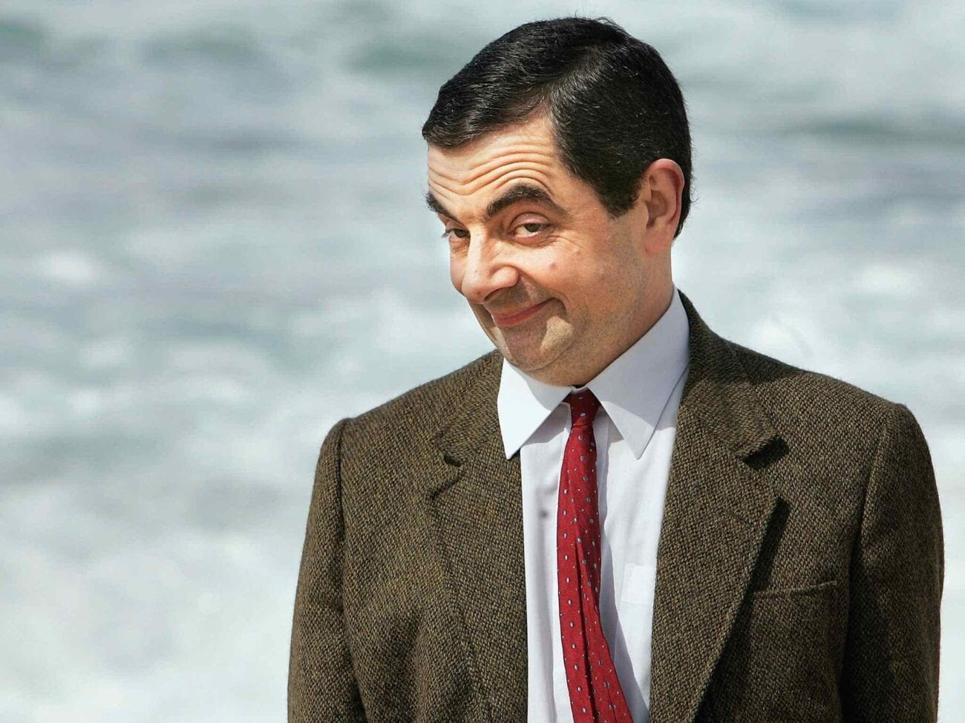
Vocabulary
comedy (n) /ˈkɒmədi/
phim hài

Slide 8
Vocabulary
fantasy (n) /ˈfæntəsi /
phim viễn tưởng
horror film (n) /'hɒrə fɪlm/
phim kinh dị
documentary (n) /dɒkjʊˈmentəri/
phim tài liệu
comedy (n) /ˈkɒmədi/
phim hài

Slide 9
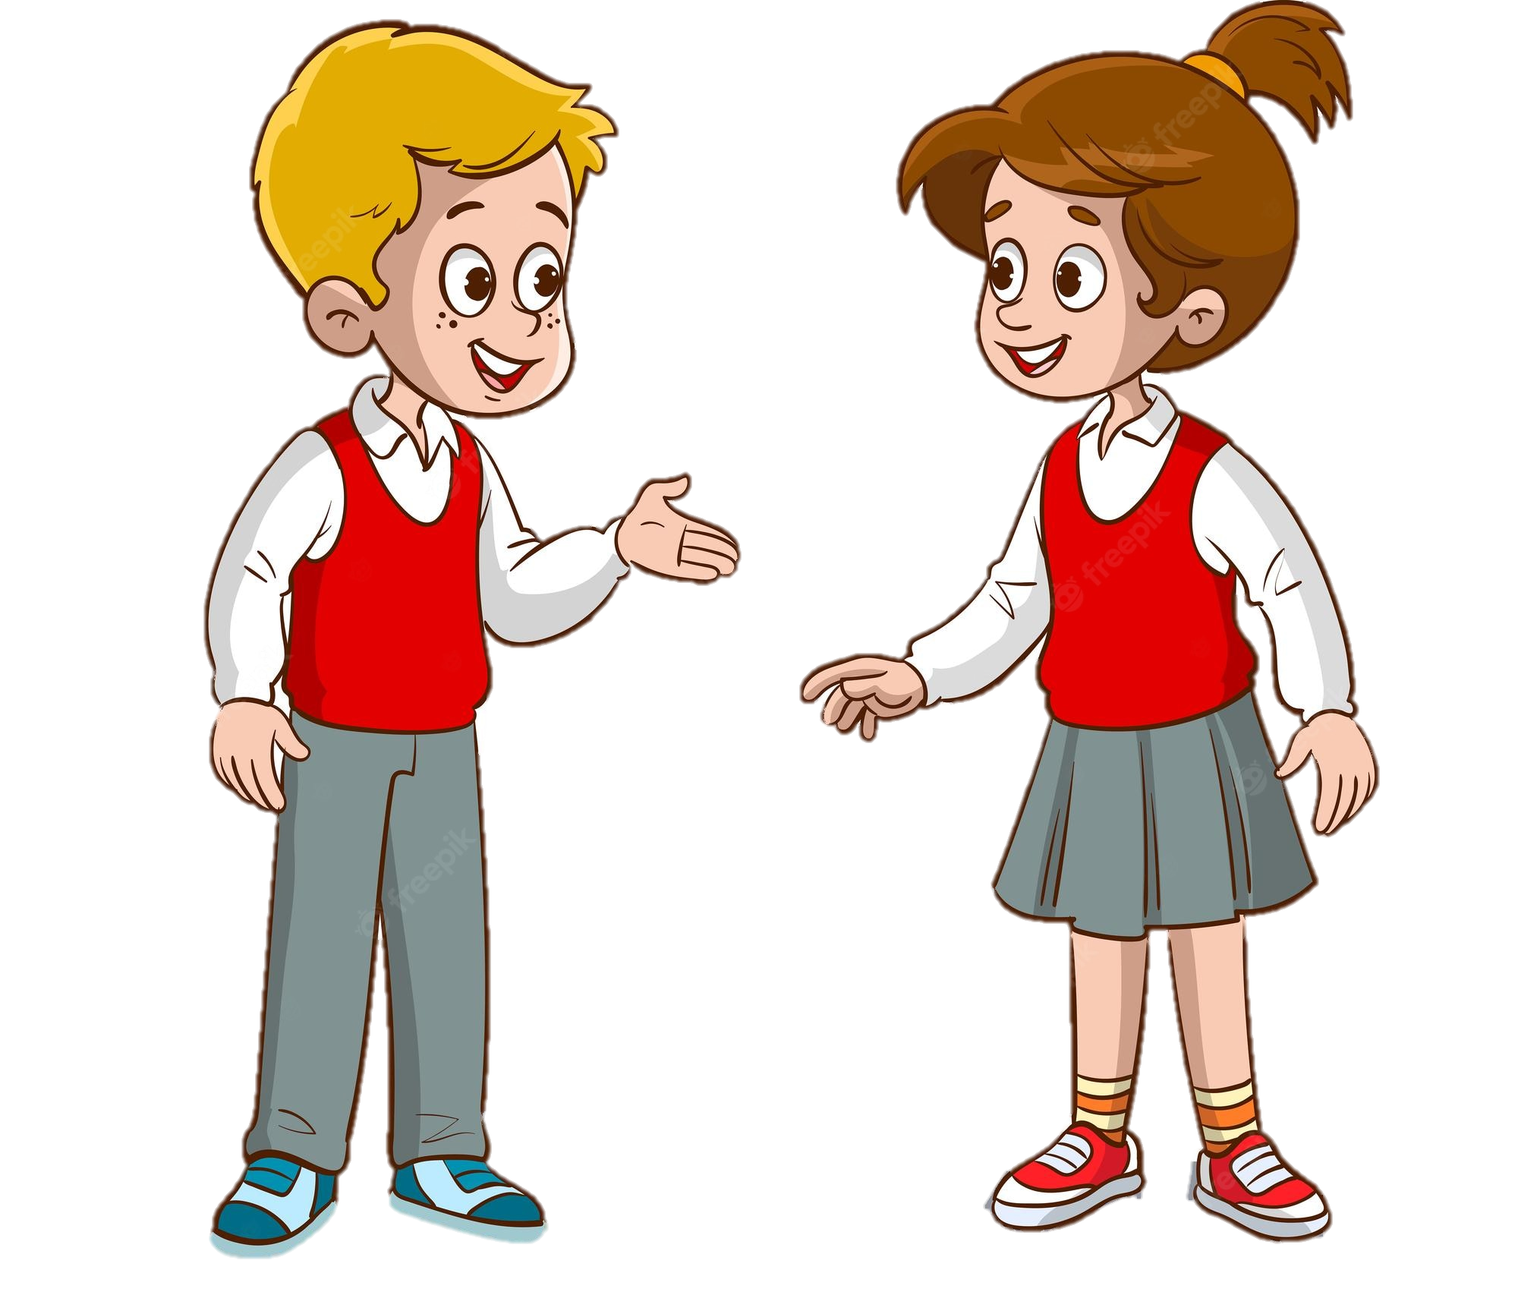
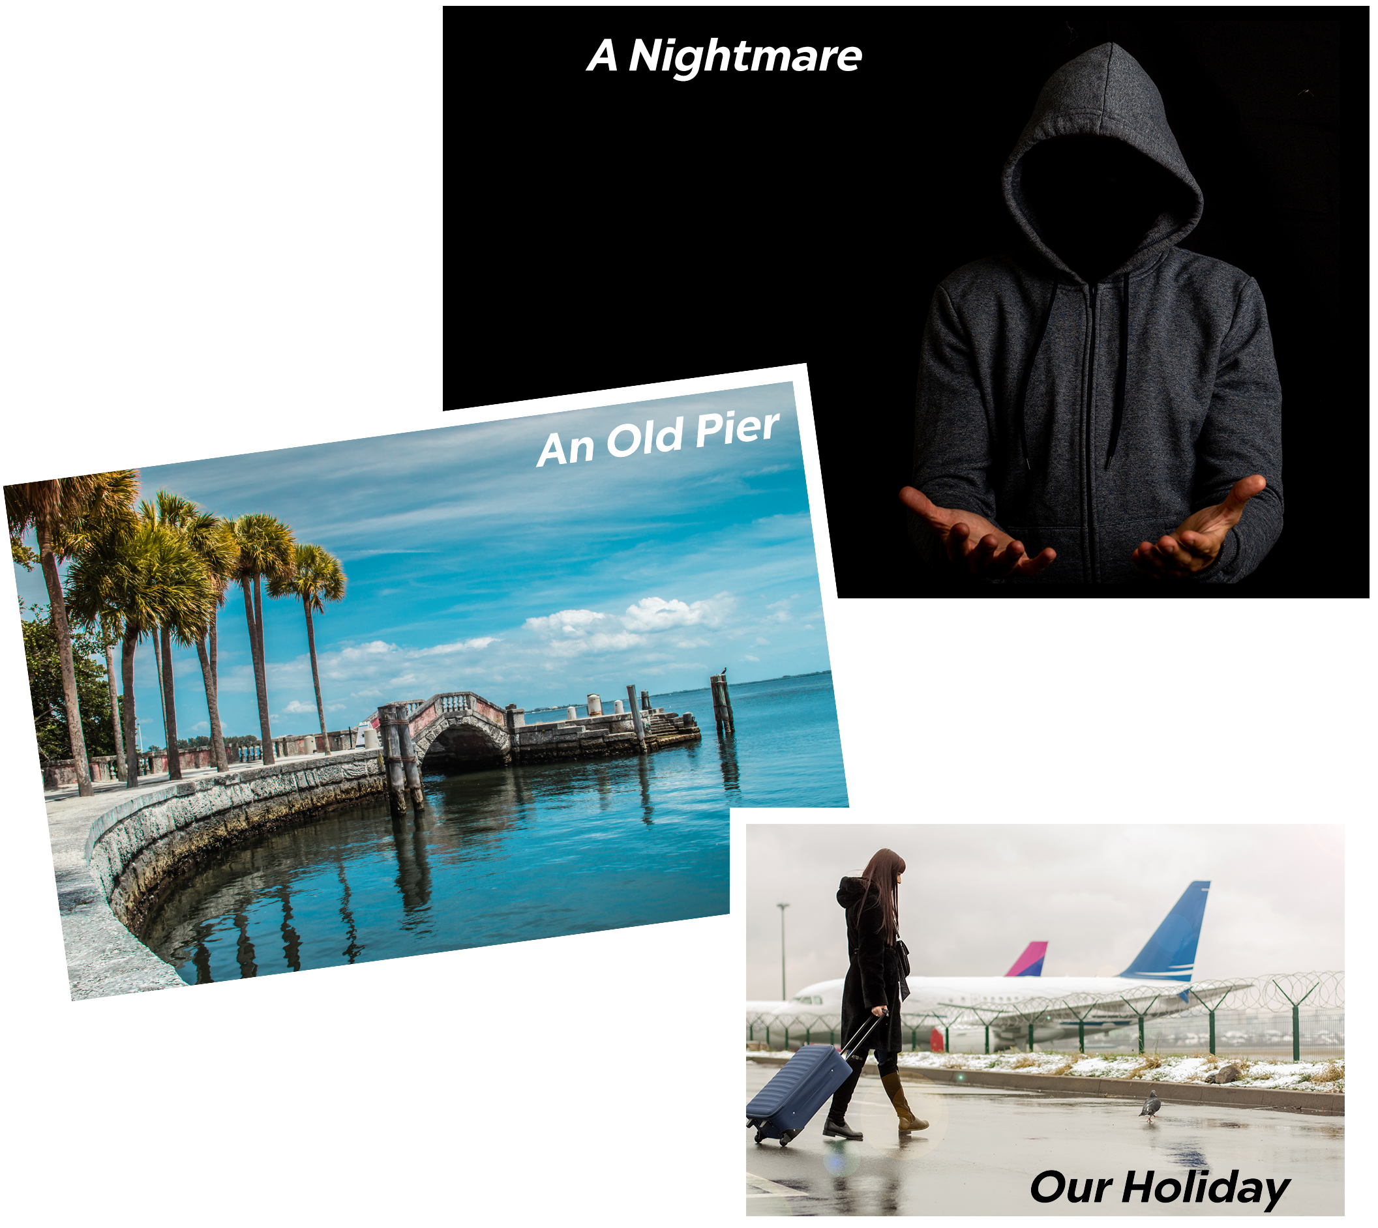
What are they talking about?
Which movie they are going to watch?
Listen and check
Mark
Mi

Slide 10
1. Read again and choose the correct answer to each question.
1. What does Mark suggest doing tonight?
A. Watching a TV show.
B. Watching a film.
C. Staying at home.
2. Why doesn't Mark want to see An Old Pier?
A. He doesn't like that type of film.
B. It's not on at a convenient time.
C. He saw it last week.
3. The word "reviews" in the conversation mostly means
A. people's opinions about a film
B. interesting scenes in a film
C. what people don't like about a film
4. What do people think of Our Holiday?
A. Everyone likes it.
B. No one likes it.
C. Most people like it.
Mark: Let’s go to the cinema tonight!
Mi: Good idea! What shall we see?
Mark: A Nightmare is on at Sao Mai Cinema tonight.
Mi: Is it a fantasy?
Mark: No, it’s a horror film.
Mi: That’s too scary for me. Look! An Old Pier is on at Town Cinema. It’s a documentary.
Mark: I don’t really like documentaries. They’re often boring. What about Our Holiday?
Mi: What kind of film is it?
Mark: It’s a comedy.
Mi: And who stars in it?
Mark: Kate Harrison and Lily Collins.
Mi: Um, they're pretty good. What's it about?
Mark: It’s about two women living in different countries and they decide to exchange houses.
Mi: What are the reviews like?
Mark: Well, although a few people say it’s a bit silly, most say it’s funny and interesting.
...

Slide 11
1. Read again and choose the correct answer to each question.
1. What does Mark suggest doing tonight?
A. Watching a TV show.
B. Watching a film.
C. Staying at home.
2. Why doesn't Mark want to see An Old Pier?
A. He doesn't like that type of film.
B. It's not on at a convenient time.
C. He saw it last week.
3. The word "reviews" in the conversation mostly means
A. people's opinions about a film
B. interesting scenes in a film
C. what people don't like about a film
4. What do people think of Our Holiday?
A. Everyone likes it.
B. No one likes it.
C. Most people like it.
Mark: Let’s go to the cinema tonight!
Mi: Good idea! What shall we see?
Mark: A Nightmare is on at Sao Mai Cinema tonight.
Mi: Is it a fantasy?
Mark: No, it’s a horror film.
Mi: That’s too scary for me. Look! An Old Pier is on at Town Cinema. It’s a documentary.
Mark: I don’t really like documentaries. They’re often boring. What about Our Holiday?
Mi: What kind of film is it?
Mark: It’s a comedy.
Mi: And who stars in it?
Mark: Kate Harrison and Lily Collins.
Mi: Um, they're pretty good. What's it about?
Mark: It’s about two women living in different countries and they decide to exchange houses.
Mi: What are the reviews like?
Mark: Well, although a few people say it’s a bit silly, most say it’s funny and interesting.
...

Slide 12
1. Read again and choose the correct answer to each question.
1. What does Mark suggest doing tonight?
A. Watching a TV show.
B. Watching a film.
C. Staying at home.
2. Why doesn't Mark want to see An Old Pier?
A. He doesn't like that type of film.
B. It's not on at a convenient time.
C. He saw it last week.
3. The word "reviews" in the conversation mostly means
A. people's opinions about a film
B. interesting scenes in a film
C. what people don't like about a film
4. What do people think of Our Holiday?
A. Everyone likes it.
B. No one likes it.
C. Most people like it.
Mark: Let’s go to the cinema tonight!
Mi: Good idea! What shall we see?
Mark: A Nightmare is on at Sao Mai Cinema tonight.
Mi: Is it a fantasy?
Mark: No, it’s a horror film.
Mi: That’s too scary for me. Look! An Old Pier is on at Town Cinema. It’s a documentary.
Mark: I don’t really like documentaries. They’re often boring. What about Our Holiday?
Mi: What kind of film is it?
Mark: It’s a comedy.
Mi: And who stars in it?
Mark: Kate Harrison and Lily Collins.
Mi: Um, they're pretty good. What's it about?
Mark: It’s about two women living in different countries and they decide to exchange houses.
Mi: What are the reviews like?
Mark: Well, although a few people say it’s a bit silly, most say it’s funny and interesting.
...

Slide 13
1. Read again and choose the correct answer to each question.
1. What does Mark suggest doing tonight?
A. Watching a TV show.
B. Watching a film.
C. Staying at home.
2. Why doesn't Mark want to see An Old Pier?
A. He doesn't like that type of film.
B. It's not on at a convenient time.
C. He saw it last week.
3. The word "reviews" in the conversation mostly means
A. people's opinions about a film
B. interesting scenes in a film
C. what people don't like about a film
4. What do people think of Our Holiday?
A. Everyone likes it.
B. No one likes it.
C. Most people like it.
Mark: Let’s go to the cinema tonight!
Mi: Good idea! What shall we see?
Mark: A Nightmare is on at Sao Mai Cinema tonight.
Mi: Is it a fantasy?
Mark: No, it’s a horror film.
Mi: That’s too scary for me. Look! An Old Pier is on at Town Cinema. It’s a documentary.
Mark: I don’t really like documentaries. They’re often boring. What about Our Holiday?
Mi: What kind of film is it?
Mark: It’s a comedy.
Mi: And who stars in it?
Mark: Kate Harrison and Lily Collins.
Mi: Um, they're pretty good. What's it about?
Mark: It’s about two women living in different countries and they decide to exchange houses.
Mi: What are the reviews like?
Mark: Well, although a few people say it’s a bit silly, most say it’s funny and interesting.
...

Slide 14
1. Read again and choose the correct answer to each question.
1. What does Mark suggest doing tonight?
A. Watching a TV show.
B. Watching a film.
C. Staying at home.
2. Why doesn't Mark want to see An Old Pier?
A. He doesn't like that type of film.
B. It's not on at a convenient time.
C. He saw it last week.
3. The word "reviews" in the conversation mostly means
A. people's opinions about a film
B. interesting scenes in a film
C. what people don't like about a film
4. What do people think of Our Holiday?
A. Everyone likes it.
B. No one likes it.
C. Most people like it.
Mark: Let’s go to the cinema tonight!
Mi: Good idea! What shall we see?
Mark: A Nightmare is on at Sao Mai Cinema tonight.
Mi: Is it a fantasy?
Mark: No, it’s a horror film.
Mi: That’s too scary for me. Look! An Old Pier is on at Town Cinema. It’s a documentary.
Mark: I don’t really like documentaries. They’re often boring. What about Our Holiday?
Mi: What kind of film is it?
Mark: It’s a comedy.
Mi: And who stars in it?
Mark: Kate Harrison and Lily Collins.
Mi: Um, they're pretty good. What's it about?
Mark: It’s about two women living in different countries and they decide to exchange houses.
Mi: What are the reviews like?
Mark: Well, although a few people say it’s a bit silly, most say it’s funny and interesting.
...

Slide 15
2. Choose the correct word or phrase to complete each of the following sentences.
1. A film that tries to make the audience laugh is a (comedy / documentary).
2. A film that is based only on imagination, not on real facts, is a (comedy / fantasy).
3. A film that shows real life events or stories is a (documentary / horror film).
4. A film that is set in the future, often about science, is a (cartoon / science fiction film).
5. A film in which strange and frightening things happen is a (horror film / comedy).
2. Choose the correct word or phrase to complete each of the following sentences.
1. A film that tries to make the audience laugh is a (comedy / documentary).
2. A film that is based only on imagination, not on real facts, is a (comedy / fantasy).
3. A film that shows real life events or stories is a (documentary / horror film).
4. A film that is set in the future, often about science, is a (cartoon / science fiction film).
5. A film in which strange and frightening things happen is a (horror film / comedy).
audience: khán giả
laugh: cười vang
based on: dựa trên
imagination: trí tưởng tượng
real life events: các sự kiện có thật
science: khoa học
science fiction: khoa học viễn tưởng
cartoon: hoạt hình
strange: kỳ lạ
frightening: gây sợ

Slide 16
CHECK: How do Mark and Mi feel about these films?
Mark: Let’s go to the cinema tonight!
Mi: Good idea! What shall we see?
Mark: A Nightmare is on at Sao Mai Cinema tonight.
Mi: Is it a fantasy?
Mark: No, it’s a horror film.
Mi: That’s too scary for me. Look! An Old Pier is on at Town Cinema. It’s a documentary.
Mark: I don’t really like documentaries. They’re often boring. What about Our Holiday?
Mi: What kind of film is it?
Mark: It’s a comedy.
Mi: And who stars in it?
Mark: Kate Harrison and Lily Collins.
Mi: Um, they're pretty good. What's it about?
Mark: It’s about two women living in different countries and they decide to exchange houses.
Mi: What are the reviews like?
Mark: Well, although a few people say it’s a bit silly, most say it’s funny and interesting.
...
Adjectives describing films

Slide 17
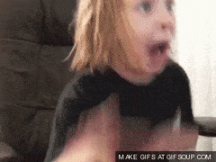
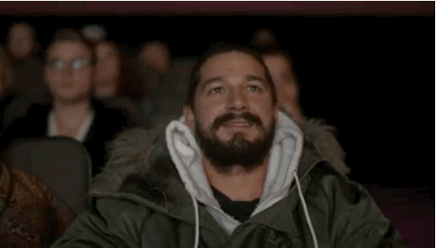
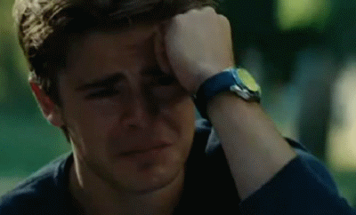
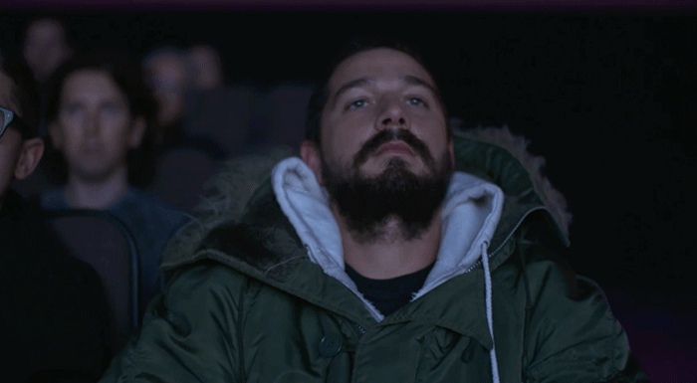
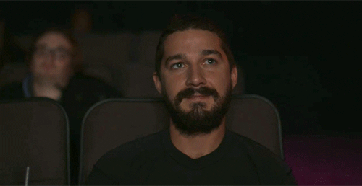
4. Complete the following sentences with the words in the box.
funny interesting frightening moving boring
1. Going to the hospital can be _________________ for a child.
2. The film was so _______________ that the audience couldn’t stop laughing.
3. Many people cried when they saw the _______________
scenes of the film.
4. The film last night was so ___________ that we fell asleep.
5. This book is ______________. I got a lot of useful information from it.
frightening
funny
moving
boring
interesting

Slide 18
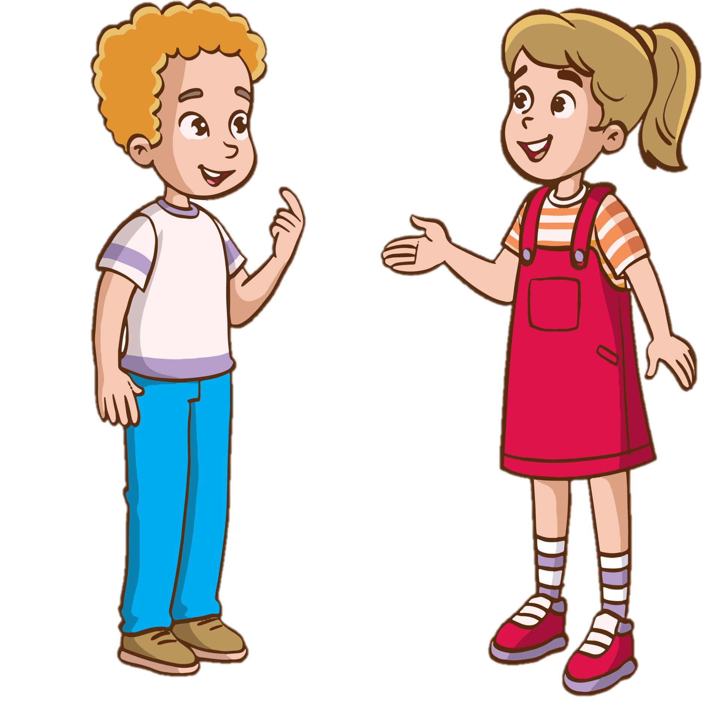

4. Work in pairs. Ask and answer about a type of film. Use some of the adjectives in 4.
Do you like documentaries?
No, I don't.
Why not?
I think they're boring.

Slide 19

THANKS for your attention!

