Slide 1

TRAN HUY VONG - QUANG PHUC SECONDARY SCHOOL

Slide 2



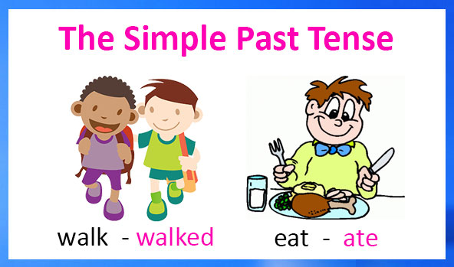
Unit
3
COMMUNITY SERVICE
LESSON 3: A CLOSER LOOK 2

Slide 3
LESSON 3: A CLOSER LOOK 2
IRREGULAR VERBS
REGULAR VERBS
V_{1 →} V _{2 ( S. P)}
V₁ → V-ed
grow → grew
Collect → collected
make → made
Reuse → reused
Send → sent
Join → joined
Teach → taught
Help → helped
Take → took
Plant → planted
Buy → bought
Pick → picked
See → saw
Read → read
Volunteer → volunteered

Slide 4

WARM-UP
What did you do last weekend?
What did you watch yesterday?
Who did you meet two days ago?

Slide 5
1: GRAMMAR: PAST SIMPLE TENSE
TO BE
+ S + Was/were +…
They were friends
VERBS
+ S + V_ed/V2 + …
She worked yesterday.
S + was/were not + …
They weren’t friends.
S + didn’t + V(base form ) + …
She didn’t work yesterday.
? Was/Were + s +…?
Yes, S + was/were.
No, S + was/were not.
Were they friends?
Yes, they were.
? Did + S + V(base form) + …?
Yes, S + did.
No, S + didn’t.
Did she work yesterday?
No, she didn’t.
USAGE:
Yesterday, last…, …ago, this morning, in 2022, 2021,… ; in the past, …

Slide 6
2: PRACTICE
Task 1: Circle the correct answer A, B, or C to complete each sentence.
1. Green School ______ vegetables for an orphanage last spring. A. is growing B. grew C. grows 2. Children ______ plastic bottles for recycling a month ago. A. are collecting B. collect C. collected 3. We ______ English to children in a primary school last summer. A. are teaching B. taught C. teach

Slide 7
2: PRACTICE
Task 1: Circle the correct answer A, B, or C to complete each sentence.
4. Our school club ______ gloves for old people in nursing homes last winter. A. made B. is making C. make 5. We ______ bottles to help the environment last month. A. are reusing B. reuse C. reused

Slide 8
2: PRACTICE
Task 2: Complete the sentences the the past simple form of the given verbs.
took
1. Care for Animals (take) _______ care of thousands of homeless dogs and cats last year. 2. ___________ teenagers (join) ___________ Lending Hand in 2015? 3. We (help) ___________ the elderly in a village last summer. 4. Last year, we (send) ___________ textbooks to help children in a rural village. 5. Tom (volunteer) ______________ to teach English in our village last winter.
Did
join
helped
sent
volunteered

Slide 9
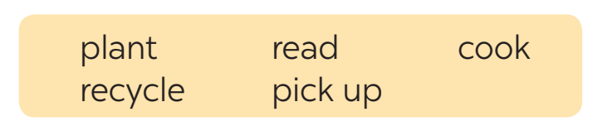
2: PRACTICE
Task 3: Complete the sentences with the correct forms of the verbs from the box.
1. The club members _____________ food for patients every Sunday. 2. ________ you _____________ those trees in the playground last month? 3. Nick and his friends _________________ rubbish on the beach now. 4. Tom ______________ the plastic bottles, and now he has some nice vases. 5. We often ____________ books to old people in a nursing home.
cook
Did
plant
are picking up
recycled
read

Slide 10
2: PRACTICE
Task 4: Write complete sentences from the prompts.
1. last year / our club / donate / books / children in rural areas. _____________________________________________________ 2. children / send / you thank-you cards / a week ago? _____________________________________________________ 3. I / teach / two children in grade 2 / last summer. _____________________________________________________ 4. Last spring / we / help / the elderly / nursing home. _____________________________________________________ 5. How / you / help / people / in flooded areas / last year? _____________________________________________________
Last year, our club donated books to children in rural areas.
Did children send you thank-you cards a week ago?
I taught two children in grade 2 last summer.
Last spring, we helped the elderly in a nursing home.
How did you help the people in flooded areas last year?

Slide 11

3: CONSOLIDATION
HOMEWORK
Complete exercises in the Workbook.

Slide 12

Website: sachmem.vn
Fanpage: facebook.com/sachmem.vn/

