Slide 1

TRAN HUY VONG - QUANG PHUC SECONDARY SCHOOL

Slide 2


LESSON 7: LOOKING BACK & PROJECT

Slide 3


Tug of war
PLAY

Slide 4


This type of film makes you laugh.
documentary
horror
science fiction
comedy
fantasy
NEXT

Slide 5
This type of film has supernatural events.
fantasy
horror
science fiction
documentary
comedy
NEXT

Slide 6
This type of film gives us useful information about animals, science or technology.
science fiction
documentary
horror
fantasy
comedy
NEXT

Slide 7
This type of film is about life in the future, robots, and space travel
fantasy
comedy
horror
documentary
science fiction
NEXT

Slide 8
This is a frightening type of film.
science fiction
comedy
horror
fantasy
documentary
NEXT

Slide 9
The film was long and _____. Many people went home before it ended.
dull
dull
funny
shocking
NEXT

Slide 10
The film is too_________with a lot of fighting and killing scenes.
violent
violent
funny
interesting
NEXT

Slide 11
A____________story often makes us feel afraid.
frightening
frightening
moving
interesting
NEXT

Slide 12
The news was___________. I couldn’t believe it.
shocking
shocking
funny
confusing
NEXT

Slide 13
moving
_________ films often make us cry.
moving
funny
amusing
EXIT

Slide 14
The road signs were_________ and we soon got lost.
confusing
confusing
interesting
shocking
EXIT

Slide 15
LESSON 7: LOOKING BACK & PROJECT
WARM-UP
Spin the wheel: Types of films
(Task 2: Give an example for every film type in the box.)
Game: Tug of war
Task 1: Match the types of film in column A with their descriptions in column B.
Task 3: Choose the correct answer (A, B, or C) to complete each of the following sentences.
VOCABULARY REVIEW
GRAMMAR REVIEW
Task 4: Match the sentences or sentence halves in columns A and B.

Slide 16

GRAMMAR REVIEW
4
Match the sentences or sentence halves in columns A and B.
Aim of the task:
To help students revise the connectors: although/though and however.

Slide 17
GRAMMAR REVIEW
4
Match the sentences or sentence halves in columns A and B.
A | B
1. Although he arrived late, | a. people still buy them.
2. The film received good reviews. | b. However, the number of people going to cinemas is increasing.
3. Though popcorn and other snacks in the cinema are very expensive, | c. I don’t want to stay home tonight.
4. Cinema tickets are expensive. | d. he left the cinema early.
5. Although I don’t really like to go to the cinema, | e. However, only a few people saw it.
1. d
2. e
3.a
4. b
5. c

Slide 18
LESSON 7: LOOKING BACK & PROJECT
WARM-UP
Spin the wheel: Types of films
(Task 2: Give an example for every film type in the box.)
Game: Tug of war
Task 1: Match the types of film in column A with their descriptions in column B.
Task 3: Choose the correct answer (A, B, or C) to complete each of the following sentences.
VOCABULARY REVIEW
GRAMMAR REVIEW
Task 4: Match the sentences or sentence halves in columns A and B.
PROJECT
Project: Posters exhibition

Slide 19

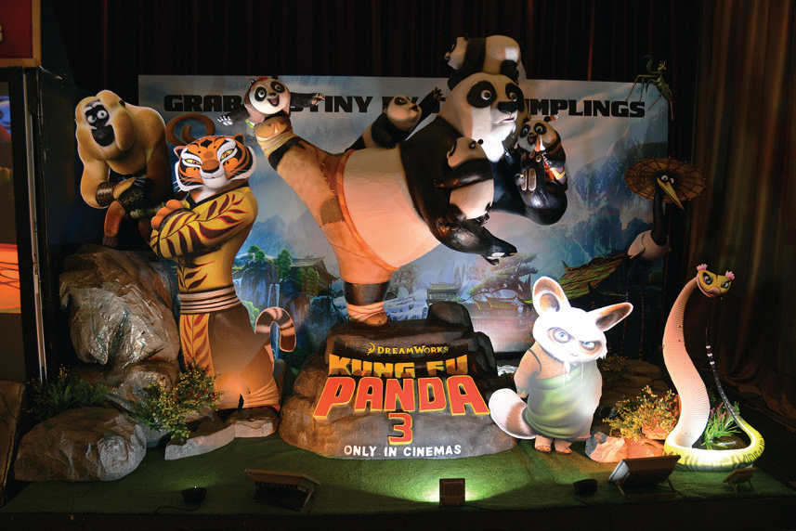

PROJECT
Posters exhibition
5
Work in groups.
1
Choose one of your favourite films and design a poster for it, including:
- name of the film; - type of film; - its director and main actors / actresses; - a short summary; - your overall opinions about the film; - the showtime and cinema; - pictures or photos to illustrate the film.
2
Organise them into an exhibition.
3
Vote for the best poster.

Slide 20
LESSON 7: LOOKING BACK & PROJECT
WARM-UP
Spin the wheel: Types of films
(Task 2: Give an example for every film type in the box.)
Game: Tug of war
Task 1: Match the types of film in column A with their descriptions in column B.
Task 3: Choose the correct answer (A, B, or C) to complete each of the following sentences.
VOCABULARY REVIEW
GRAMMAR REVIEW
Task 4: Match the sentences or sentence halves in columns A and B.
PROJECT
Project: Posters exhibition
CONSOLIDATION
Wrap-up
Homework

Slide 21
CONSOLIDATION
1
Wrap-up
Vocabulary review
Grammar review
Project: Design film posters

Slide 22

CONSOLIDATION
2
Homework
Prepare for the next lesson: Unit 9: Festivals around the world Lesson 1: Getting started

Slide 23

Website: hoclieu.vn
Fanpage: facebook.com/www.tienganhglobalsuccess.vn/

