Slide 1
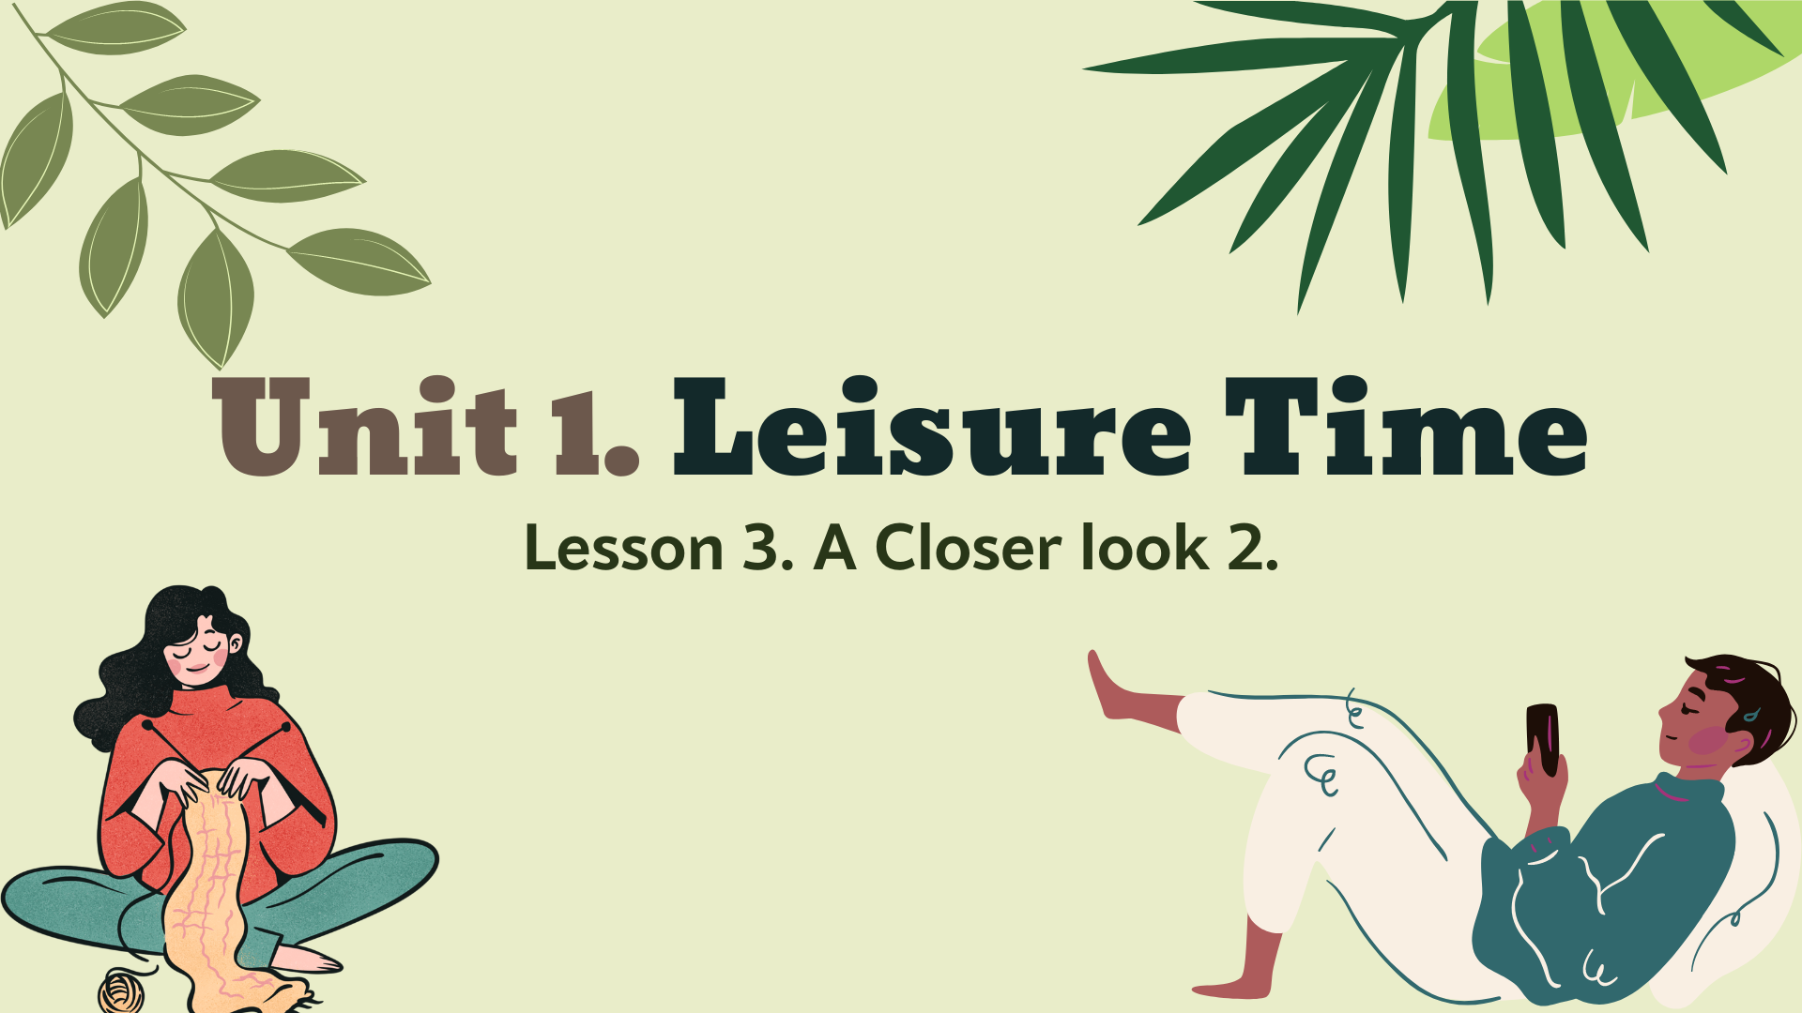

Slide 2
GRAMMAR
Verb of liking/disliking + gerunds.
Verb of liking/disliking + to_infinitive.

Slide 3
Verb of liking/disliking + gerunds.
Verb of liking/disliking + to_infinitive.
Lưu ý: Một số từ vựng chỉ sự thích / không thích chỉ có thể đi với động từ đuôi – ing (gerunds).
e.g. They dislike cooking.
TUY NHIÊN, một số từ vựng có thể đi với cả động từ đuôi – ing (gerunds) và động từ có “to” (to_infinitive).
e.g. They love cooking.
to cook

Slide 4

1. Work in pairs. Put the verbs in the appropriate column.
Verbs followed by gerunds only. | Verbs followed by both gerunds and to-inf.
detest
fancy
dislike
enjoy
love
like
hate
prefer

Slide 5
detest; dislike; hate (v) ghét, không thích.
like, love, fancy, enjoy, prefer (v) thích.

Slide 6
2. Choose the correct answer(s).
1. I love …, so in my leisure time, I go to some villages near Ha Noi to relax and enjoy the outdoors.
A. travelling B. travel C. to travel
2. Tom enjoys … puzzles, especially Sudoku. A. doing B. do C. to do
3. When do you like … TV? A. to watch B. watch C. watching
4. Do you fancy … to the cinema this weekend? A. go B. going C. to go
5. I detest … I think it's cruel to harm animals. A. hunting B. to hunt C. hunt

Slide 7
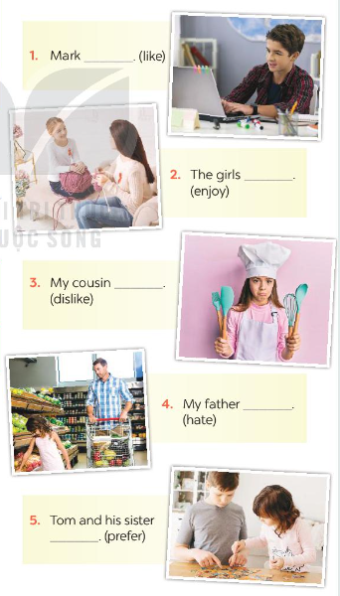
3. Look at the pictures and complete the sentences, using the verbs in brackets in their suitable form.
Mark (like) _____________________________
The girls (enjoy) _________________________
My cousin (dislike) _______________________
My father (hate)_________________________
Tom and his sister (prefer) ___________________
likes surfing / to surf the net
enjoy doing DIY
dislikes cooking
hates going / to go shopping
prefer doing / to do puzzles

Slide 8
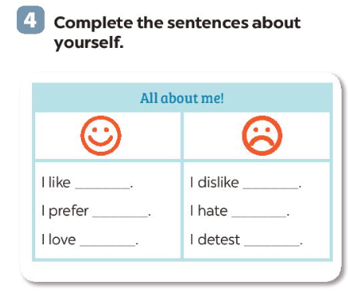

Slide 9
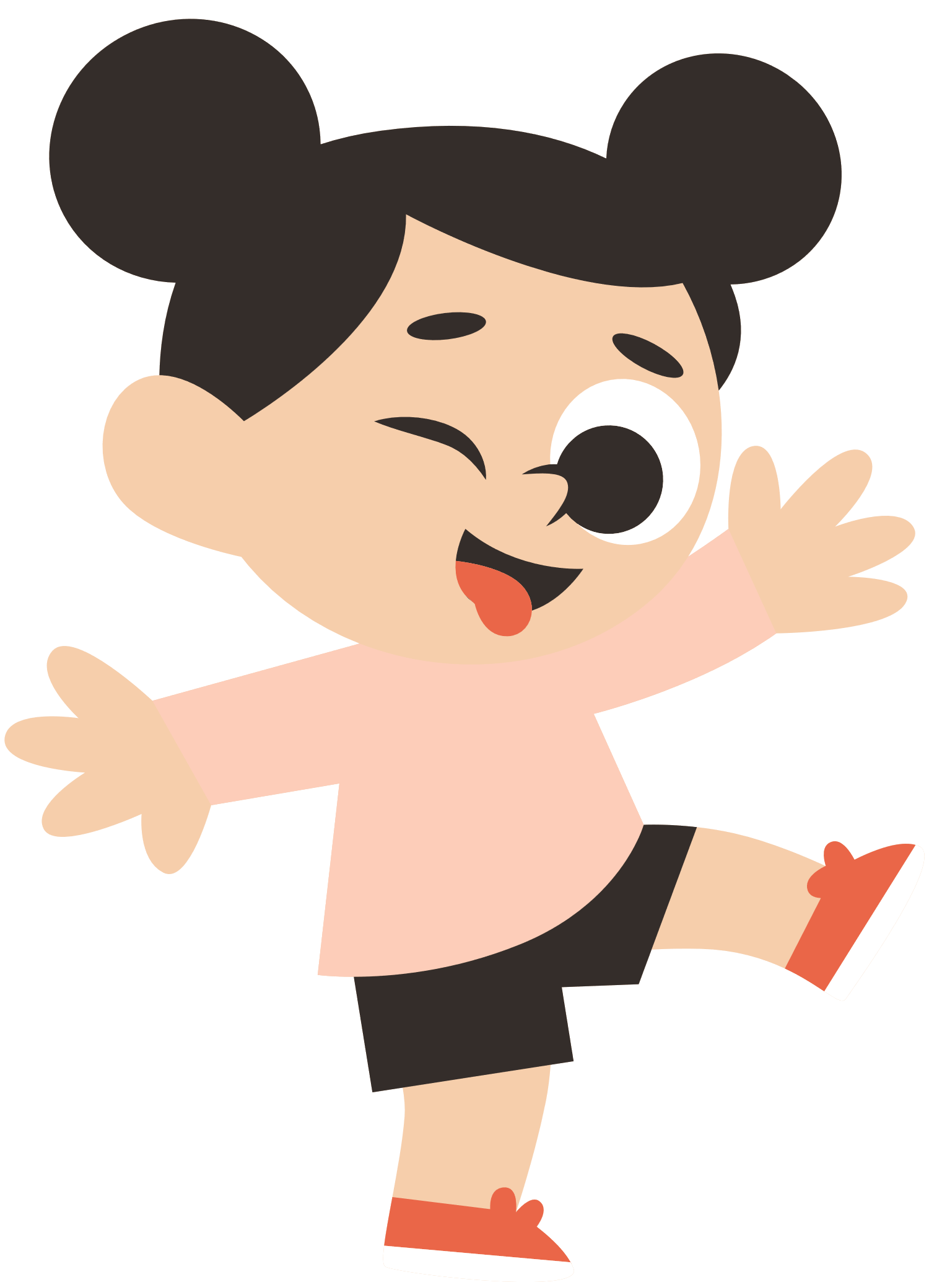
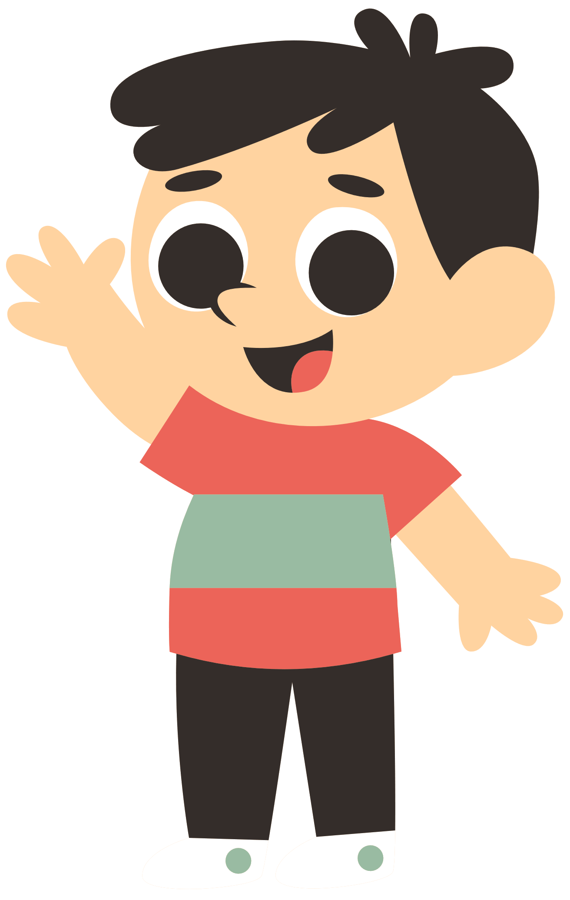
Good bye class!
See you in next lessons!

