Slide 1
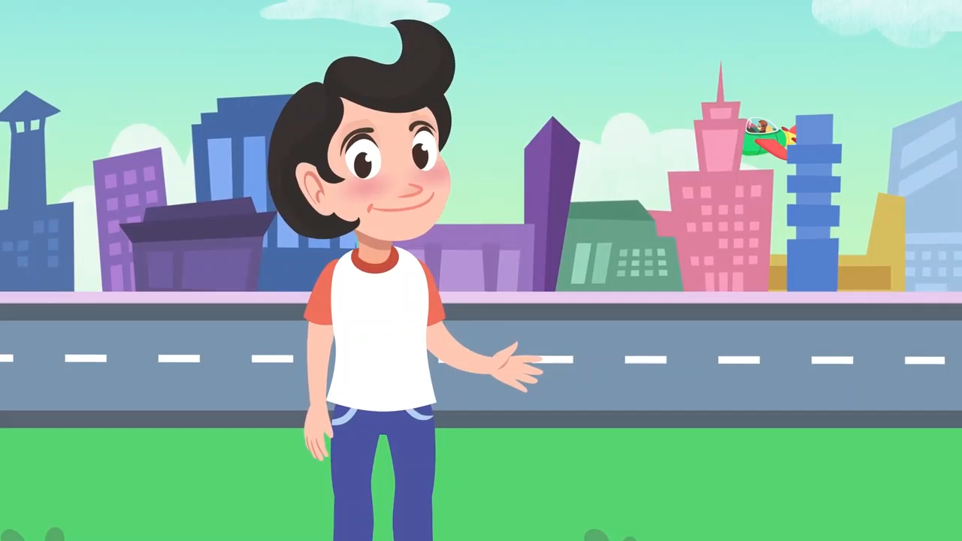
What means of transportation do you remember?

Slide 2
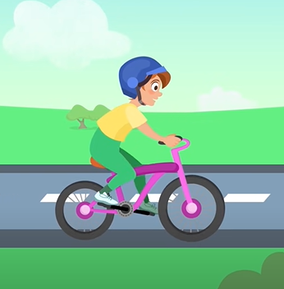
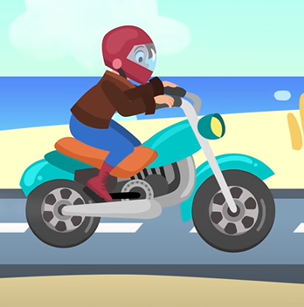
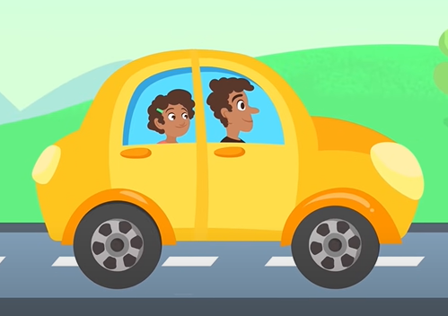
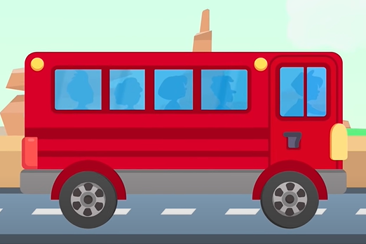
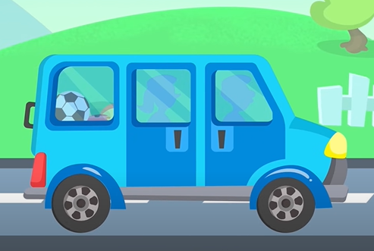
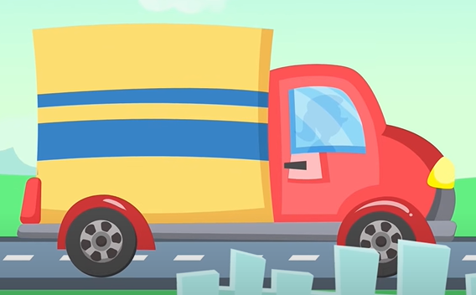
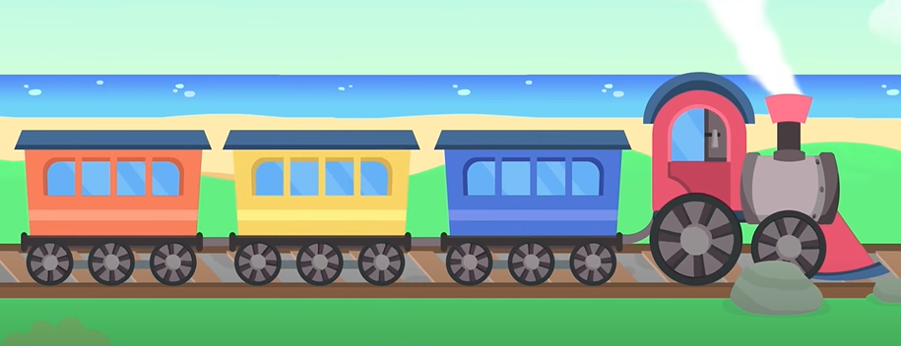
List some means of transportation you remember
bike
motorbike
car
bus
van
truck
train

Slide 3
UNIT 7:
TRAFFIC
Lesson 1: Getting started

Slide 4
Objectives
Have an overview of the unit topic: Traffic
Listen to a short dialogue for gist
Read a short dialogue for specific details

Slide 5
NEW WORDS

Slide 6


NEW WORDS
cycle (v)
/ˈsaɪ.kəl/
đạp xe

Slide 7
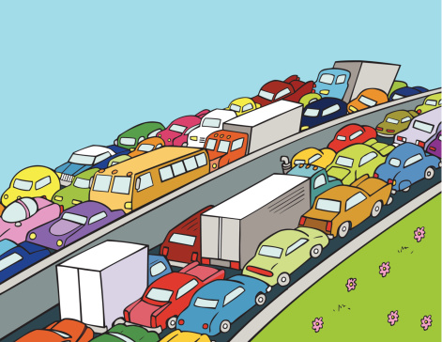
NEW WORDS
traffic jam (n.phr.)
/ˈtræf.ɪk ˌdʒæm/
tắc đường

Slide 8
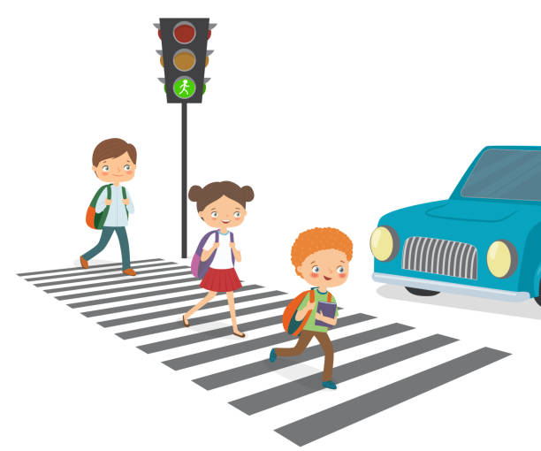
NEW WORDS
cross the road
/krɒs ðə rəʊd/
băng qua đường

Slide 9

NEW WORDS
rush hour
(n. phr.)
/ˈrʌʃ aʊə(r/
giờ cao điểm

Slide 10
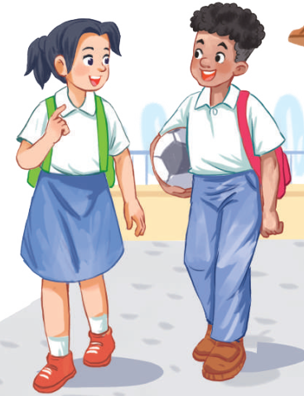
Look and answer.
1. Who are they?
They are Lan and Mark.
2. Where are they?
They are in the school yard.
3. What are they talking about?
sports
traffic
films

Slide 11
Listen and choose.
3. What are they talking about?
sports
traffic
films
Lan: About 10 minutes. Sometimes,
when there are traffic jams, it takes
longer.
Mark: You should be careful, especially
when you cross the road.
Lan: Right. The roads get really crowded.

Slide 12
Ex 2. Read and choose the correct answers.
1. How does Lan often go to school?
A. By bicycle. B. By motorbike. C. On foot.
2. It normally takes Lan ___ to get to school.
A. two minutes B. ten minutes C. twenty minutes
3. Lan and Mark agree to go cycling ______.
A. tomorrow B. every day C. at the weekend

Slide 13
Underline key words
1. How does Lan often go to school?
A. By bicycle. B. By motorbike. C. On foot.
2. It normally takes Lan ___ to get to school.
A. two minutes B. ten minutes C. twenty minutes
3. Lan and Mark agree to go cycling ______.
A. tomorrow B. every day C. at the weekend

Slide 14

Silent read and choose the correct answers.
Lan: Hi, Mark. How are you?
Mark: Good, thanks. And you? What did you do last Sunday?
Lan: I’m fine. Last Sunday afternoon, I cycled round the lake near my home.
Mark: That sounds really healthy. By the way, do you often cycle to school too?
Lan: Yes, but sometimes my mum takes me on her motorbike.
Mark: How far is it from your home to school?
Lan: It’s about two kilometres.
Mark: How long does it take you to cycle there?
Lan: About 10 minutes. Sometimes, when there are traffic jams, it takes longer.
Mark: You should be careful, especially when you cross the road.
Lan: Right. The roads get really crowded.
Mark: Hey, how about going cycling round the lake this Sunday?
Lan: Great! Can you come to my house at 3 p.m.?
Mark: OK, Lan. See you then.

Slide 15
Let’s check!
1. How does Lan often go to school?
A. By bicycle. B. By motorbike. C. On foot.
Mark: … By the way, do you often cycle to school too?
Lan: Yes, but sometimes my mum takes me on her motorbike.

Slide 16
Let’s check!
2. It normally takes Lan ___ to get to school.
A. two minutes B. ten minutes C. twenty minutes
Mark: How far is it from your home to school?
Lan: It’s about two kilometres.
Mark: How long does it take you to cycle there?
Lan: About 10 minutes. Sometimes, when there are traffic jams, it takes longer.

Slide 17
Let’s check!
3. Lan and Mark agree to go cycling ______.
A. tomorrow B. every day C. at the weekend
Mark: Hey, how about going cycling round the lake this Sunday?
Lan: Great! Can you come to my house at 3 p.m.?
Mark: OK, Lan. See you then.

Slide 18
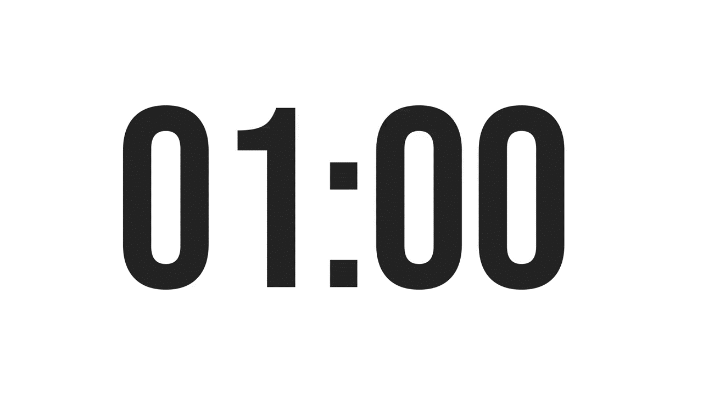
Ex 3. Write one word from the conversation to complete each sentence.
1. Last Sunday afternoon, Lan ______ round the lake near her home.
2. Mark says to Lan: “You ______ be careful, especially when you cross the road.
3. Traffic ______ are a problem in big cities.
4. – ______ does your mum go shopping?
– She often walks.
5. This road is very __________ during the rush hours.

Slide 19
Ex 3. Write one word from the conversation to complete each sentence.
1. Last Sunday afternoon, Lan ______ round the lake near her home.
2. Mark says to Lan: “You ______ be careful, especially when you cross the road.
3. Traffic ______ are a problem in big cities.
4. – ______ does your mum go shopping?
– She often walks.
5. This road is very __________ during the rush hours.
cycled
Lan: I’m fine. Last Sunday afternoon, I cycled round the lake near my home.

Slide 20
Ex 3. Write one word from the conversation to complete each sentence.
1. Last Sunday afternoon, Lan ______ round the lake near her home.
2. Mark says to Lan: “You ______ be careful, especially when you cross the road.”
3. Traffic ______ are a problem in big cities.
4. – ______ does your mum go shopping?
– She often walks.
5. This road is very __________ during the rush hours.
cycled
Mark: You should be careful, especially when you cross the road.
should

Slide 21
Ex 3. Write one word from the conversation to complete each sentence.
1. Last Sunday afternoon, Lan ______ round the lake near her home.
2. Mark says to Lan: “You ______ be careful, especially when you cross the road.”
3. Traffic ______ are a problem in big cities.
4. – ______ does your mum go shopping?
– She often walks.
5. This road is very __________ during the rush hours.
cycled
should
About 10 minutes. Sometimes, when there are traffic jams, it takes longer.
jams

Slide 22
Ex 3. Write one word from the conversation to complete each sentence.
1. Last Sunday afternoon, Lan ______ round the lake near her home.
2. Mark says to Lan: “You ______ be careful, especially when you cross the road.”
3. Traffic ______ are a problem in big cities.
4. – ______ does your mum go shopping?
– She often walks.
5. This road is very __________ during the rush hours.
cycled
should
How => manner
How does your mum go shopping? (Mẹ bạn đi mua sắm bằng gì?)
jams
How

Slide 23
Ex 3. Write one word from the conversation to complete each sentence.
1. Last Sunday afternoon, Lan ______ round the lake near her home.
2. Mark says to Lan: “You ______ be careful, especially when you cross the road.”
3. Traffic ______ are a problem in big cities.
4. – ______ does your mum go shopping?
– She often walks.
5. This road is very __________ during the rush hours.
cycled
should
jams
How
Lan: Right. The roads get really crowded.
crowded

Slide 24
How do you go to school?

Slide 25
GUESSING GAME

Slide 26
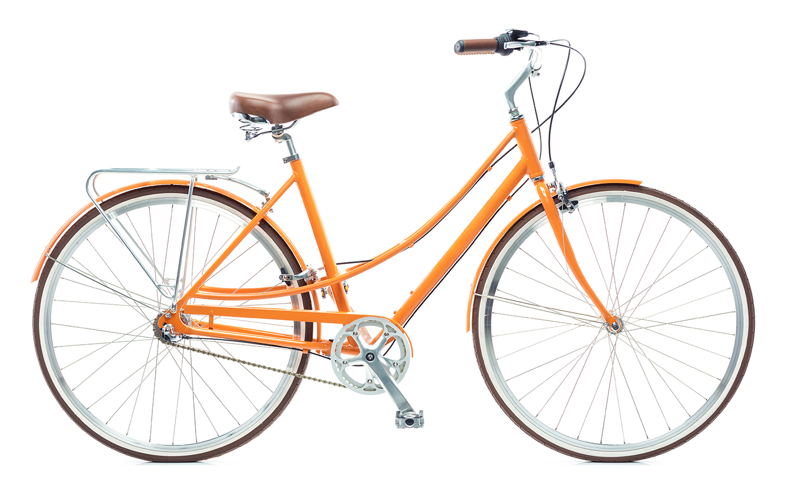
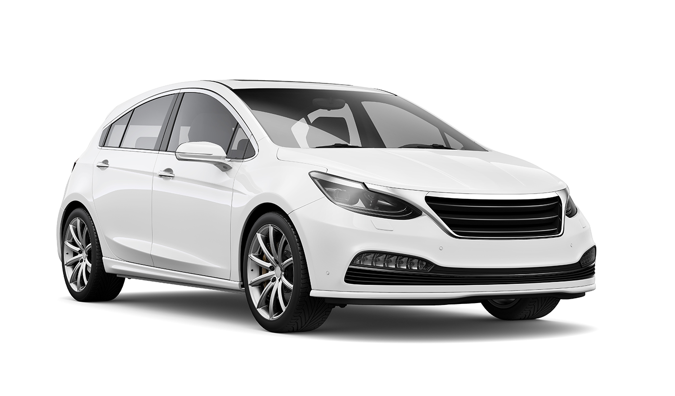
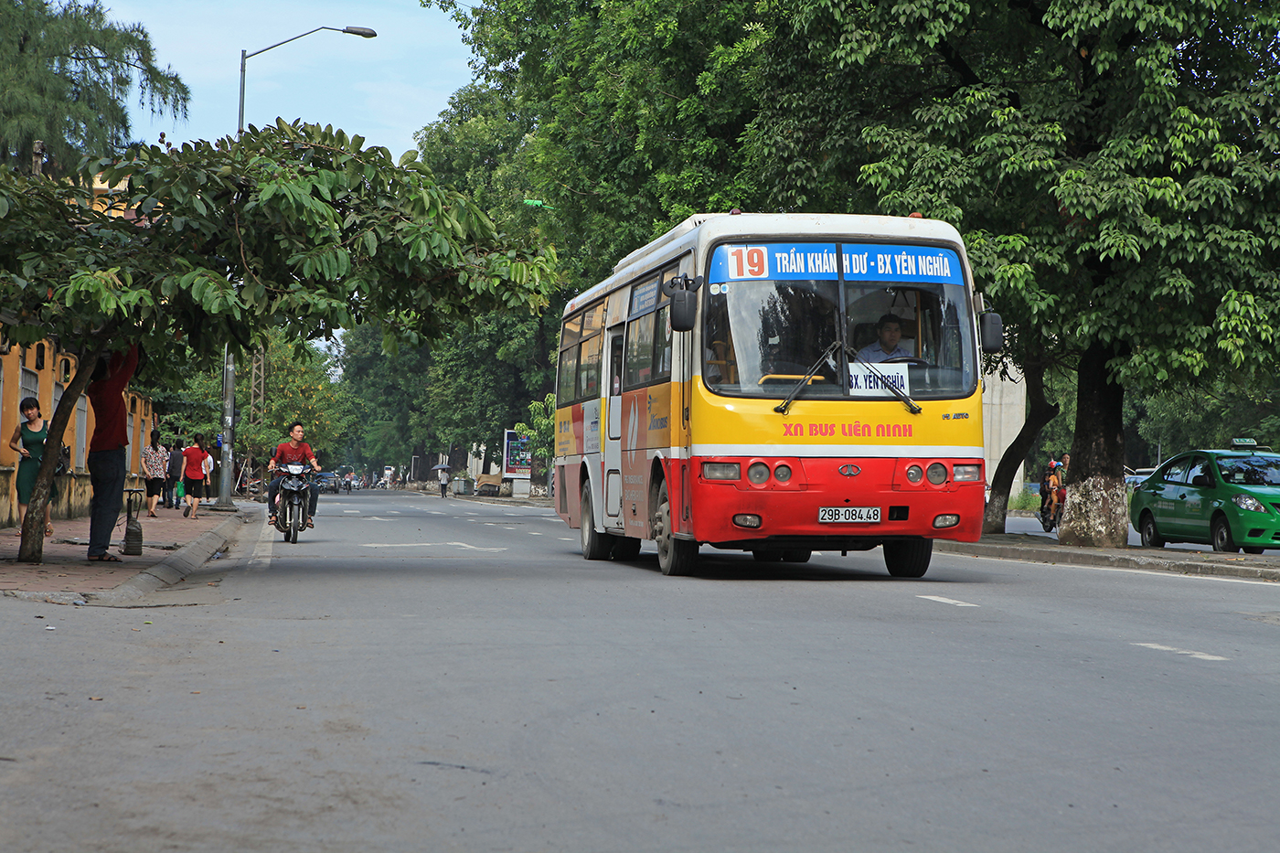
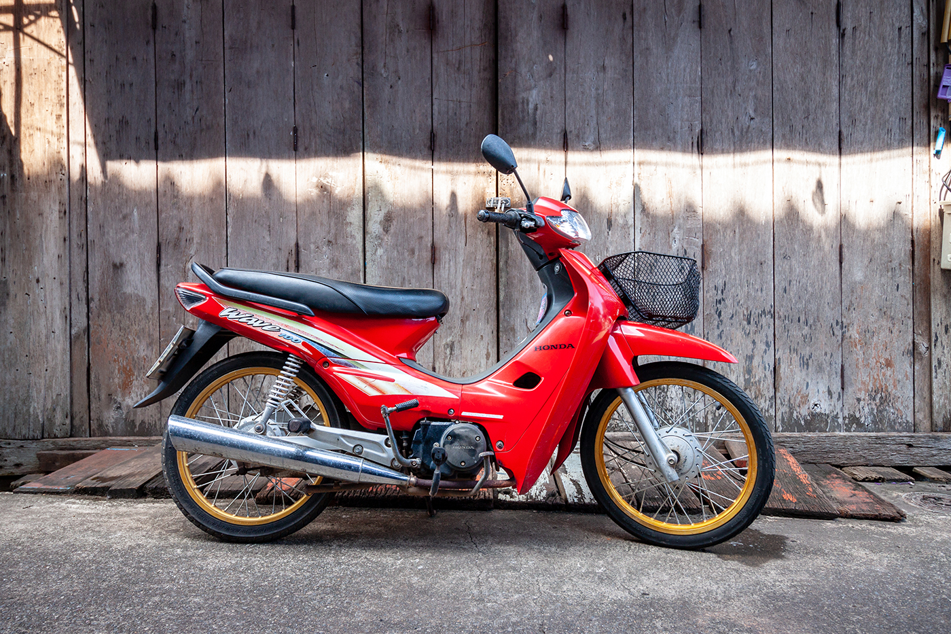
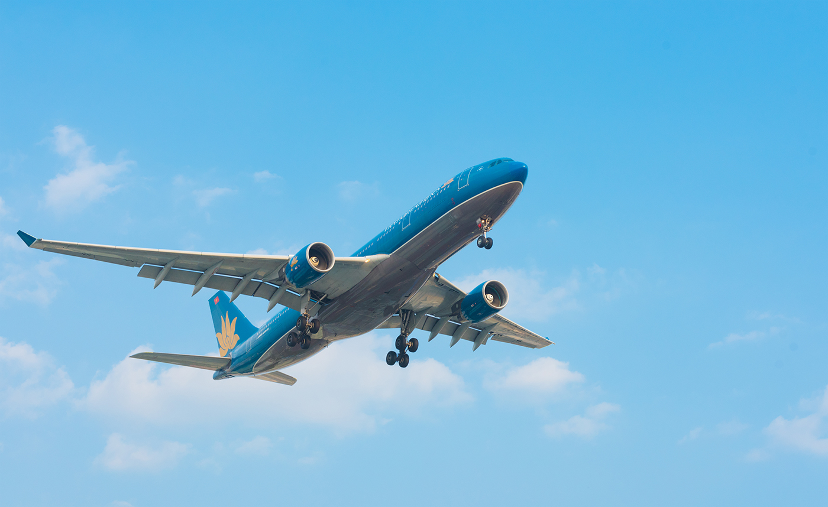
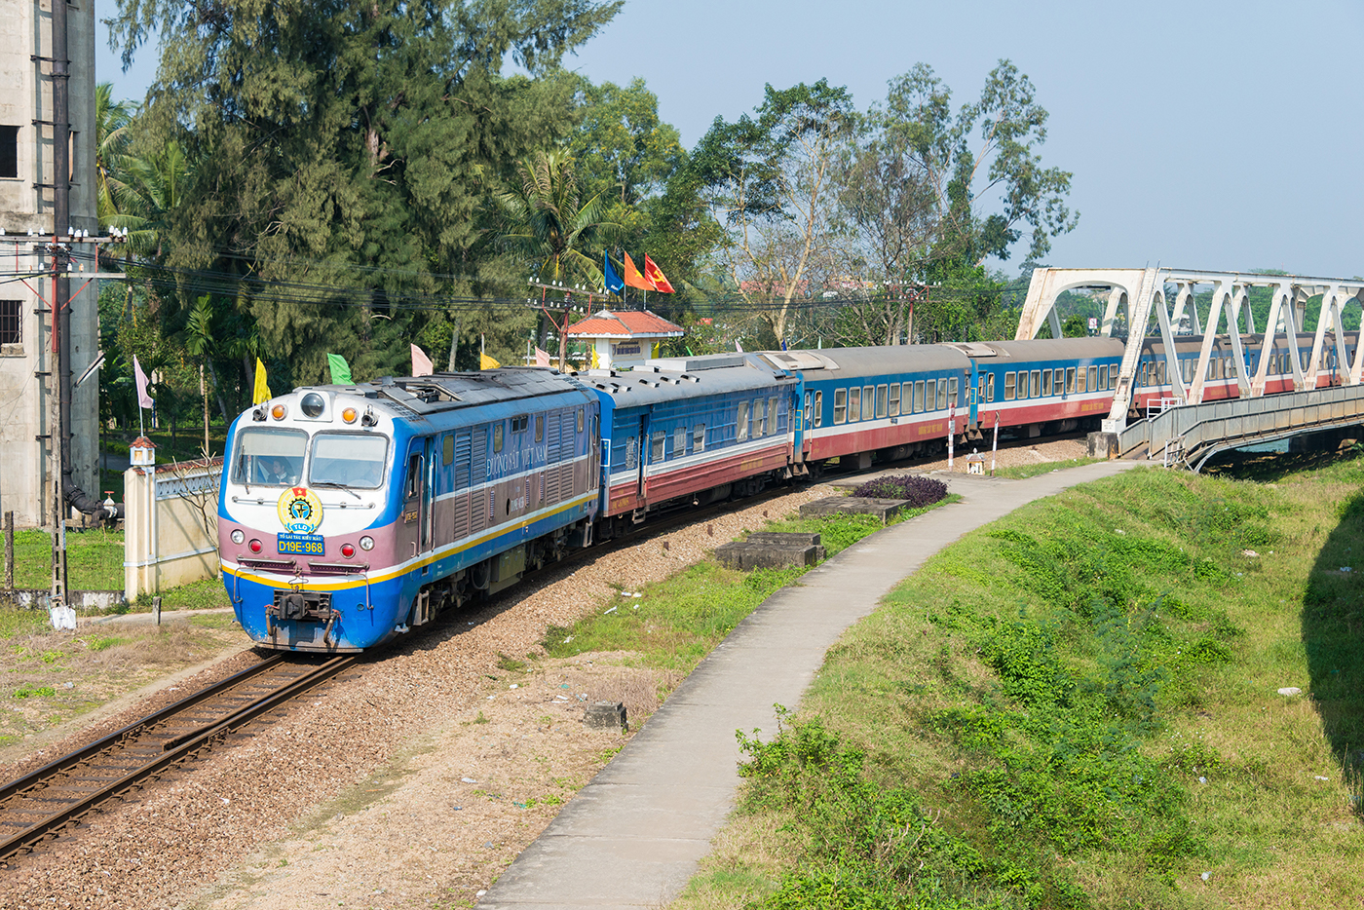
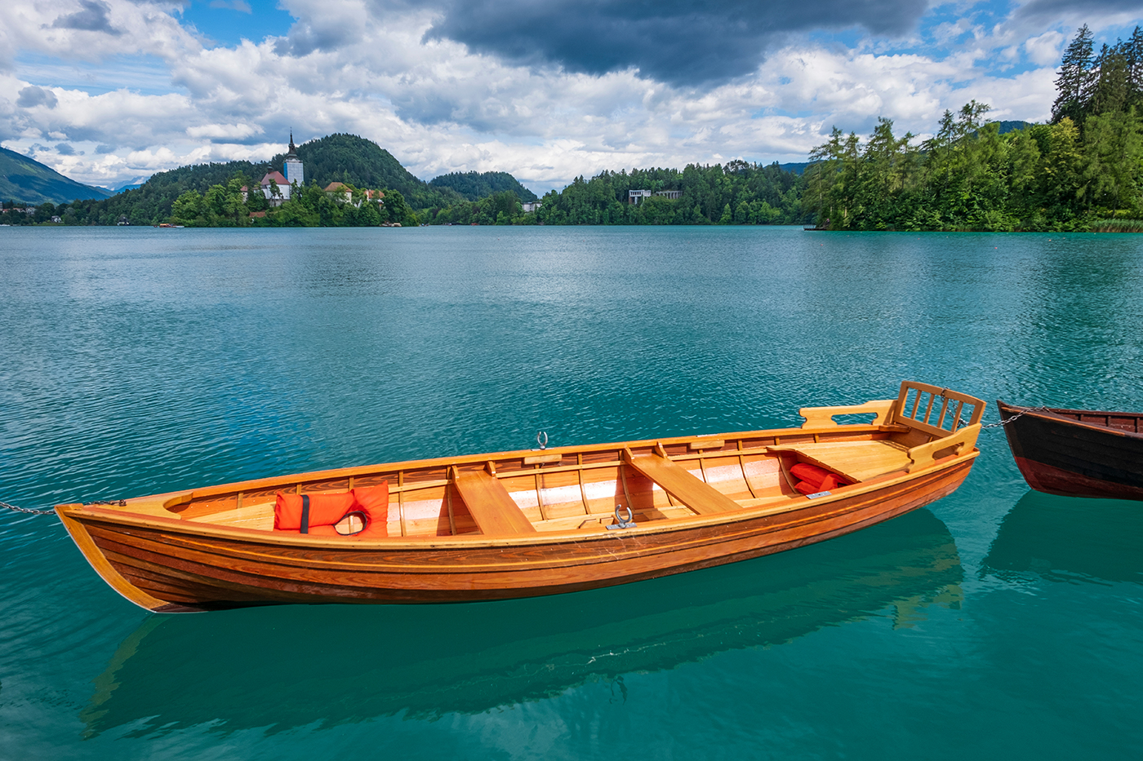
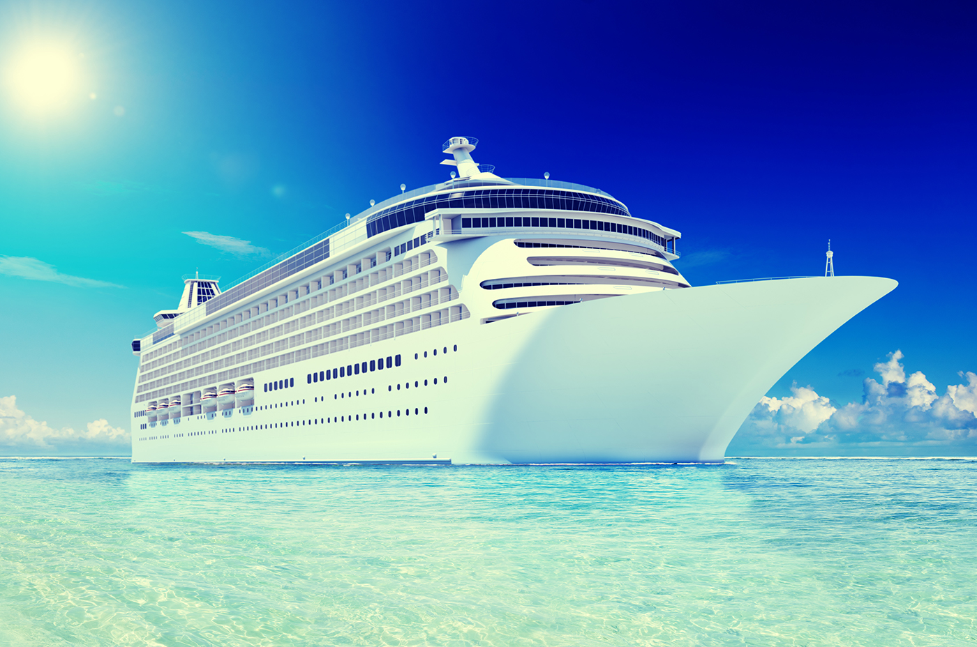
4. Look at pictures and write the words
bicycle
car
bus
motorbike
plane/ airplane
train
boat
ship

Slide 27
FIND SOMEONE WHO
SURVEY

Slide 28
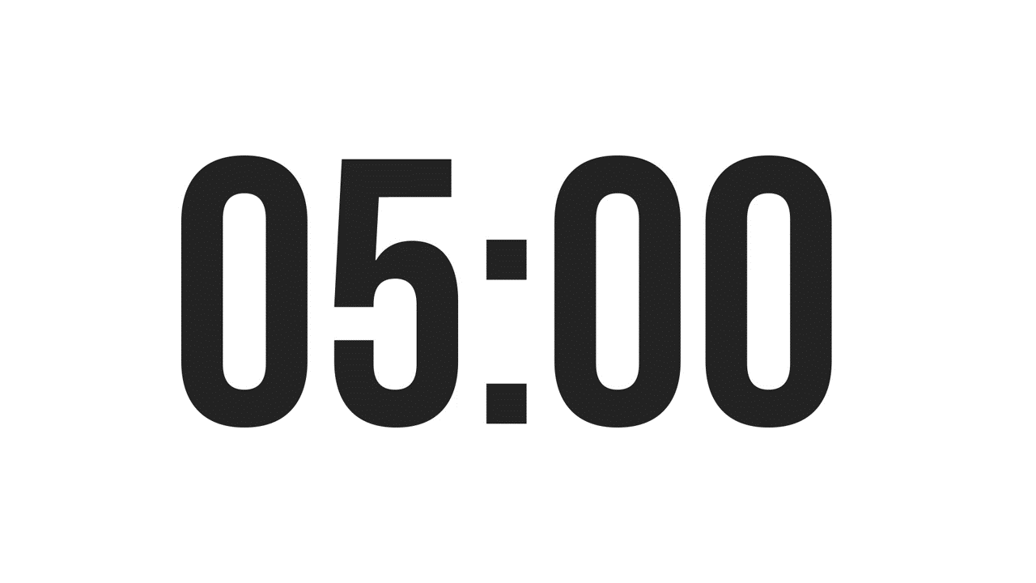
FIND SOMEONE WHO …
Activities | Name
usually walks to school | _____________
never goes to school by bus | _____________
cycles for exercise everyday | _____________
never travels by plane | _____________
sometimes go to school in a car | _____________
Do you usually walk to school?
Yes, I do. / No, I don’t.

Slide 29
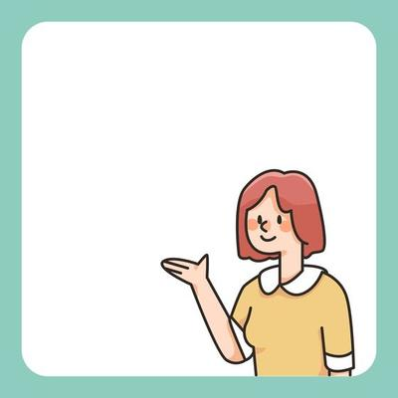
Presentation
My friend, Nam usually walks to school. He never goes to school by bus.
Tam usually cycles for exercise everyday.
…

Slide 30
WRAP-UP
What have you done today?
School activities
Means of transportation
Traffic accidents


Slide 31
Thanks!
Do you have any questions?

