Slide 2



Unit
8
TOURISM
LESSON 2: A CLOSER LOOK 1
1

Slide 3
LESSON 2: A CLOSER LOOK 1
LESSON 1: GETTING STARTED
WARM-UP
Game: BOARD RACE
Task 1: Match the words and phrases with the explanations.
Task 2: Write a phrase from the box next to the sentence to replace ‘it’.
Task 3: Complete the sentences with the words from the box.
VOCABULARY
PRONUNCIATION
Task 4: Listen and repeat the words. Pay attention to the word stress.
Task 5: Mark the stress in the underlined words. Then listen and repeat the sentences.
FURTHER PRACTICE
Game: TYPHOON GAME
CONSOLIDATION
Wrap-up
Homework

Slide 4
BOARD RACE
WARM-UP
Work in 2 teams.
Vocabulary topic: Tourism
The teams have to race to write words on the board. Each student writes one word at a time, before passing the chalk to the next student
After 2 minutes, the team with more correct words will become the winner.
RULES

Slide 5

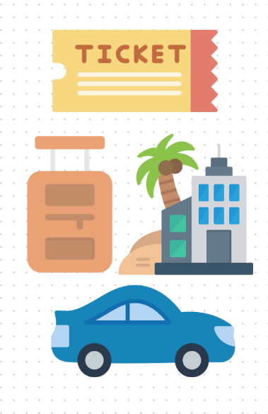
VOCABULARY
package tour (n)
/ˈpæk.ɪdʒ ˌtʊər/
chuyến đi trọn gói
Notes:
a holiday at a fixed price in which the travel company arranges your travel, hotels, and sometimes meals for you

Slide 6

VOCABULARY
self-guided (a)
/ˌselfˈɡaɪ.dɪd/
tự dẫn đường; tự điều khiển
Notes:
A self-guided activity is one which you lead or control yourself, without any direct help from other people

Slide 7

VOCABULARY
itinerary (n)
/aɪˈtɪn.ə.rer.i/
kế hoạch chi tiết của chuyến đi
Notes:
a detailed plan or route of a journey

Slide 8
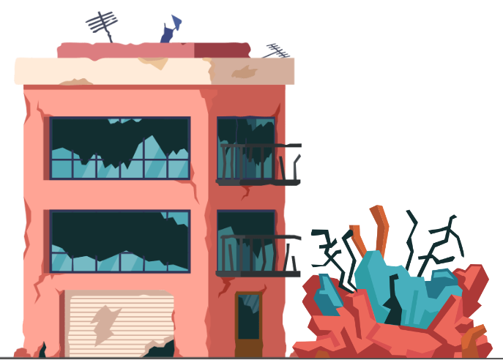
VOCABULARY
ruinous (a)
/ˈruːɪnəs/
bị phá hủy
Notes:
destroyed or severely damaged

Slide 9
VOCABULARY
New words | Pronunciation | Meaning
package tour (n) | /ˈpæk.ɪdʒ ˌtʊər/ | chuyến đi trọn gói
self-guided (a) | /ˌselfˈɡaɪ.dɪd/ | tự dẫn đường; tự điều khiển
itinerary (n) | /aɪˈtɪn.ə.rer.i/ | kế hoạch chi tiết của chuyến đi
ruinous (a) | /ˈruːɪnəs/ | bị phá hủy

Slide 10
VOCABULARY
1
Match the words and phrases with the explanations
a. a plan of a journey, including the route and the places that you visit
b. Accommodation provided in the home of a family in exchange for payment
c. a trip where a traveller does everything on his / her own
d. a web platform which shows directions to a destination
e. a vacation where a travel agent organizes everything for you
1. package holiday
2. self-guided tour
3. trip itinerary
4. homestay
5. Google Maps
Notes:
1. e 2. c 3. a 4. b 5. d

Slide 11
VOCABULARY
2
Write a phrase from the box next to the sentence to replace ‘it’.
ruinous site entrance ticket smooth trip
fixed itinerary travel agency
1. If you want to go into a place to see what is inside, you have to buy it.
2. The Colosseum in Rome is not in its original condition. You can see only parts of it.
3. It takes care of everything for travellers.
4. I don’t like it because I cannot change anything: the time, the destination, … .
5 . We had no trouble at all during it. Everything was ok.
entrance ticket
ruinous site
travel agency
fixed itinerary
smooth trip
Notes:
1. entrance ticket 2. ruinous site 3. travel agency
4. fixed itinerary 5. smooth trip

Slide 12
VOCABULARY
3
Complete the sentences with the words from the box.
entrance apps package self-guided itinerary
self-guided
We’d like to go on a(n) ___________ tour which will be interesting and
be within our budget.
2. Lan sent us the ___________ of her trip to Sa Pa for reference.
3. During the tour, we have to buy the ___________ tickets for the Glass Museum and the Art Gallery.
4. If you take a(n) ___________ holiday, you have to follow a fixed itinerary.
5. If you want to get information about domestic tourist destinations, download these ____________.
itinerary
entrance
package
apps
Notes:
1. self-guided 2. itinerary 3. entrance
4. package 5. apps

Slide 13
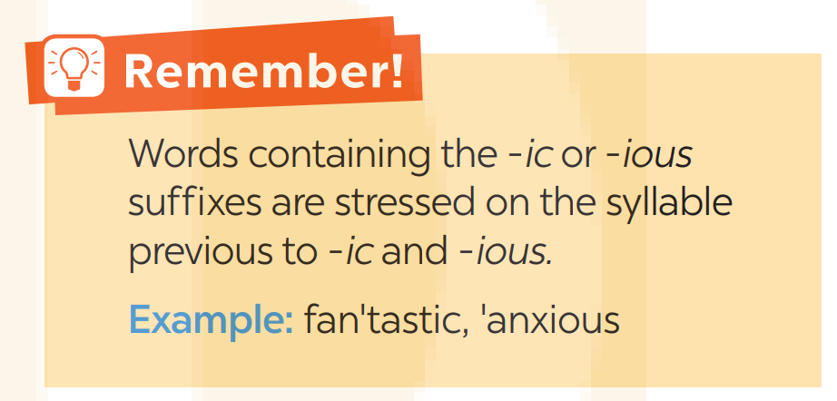
PRONUNCIATION
Stress in words ending in -ic and -ious

Slide 14
PRONUNCIATION
4
Listen and repeat the words. Pay attention to the word stress.
-ic | -ious
basic public classic domestic historic | curious serious delicious hilarious religious

Slide 15
PRONUNCIATION
5
Mark the stress in the underlined words. Then listen and repeat the sentences
1. The visitors are curious about the history of the
old public building.
2. They have an ambitious goal which is to go on a cruise across the Pacific.
.

Slide 16
PRONUNCIATION
5
Mark the stress in the underlined words. Then listen and repeat the sentences
3. We watched some classic movies while we were here on our previous holiday.
4. We stayed at a luxurious hotel near a terrific beach.
5. The village has a romantic landscape with various flower beds.

Slide 17
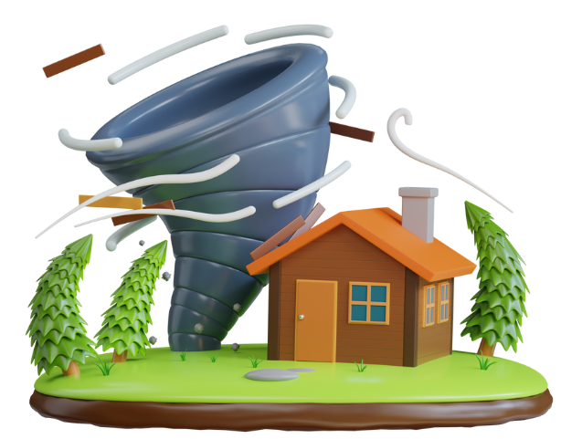
FURTHER PRACTICE TYPHOON GAME

Slide 18



Pick a box
Answer the question
Get a random prize below
The winning team has the most points
10
Blow friend’s point
Swap point
Your point

Slide 19


PICK A BOX
10
1
20
2
3
20
4
5
10
6

Slide 20


Choose A, B, or C to complete each sentence.
The bus dropped us at the square and allowed us two hours to do a ______ tour of the ancient town.
A. disastrous B. self-guided C. sport

Slide 21
Choose A, B, or C to complete each sentence.
2. We’ve booked a(n) ______ for our holiday because we want to learn more about the life of the locals.
A. homestay B. expensive hotel C. resort

Slide 22


Slide 23
Choose A, B, or C to complete each sentence.
3. Sorry, I don’t know any ______ since we have always planned our trips on our own.
A. travel agency B. tours C. places of attraction

Slide 24
Choose A, B, or C to complete each sentence.
4. My son usually uses ______ apps to buy tickets and book accommodation.
A. educational B. social media C. travel

Slide 25
Choose A, B, or C to complete each sentence.
5. The agency sent us a detailed ______ so that we can know the activities and the time for each day of our trip.
A. description B. itinerary C. timetable

Slide 26

CONSOLIDATION
1
Wrap-up
List some phrases learned in the lesson
List some other learned words / phrases related to Tourism
pronounce correctly words ending in -ic and -ious

Slide 27

CONSOLIDATION
2
Homework
- Do exercises in the workbook.

Slide 28
Website: hoclieu.vn
Fanpage: facebook.com/www.tienganhglobalsuccess.vn/

