Slide 2
WARM-UP: GAME BRAINSTORMING
Grammar Challenge
LIKING AND DISLIKNG VERBS

Slide 3
WARM-UP
LET’S PLAY

Slide 4
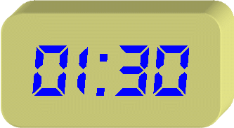

Slide 5
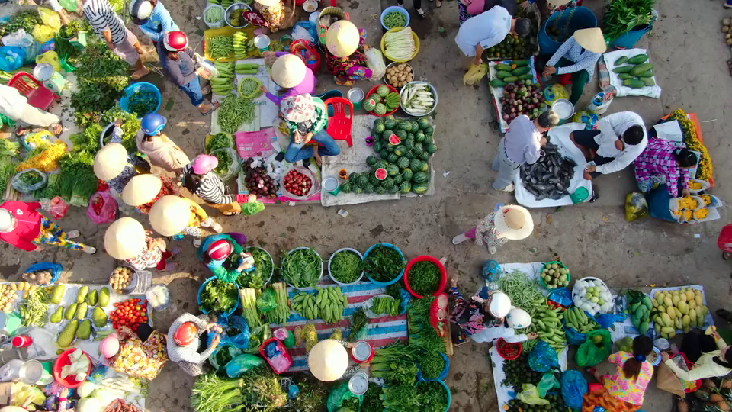


VIETNAMESE LIFESTYLE: THEN AND NOW
Unit
6
LESSON 3: A CLOSER LOOK 2

Slide 6
I. GRAMMAR
Eg1: I enjoy listening to music when I have free time.
Eg2: They promise to learn studying hard to get good grades.
- V + to V
- V+ V-ing

Slide 7

I. GRAMMAR
– The verb after want, promise, decide, agree, learn, plan has the to-infinitive form.
Example:
We decided to do some research on Thai traditional dancing.
– The verb after enjoy, fancy, finish, mind, avoid, suggest has the -ing form.
Example:
I suggested visiting the Viet Nam Museum of Ethnology.

Slide 8
II. PRACTICE
1
Write the correct form of the verbs in bracket
riding
1. fancy (ride) ___________ a buffalo
to use
2. learn (use)___________ traditional farming tools
not touching
3. mind (not touch)______________ the displays
to make
4. decide (make)______________ a kite
playing
5. avoid (play) ______________ on the streets
to learn
6. promise (learn) ______________ more about the history of our village

Slide 9
II. PRACTICE
2
Underline the correct verb form for each sentence
1. I really fancy to wear / wearing this traditional cone hat at our Fashion Show
2. My brother has decided to enter / entering the Back to Our Past Competition.
3. Do you mind to replay / replaying that Folk music? It’s lovely.
4. My uncle always avoids to tell / telling stories about his past.
5. They plan to do / doing research about life in Hue in the 19th century.

Slide 10
II. PRACTICE
3
Complete each sentence with the correct form of a verb from the box.
make learn give
work teach
to learn
1. We want __________________ how to make toys from natural materials.
working
2. Yesterday, we finished __________________ on the poster for our Good Old Days project
to teach
3. I have promised __________________ my grandfather how to find news online.

Slide 11
II. PRACTICE
3
Complete each sentence with the correct form of a verb from the box.
make learn give
work teach
making
4. My grandmother suggested __________________ a traditional long dress for the wedding
to give
5. Our group agreed __________________ a presentation about school uniforms in the 20th century.

Slide 12
CONSOLIDATION
DUCK RACING GAME

Slide 13
PRACTICE
4
Choose the incorrect underlined word or phrase in each sentence
having
1. Just a few years ago, I would never fancy to have a smart TV in my home.
A
B
C
D
to add
2. Tom promised adding some information about the past to his presentation.
A
B
C
D

Slide 14
PRACTICE
4
Choose the incorrect underlined word or phrase in each sentence
to learn
3. I’ve decided learning how ethnic minority people use natural materials to dye cloth.
A
B
C
D
to research
4. My children plan researching and make our family tree for the past hundred years.
A
B
C
D

Slide 15
PRACTICE
4
Choose the incorrect underlined word or phrase in each sentence
talking
5. Do you mind not to talk about the past in such a negative way?.
A
B
C
D

Slide 16
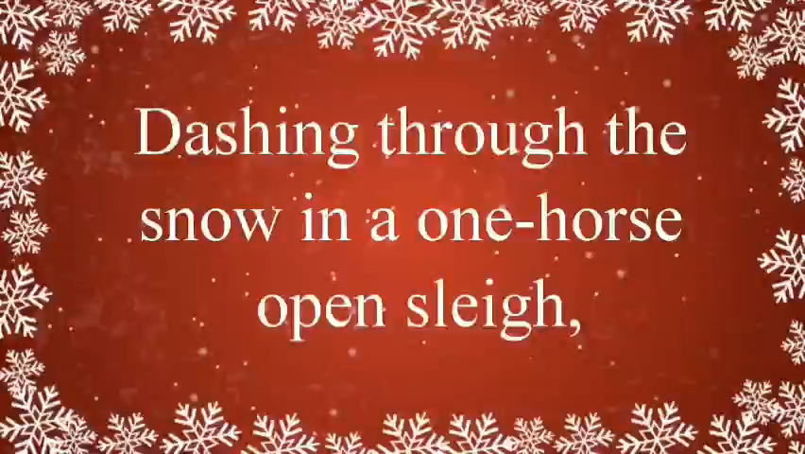
PRODUCTION
5
-Using V to make sentences/ best wishes about Christmas.
- Underline V + to V or V + V-ing.

Slide 17

HOME ASSIGNMENT
- Do exercises in the workbook.
- Make 5 sentences by using to-infinitive and V-ing

Slide 18


THANKS FOR YOUR ATTENTION

