Slide 1
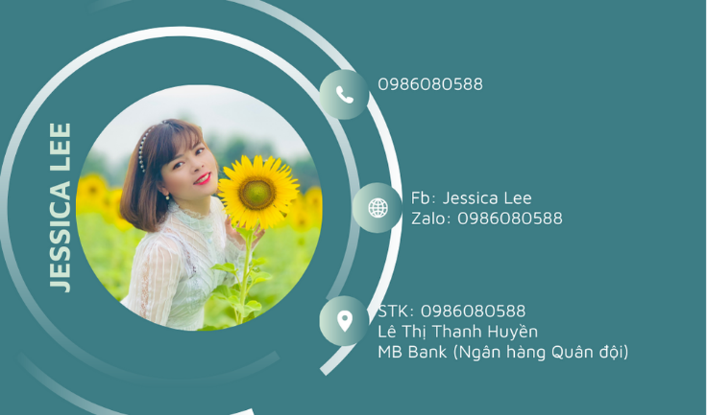

Slide 2
Unit 8
FILMS
A CLOSER LOOK 2

Slide 3
Grammar
Although/ Though

Slide 4


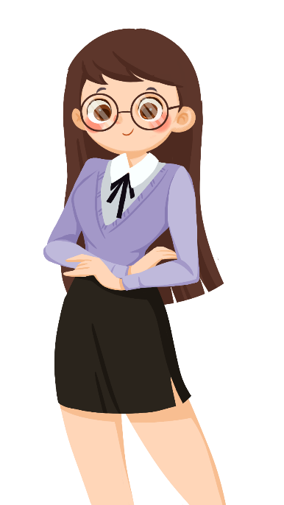
We use although/ though or however to connect 2 contrasting ideas.
however
connect 2 contrasting ideas
in 2 sentences
although/ though
connect 2
contrasting ideas
in the same sentence
Although / Though John Peters is an amateur actor, he gave a great performance in his film.
John Peters is an amateur actor. However, he gave a great performance in his film.

Slide 5
Unit 8. FILMS
A Closer look 2
1. Combine the two sentences, using although / though.

Slide 6

1. Although/ Though the questions were very difficult, he solved them easily.
or He solved the questions easily although/though they were very difficult.
2. Although/ Though he was a great actor, he never played a leading role in a film.
or He never played a leading role in a film although/though he was a great actor.
3. Although/ Though they spent a lot of money on the film, it wasn’t a big success.
or The film wasn’t a big success although/though they spent a lot of money on it.
4. Although/ Though the film was a comedy, I didn’t find it funny at all.
or I didn’t find the film funny at all although/though it was a comedy.
5. Although/ Though we played well, we couldn’t win the match.
or We couldn’t win the match although/though we played well.

Slide 7

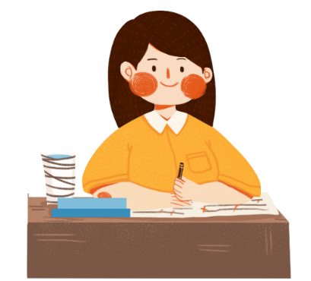
Explanation
Chúng ta sử dụng
“although / though”
trước một mệnh đề để nối hai ý tương phản trong cùng một câu.

Slide 8
Unit 8. FILMS
A Closer look 2
1. Combine the two sentences, using although / though.
2. Complete the sentences, using although/ though or however.

Slide 9

1. _________________ the acting in the film was good, I didn’t like its story.
2. I felt really tired. _____________, I went to see the film.
3. I really enjoyed the new film ________________ most of my friends didn’t like it.
4. He studied hard for the exam. ______________, he failed it.
5. Mai speaks English very well _______________ her native language is Vietnamese.
Although/ Though
However
although/ though
However
although/ though
Wordwall game: https://wordwall.net/resource/27225435

Slide 10
Explanation
- Chúng ta sử dụng “although / though” trước một mệnh đề để nối hai ý tương phản trong cùng một câu.
- Chúng ta sử dụng “however” để chỉ sự đối lập giữa ý trong hai vế của câu, thường được sử dụng sau dấu phẩy.

Slide 11
Unit 8. FILMS
A Closer look 2
1. Combine the two sentences, using although / though.
2. Complete the sentences, using although/ though or however.
3. Use your own ideas to complete the following sentences. Then compare your sentences with a partner's.

Slide 12

1. I don’t really like the film though ______.
2. He felt very well. However, ______.
3. The film was a great success. However, ______.
4. Although it rained all day, ______.
5. The music in the film was terrible. However, ______.

Slide 13
Suggestion ideas:
1. I don't really like the film though its storyline was intriguing.
(Mình không thực sự thích bộ phim mặc dù cốt truyện của nó hấp dẫn.)
2. He felt very well. However, he was diagnosed with cancer.
(Anh ấy cảm thấy rất khỏe. Tuy nhiên, anh đã được chẩn đoán mắc bệnh ung thư.)
3. The film was a great success. However, the acting was disappointing.
(Bộ phim thành công rực rỡ. Tuy nhiên, diễn xuất gây thất vọng.)
4. Although it rained all day, he decided to hang out alone.
(Dù trời mưa cả ngày nhưng cậu ta vẫn quyết định đi chơi một mình.)
5. The music in the film was terrible. However, it contributed to drawing public attention.
(Âm nhạc trong phim thật khủng khiếp. Tuy nhiên, nó đã góp phần thu hút sự chú ý của công chúng.)

Slide 14
Unit 8. FILMS
A Closer look 2
1. Combine the two sentences, using although / though.
2. Complete the sentences, using although/ though or however.
3. Use your own ideas to complete the following sentences. Then compare your sentences with a partner's.
4. Choose the correct answer A, B, or C to complete each sentence.

Slide 15

1. Mary overslept this morning ______ she went to bed early last night.
A. although B. because C. so
2. ______ the sun is shining, it isn’t very warm.
A. Because B. However C. Though
3. I don’t like running, ______ I like swimming.
A. but B. so C. however
4. ______ the film was exciting, Jim fell asleep in the cinema.
A. However B. Because C. Although
5. The story of the film is silly. ______, many people still enjoyed it.
A. However B. Though C. But
Wordwall game https://wordwall.net/resource/27224858

Slide 16
Unit 8. FILMS
A Closer look 2
1. Combine the two sentences, using although / though.
2. Complete the sentences, using although/ though or however.
3. Use your own ideas to complete the following sentences. Then compare your sentences with a partner's.
4. Choose the correct answer A, B, or C to complete each sentence.
5. GAME Chain story
Work in groups. Develop a story using although / though.

Slide 17
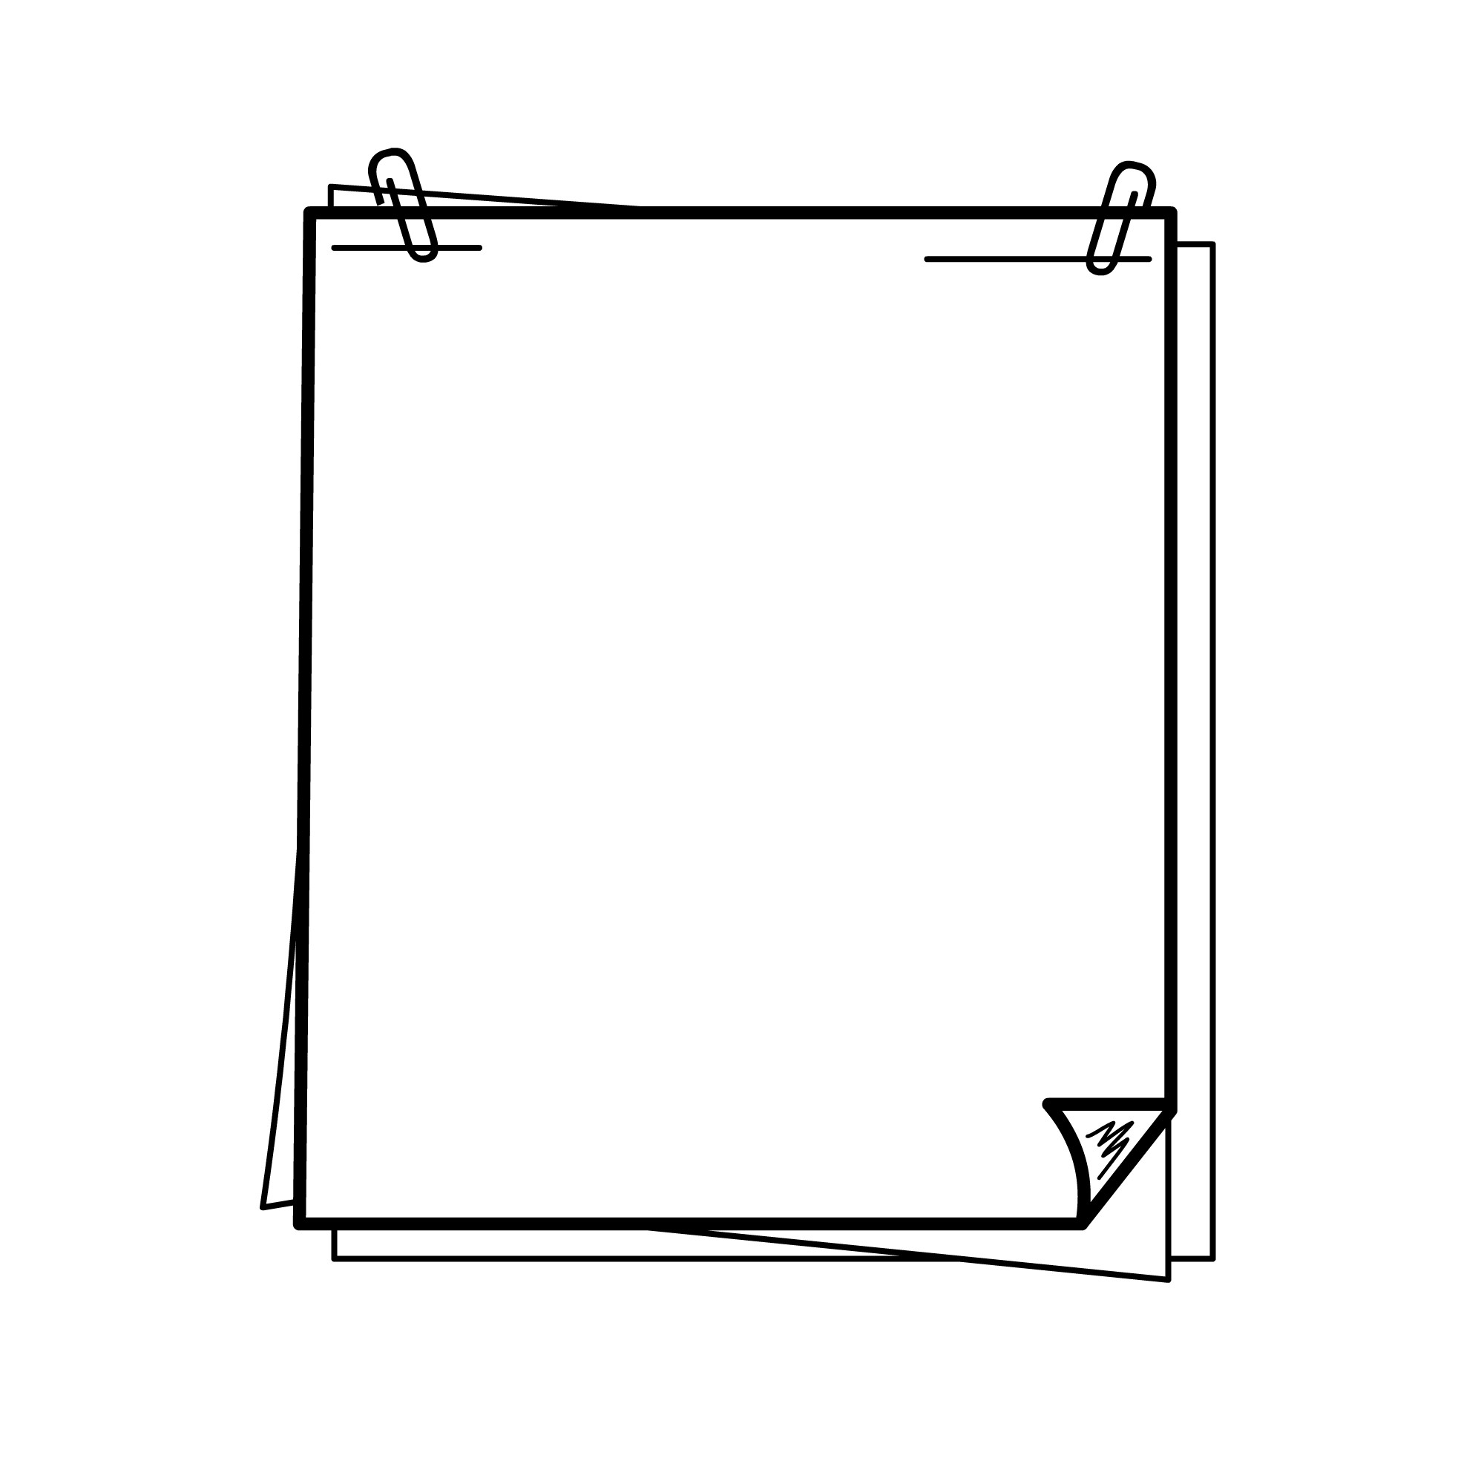
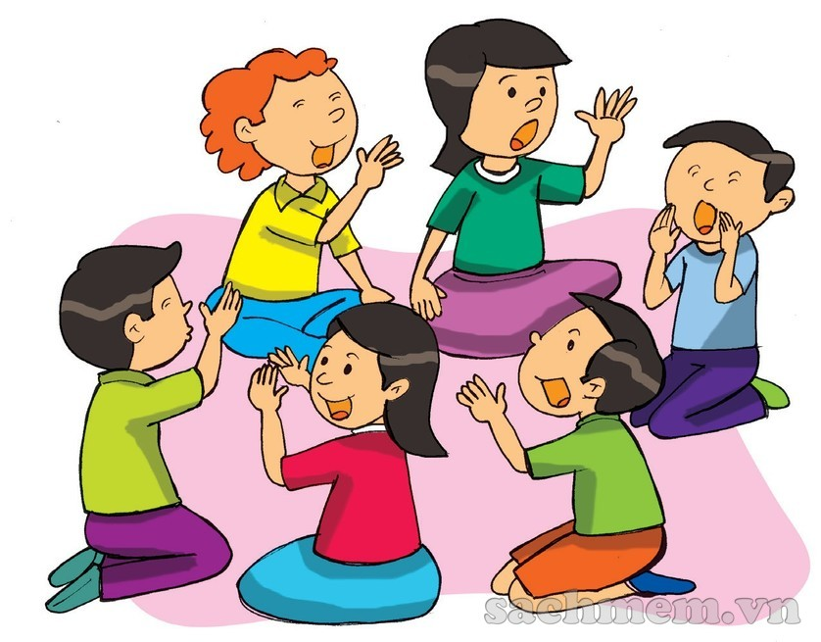
A: Although/ Though it rained yesterday, we went shopping.
B: Although/ Though we went shopping, we didn’t buy anything.
C: ________________

Slide 18
Consolidation

Slide 19

Grammar: Connectors of contrast
however
although/ though

Slide 20
Home-link
Complete exercises in the Workbook.

Slide 21



