Slide 1


Slide 2
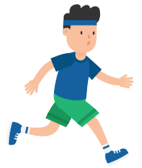
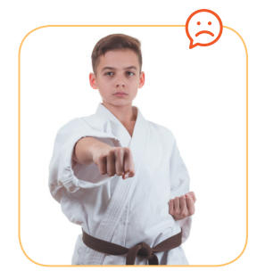
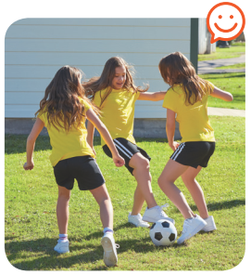


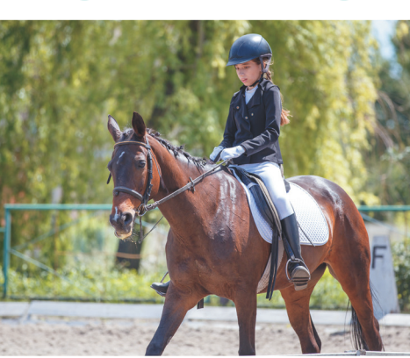
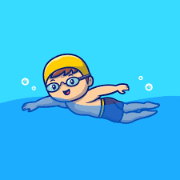

KIM’S GAME
Notes:
Good morning class, How are you today?
Good! Are you ready for a very exciting game?
Today we have Kim’s Game. This side is team A, that side is team B.
You have 3 seconds to remember everything on the screen

Slide 3
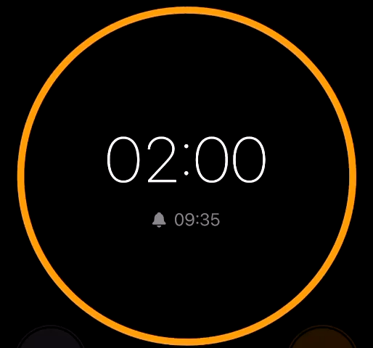
KIM’S GAME
Notes:
Now, I give you 12 hobbies and you have 2’ to find 8 hobbies in showed picture.
Which team finishes first and has correct answer will be the winner.

Slide 4
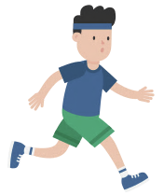
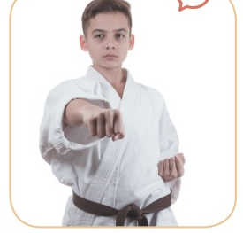



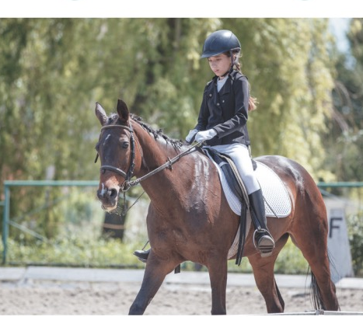
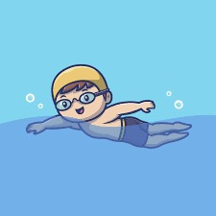

KIM’S GAME
Notes:
I reopen the picture and check 2 teams’ answer

Slide 5



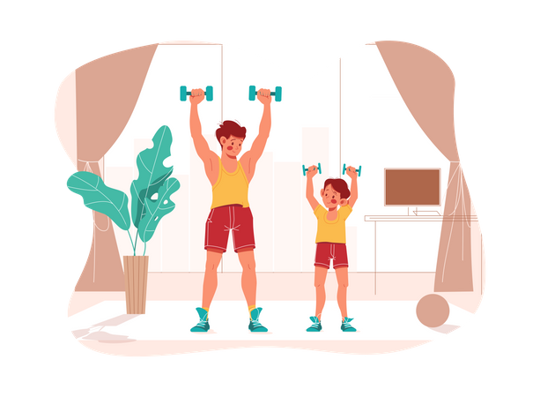
Unit
1
HOBBIES
LESSON 4: COMMUNICATION
Unit
HOBBIES
Notes:
Today we continue talking about hobbies, by asking and answering about what we like and dislike.
Has everybody got a book? Ok, good.
Let’s open your book, page 13 Unit 1 Lesson 4 Communication.

Slide 6


Act 1
Mi: Do you like reading books?
Ann: Yes, very much, especially books about science.
Mi: What about painting? Do you like it?
Ann: No, I don’t. I’m not interested in art.
Notes:
First, look at Ex.1, listen and read the dialogue. Pay attention to the questions and answers.
Play the audio.
I would like to hear some of you read the dialogue again. 2 pairs
Nếu HS không đọc đúng ngữ điệu của câu hỏi → We should pay attention to intonation of the questions

Slide 7


Act 2
2
Notes:
So, now, for this activity, you work in pairs, ask and answer questions about what you like and don’t like doing. You have 2 minutes. Start!
Time’s up, stop working now. Let’s hear some pairs’ talk.

Slide 8
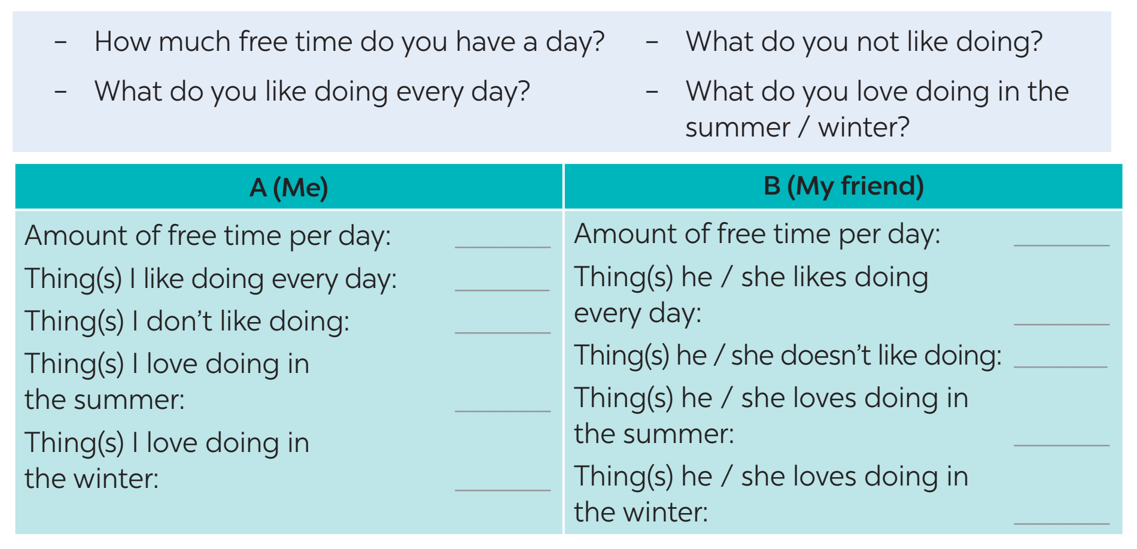

Act 3
How much free time do you have a day?
What do you like doing every day?
What do you not like doing?
What do you love doing in the summer?
What do you love doing in the winter?
Notes:
Let’s move on to the next task. Look at 5 questions on the screen, I need 1 student reads outloud questions and 1 stusent answers. Anyone?
Question 1, please. … Ok, so amount of free time per day, I fill … hour.
…
Now, all of you fill in column A (in Ex 3 on page 13) by answering 5 questions on the screen about yourself.
You have 2 minutes. Time’s up.

Slide 9

Act 4
How much free time do you have a day?
What do you like doing every day?
What do you not like doing?
What do you love doing in the summer?
What do you love doing in the winter?
Notes:
Have you all finished column A? Ok, good.
Come to column B. You work in pair, interview your partner by asking 5 questions then write down his/her answers in column B.
You can use structure: “How about you?” when you want to ask the same questions. For example, …
You have 3 minutes.
I will ask 2 students from 2 pairs to ask and answer.

Slide 10
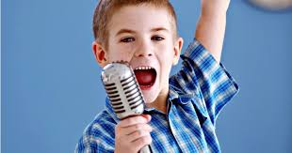
Act 5
Example:
Good morning everyone,
I’m Minh, I’m from class 7B5, Le Hong Phong secondary school. Today I talk to you about what I and my friend Lan like doing.
I have one hour of free time a day, but my friend Lan has only about 30 minutes. I like listening to music every day, and Lan likes it too. I don’t like exercising, but Lan does.
In the summer, ...
In the winter, ...
5
Greeting
Introduce yourself and your friend’s name
Compare your answers with your friend’s
Notes:
For the last task of this lesson, we have chance to think and compare your hobbies with your friends you ask in exercise 4.
Look at the screen. I make a simple model for you.
You have 4 minutes to prepare. I will ask some students to share with our class.

Slide 11

1
WRAP-UP
In this lesson, we have learn to:
use the lexical items related to the topic Hobbies
describe and give opinions about hobbies
Notes:
We’ve asked, discussed a lot about hobbies in this lesson. You can entertain/play and study in the same time. For physical hobbies, you can develop your health, your body and your team work skill. For creative hobbies, you can discover your inner ability and build your strong personality.
BAD HOBBIES ???? Should be limited ?
I hope all of you can choose the right hobbies for yourself and enjoy them.

Slide 12
2
HOMEWORK
Complete your presentation
Prepare for PROJECT lesson
1. Spring
2. Summer
3. Fall
4. Winter
4 GROUPS

Slide 13
MARKING CRITERION
Format: Poster, picture, film, powerpoint, role - play. | 2 points
Content | 4 points
Interact | 2 points
Pronunciation | 2 point

Slide 14

Website: sachmem.vn
Fanpage: facebook.com/sachmem.vn/

