Slide 1







- TEACHER: NGUYEN THI LIEN
- CLASS: 7C1
- SCHOOL: QUANG TRUNG LOWER SECONDARY SCHOOL

Slide 2


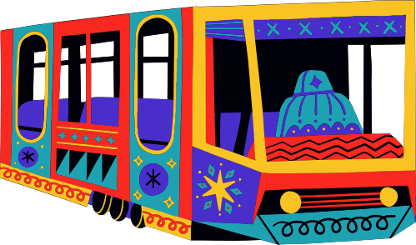
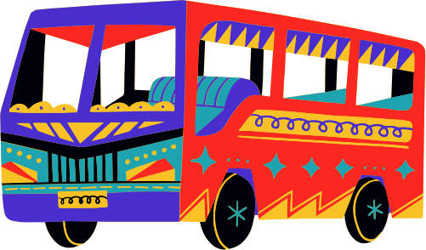
GAME:WHO IS FASTER?
VEHICLES AND ROAD SIGNS

Slide 3
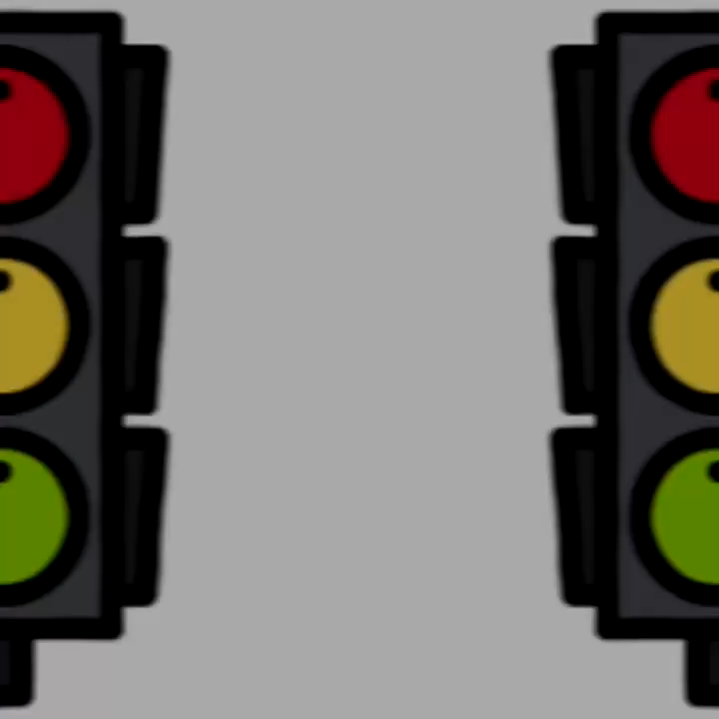

Slide 4



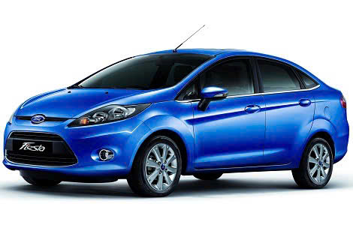

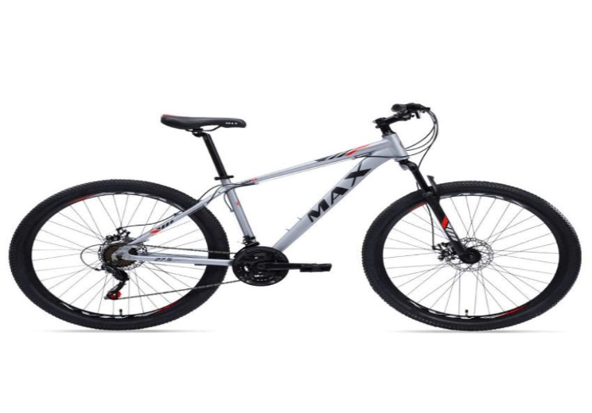
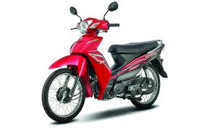
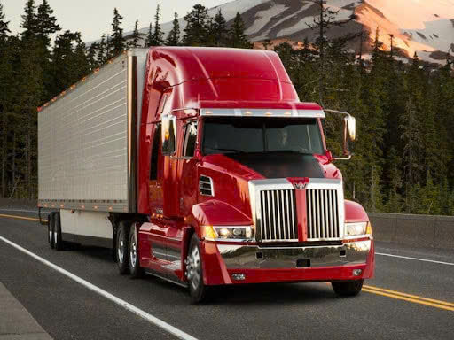
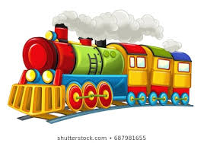


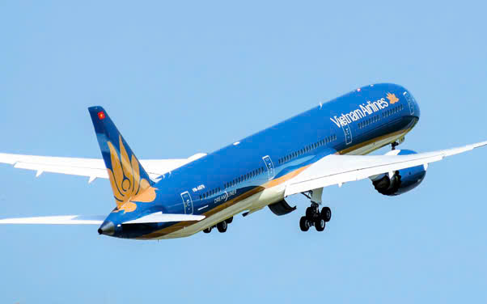
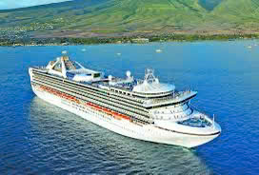

VEHICLES AND ROAD SIGNS
1- Traffic lights
2. Car
3- Bike/ bicycle
4- School ahead
6- Motorbike
5- Truck
8- Train
7- No turn right
9- Hospital ahead
10- Plane
11- No cycling
12- Ship

Slide 5


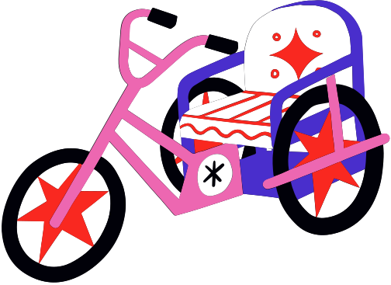

QUESTIONS
How do you go to school?
I go to school by ……………………….
2. How far is it from your house to school?
=> It’s (about) ………………………………

Slide 6


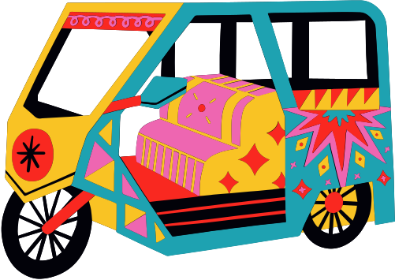
UNIT 7: TRAFFIC
LESSON 3
A CLOSER LOOK 2

Slide 7
GRAMMAR
“It” indicating distance
Should/ shouldn’t

Slide 8
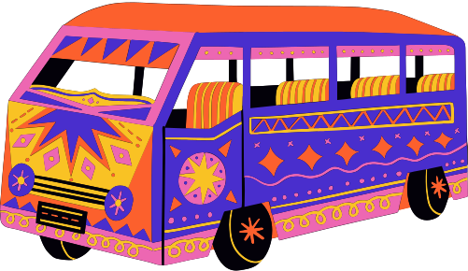
I. “It” indicating distance
Example:
How far is it from your house to school.
It is about 500 meters (from my house to school)
STRUCTURE
How far is it from place(địa điểm) + to + place (địa điểm)
It is (about) + distance (khoảng cách) ……………

Slide 9
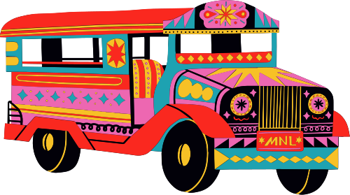
PRACTICE
TASK 1. Write the sentences with “ It”. Use the cues.
Example: 500 metres/my house/ nearest shop.
It is about 500 metres from my house to the nearest shop.
700 metres / my flat/ Youth club.
……………………………………………………………………………………………..
2. 5 kilometres / my village/ nearest town.
=> ……………………………………………………………………………………………..
3. About 120 km/ Ho Chi Minh City/ Vung Tau
=> ……………………………………………………………………………………………..
4. 384,400 km/ the Earth/ the Moon.=> ……………………………………………………………………………………………..
5. Not very far/ Ha Noi centre / Noi Bai Airport.
=> …………………………………………………………………………………………….
6. 2 km/my house/ Quang Trung Secondary school.
=> ……………………………………………………………………………………………..

Slide 10
Task 1. Write the sentences with “ It”. Use the cues.
700 metres / my flat/ Youth club.
……………………………………………………………………………………………..
2. 5 kilometres / my village/ nearest town.
=> ……………………………………………………………………………………………..
3. About 120 km/ Ho Chi Minh City/ Vung Tau
=> ……………………………………………………………………………………………..
4. 384,400 km/ the Earth/ the Moon.
=> ……………………………………………………………………………………………..
5. Not very far/ Ha Noi centre / Noi Bai Airport.
=> …………………………………………………………………………………………….
6. 2 km/my house/ Quang Trung Secondary school.
=> ……………………………………………………………………………………………..
KEYS =>
It’s 700 metres from my flat to the Youth Club.
It’s 5 kilometres from my village to the nearest town.
It’s about 120 km from Ho Chi Minh City to Vung Tau.
It’s about 384,400km from the Earth to the Moon.
It’s not very far from Ha Noi centre to Noi Bai Airport.
It’s 2km from my house to Quang Trung Secondary school .

Slide 11
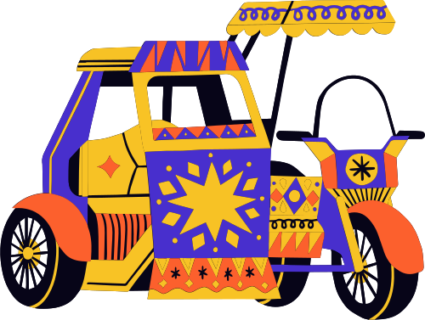
TASK 2: Work in pairs. Ask and answer questions about distance in your neighborhood.
How far is it from…..to………….?
=> It’s (about) ……………………..
You can use these cues:
-Your home- open market/supermarket.
Your home- playground
Your home- hospital
Your home- train station
………………

Slide 12
II. SHOULD/ SHOULDN’T
Example:
We should do homework before class.
We shouldn’t go out late at night.
Structure:
(+) S+ should + V bare ………………...
(-) S+ should not/ shouldn’t + V bare…..
(?) Should/ Shouldn’t + S+ V bare …..?
To give advice.
To say what is the correct or best thing to do.

Slide 13
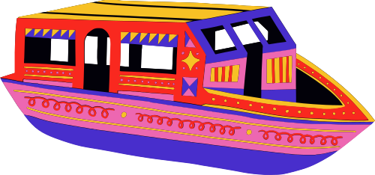

Task 3: Choose the correct option in brackets:
That’s an interesting book. You (should/ shouldn’t ) read it.
You nearly fell off your bike. You really (should/ shouldn’t) be more careful.
We (should/ shouldn’t) go swimming right after eating.
I think that he (should/ shouldn’t) eat less. He’s becoming overweight.
There are a lot of cars out today. He (should/ shouldn’t) drive so fast.

Slide 14
Task 3: Choose the correct option in brackets:
should
1. That’s an interesting book. You …………….…read it.
should
should
2. You nearly fell off your bike. You really ………………be more careful.
shouldn’t
3. We …………………….go swimming right after eating.
should
4. I think that he ……………………eat less. He’s becoming overweight.
shouldn’t
5. There are a lot of cars out today. He ………..……… drive so fast.

Slide 15
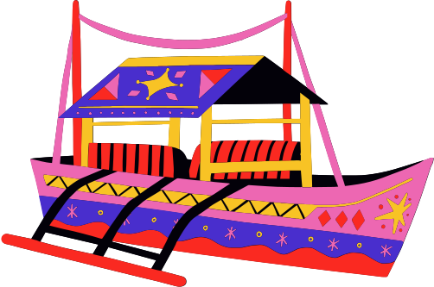
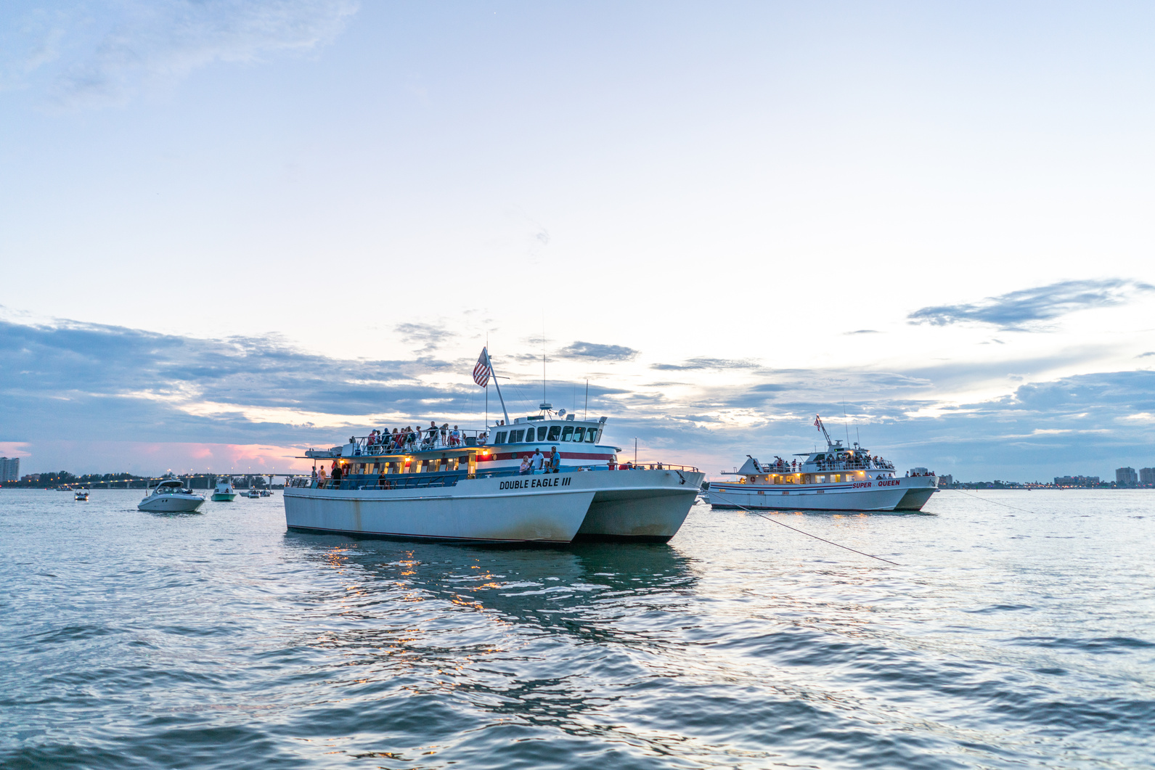
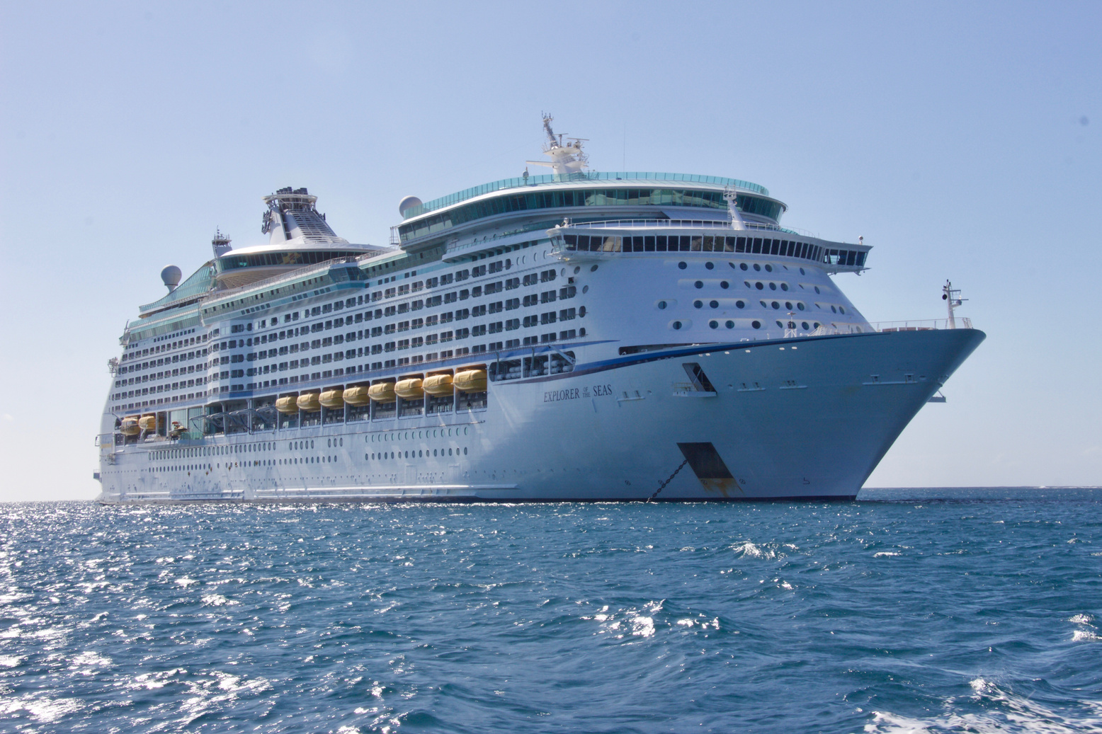

Task 4: Complete each sentence, using should/ shouldn’t.
We ________ ride our motorbikes very fast in the rain
You ________ study instead of watching YouTube.
My little sister ________ play outside late at night.
You ________ help your mum wash the dishes after dinner.
You look tired. You ________ probably get some sleep.
The children ________ eat so much ice cream.

Slide 16
Task 4: Complete each sentence, using should/ shouldn’t.
shouldn’t
We ________ ride our motorbikes very fast in the rain
You ________ study instead of watching YouTube.
My little sister ________ play outside late at night.
You ________ help your mum wash the dishes after dinner.
You look tired. You ________ probably get some sleep.
The children ________ eat so much ice cream.
should
shouldn’t
should
should
shouldn’t

Slide 17

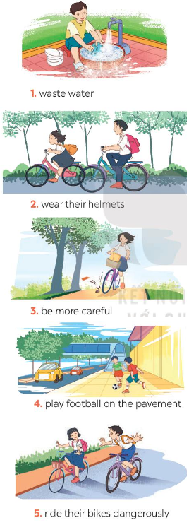
TASK 5: Look at the pictures . Make sentences, using should/ shouldn’t and the cues.

Slide 18
HOME ASSIGNMENT
- Make sentences with “It indicating distance “ and “ should/ shouldn’t”
- Find 10 things you should or shouldn’t do.

Slide 19

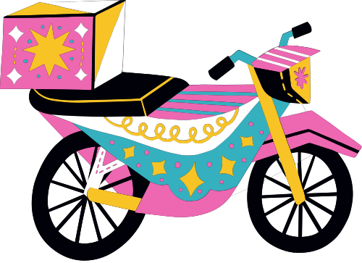
THANK YOU FOR ATTENDING!

Slide 20
PRACTICE
Choose the correct answer among A,B or C to complete the following sentences:
We ________ go to school on time.
Should B. shouldn’t C. not should
2. It is about 3 metres from my house ____ the book shop.
From B. to C. at
3. How ______ is it from Hai Phong to Ha Noi?
long B. old C. far
4. We ______ be lazy.
shouldn’t B. should D. isn’t
5. Students ____ finish homework before school.
A. shouldn’t B. should not D. should

