Slide 1



Unit
5
FOOD AND DRINK
Lesson 5: SKILLS 1

Slide 2
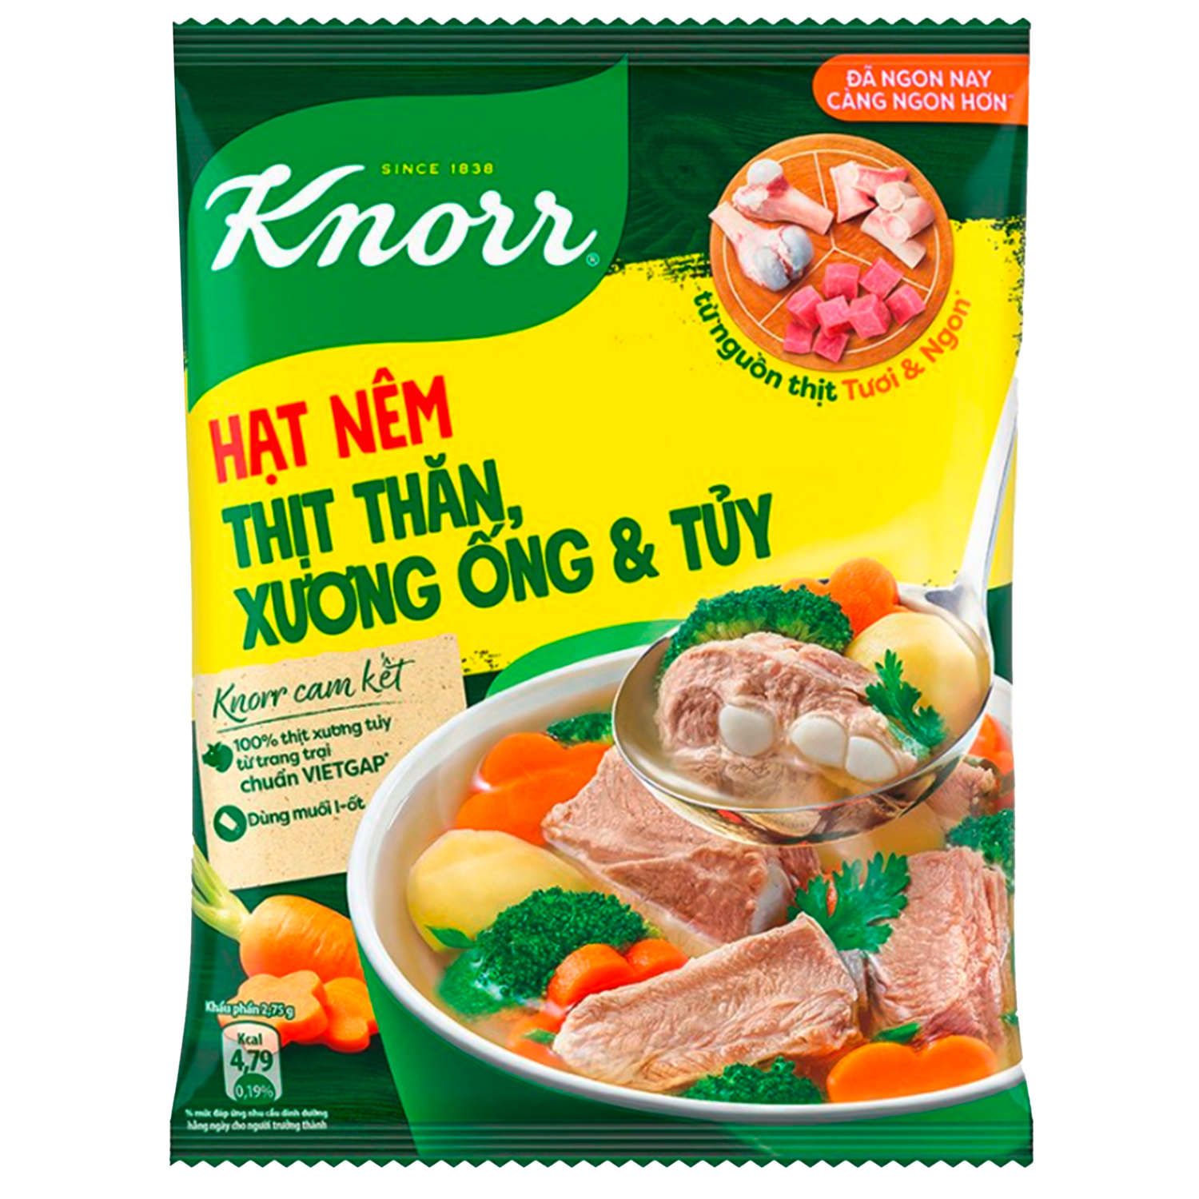
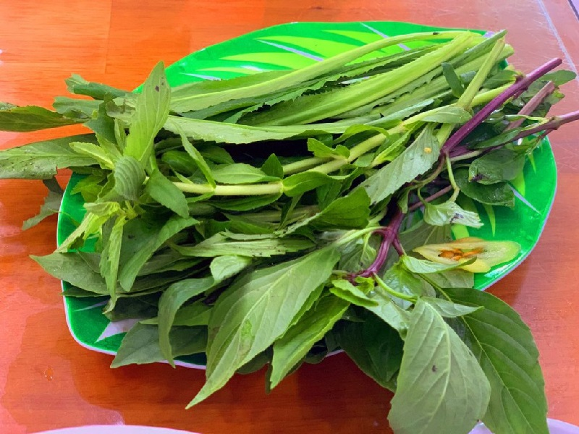
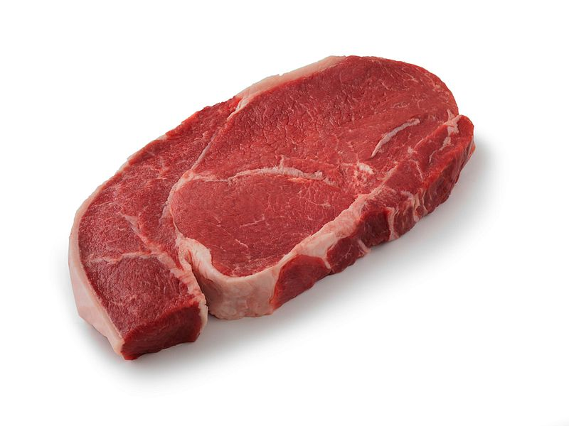
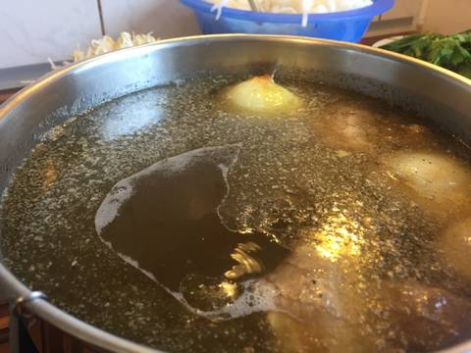
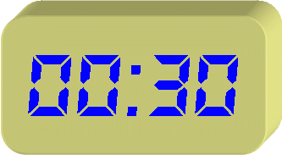
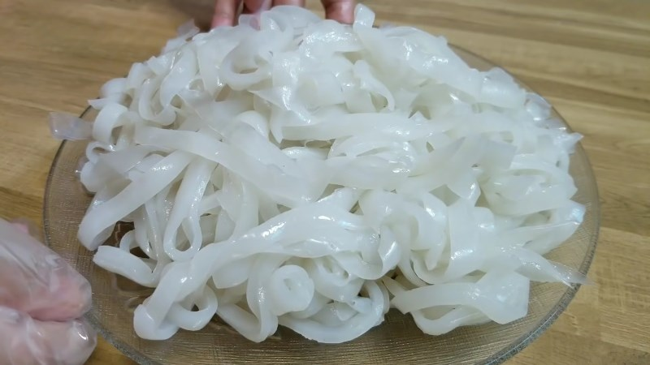
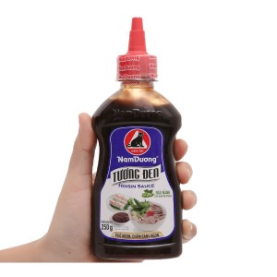
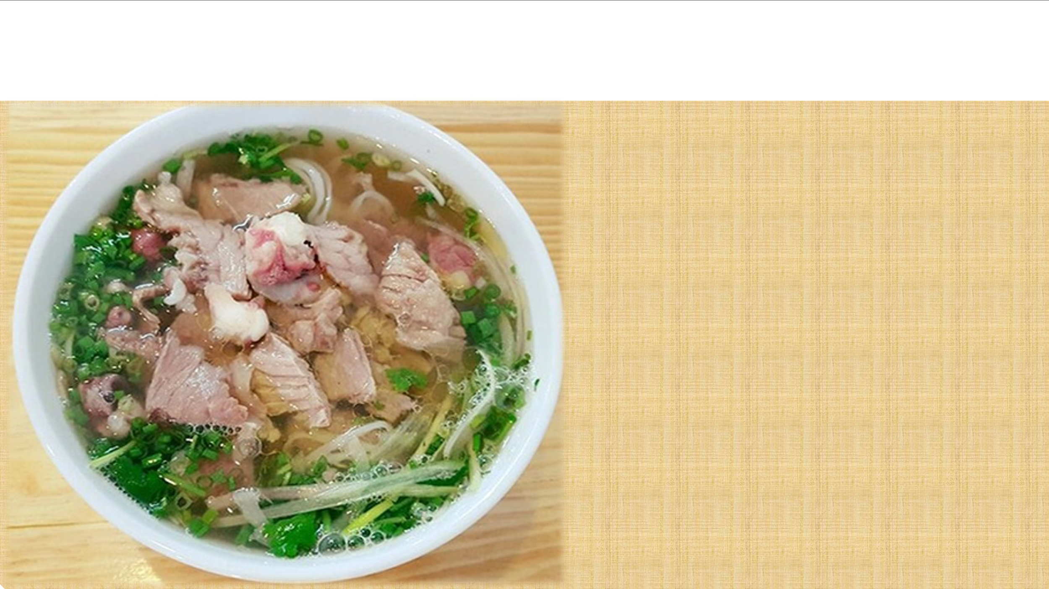
GUESSING GAME : WHAT FOOD IS IT?
PHO – BEEF NOODLES SOUP

Slide 3
READING
1
Work in pairs. Discuss the following questions.
1. Is pho popular in your neighbourhood?
2. When can we have pho?
3. What are the main ingredients of pho?

Slide 4

READING
Read Phong's blog. Match the underlined words in the text with their meanings.
Pho is a special kind of traditional Vietnamese dish. Its main ingredients are rice noodles and slices of beef or chicken. It is one of the most common dishes you will find in Viet Nam. People enjoy pho at all times of the day, even for a late night snack. Pho has a very special taste. The rice noodles are made from the best kind of rice. There are two main kinds of pho: pho bo (beef noodle soup) and pho ga (chicken noodle soup). The broth for pho is made by stewing beef or chicken bones for a long time in a big pot. The meat (beef and chicken) served with pho is boneless and cut into thin slices ... It's really delicious! Tell me about a popular dish in your area!
Posted by Phong on Feb 22 at 5:30 p.m.

Slide 5
READING
1
Read Phong's blog. Match the underlined words in the text with their meanings.
Pho is a special kind of traditional Vietnamese dish. Its main ingredients are rice noodles and slices of beef or chicken. It is one of the most common dishes you will find in Viet Nam. People enjoy pho at all times of the day, even for a late night snack. Pho has a very special taste. The rice noodles are made from the best kind of rice. There are two main kinds of pho: pho bo (beef noodle soup) and pho ga (chicken noodle soup). The broth for pho is made by stewing beef or chicken bones for a long time in a big pot. The meat (beef and chicken) served with pho is boneless and cut into thin slices ... It's really delicious! Tell me about a popular dish in your area!
Posted by Phong on Feb 22 at 5:30 p.m.
1. snack
a. cooking something slowly, often in water
d. a small meal, usually eaten in a hurry
2. taste
b. the flavour of something
b. the flavour of something
c. soup made by boiling bones, meat, etc, and vegetables in water
c. soup made by boiling bones, meat, etc, and vegetables in water
3. broth
4. stewing
a. cooking something slowly, often in water
d. a small meal, usually eaten in a hurry
5. boneless
e. without bones
e. without bones

Slide 6
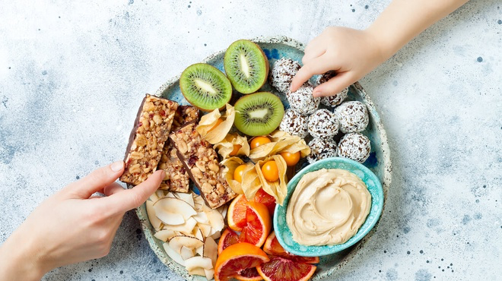
Vocabulary check
snack
/snæk/
đồ ăn vặt

Slide 7
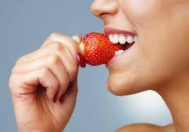
Vocabulary check
taste
/teɪst/
nếm

Slide 8
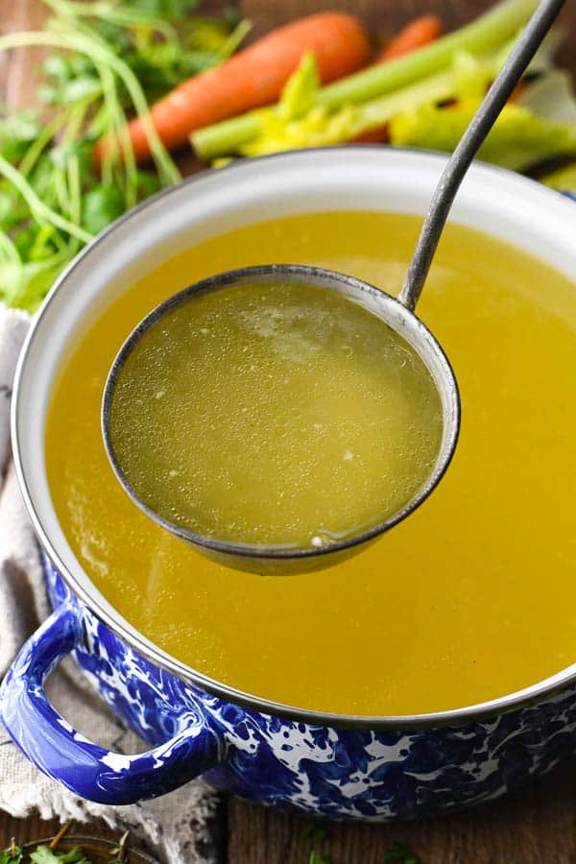
Vocabulary check
broth
/brɒθ/
nước dùng, canh

Slide 9
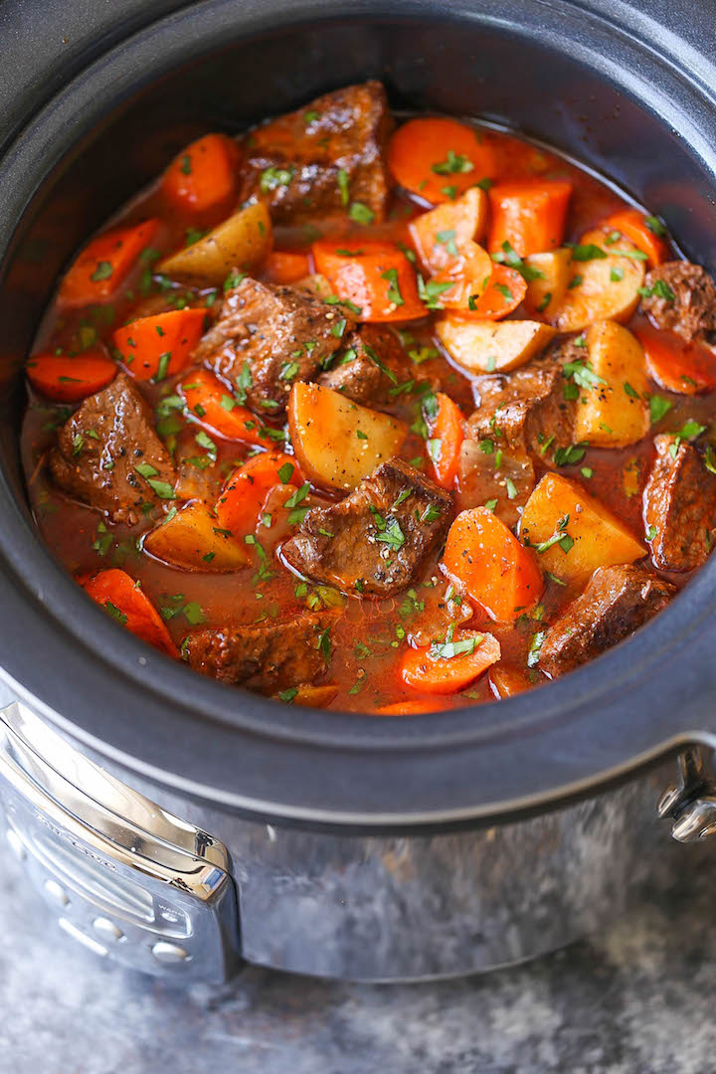
Vocabulary check
stew
/stju:/
hầm

Slide 10
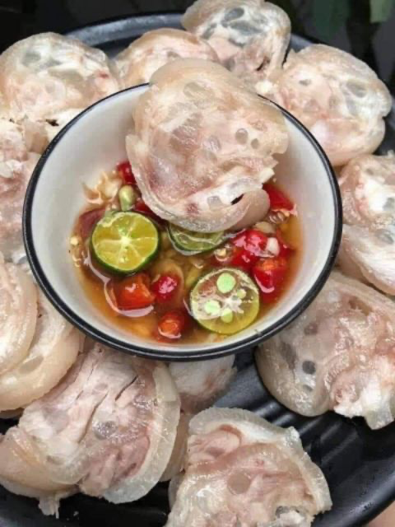
Vocabulary check
boneless
/ˈbəʊnləs/
không xương

Slide 11
Vocabulary check
New words | Meanings
Snack (unc) | thức ăn vặt
taste (v)/(n) | thử, nếm, vị
Broth (unc) | nước dùng
(to) stew | hầm
boneless | không xương

Slide 12
WHILE-READING
3
Read Phong’s blog again and circle the correct answer A, B or C.
1. The text is mainly about _____.
A. pho, a popular dish in Viet Nam
B. popular dishes in Viet Nam
C. different ways to cook pho
2. Pho is made mainly with _____.
A. rice noodles and beef or chicken
B. rice, pork, and vegetables
C. fish, shrimp, and noodles
3. We enjoy pho _____.
A. only for breakfast
B. for lunch and dinner
C. at any time of the day
4. To make noodles for pho, we use _____.
A. a variety of sticky rice
B. the best kind of rice
C. eggs and rice flour
5. The broth for pho is made by _____.
A. slowly cooking beef or chicken bones
B. cooking beef or chicken with fish sauce
C. boiling potatoes and chicken bones for a long time

Slide 13
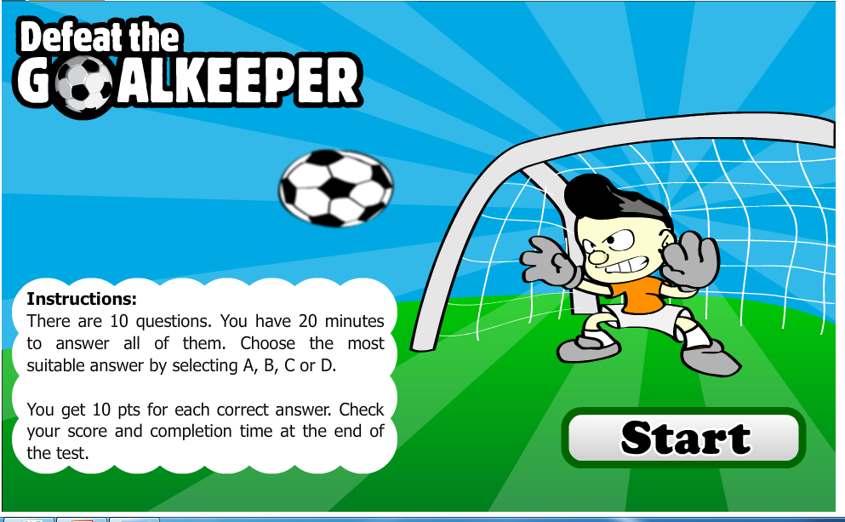
Play games

Slide 14
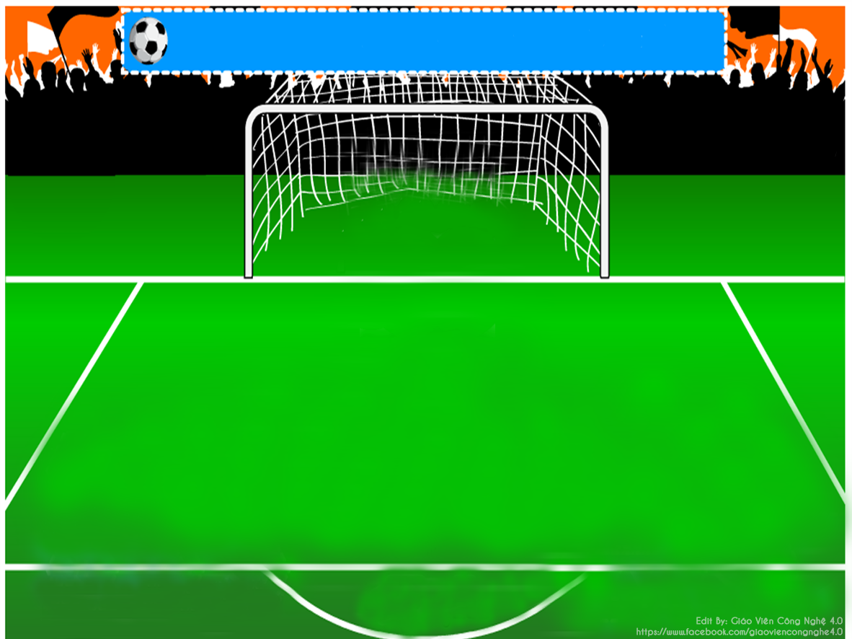


1. The text is mainly about _____.
A. popular dishes in Viet Nam
B. different ways to cook pho
C. pho, a popular dish in Viet Nam
C. pho, a popular dish in Viet Nam

Slide 15
2. Pho is made mainly with _____.
B. rice, noodles and beef or chicken
A. rice, pork, and vegetables
B. rice, noodles and beef or chicken
C. fish, shrimp, and noodles

Slide 16
3. We enjoy pho _____.
A. only for breakfast
B. at any time of the day
C. for lunch and dinner
B. at any time of the day

Slide 17
4. To make noodles for pho, we use _____.
C. eggs and rice flour
the best kind of rice
a variety of sticky rice
the best kind of rice

Slide 18
5. The broth for pho is made by _____.
A. cooking beef or chicken with fish sauce
B. slowly cooking beef or chicken bones
B. slowly cooking beef or chicken bones
C. boiling potatoes and chicken bones for a long time

Slide 19
WHILE-READING
3
Read Phong’s blog again and circle the correct answer A, B or C.
1. The text is mainly about _____.
A. pho, a popular dish in Viet Nam
B. popular dishes in Viet Nam
C. different ways to cook pho
2. Pho is made mainly with _____.
A. rice noodles and beef or chicken
B. rice, pork, and vegetables
C. fish, shrimp, and noodles
3. We enjoy pho _____.
A. only for breakfast
B. for lunch and dinner
C. at any time of the day
4. To make noodles for pho, we use _____.
A. a variety of sticky rice
B. the best kind of rice
C. eggs and rice flour
5. The broth for pho is made by _____.
A. slowly cooking beef or chicken bones
B. cooking beef or chicken with fish sauce
C. boiling potatoes and chicken bones for a long time

Slide 20
SPEAKING
4
Make notes about a popular food and drink in your area. Think about its main ingredients, how often and when you have it.
1
main
ingredients
How often?
a popular food and drink in your area
When?
Where?

Slide 21
SPEAKING
5
Work in groups of 3 or 4. Take turns to talk about a popular food or drink in your area.
1
main
ingredients
How often?
a popular food and drink in your area
When?
Where?

Slide 22
CONSOLIDATION
1
WRAP-UP
In this lesson, we have learn to:
Read for specific information about food and drink
Talk about popular food in the area.

Slide 23
CONSOLIDATION
2
HOMEWORK
Video your presentation about popular food and drink
Prepare for the next lesson: Skills 2

Slide 24
THANKS FOR YOUR ATTENDENCE

