Slide 2


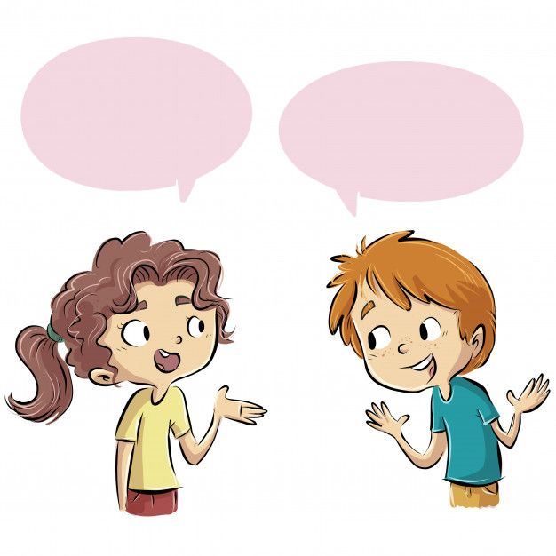
Unit
8
TOURISM
LESSON 5: SKILLS 1
1

Slide 3
LESSON 5: SKILLS 1
LESSON 1: GETTING STARTED
WARM-UP
Brainstorming
Task 1: Write the words under their correct pictures.
Task 2: Read the passage and match the words and phrases in A with the definitions in B.
Task 3: Read the passage again and answer the questions.
READING
Task 4: Work in pairs. Take turns to interview your partner about his / her recent tour. Take notes of your partner’s answers.
Task 5: Share with the class your partner’s travel experience. You can then share what you think about it.
SPEAKING
CONSOLIDATION
Wrap-up
Homework

Slide 4
WARM-UP
BRAINSTORMING
Work in pairs. Discuss the following questions:
1. What are different types of tours? Give some information about them.
2. What types of tours have you been on?
3. Were they positive/negative experiences?

Slide 5
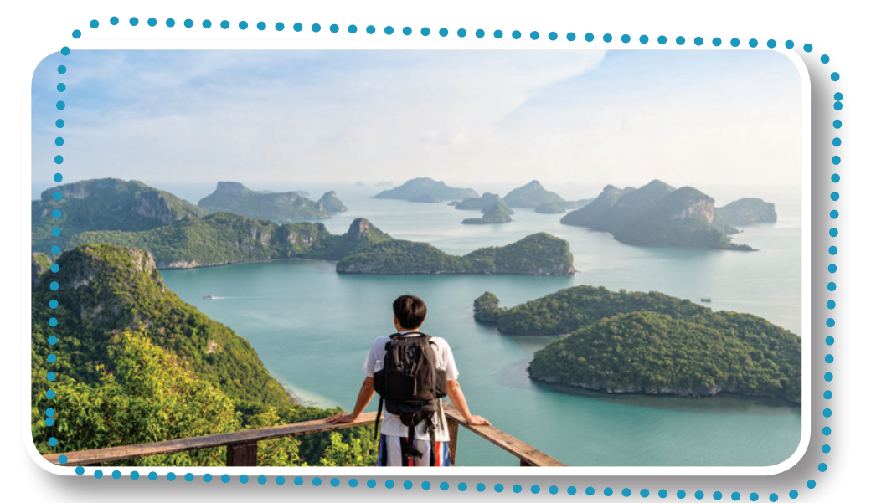
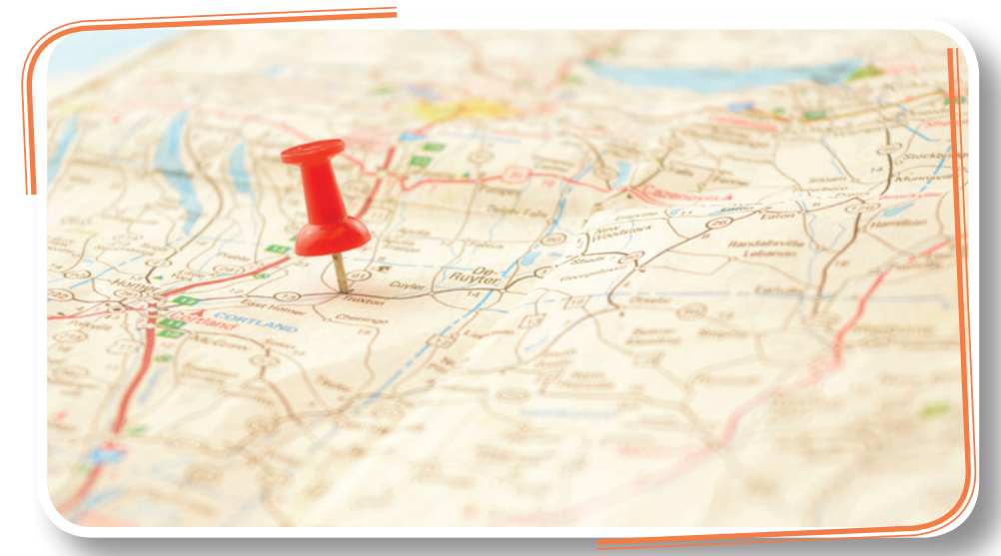
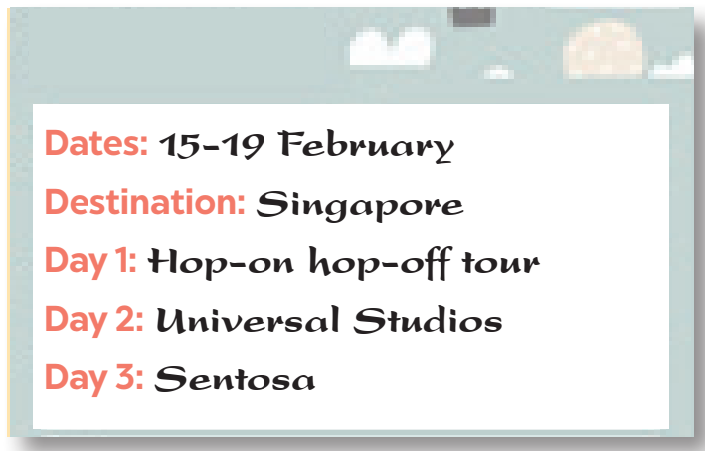
READING
1
Write the words under their correct pictures.
a. destination b. traveller c. itinerary
1. b. traveller
2. a. destination
3. c. itinerary

Slide 6
READING
2
Read the passage and match the words and phrases in A with the definitions in B.
The two most popular types of tours now are package and self-guided tours. When you buy a package tour, a travel agency takes care of almost everything for you. You will get a notice about the places of your visit, the detailed itinerary, and the cost. They will protect you if something goes wrong during the trip. This type of holiday saves time and reduces stress for travellers. It offers a convienient option for people who are elderly, who do not want to spend much time searching on their own, or who are not confident about using online apps. One disadvantage of this type is you have to follow a fixed itinerary.
Nowadays, more young people choose self-guided tours which require them to do everything on their own. They have to look for a destination, work out an itinerary, and estimate the cost. They then hunt for tickets and accommodation, usually homestay. This type of holiday may require people more time and effort, but it is cheaper and more flexible than a package holiday. It gives travellers more freedom to decide where to go and how much time and money to spend at a place. However, to have a smooth trip and avoid trouble, these travellers should be good at using apps.

Slide 7
READING
2
Read the passage and match the words and phrases in A with the definitions in B.
a. happening or continuing without any problems
b. money spent on something
c. not changing
d. look for
1. cost
2. fixed
3. hunt for
4. smooth
Notes:
1. b 2. d 3. a 4. c

Slide 8
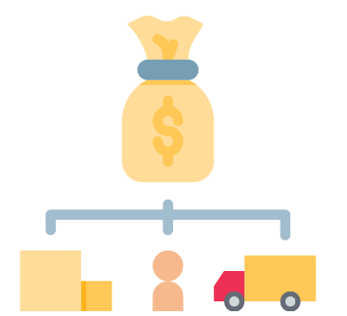

READING
cost (n)
/kɒst/
chi phí
Notes:
the amount of money needed to buy, do, or make something

Slide 9

READING
fixed (adj)
.
/fɪkst/
cố định
Notes:
arranged or decided already and not able to be changed

Slide 10
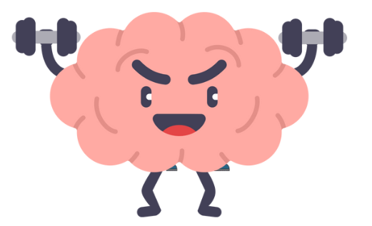
READING
work out (ph.v)
.
/ˈwɜːkaʊt/
suy nghĩ, lên kế hoạch
Notes:
to plan or think of something

Slide 11

READING
estimate (v)
/ˈestɪmeɪt/
đánh giá, ước lượng
Notes:
to guess or calculate the cost, size, value, etc. of something

Slide 12
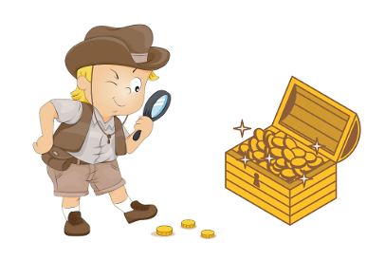
READING
hunt (for sth) (v)
/hʌnt/
săn lùng
Notes:
look for something that is difficult to find

Slide 13
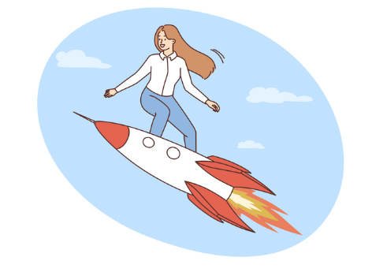
READING
smooth (adj)
/smuːð/
trôi chảy, suôn sẻ
Notes:
happening or continuing without any problems

Slide 14
READING
New words | Pronunciation | Meaning
1. cost (n) | /kɒst/ | chi phí
2. fixed (adj) | /fɪkst/ | cố định
3. work out (ph.v) | /ˈwɜːkaʊt/ | suy nghĩ, lên kế hoạch
4. estimate (v) | /ˈestɪmeɪt/ | đánh giá, ước lượng
5. hunt (v) | /hʌnt/ | săn lùng
6. smooth (adj) | /smuːð/ | trôi chảy, suôn sẻ

Slide 15
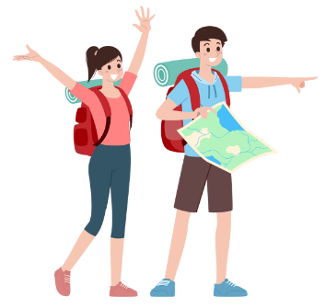
READING
3
Read the text again and answer the following questions.
1. What can a package tour save you?
2. What disadvantage of a package tour does the passage mention?
3. What do travellers have to do on a self-guided tour?
4. What is an advantage of self-guided tours?
5. What skill should you have if you go on a self-guided tour?

Slide 16
READING
3
Read the text again and answer the following questions.
1. What can a package tour save you?
2. What disadvantage of a package tour does the passage mention?
Time.
Travellers have to follow a fixed itinerary.

Slide 17
READING
3
Read the text again and answer the following questions.
3. What do travellers have to do on a self-guided tour?
4. What is an advantage of self-guided tours?
5. What skill should you have if you go on a self-guided tour?
They have to do everything on their own.
They are cheap and flexible.
Using online apps.

Slide 18

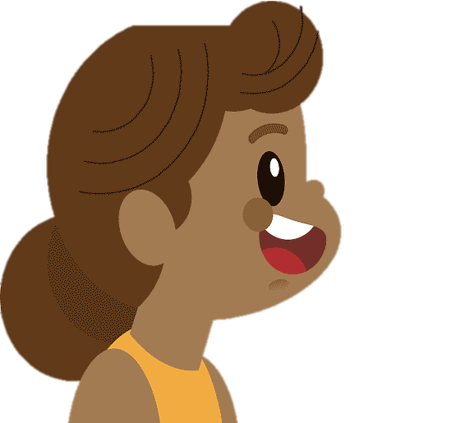

SPEAKING
4
Work in pairs. Take turns to interview your partner about his /
her recent tour. Take notes of your partner’s answers.
You can ask about:
1. where he / she went
2. which tour he / she took:
package or self-guided
3. how he / she travelled
4. where he / she stayed
5. what he / she did / saw

Slide 19
SPEAKING
5
Share with the class your partner’s travel experience. You can then share what you think about it.
Suggested answers:
Last summer, Mai’s family went to Hue. Since her parents did not have much time to organize the tour by themselves, they booked a four-day package tour. The travel agency arranged everything for them: the air tickets, accommodation, the places to visit, and transportation. The tour was trouble-free as Mai’s father said. They had to follow a fixed schedule, but they felt ok with it. The tour guide was friendly and helpful. Coming home, everybody was satisfied with the service the agency offered.

Slide 20

CONSOLIDATION
1
Wrap-up
What have we learnt in this lesson?
Vocabulary related to related to tourism;
Reading for specific information;
Talking about partner’s travel experience.

Slide 21

CONSOLIDATION
2
Homework
Do exercises in the workbook.

Slide 22
Website: hoclieu.vn
Fanpage: facebook.com/tienganhglobalsuccess.vn/

