Slide 1


Welcome to classes 7
Teacher : Phạm Thi Nhàn

Slide 2

QUYET TIEN SECONDARY SCHOOL
Warmly welcome all students
attending our lesson today!
Teacher: Phạm Thị Nhàn
School year: 2025 - 2026

Slide 3
Period 1. REVISION + INTRODUCTION

Slide 4
My home
My friends
My new school
My neighbourhood
Natural wonders of the world
VOCABULARY
( TOPICS)
Robots
Our Tet holiday
Television
Our green world
Sports and games
Our house in the future
Cities of the world

Slide 5
Present Simple
Present Progressive
Present Perfect
TENSES
Future Simple
Past Simple
Modal verbs

Slide 6
Wh- questions
Prepositions of place
Comparative adjectives
Superlative of short/ long adjectives
STRUCTURES
Adverds of frequency
Imperatives
Conjunctions
Conditional sentences- Type 1

Slide 7
Match the tense/ grammatical point in column A with the structure/ words in column B.
Present progressive
Future simple
Present simple
Conjunctions
Modal verbs
Past simple
Superlative of short adjectives
Present perfect
Conditional sentence
Comparative adjectives
Superlative of long adjectives
S + am/is/are
V-inf/V-s/-es
If + S + V-inf/ s/es, S + will/ won’t + V-inf
2
1
S + was/were
V-ed/V2
and, but, so, although
S + might/must/ should + V-inf
5
3
4
S + be + adj-ER
MORE + adj
S + have/has + V (p.p/ V3)
S + be + + THE +adj-EST
6
7
8
S + be + THE MOST + adjective
S + am/is/are + V-ing
S + will + V-inf
9
10
11

Slide 8
Practice
Put the verbs in the correct tenses or forms.
1. He (go)…………….….to school every morning.
2. My father (work)……………………for that company.
3. He (come)……………….to Da Lat next week.
4. They (watch)……………………..……TV now.
5. Which class (you be)………………..……in?
6. He (teach)…………………….us English last year.
goes
has worked
will come
are watching
are you
taught

Slide 9
Practice
Rewrite the sentences.
1.My bag is smaller than yours. ( big)
Yours bag...........................................................................................................
2.A house in the countryside is cheaper than a house in a city. ( expensive)
A house in a city is…………………………………………………………….
3. The Andes is longer than all the other mountain rangers in the world.
The Andes is the……………………………………………………………….
4. We pollute the air. We have breathing problems. ( If )
If we pollute…………………………………………………………………....
5. Along the coast is a famous TV series. I have never watched it (although)
Although………………………………………………………………….........
is bigger than my bag/ mine.
more expensive than a house in the countryside.
longest mountain range in the world.
the air, we will have breathing problems.
Along the coast is a famous TV series, I have never watched it.

Slide 10
The Syllabus of English 7
+
12 UNITS
+
Each unit: 7periods, consisting of:
GETTING STARTED
A CLOSER LOOK 1
A CLOSER LOOK 2
COMMUNICATION
SKILLS 1
SKILLS 2
LOOKING BACK + PROJECT
+
Mid-term test after two units. The first/second-term test
+
3 periods of English a week

Slide 11


Homework
- Use I-mind map to complete tenses and structures
- Redo the exercise
- Prepare Unit 1- Getting started.

Slide 12
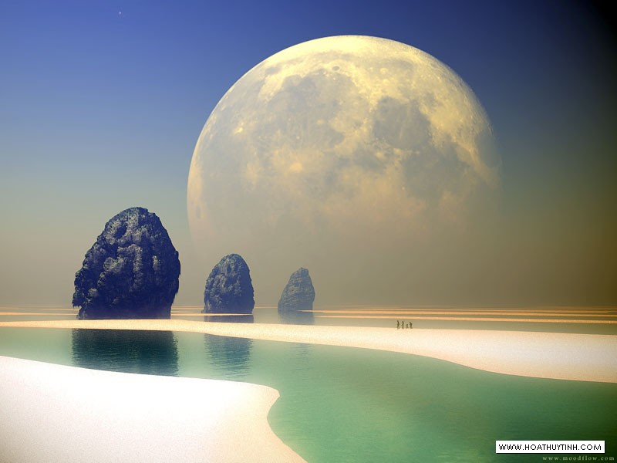



Thanks for your attention.

