Slide 1


Slide 2



Unit
1
MY HOBBIES
LESSON 1: GETTING STARTED
My favourite hobby
Unit
HOBBIES

Slide 3
WARM-UP
Answer the questions:
1. What do you like doing in your free time?
2. Do you like collecting dolls?
3. Do you like collecting glass bottles?
4. Do you enjoy mountain climbing?
HOBBY

Slide 4
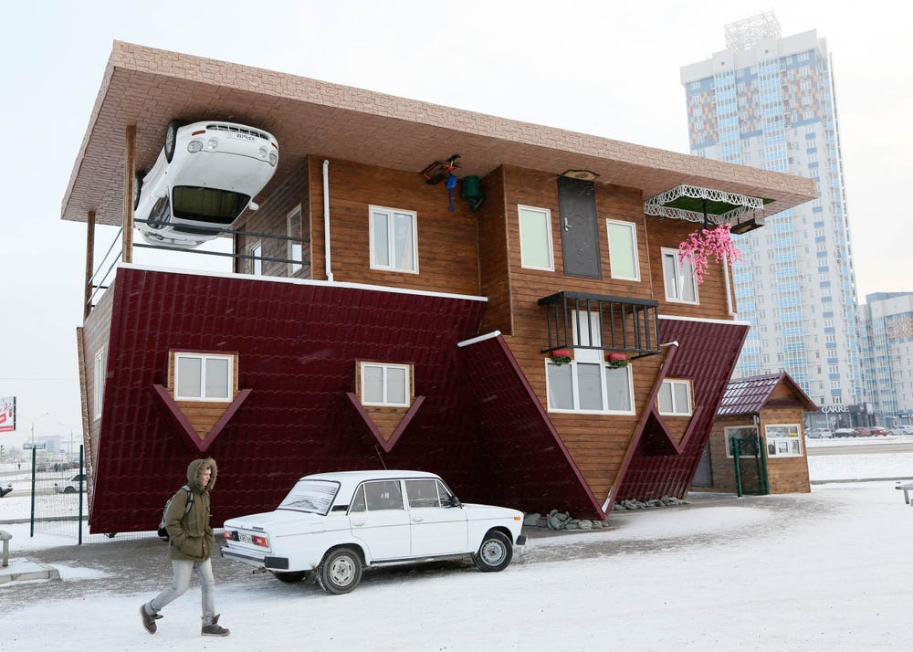

PRESENTATION
unusual (adj)
/ʌnˈjuːʒuəl/
khác thường

Slide 5

PRESENTATION
creativity (n)
/ˌkriːeɪˈtɪvəti/
sự sáng tạo

Slide 6
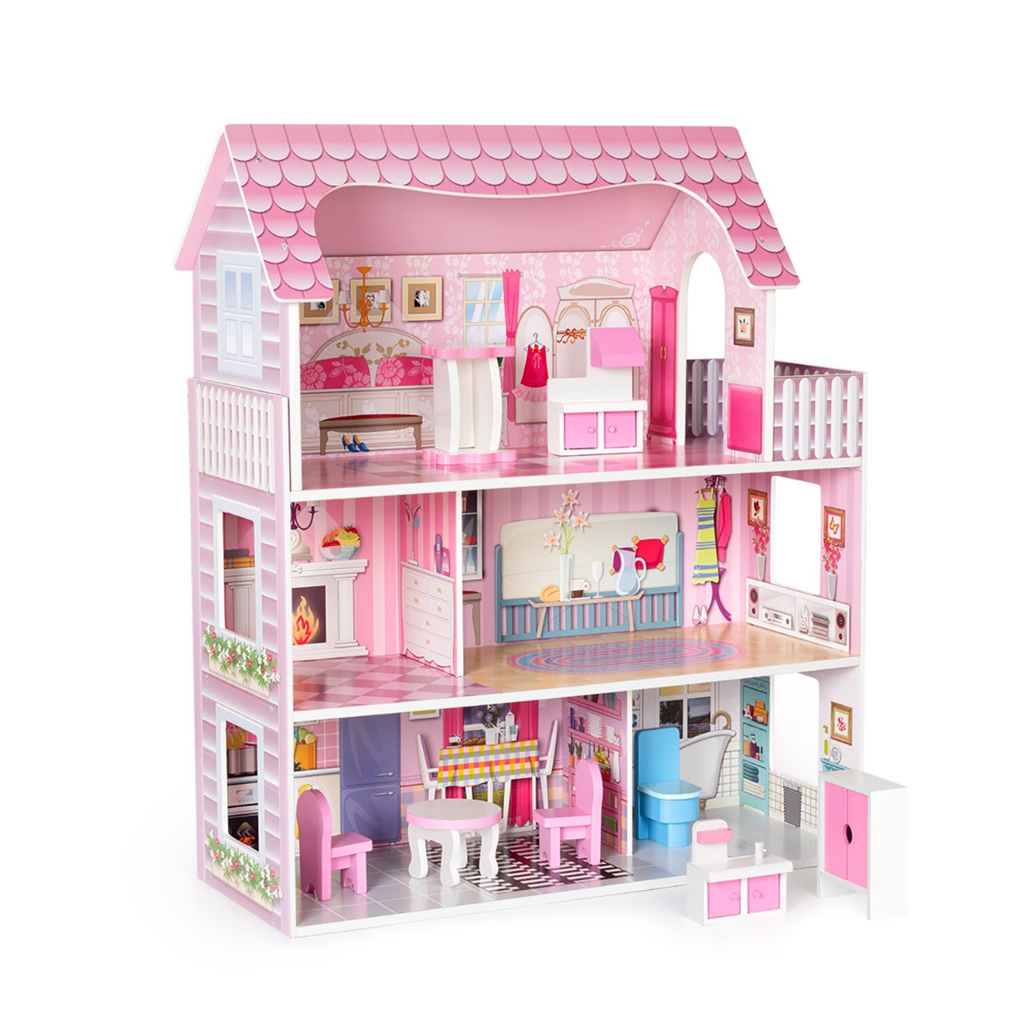
PRESENTATION
dollhouse (n)
/ ˈdɒlhaʊs/
nhà búp bê

Slide 7
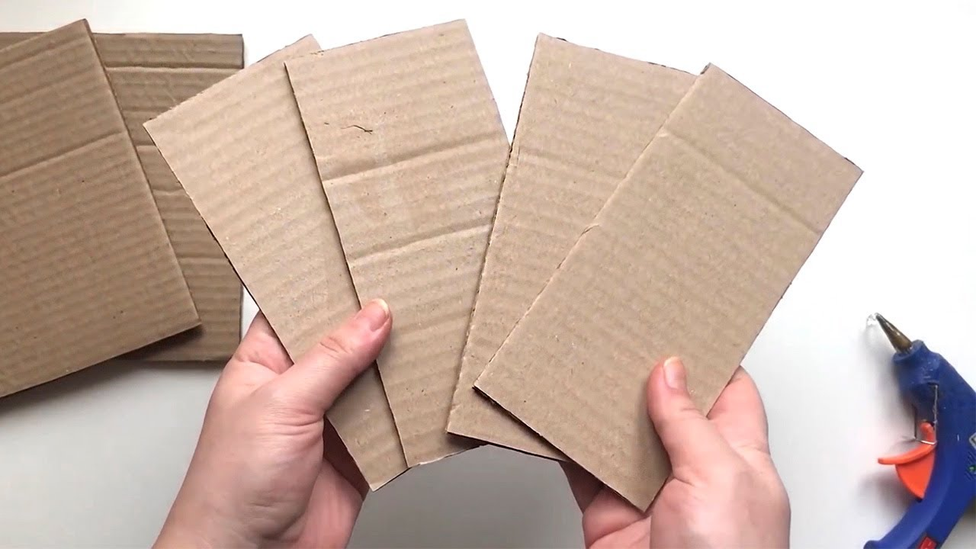
PRESENTATION
cardboard (n)
/ˈkɑːdbɔːd/
bìa các tông

Slide 8
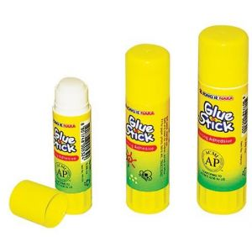
PRESENTATION
glue (n)
/ɡluː/
keo dán, hồ

Slide 9
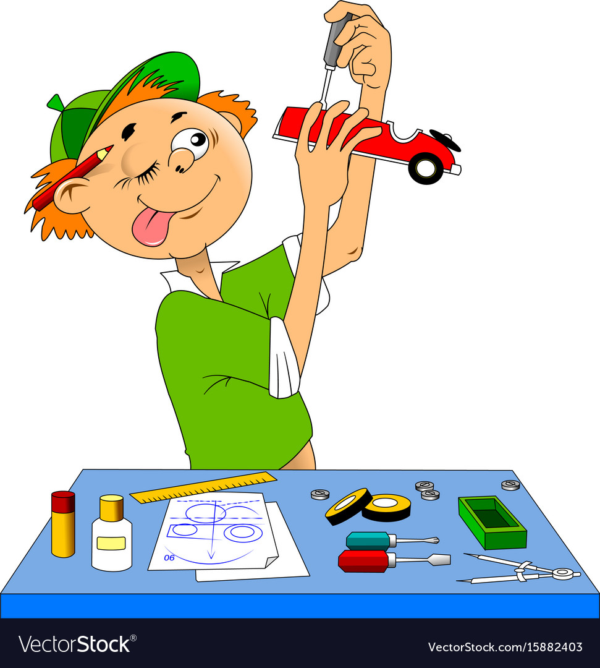
PRESENTATION
making models
/ˈmeɪkɪŋ ˈmɒdlz/
làm mô hình

Slide 10
PRESENTATION
New words | Pronunciation | Meaning
1. unusual (adj) | /ʌnˈjuːʒuəl/ | khác thường
2. creativity (n) | /ˌkriːeɪˈtɪvəti/ | sự sáng tạo
3. dollhouse (n) | /ˈdɒlhaʊs/ | nhà búp bê
4. cardboard (n) | /ˈkɑːdbɔːd/ | bìa các tông
5. glue (n) | /ɡluː/ | keo dán, hồ
6. making models | /ˈmeɪkɪŋ ˈmɒdlz/ | làm mô hình

Slide 11
PRACTICE
1
Listen and read.
Ann: Your house is very nice, Trang.
Trang: Thanks! let’s go upstairs. I’ll show you my room.
Ann: I love your dollhouse. It’s amazing. Did you make it yourself?
Trang: Yes. I like building dollhouses very much.
Ann: Really? Is it hard to build one?
Trang: not really. All you need is some cardboard and glue. Then just use a bit of creativity. What do you do in your free time?
Ann: I like horse riding.
Trang: That’s rather unusual. Not many people do that.
Ann: Actually, it’s more common than you think. There are some horse riding clubs in
Ha Noi now. I go to the Riders’ Club every Sunday.
Trang: I’d love to go to your club this Sunday. I want to learn how to ride.
Ann: Sure. My lesson starts at 8 a.m.

Slide 12
PRACTICE
2
Read the conversation again and write T (True) or F (False).
F
1. Trang needs help with building dollhouses. ______
2. Trang uses glue and cardboard to build her dollhouse. ______
3. To build a dollhouse, you need to use your creativity. ______
4. Ann goes to a horse riding club every Sunday. ______
5. Ann’s lesson starts at 8 p.m. ______
T
T
T
F

Slide 13
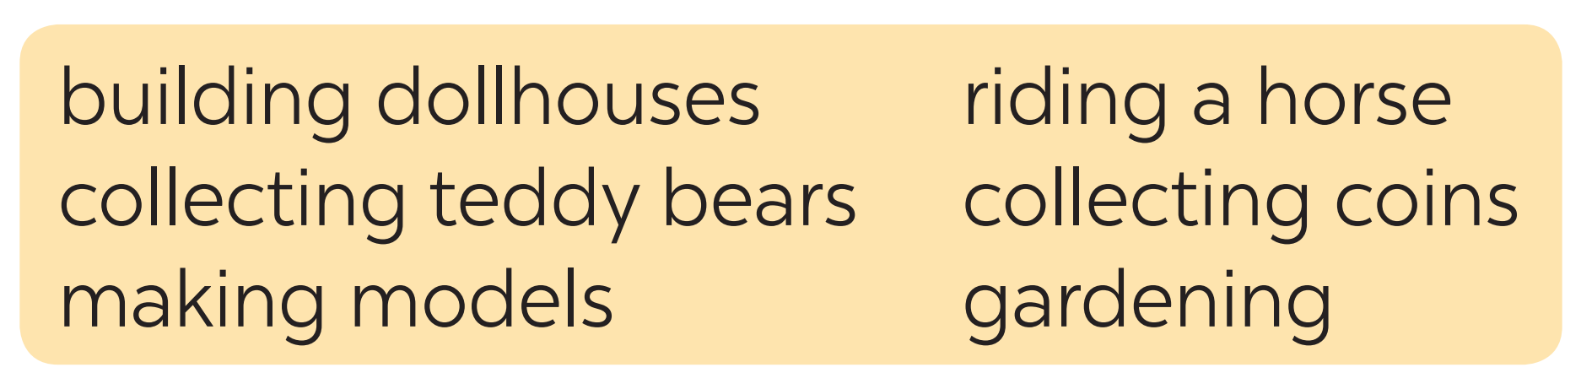
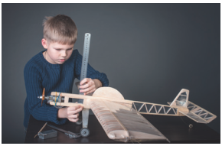
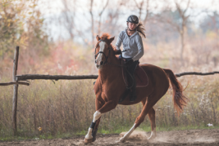
PRACTICE
3
Write the words and phrases from the box under the correct pictures. Then listen, check, and repeat.
making models
riding a horse

Slide 14
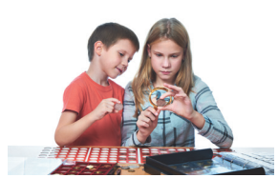
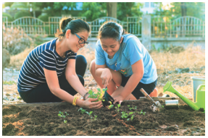
PRACTICE
3
Write the words and phrases from the box under the correct pictures. Then listen, check, and repeat.
collecting coins
gardening

Slide 15
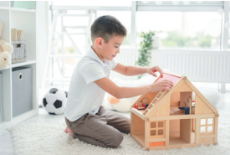
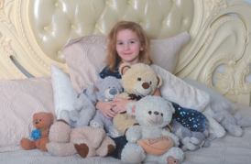
PRACTICE
3
Write the words and phrases from the box under the correct pictures. Then listen, check, and repeat.
building dollhouses
collecting teddy bears

Slide 16
PRACTICE
3
Write the words and phrases from the box under the correct pictures. Then listen, check, and repeat.
making models
riding a horse
collecting coins
gardening
building dollhouses
collecting teddy bears

Slide 17
PRACTICE
4
Work in pairs. Write the hobbies from Task 3 in the suitable columns.
doing things | making things | collecting things
riding a horse
making models
collecting coins
gardening
building dollhouses
collecting teddy bears
(others: travelling, skiing, doing yoga, etc.)
(others: painting, making pottery, etc.)
(others: collecting toys, collecting books, etc.)

Slide 18
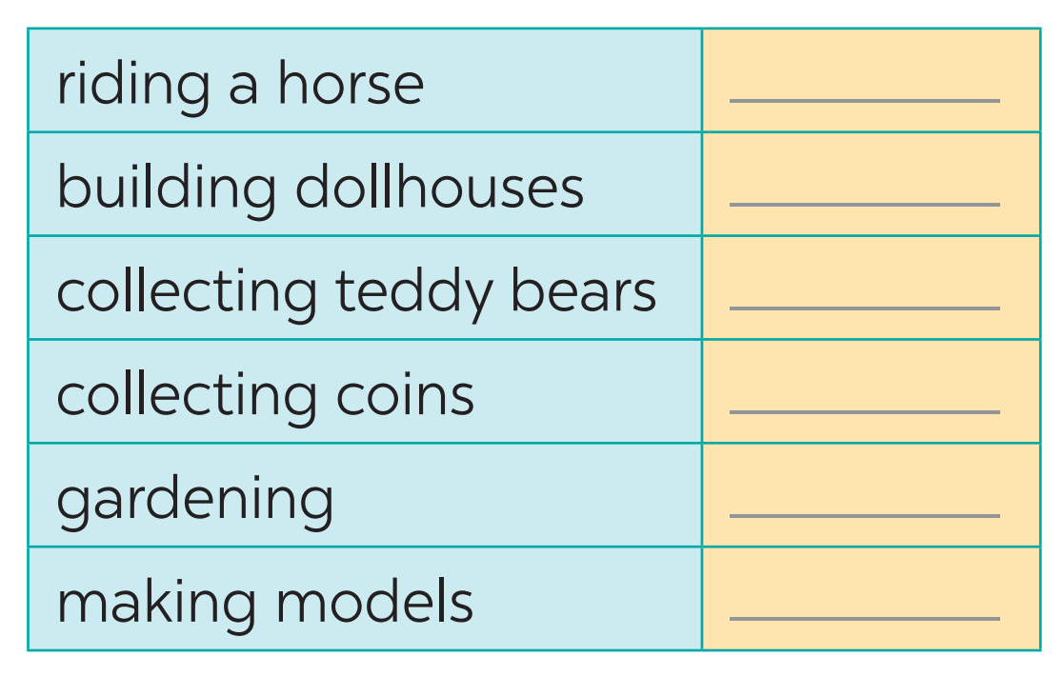

PRODUCTION
5
GAME: Find someone who likes…

Slide 19

CONSOLIDATION
2
HOMEWORK
Name a list of cheap hobbies, expensive hobbies, easy and difficult hobbies.
Prepare for the project.

Slide 20

Website: hoclieu.vn
Fanpage: facebook.com/www.tienganhglobalsuccess.vn/

