Slide 1


Slide 2



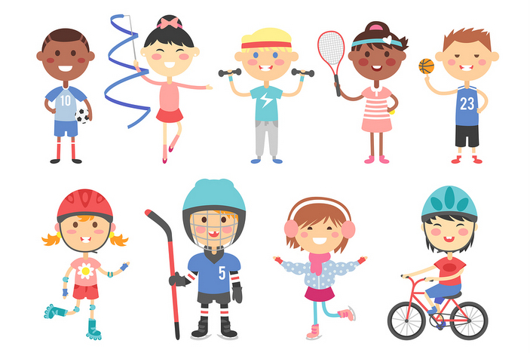

Unit
1
HOBBIES
LESSON 6: SKILLS 2

Slide 3
WARM-UP
What will you mention when you talk about someone’s hobby?
The time he / she started the hobby
His / Her feelings about the hobby
His / Her future plan about the hobby

Slide 4
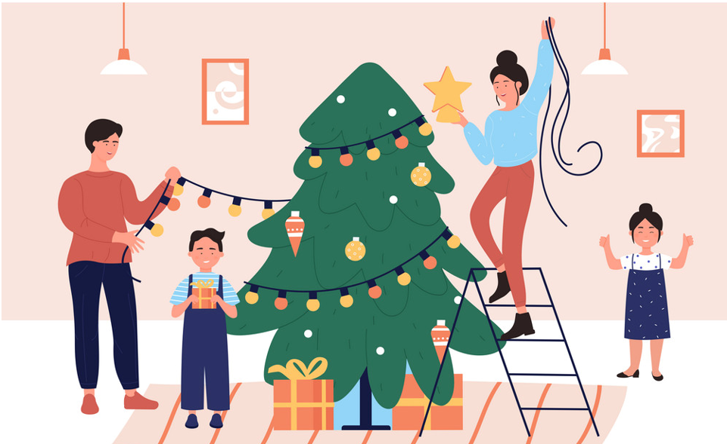

UNIT 1: HOBBIES
Lesson 6: Skills 2
1. Vocabulary:
- decorate (v)
/ˈdekəreɪt/
trang trí

Slide 5


UNIT 1: HOBBIES
Lesson 6: Skills 2
1. Vocabulary
- benefit (n)
/ˈbenɪfɪt/
lợi ích
- duty /ˈdjuːti/ (n): nghĩa vụ, bổn phận

Slide 6
Become : trở nên
Patient (a) : kiên nhẫn
Creative (a) : sáng tạo
Cloth : vải
Cousin : người chị họ

Slide 7
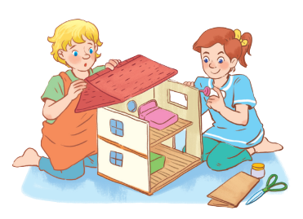
II. LISTENING
1
Look at the picture.
What hobby is it?
Do you think it is a good hobby? Why or why not?
In the picture, I can see two girls. They build a dollhouse. In my opinion, their hobby is building dollhouses. I think It’s a good hobby. Because it develops your creativity. It also makes you more patient.

Slide 8
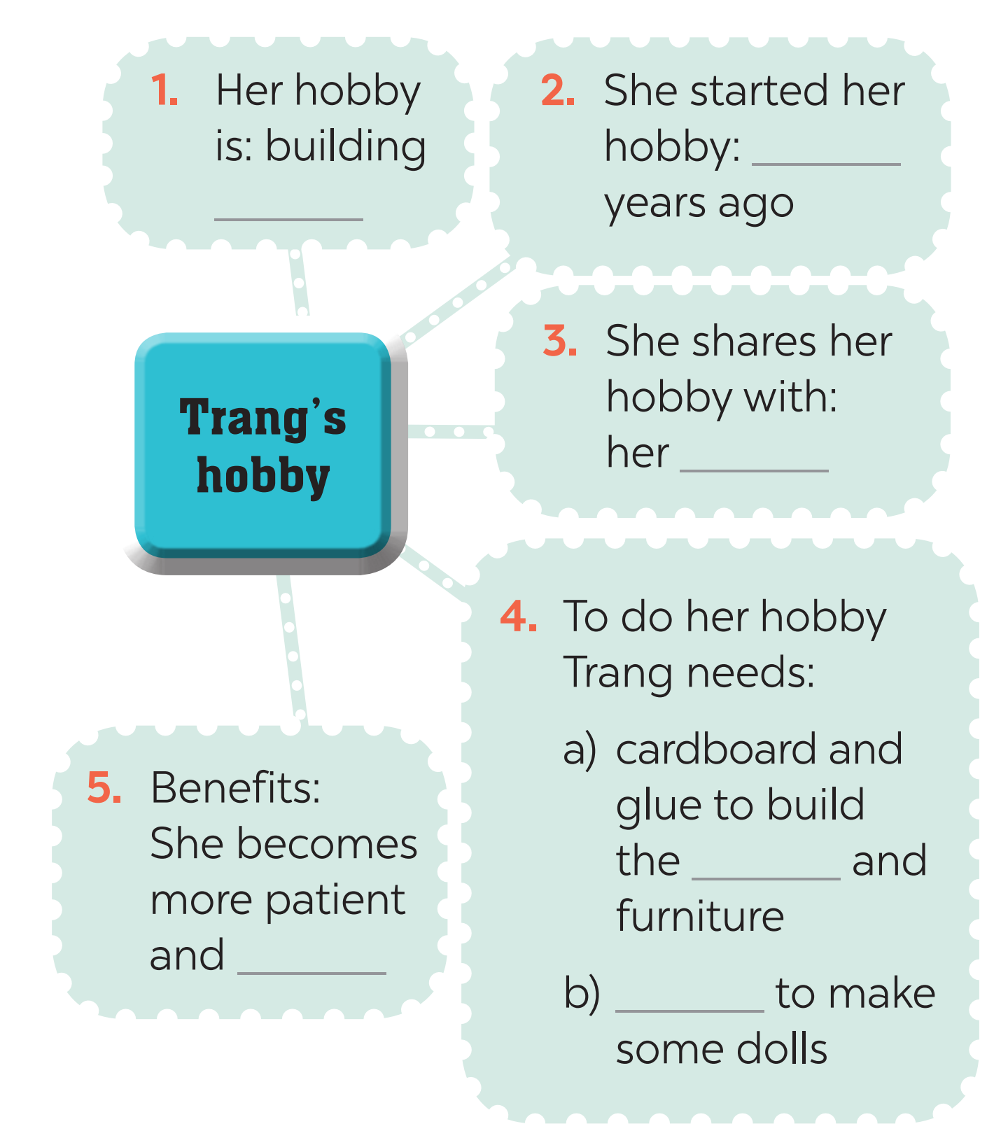
2
Listen to an interview about Trang’s hobby. Fill in each blank in the mind map with one word or number.

Slide 9
* Tapescript:
Lan: Today we'll talk about hobbies. I know that your hobby is building dollhouses. It's quite unusual, isn't it?
Trang: Not really. A lot of girls like it.
Lan: When did you start doing this?
Trang: Three years ago. I read an article about building dollhouses. I loved the idea right away.
Lan: Do any of your friends or relatives build dollhouses too?
Trang: Yes, my cousin Mi loves building them too.
Lan: Is it hard to build a dollhouse?
Trang: No, it isn't. I use cardboard and glue to build the house and make the furniture. Then I make the dolls from cloth. Finally, I decorate the house.
Lan: What are the benefits of the hobby?
Trang: Well, I'm more patient and creative now.

Slide 10
2
Listen to an interview about Trang’s hobby. Fill in each blank in the mind map with one word or number.
Trang’s hobby:
1. Her hobby is: building ________
2. She started her hobby: ________ years ago
3. She shares her hobby with: her _________
4. To do her hobby Trang needs:
a) cardboard and glue to build the ________ and furniture
b) _______ to make some dolls
5. Benefits: She becomes more patient and _______
dollhouses
three
cousin
house
cloth
creative

Slide 11
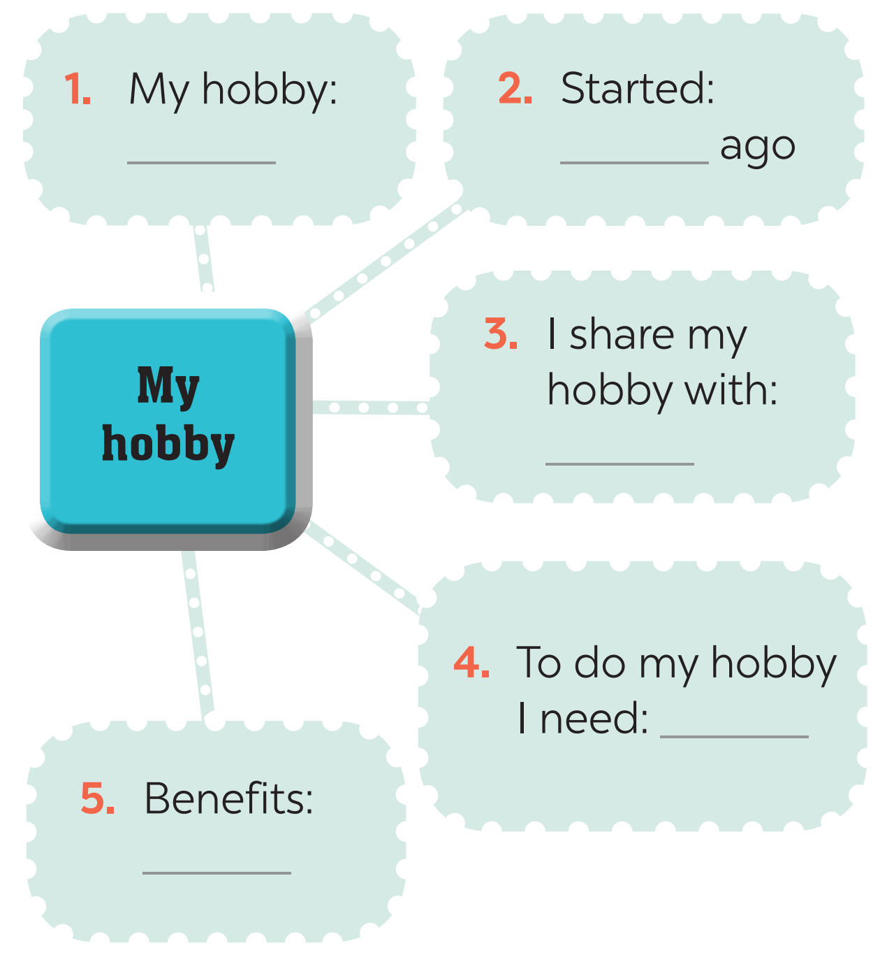
III. WRITING
3
What is your hobby? Fill in the blanks below.

Slide 12
Ex 3. What is your hobby? Fill in the blanks below.
1. My hobby: gardening
2. Started: 3 years ago
3. I share my hobby with: my family
4. To do my hobby I need: plants, gloves, pots, soil,...
5. Benefits: learn about insects and bugs, protect our environment, be more patient and responsible,...

Slide 13
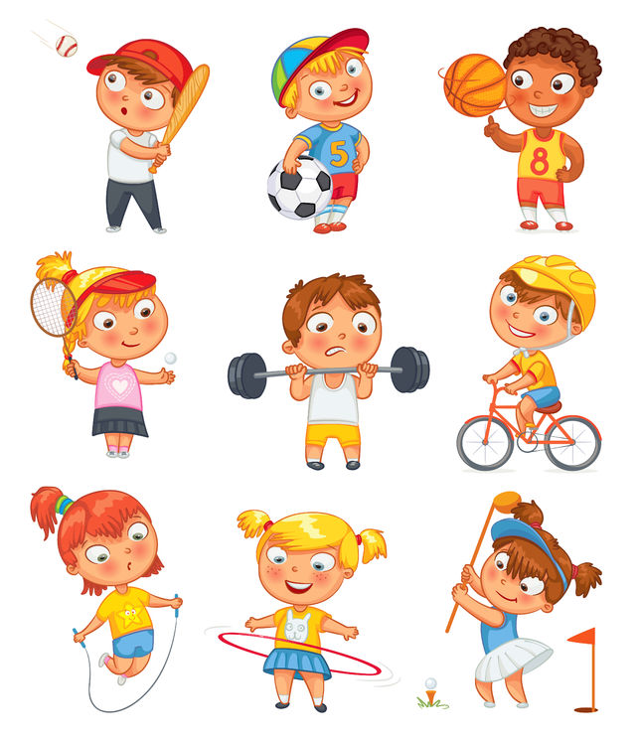
Now write a paragraph of about 70 words about your hobby. Use the notes in Task 3. Start your paragraph as shown below.
4
My hobby is ________________________________ ___________________________________________________ ___________________________________________________ ___________________________________________________ ___________________________________________________ ___________________________________________________ ___________________________________________________

Slide 14
* Sample Writing:
My hobby is gardening. I started my hobby 3 years ago. I really like it because I can do it with my family. My family can join in and do something together. We usually spend an/ one hour on Sunday morning in our garden. I need some plants, gloves, pots and soil to do my hobby. Gardening has many benefits. It helps me become more patient and responsible. I also learn about insects and bugs. Gardening can help us to protect our environment.

Slide 15
Ex 3. What is your hobby? Fill in the blanks below.
1. My hobby: collecting stamps
2. Started: 3 years ago
3. I share my hobby with: my friends and family
4. To do my hobby I need: stamps
5. Benefits: make me more patient and reduce stress,...
Sample 2: My hobby is collecting stamps. I started this hobby three years ago. I shared it with my friends and family. To do this hobby, I need a lot of stamps of Viet Nam and the world. Collecting stamps makes me more patient and reduce stress.

Slide 16
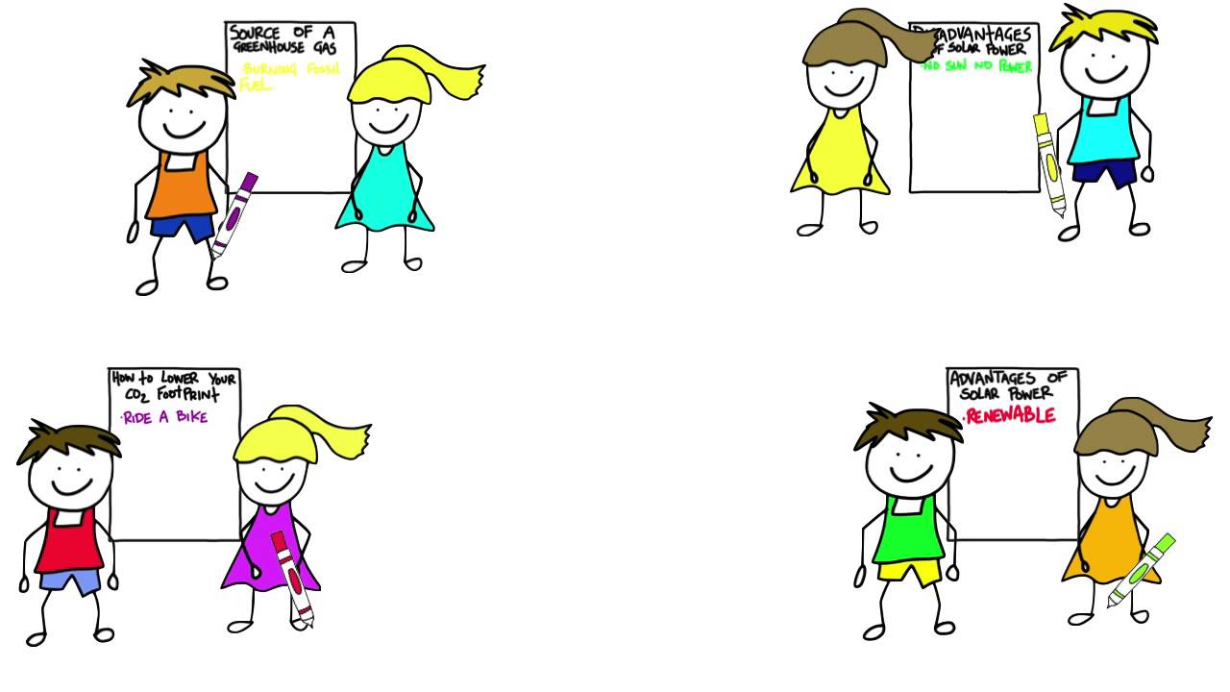
IV. PRODUCTION
CLASS GALLERY
Students can:
go and see others’ work
give comments to one another

Slide 17

UNIT 1: HOBBIES
Lesson 6: Skills 2
V. HOMEWORK
- Learn by heart Vocabulary.
- Prepare for the next lesson: Looking back & Project

Slide 18

Website: sachmem.vn
Fanpage: facebook.com/sachmem.vn/

