Slide 1
UNIT 8: FILMS
Lesson 4: COMMUNICATION

Slide 2


Slide 3
Everyday English
1
Accepting and declining suggestions

Slide 4



1. Listen and read the conversations. Pay attention to the highlighted sentences.
Tom: How about going to the cinema tonight?
Anna: That's a great idea.
Accepting suggestions
Minh: Let's go to see A Nightmare at Sao Mai Cinema tonight.
Mi: I'd love to, but that's too far for me to travel.
Declining suggestions

Slide 5

Suggestions
Responses?
Why don’t we + V…?
How about + V_ing/N…?
Let’s + V…!

Slide 6
Can you add more responses?
Accepting suggestions
Declining suggestions
That's a great idea.
I'd love to, but …
It sounds good/interesting…
Yes, I’d love to.
What a good idea!
I can’t agree more.
Thanks, but I can’t…
No, I'd rather not.
I don't feel like it.
I’m not interested…

Slide 7
2. Work in pairs. Make similar conversations with the following situations.
- Student A suggests going to the cinema and student B accepts
- Student A suggests going for a picnic but student B declines.
- Student A suggests playing badminton after school, student B accepts.
?
…
A
B

Slide 8
2
A survey about films

Slide 9
3. Listen to the conversation and fill in the blanks with the words you hear.
Tom: Hi Lan. I’m doing a survey about films. Can I ask you some questions?
Lan: Sure. Go ahead.
Tom: What kind of films do you like (1) _____________?
Lan: I love (2) _____________.
Tom: What’s the name of your (3) _____________ comedy?
Lan: It’s Dr Johnny.
Tom: Who (4) _____________ in it?
Lan: Bill Harris.
Tom: What do you think of it?
Lan: It’s very (5) _____________.
Tom: Thank you.

Slide 10
3. Listen to the conversation and fill in the blanks with the words you hear. ▶ CHECK YOUR ANSWERS
Tom: Hi Lan. I’m doing a survey about films. Can I ask you some questions?
Lan: Sure. Go ahead.
Tom: What kind of films do you like (1) _____________?
Lan: I love (2) _____________.
Tom: What’s the name of your (3) _____________ comedy?
Lan: It’s Dr Johnny.
Tom: Who (4) _____________ in it?
Lan: Bill Harris.
Tom: What do you think of it?
Lan: It’s very (5) _____________.
Tom: Thank you.
best
comedies
favourite
stars
funny

Slide 11
Complete the table with the information about Lan.
Tom: Hi Lan. I’m doing a survey about films. Can I ask you some questions?
Lan: Sure. Go ahead.
Tom: What kind of films do you like best?
Lan: I love comedies.
Tom: What’s the name of your favorite comedy?
Lan: It’s Dr Johnny.
Tom: Who stars in it?
Lan: Bill Harris.
Tom: What do you think of it?
Lan: It’s very funny.
Tom: Thank you.
Name
Name of the film
Type of film
Main actor(s)/ actress(es)
Reviews
Lan
Dr Johnny
Tom: What’s the name of your favorite comedy?
Dr Johnny.

Slide 12
Complete the table with the information about Lan.
Tom: Hi Lan. I’m doing a survey about films. Can I ask you some questions?
Lan: Sure. Go ahead.
Tom: What kind of films do you like best?
Lan: I love comedies.
Tom: What’s the name of your favorite comedy?
Lan: It’s Dr Johnny.
Tom: Who stars in it?
Lan: Bill Harris.
Tom: What do you think of it?
Lan: It’s very funny.
Tom: Thank you.
Name
Name of the film
Type of film
Main actor(s)/ actress(es)
Reviews
Lan
Tom: What kind of films do you like best?
Dr Johnny
comedies
comedy

Slide 13
Complete the table with the information about Lan.
Tom: Hi Lan. I’m doing a survey about films. Can I ask you some questions?
Lan: Sure. Go ahead.
Tom: What kind of films do you like best?
Lan: I love comedies.
Tom: What’s the name of your favorite comedy?
Lan: It’s Dr Johnny.
Tom: Who stars in it?
Lan: Bill Harris.
Tom: What do you think of it?
Lan: It’s very funny.
Tom: Thank you.
Name
Name of the film
Type of film
Main actor(s)/ actress(es)
Reviews
Lan
Dr Johnny
comedy
Tom: Who stars in it?
Bill Harris
Bill Harris

Slide 14
Complete the table with the information about Lan.
Tom: Hi Lan. I’m doing a survey about films. Can I ask you some questions?
Lan: Sure. Go ahead.
Tom: What kind of films do you like best?
Lan: I love comedies.
Tom: What’s the name of your favorite comedy?
Lan: It’s Dr Johnny.
Tom: Who stars in it?
Lan: Bill Harris.
Tom: What do you think of it?
Lan: It’s very funny.
Tom: Thank you.
Name
Name of the film
Type of film
Main actor(s)/ actress(es)
Reviews
Lan
Dr Johnny
comedy
Bill Harris
Tom: What do you think of it?
very funny
very funny

Slide 15
4. Work in groups. Do a survey about your group members’ favourite films.
Member’s name
Name of the film
Type of film
Main actor(s)/ actress(es)
Reviews
Lan
Dr Johnny
comedy
Bill Harris
very funny

Slide 16
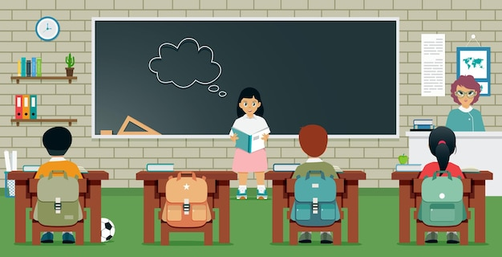
5. Report your results to the class.

Slide 17
In this lesson, we have learnt to:
- accept and decline suggestions
do a survey about group members’ favourite films
report the survey’s result to class

Slide 18
Home assignments
- Revise structures you’ve learnt.
- Talk about your favourite films.

Slide 19
Thank you a lot for your attention!

