Slide 1

Unit 4.
Ethnic groups of Vietnam
Tuesday, 18th November 2025
Lesson 4. Communication

Slide 2
VOCABULARY

Slide 3
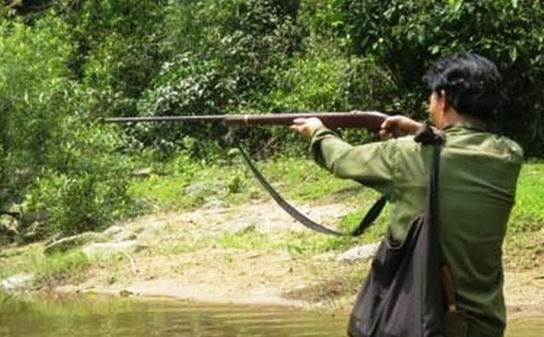

Vocabulary
01
hunt (v)
=> go hunting
/hʌnt/
đi săn, săn bắn

Slide 4
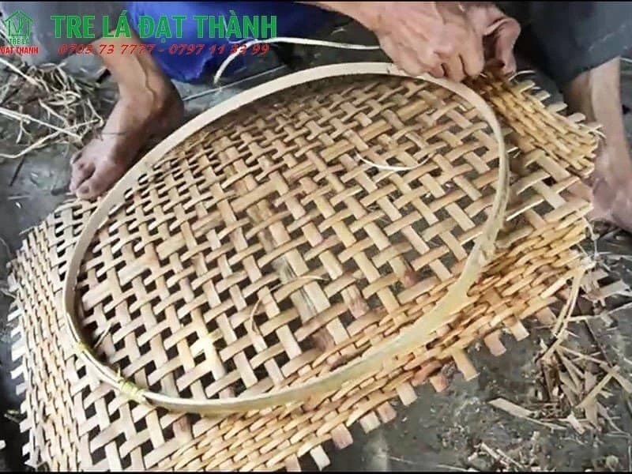
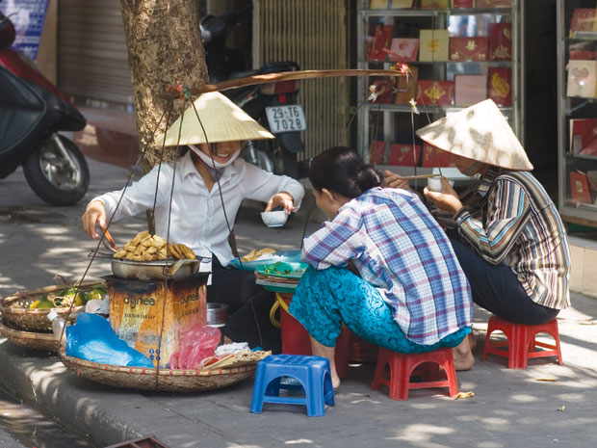
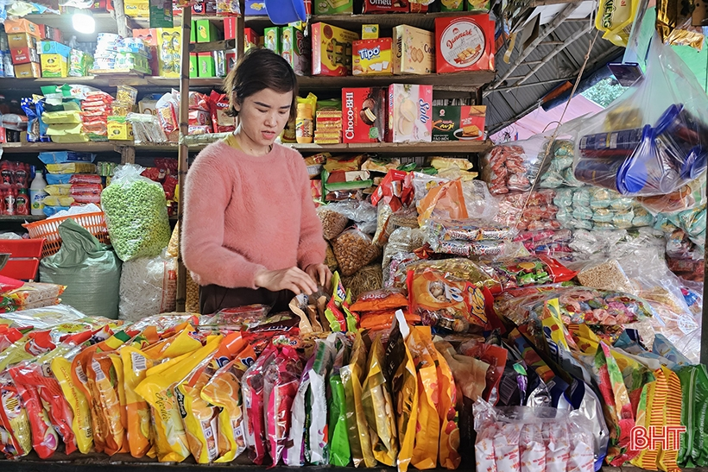
Vocabulary
02
earn for (one’s) living from…
/ɝːn fər ˈwʌnz ˈlɪvɪŋ/
kiếm sống bằng…

Slide 5
Vocabulary
03
role (n)
/roʊl/
Women play a dominant role
vai trò

Slide 6
VOCABULARY
- hunt (v) | /hʌnt/ | săn, săn đuổi
- earn for (one’s) living from… | /ɝːn fər ˈwʌnz ˈlɪvɪŋ/ | kiếm sống bằng…
- role (n) | /rəʊl/ | vai trò

Slide 7
Everyday
English
Giving opinions

Slide 8

1. Listen and read the conversations.
Pay attention to the highlighted parts.
What do you think about life in the mountains?
Structures giving opinions
I think it’s very interesting. People in the mountains live close to nature.
01
I think…
02
To my way of thinking…
In my opinion
What about you, Mai? What do you think?
In my view
According to me
To my way of thinking, there are better services in the city.

Slide 9
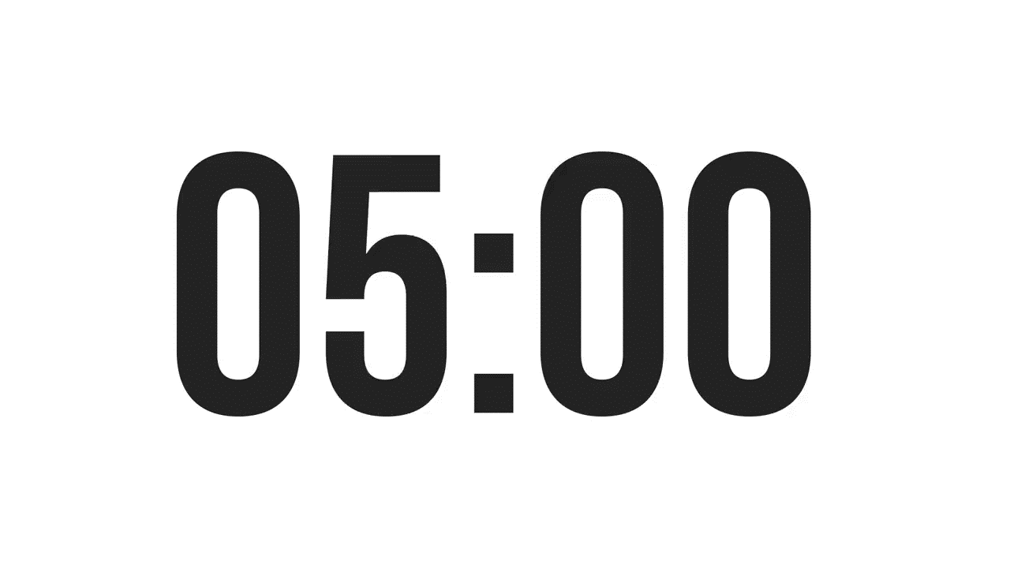
2. Work in pairs in 5 minutes. One asks the questions and the other gives opinions about these topics.
Topics
Playing traditional games
Living close to nature
A: What do you think about playing traditional games?
B: I think it's very interesting. Children always love playing traditional games. And What about you, A? What do you think?
A: I think playing traditional games will bring people together.
A: What do you think about living close to nature?
B: That sounds great. We can learn how to protect our planet. What about you, A? What do you think?
A: To my way of thinking you are right. Additionally, living close to nature will improves our mental health.

Slide 10
The Jrai

Slide 11
4. Work in pairs. Read the information below about the Jrai. Take turns to ask and answer about the information.
QUESTIONS
How many population in Jrai?
It’s…..
1
Where do they mainly live?
Mainly in……
2
What type of house do they live in?
It’s…..
3
What do they earn for their living?
Growing crops, …
4
What are their traditional culture?
They are rich in traditional folk dances, songs, games, and musical instruments.
5
Who plays the dominant role in the family?
Women plays the dominant role in the family.
6

