Slide 2
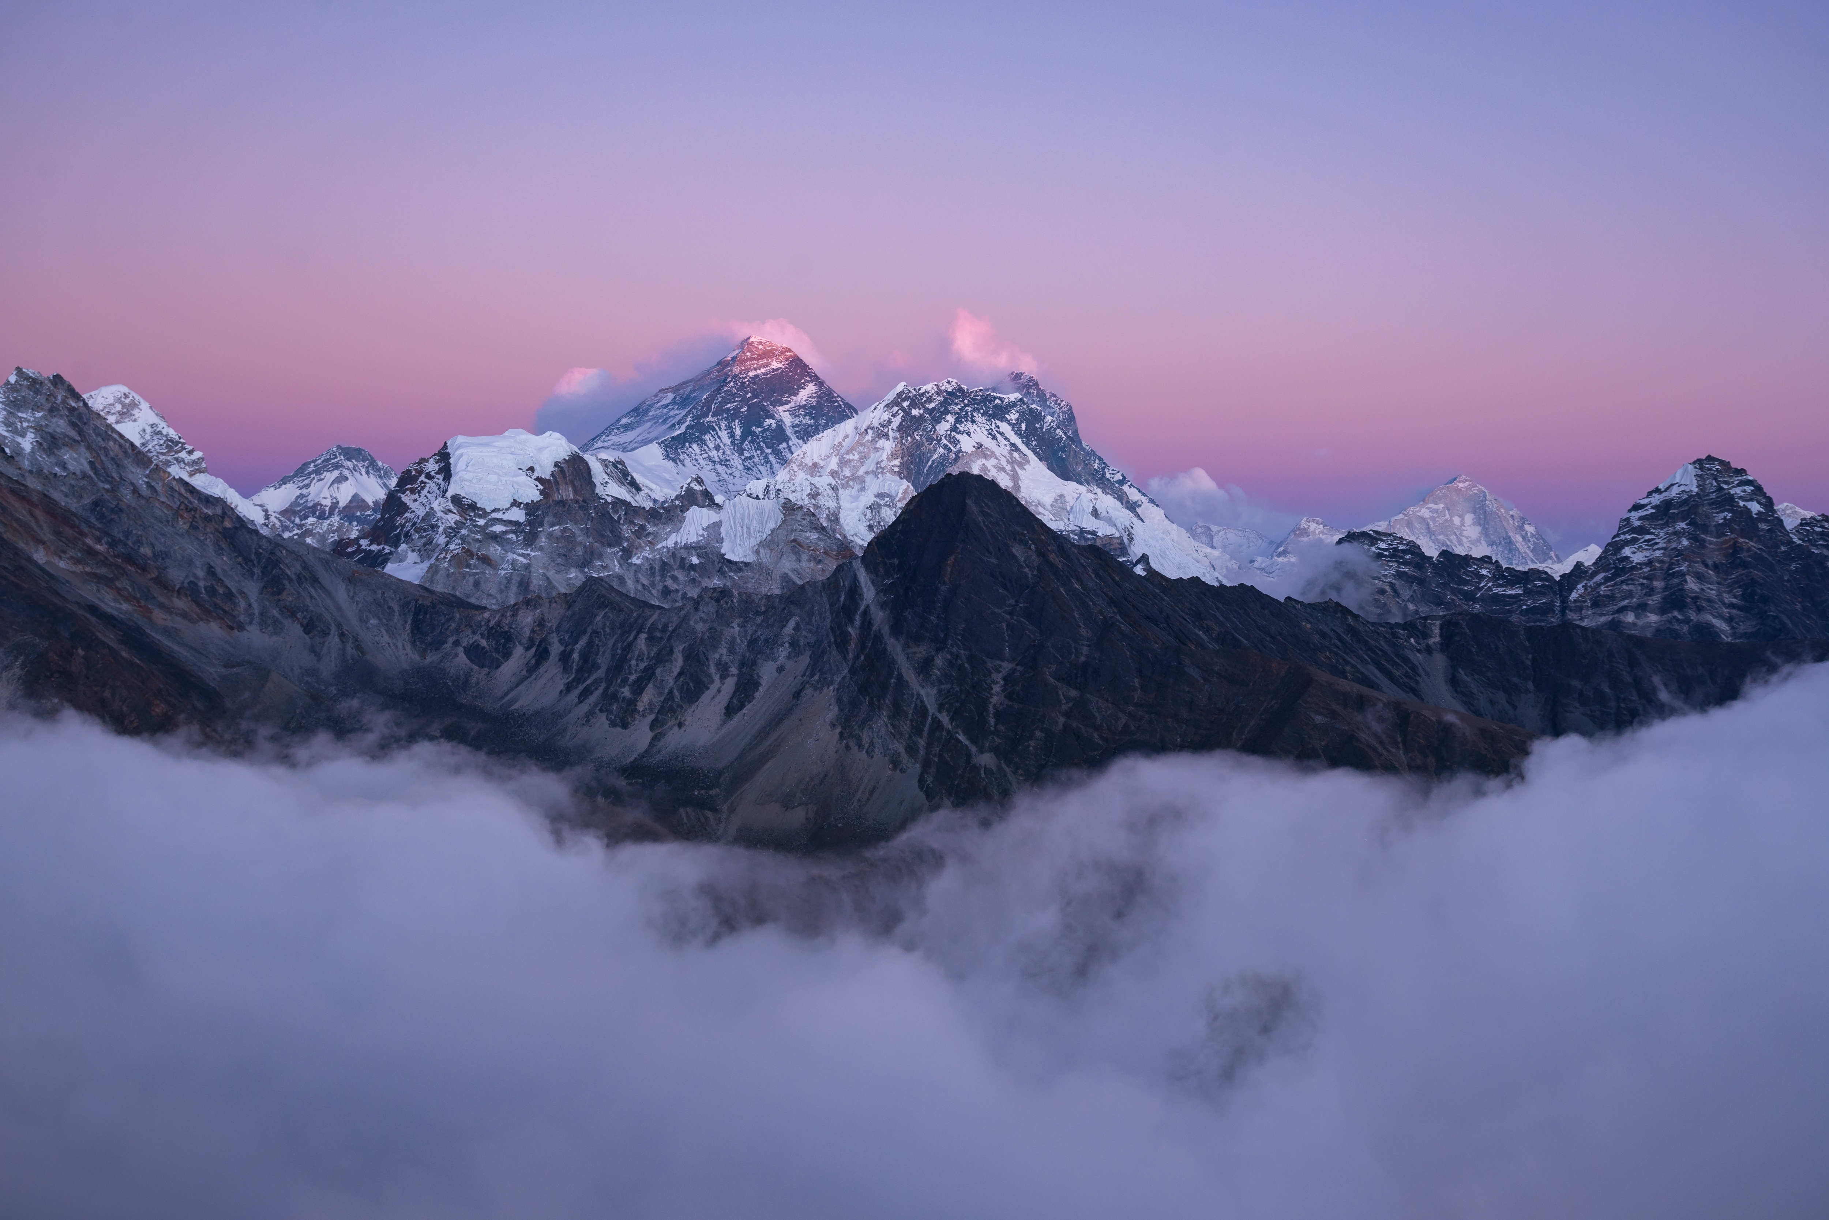


Unit
7
NATURAL WONDERS
LESSON 1: GETTING STARTED
Meeting on the corridor

Slide 3

OBJECTIVES
By the end of the lesson, students will be able to:
Use the words related to natural wonders of the world
Gain vocabulary to talk about natural wonders of the world

Slide 4
LESSON 1: GETTING STARTED
LESSON 1: GETTING STARTED
WARM-UP
Option 1: Think!
Option 2: Create a Travel Brochure
Vocabulary
PRESENTATION
Task 1: Listen and read.
Task 2: Read the conversation again and tick (√) T (True) of F (False) for each sentence.
Task 3: Complete each sentence with a word or a phrase from the box
Task 4: Underline the correct answer to complete each sentence.
PRACTICE
PRODUCTION
Task 5: Natural Wonders Knowledge
CONSOLIDATION
Wrap-up
Homework

Slide 5

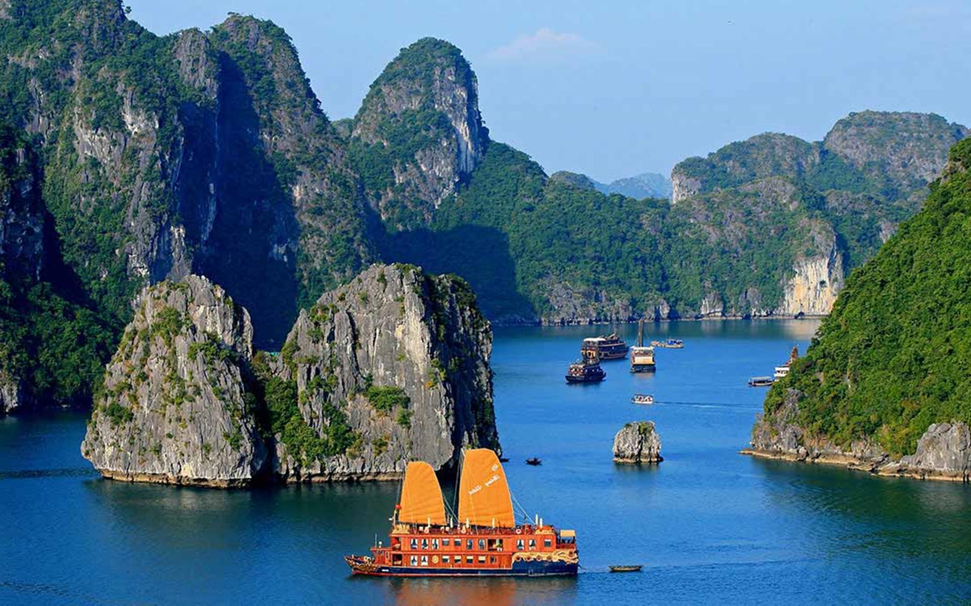
WARM-UP
OPTION 1
Questions:
Where are the most beautiful places in your country?
Where are they?
Are they natural or man made? …
THINK

Slide 6
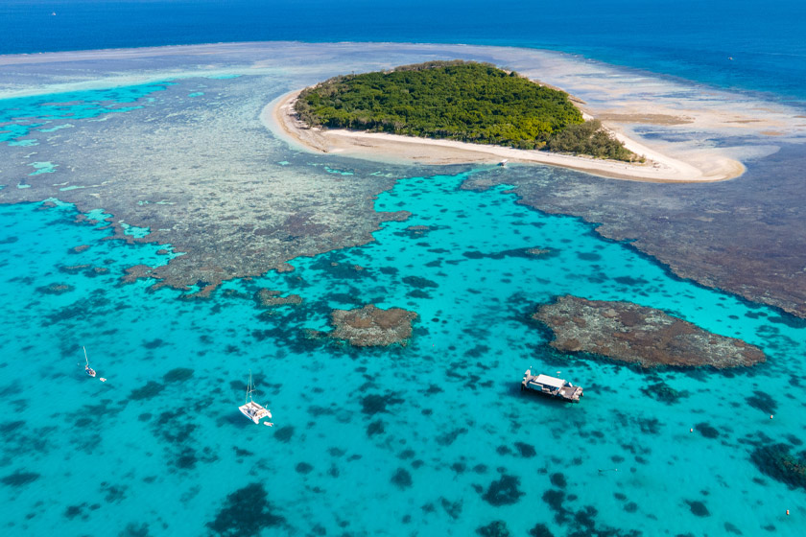
WARM-UP
OPTION 1
HA LONG BAY

Slide 7
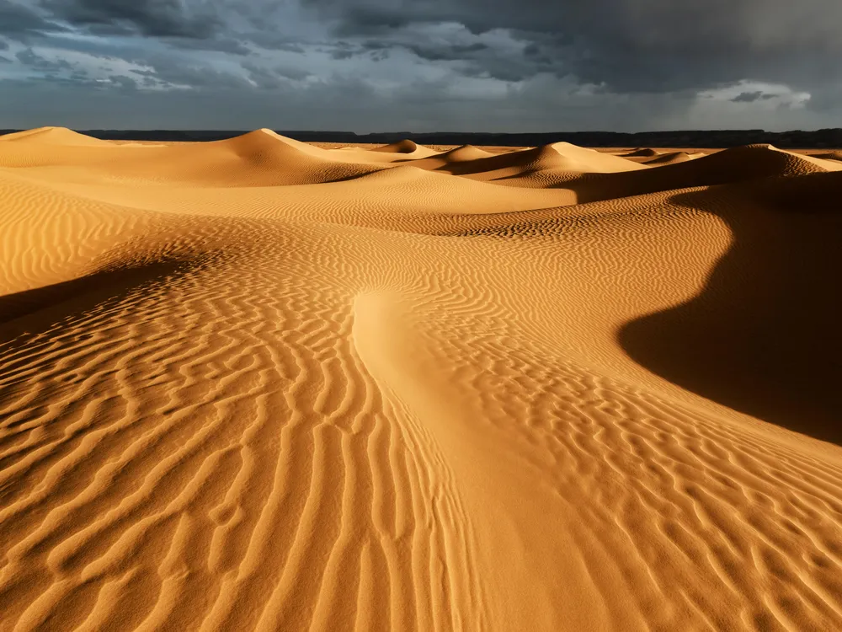
WARM-UP
OPTION 1
GREAT BARRIER
REEF

Slide 8
WARM-UP
OPTION 1
SAHARA DESERT

Slide 9

WARM-UP
OPTION 2
CREATE
TRAVEL
BROCHURE

Slide 10
WARM-UP
OPTION 2
- Work in groups
- Each group chooses a beautiful place you like
- Use the information you find to create a travel brochure for that place.
Information in brochures:
- Location
- Climate
- Why someone should visit
CREATE
TRAVEL
BROCHURE

Slide 11

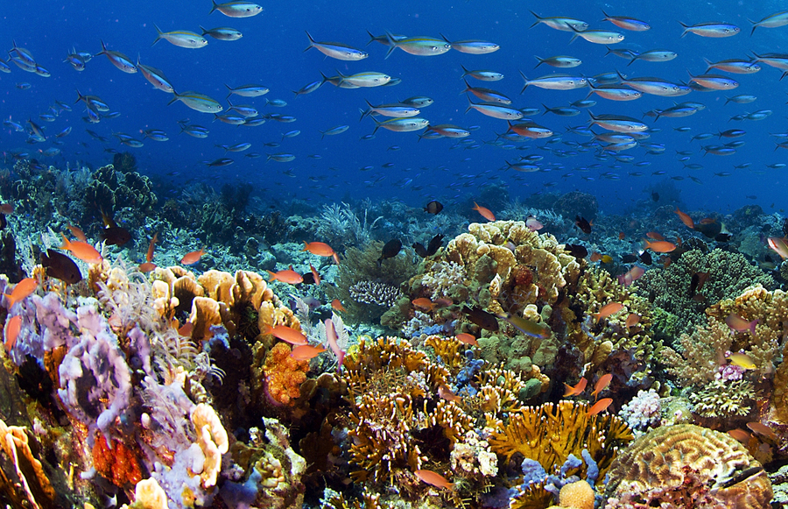
PRESENTATION
crazy (adj) about so/sth
like so/sth very much
Ex: I was crazy about baseball when I was seven.
/ˈkreɪzi/
thích mê

Slide 12
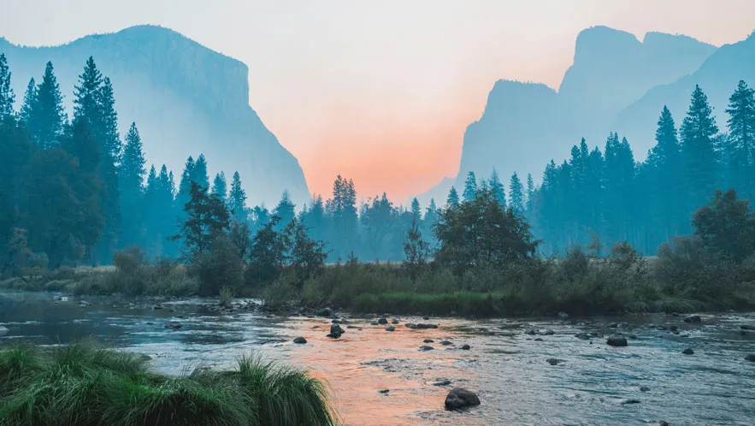
PRESENTATION
a substance like rock, formed in the sea by groups of particular types of small animal, often used in jewelry.
coral (n,adj)
/ˈkɒrəl/
san hô

Slide 13
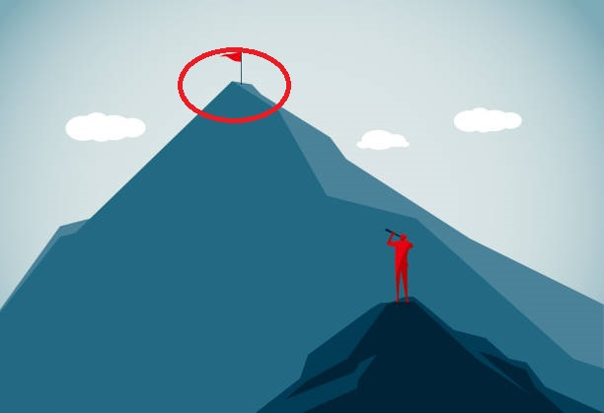
PRESENTATION
a view or picture of the countryside, or the art of making such pictures.
landscape (n)
/ˈlænd.skeɪp/
phong cảnh

Slide 14
PRESENTATION
the highest point
peak (n)
/piːk/
đỉnh, đỉnh núi

Slide 15
PRESENTATION
pleasant and attractive
charming (adj)
/ˈtʃɑː.mɪŋ/
Ex: What a charming street this is.
đẹp

Slide 16

PRESENTATION
able to be maintained or continued
sustainable (adj)
Ex: The website encourages sustainable fashion through swapping.
/səˈsteɪnəbl/
đẹp

Slide 17
PRESENTATION
a place or position
location (n)
/ləʊˈkeɪʃn/
địa điểm, nơi chốn

Slide 18
PRESENTATION
to have or own sth
possess (v)
Ex: I don't possess a single DVD (= I don't have even one DVD).
/pəˈzes/
có, sở hữu

Slide 19
PRESENTATION
New words | Pronunciation | Meaning
1. crazy (adj) about so/sth | /ˈkreɪzi/ | thích mê
2. coral (n,adj) | /ˈkɒrəl/ | san hô
3. landscape (n) | /ˈlænd.skeɪp/ | phong cảnh
4. peak (n) | /piːk/ | đỉnh, đỉnh núi

Slide 20
PRESENTATION
New words | Pronunciation | Meaning
5. charming (adj) | /ˈtʃɑː.mɪŋ/ | đẹp
6. sustainable (adj) | /səˈsteɪnəbl/ | bền vững
7. location (n) | /ləʊˈkeɪʃn/ | địa điểm, nơi chốn
8. possess (v) | /pəˈzes/ | có, sở hữu

Slide 21
LESSON 1: GETTING STARTED
LESSON 1: GETTING STARTED
WARM-UP
Option 1: Think!
Option 2: Create a Travel Brochure
Vocabulary
PRESENTATION
Task 1: Listen and read.
Task 2: Read the conversation again and tick (√) T (True) of F (False) for each sentence.
Task 3: Complete each sentence with a word or a phrase from the box
Task 4: Underline the correct answer to complete each sentence.
PRACTICE

Slide 22
PRACTICE
- Answer the questions:
+ Have you ever been to Ha Long Bay?
+ Do you know that it is a famous natural wonder of the world?
+ Have you heard of / read about other wonders: Mt. Everest, the Dead Sea, …?

Slide 23
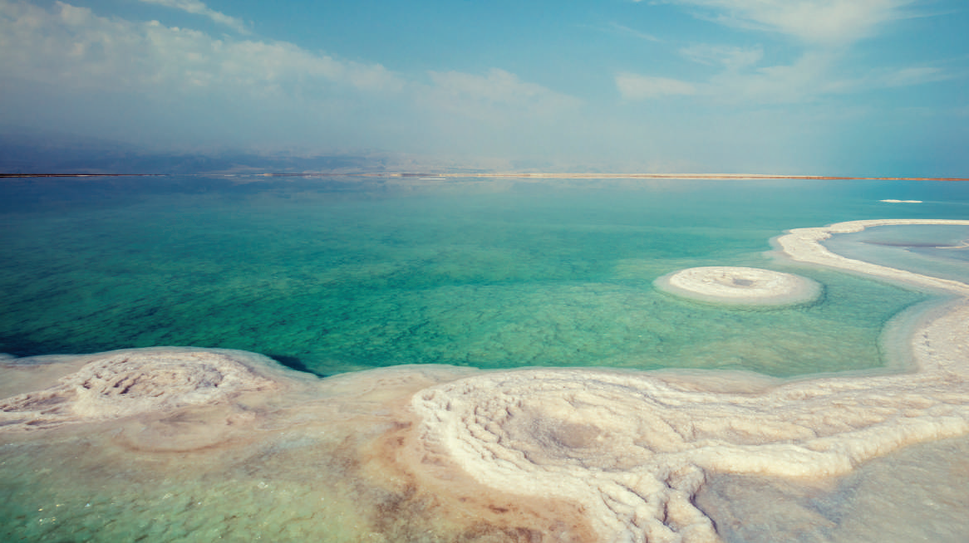
PRACTICE
Look at the pictures on pages 72 and answer:
What the conversation between Lan and Tom is about?

Slide 24

PRACTICE
Task 1: Listen and read (p.72)
Lan: Hi, Tom. I hear that you’ve won second prize in the Natural Wonders Contest. Congratulations!
Tom: Thanks, Lan. I like exploring the wonders of nature. I’m crazy about them.
Lan: What did you talk about in the contest?
Tom: I talked about some natural wonders like Mount Everest, the Great Barrier Reef, and the Dead Sea.
Lan: Wonderful! I’m interested in them too.
Tom: Well, you know our planet has so many beautiful landscapes, from snow-covered peaks to charming rivers, lakes, and other natural places that we can’t help admiring. So that’s what I talked about.

Slide 25
PRACTICE
Task 1: Listen and read (p.72)
Lan: Oh yeah … And what else did you mention?
Tom: Well, I mentioned the risk of us, humans, destroying natural wonders,
and I suggested ways to preserve them and support sustainable development.
Lan: Sounds interesting. Do you want to visit any of these places?
Tom: The host also asked me if I wanted to visit those places, and I answered that I wanted to see two of them: the Grand Canyon and Ha Long Bay.
Lan: I’d love to visit them too.

Slide 26
PRACTICE
Questions:
1. Which prize did Tom win?
2. Which natural wonders did Tom talk about?
3. Which risks did Tom mention?
4. Where will Tom visit?
the second prize in the Natural Wonders Contest
Mount Everest, the Great Barrier Reef, and the Dead Sea
humans, destroying natural wonders.
the Grand Canyon and Ha Long Bay.
 | T | F
1. Tom took part in the Natural Wonders Contest.
2. Lan is not keen on natural wonders.
3. Tom suggested ways to preserve natural wonders.
4. Tom asked the host if he wanted to go to Ha Long Bay.

Slide 27
PRACTICE
2
Read the conversation again and tick (√) T (True) of F (False) for each sentence.
 | T | F
1. Tom took part in the Natural Wonders Contest.
2. Lan is not keen on natural wonders.
3. Tom suggested ways to preserve natural wonders.
4. Tom asked the host if he wanted to go to Ha Long Bay.
√
√
√
√

Slide 28
PRACTICE
3
Complete the sentences with the words from the box.
explore
couldn’t help
landscape
support
development
1. A _____________________ is everything you can see in a large area of land, especially in the countryside.
4. Environmentalists strongly ______________ measures to save these heritage trees.
2. It was risky for him to climb the peak, but we ______________ admiring his courage.
5.Sustainable ________________ goals will guide us to create a more sustainable future for all.
3.The best way to _____________ the Trang An Landscape Complex is by boat.

Slide 29
PRACTICE
3
Complete the sentences with the words from the box.
explore
couldn’t help
landscape
support
development
1. A _____________________ is everything you can see in a large area of land, especially in the countryside.
4. Environmentalists strongly ______________ measures to save these heritage trees.
2. It was risky for him to climb the peak, but we ______________ admiring his courage.
5.Sustainable ________________ goals will guide us to create a more sustainable future for all.
3.The best way to _____________ the Trang An Landscape Complex is by boat.

Slide 30
PRACTICE
4
Underline the correct answer to complete each sentence.
1. Charles is crazy / interested about football. He follows all the World Cup matches.
matches.
2. When you go to Mui Ne, you can see the unique location / landscape of a desert.
3. The children were very eager to explore/ possess the surrounding countryside.
4. Can you suggest / discover ways of boosting our local tourism?
5. Tourism develops / contributes millions of dollars to our country’s economy.

Slide 31
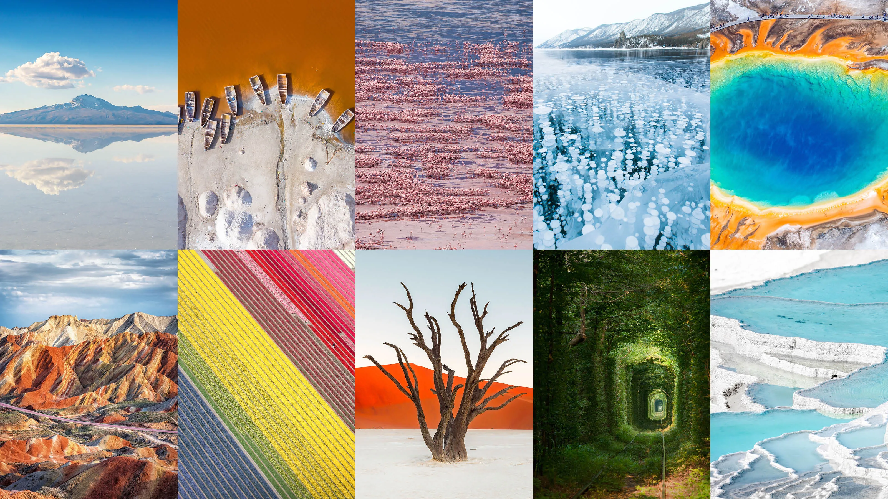
LESSON 1: GETTING STARTED
LESSON 1: GETTING STARTED
WARM-UP
Option 1: Think!
Option 2: Create a Travel Brochure
Vocabulary
PRESENTATION
Task 1: Listen and read.
Task 2: Read the conversation again and tick (√) T (True) of F (False) for each sentence.
Task 3: Complete each sentence with a word or a phrase from the box
Task 4: Underline the correct answer to complete each sentence.
PRACTICE
PRODUCTION
Task 5: Natural Wonders Knowledge

Slide 32
PRODUCTION
GAME: Natural Wonders Knowledge.
Work in groups. List some natural wonders and say where they are located. The group that has the most correct answers wins.
5

Slide 33
PRODUCTION
SUGGESTED ANSWERS:
- The Grand Canyon, USA
- The Great Barrier Reef, Australia
- Ha Long Bay, Vietnam
- Northern Lights, Arctic and Antartic.

Slide 34
LESSON 1: GETTING STARTED
LESSON 1: GETTING STARTED
WARM-UP
Option 1: Think!
Option 2: Create a Travel Brochure
Vocabulary
PRESENTATION
Task 1: Listen and read.
Task 2: Read the conversation again and tick (√) T (True) of F (False) for each sentence.
Task 3: Complete each sentence with a word or a phrase from the box
Task 4: Underline the correct answer to complete each sentence.
PRACTICE
PRODUCTION
Task 5: Natural Wonders Knowledge
CONSOLIDATION
Wrap-up
Homework

Slide 35

CONSOLIDATION
2
Homework
- Do exercises in the workbook.

Slide 36
CONSOLIDATION
2
Homework
- Prepare for the Project of the unit
- Open book p.81, look at the picture and say what the topic of the project is
- Work in groups to design a poster.
- You will show and present in Lesson 7 – Looking back and Project.

Slide 37
CONSOLIDATION
2
Homework
Collecting information and pictures (searching the Internet, reading books / magazines, brainstorming ideas, etc. about a natural wonder: its location, its special features / attractions, threats to its existence, and ways / plans to preserve it.
Step 1
Organising ideas and visuals, and designing the posters .
Step 2
Practising explaining your posters and answering questions about the content
Step 3

Slide 38
Website: hoclieu.vn
Fanpage: facebook.com/www.tienganhglobalsuccess.vn/

