Slide 1
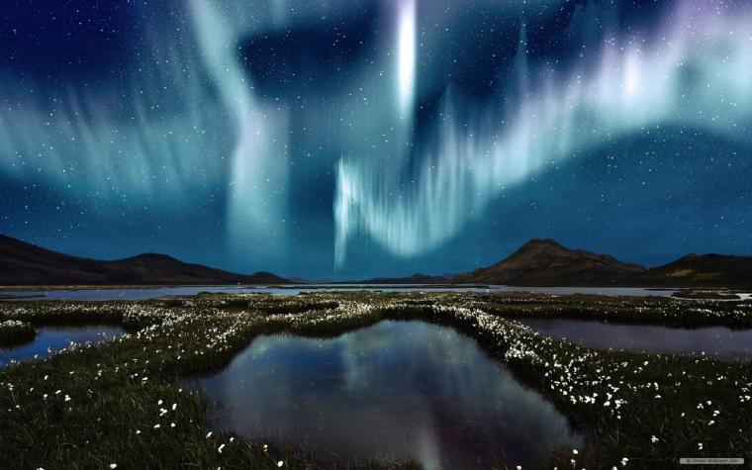

Slide 2


Unit
7
NATURAL WONDERS
LESSON 2: A CLOSER LOOK 1

Slide 3

OBJECTIVES
By the end of the lesson, students will be able to:
Use the lexical items related to the topic NATURAL WONDERS
Pronounce the sounds /sl/ and /sn/ in words and sentences correctly

Slide 4
LESSON 2: A CLOSER LOOK 1
LESSON 2: A CLOSER LOOK 1
WARM-UP
Option 1: Brainstorm
Option 2: Would you rather?
Vocabulary
Task 1: Match the words in A with their definitions/explanations in B.
Task 2: Complete the following table. There is one example.
Task 3: Complete the following sentences with the words from the box.
VOCABULARY
PRONUNCIATION
Task 4: Listen and repeat the words. Pay attention to the sounds /sl/ and /sn/
Task 5: Listen and repeat the sentences. Pay attention the the underlined words.
CONSOLIDATION
Wrap-up
Homework

Slide 5

WARM-UP
OPTION 1
Brainstorm

