Slide 1
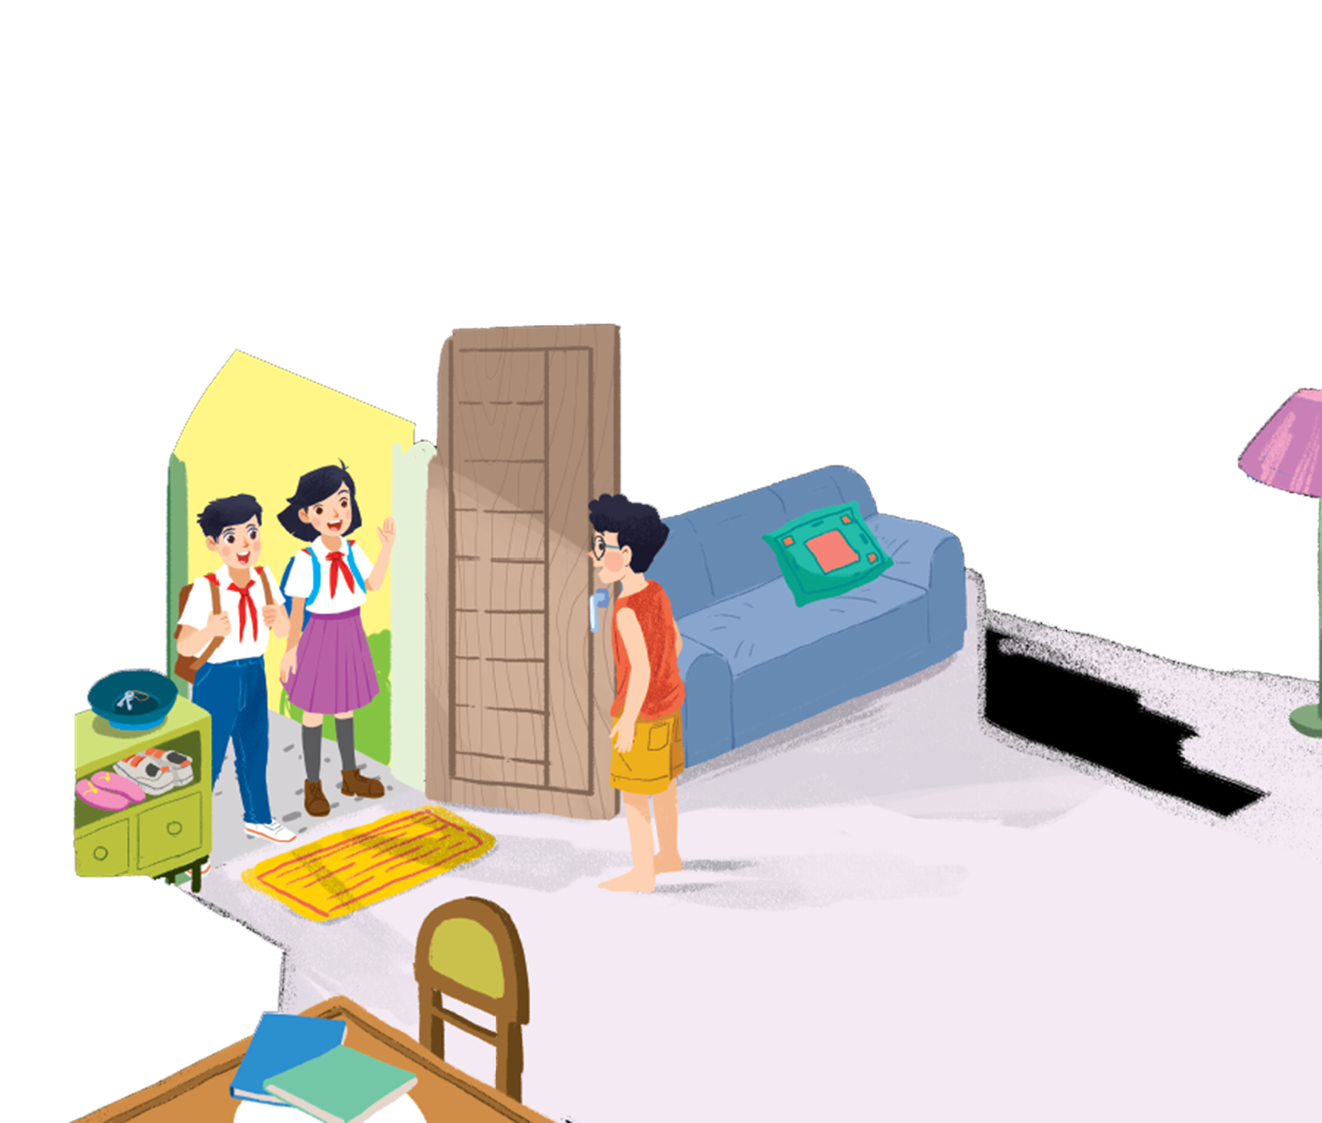
      UNIT 1: MY NEW SCHOOL
      LESSON 1: GETTING STARTED
English 6

Slide 2
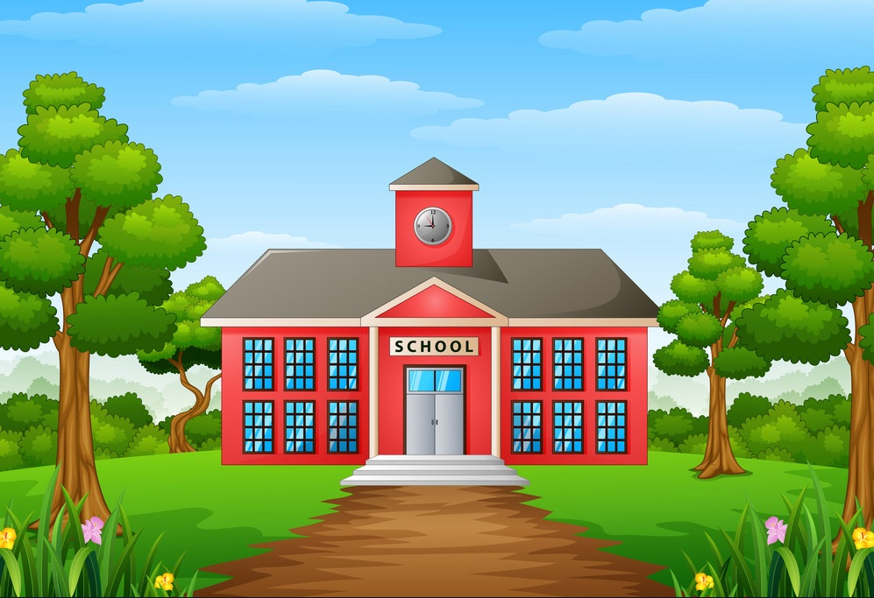


1. How many people can you see in the picture?
2. Who are they?
3. Where are they?
4. What are the students carrying on their backs?
5. Where are they going to go?

Slide 3
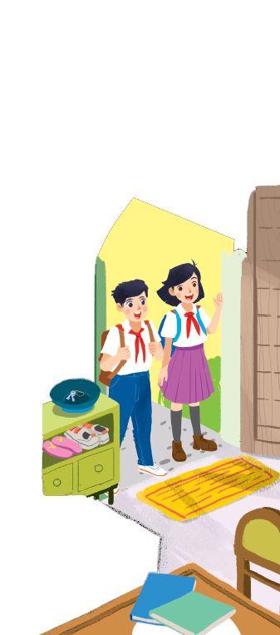
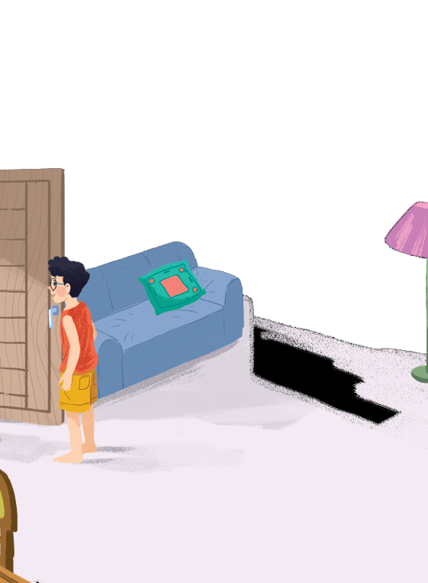

1
Listen and read.
A special day
Where are they?
Who are Vy and Duy
Notes:
Thiếu tên bài đọc.

Slide 4


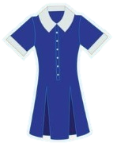
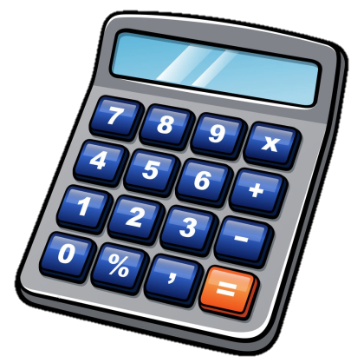
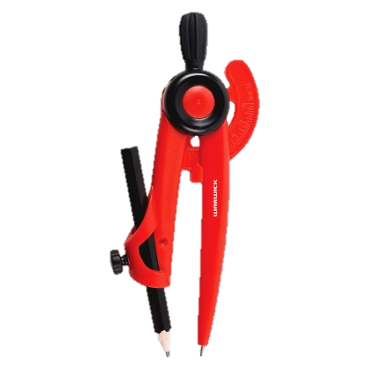
Vocabulary
‘compass (n)
knock (v)
‘heavy (a)
‘subject (n)
smart (a)
‘uniform (n)
put on (v)
‘calculator (n)
compa
gõ (cửa)
nặng
môn học
bảnh bao, sáng sủa
đồng phục
mặc vào
máy tính

Slide 5



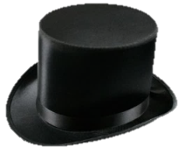


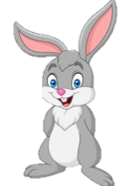
What and Where
compass
subject
knock
smart
heavy
uniform
put on
calculator

Slide 6

A special day
(Loud knock)
Phong: Hi, Vy.
Vy: Hi, Phong. Are you ready?
Phong: Just a minute.
Vy: Oh, this is Duy, my new friend.
Phong: Hi, Duy. Nice to meet you.
Duy: Hi, Phong. I live near here, and we go to the same school!
Phong: Good. Hmm, your school bag looks heavy.
Duy: Yes! I have new books, and we have new subjects to study.
Phong: And a new uniform, Duy! You look smart!
Duy: Thanks, Phong. We always look smart in our uniforms.
Phong: Let me put on my uniform. Then we can go.
Vy introduces her new friend, Duy. Then they talk about their new school and their first day at school

Slide 7
Structure
(Loud knock)
Phong: Hi, Vy.
Vy: Hi, Phong. Are you ready?
Phong: Just a minute.
Vy: Oh, this is Duy, my new friend.
Phong: Hi, Duy. Nice to meet you.
Duy: Hi, Phong. I live near here, and we go to the same school!
Phong: Good. Hmm, your school bag looks heavy.
Duy: Yes! I have new books, and we have new subjects to study.
Phong: And a new uniform, Duy! You look smart!
Duy: Thanks, Phong. We always look smart in our uniforms.
Phong: Let me put on my uniform. Then we can go.

Slide 8
Read the conversation again and tick () T (true) or F (false)
2
 |  | T | F
1. | Vy, Phong, and Duy go to the same school.
2. | Duy is Phong’s friend.
3. | Phong says Duy looks smart in his uniform.
4. | They have new subjects to study
5. | Phong is wearing a school uniform.
✓
✓
✓
✓
✓

Slide 9
Write ONE word from the box in each gap.
3
go
subjects
has
wear
uniforms
Students their uniforms on Monday.
1.
wear
has
2.
Vy a new friend, Duy.
- Do Phong, Vy, and Duy to the same school?
3.
go
- Yes, they do.
uniforms
4.
Students always look smart in their .
5.
- What do you like to study?
subjects
- I like to study English and history.

Slide 10
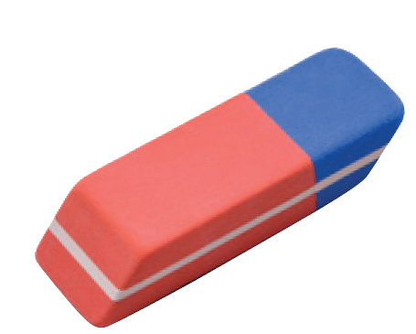
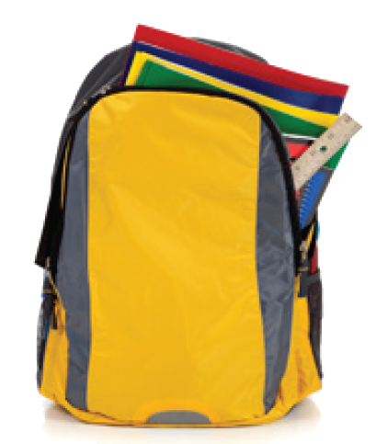
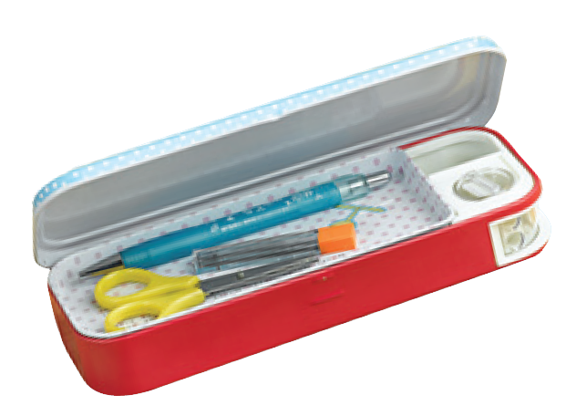
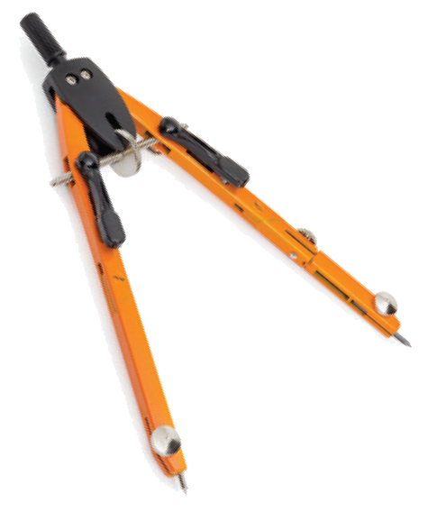
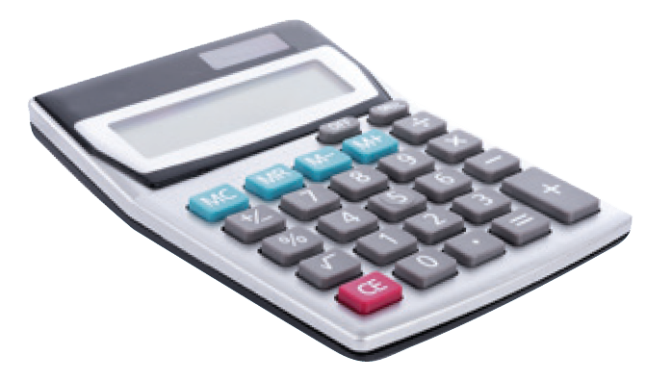
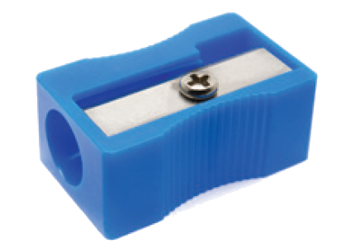
Match the word with the school things. Then listen and repeat.
4
pencil sharpener
4
compass
1
school bag
2
calculator
5
rubber
3
pencil case
6

Slide 11
Match the word with the school things. Then listen and repeat.
4
school bag
rubber
4
1
compass
pencil case
2
5
pencil sharpener
calculator
3
6

Slide 12

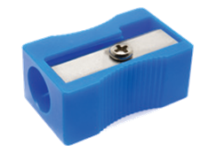
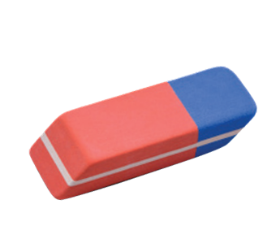
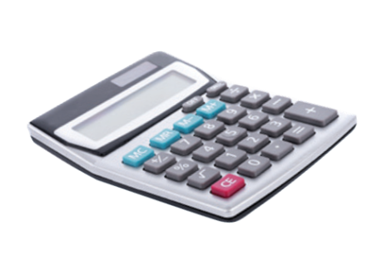
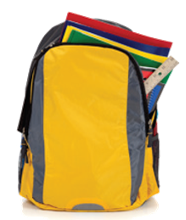
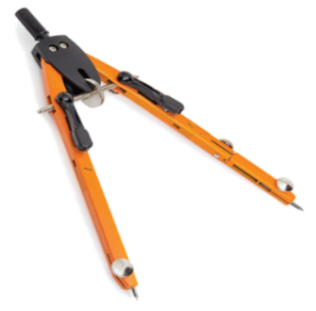
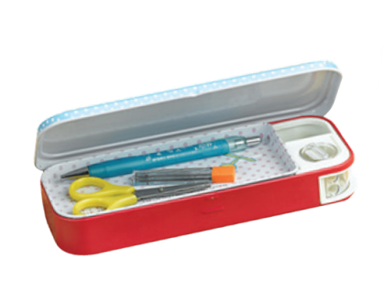
12
12
12
12
12
12
12
12
12
12
12
0
⋅
A
12
B
➢
8
7
6
5
4
3
2
1
10
9
8
7
6
5
4
3
2
1
0
8
7
6
5
4
3
2
1
Pelmanism
Score
0
9
3
9
9
9
9
9
9
9
9
9
9
3
3
3
3
3
3
3
3
3
3
9
3
.
6
6
6
6
6
6
6
6
6
6
6
6
1
5
9
school bag
2
6
10
rubber
3
7
11
compass
pencil case
4
8
pencil sharpener
12
calculator

Slide 13

Homeassignment
Make sentences with words in vocabulary.
Make 2 dialogues using the expressions in 1b.

